Slide 1
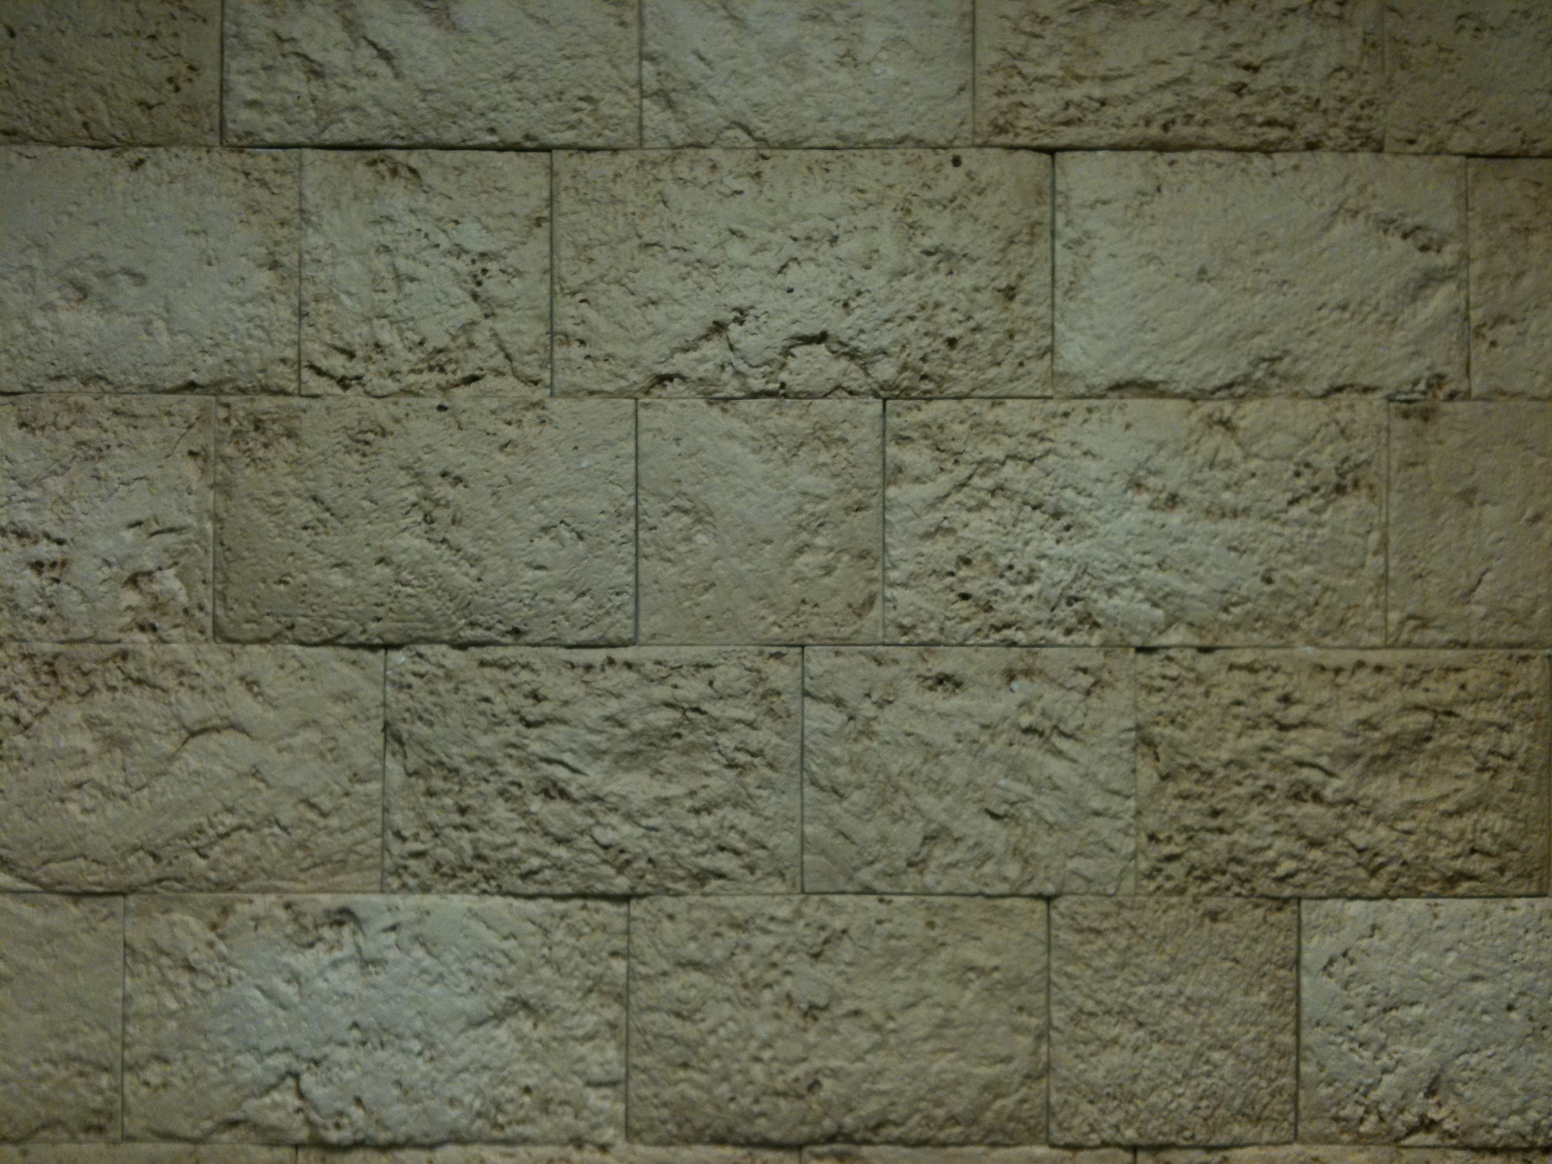
Book
of
Revelation

Slide 2
Penned by: The Apostle John
When: About 95 AD
Location: Heaven & Earth

Slide 3
1 2 3 4 5 6 7 8 9 10 11 12 13 14 15 16 17 18 19 20 21 22

Slide 4
Past
Present
(95 AD)
Future
1 2 3 4 5 6 7 8 9 10 11 12 13 14 15 16 17 18 19 20 21 22

Slide 5
Past
Present
(95 AD)
Future
1 2 3 4 5 6 7 8 9 10 11 12 13 14 15 16 17 18 19 20 21 22
NOT Chronological

Slide 6
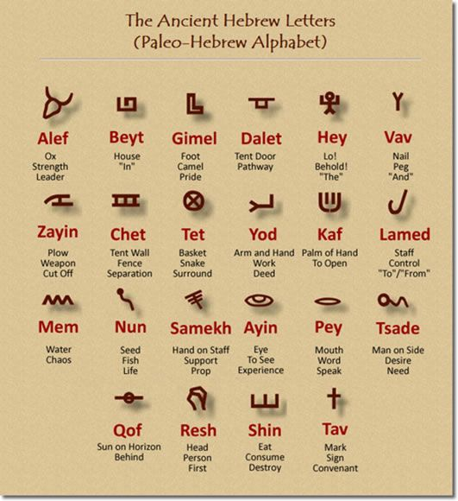

Slide 7
Power
Cross

Slide 9
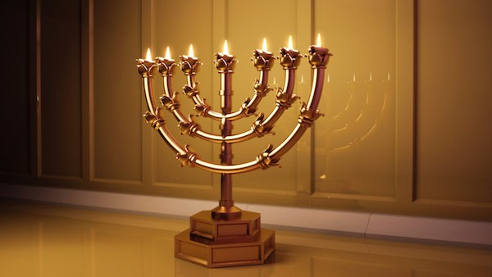
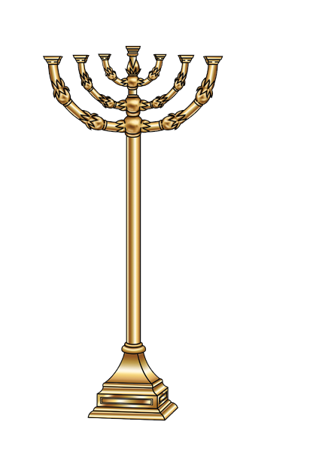

Slide 10
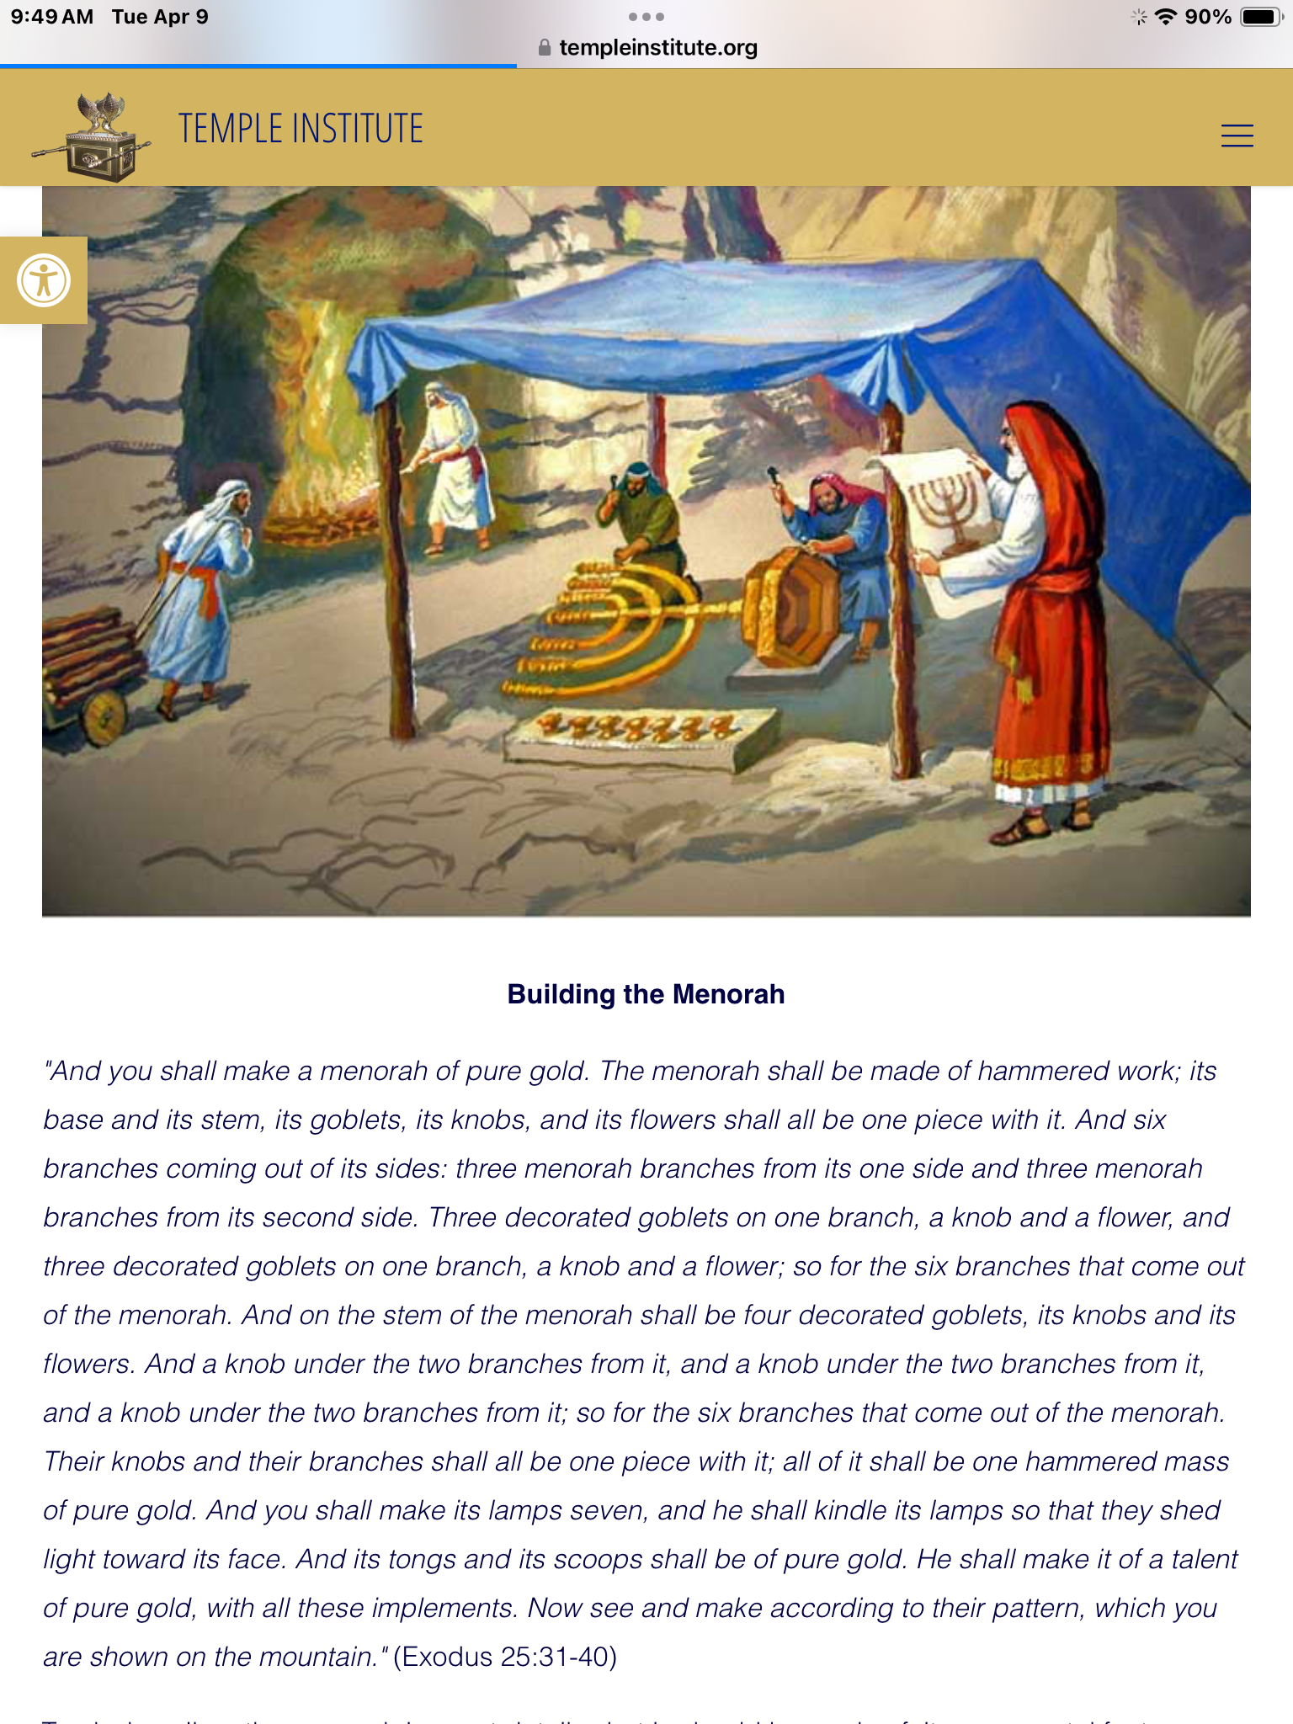

Slide 11
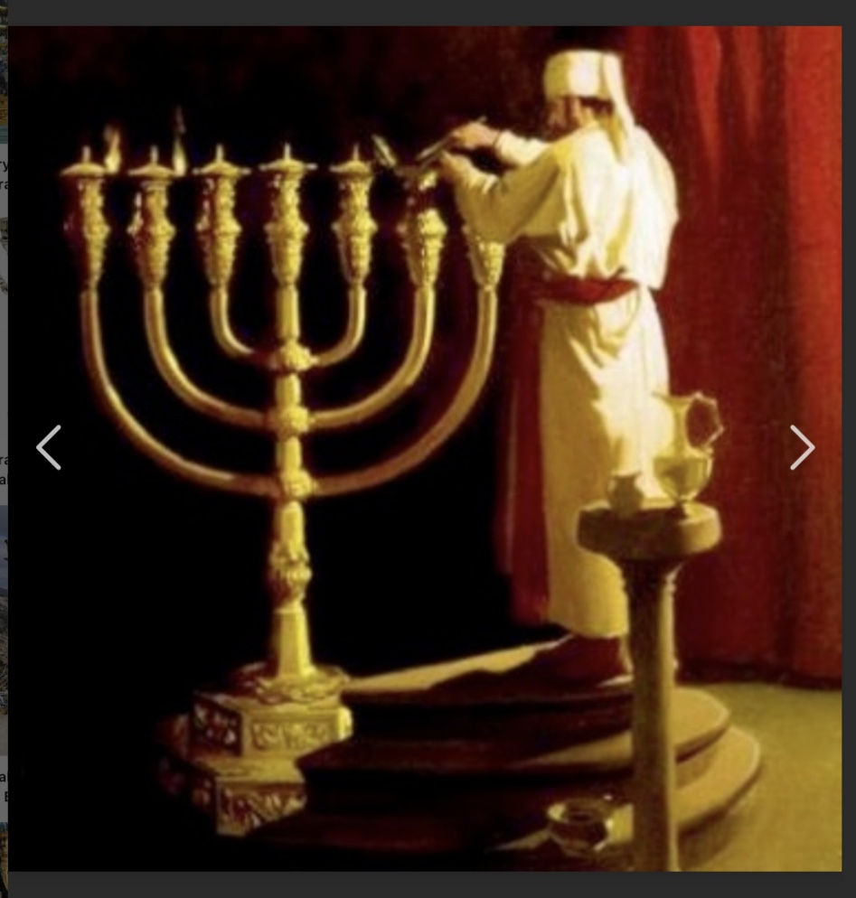

Slide 12
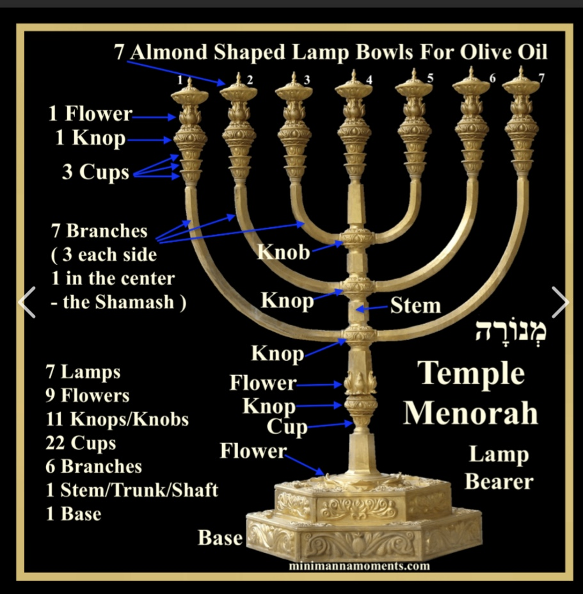

Slide 13
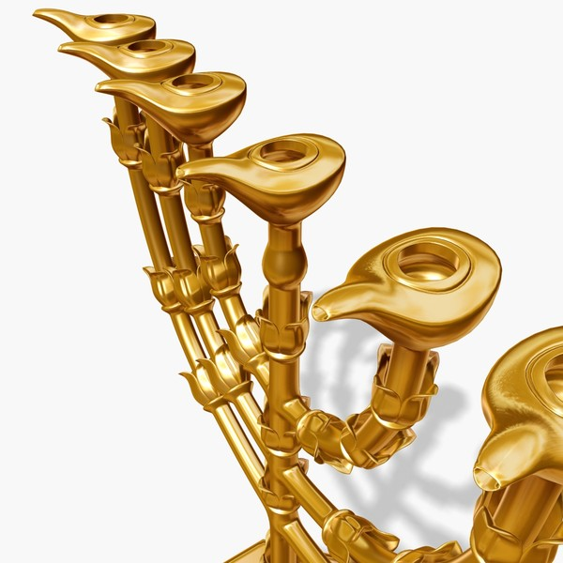

Slide 15
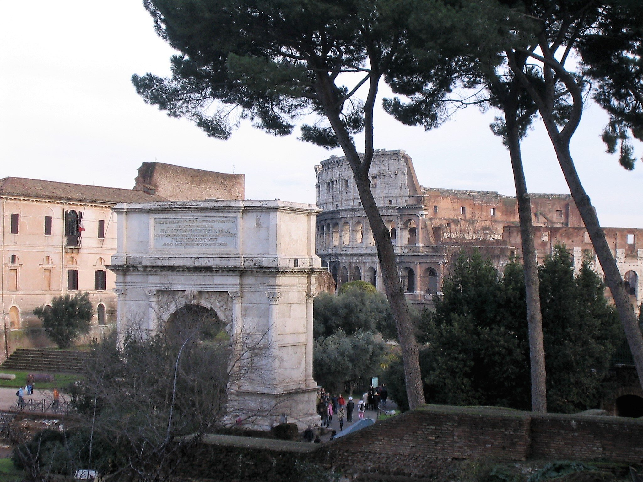

Slide 16
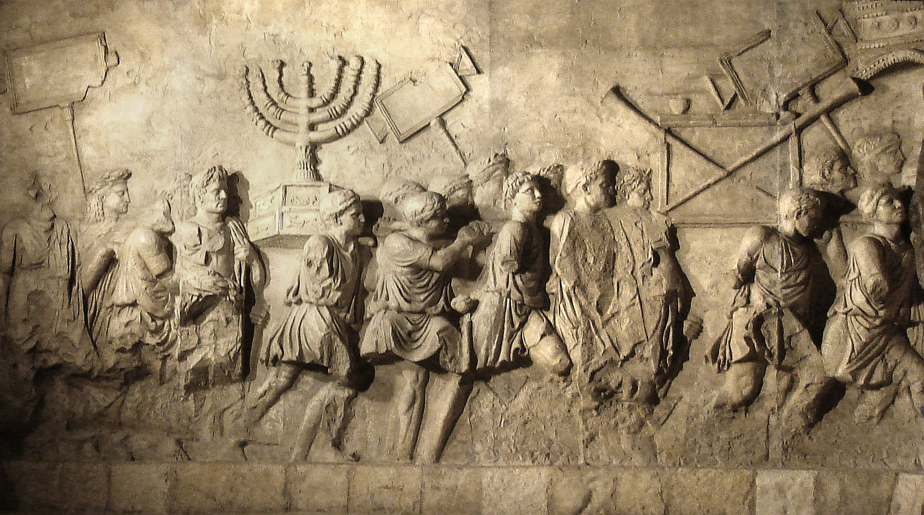

Slide 17


Slide 18
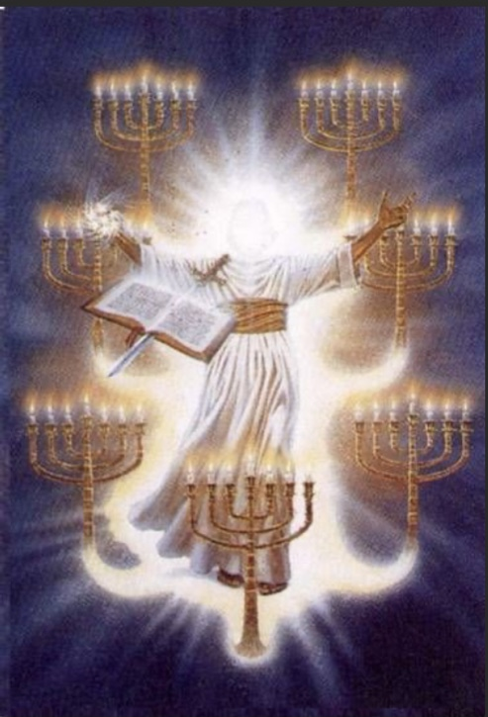

Slide 19
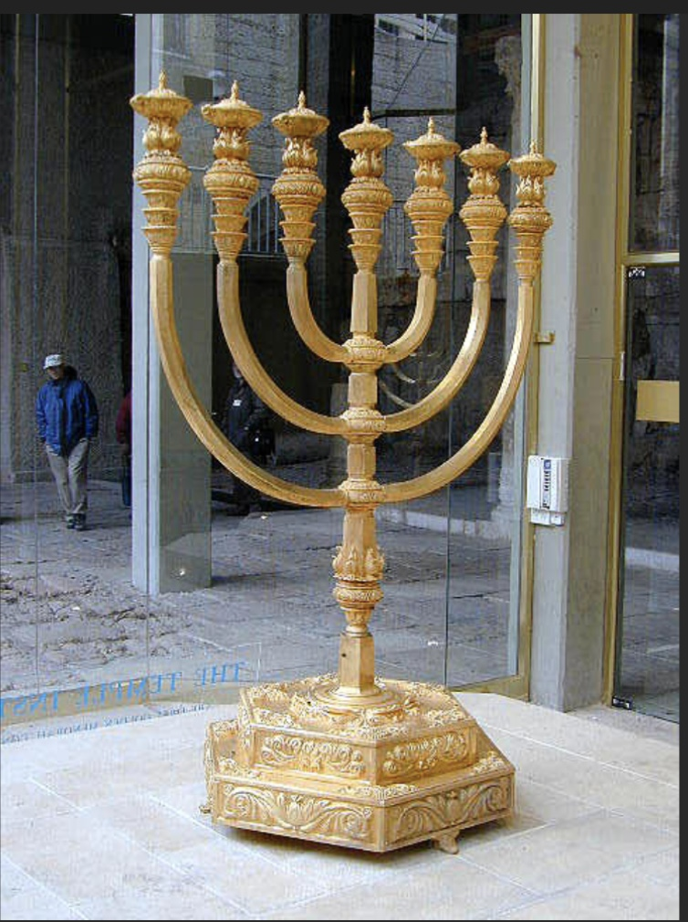

Slide 21
Power
Cross

Slide 22
Power
“I AM the Power of the Cross”
Cross

Slide 23
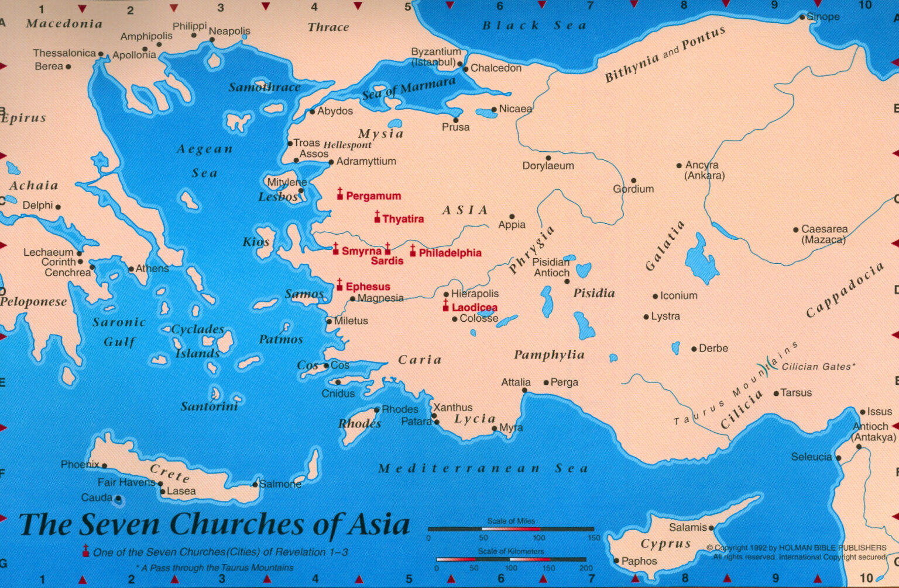

Slide 24
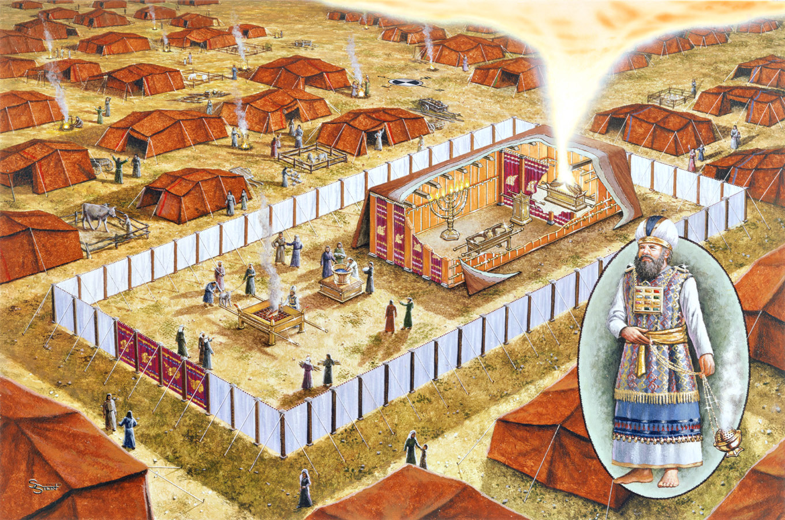
Incense Altar
Lamp-
Stand
Table of Shewbread

Slide 25
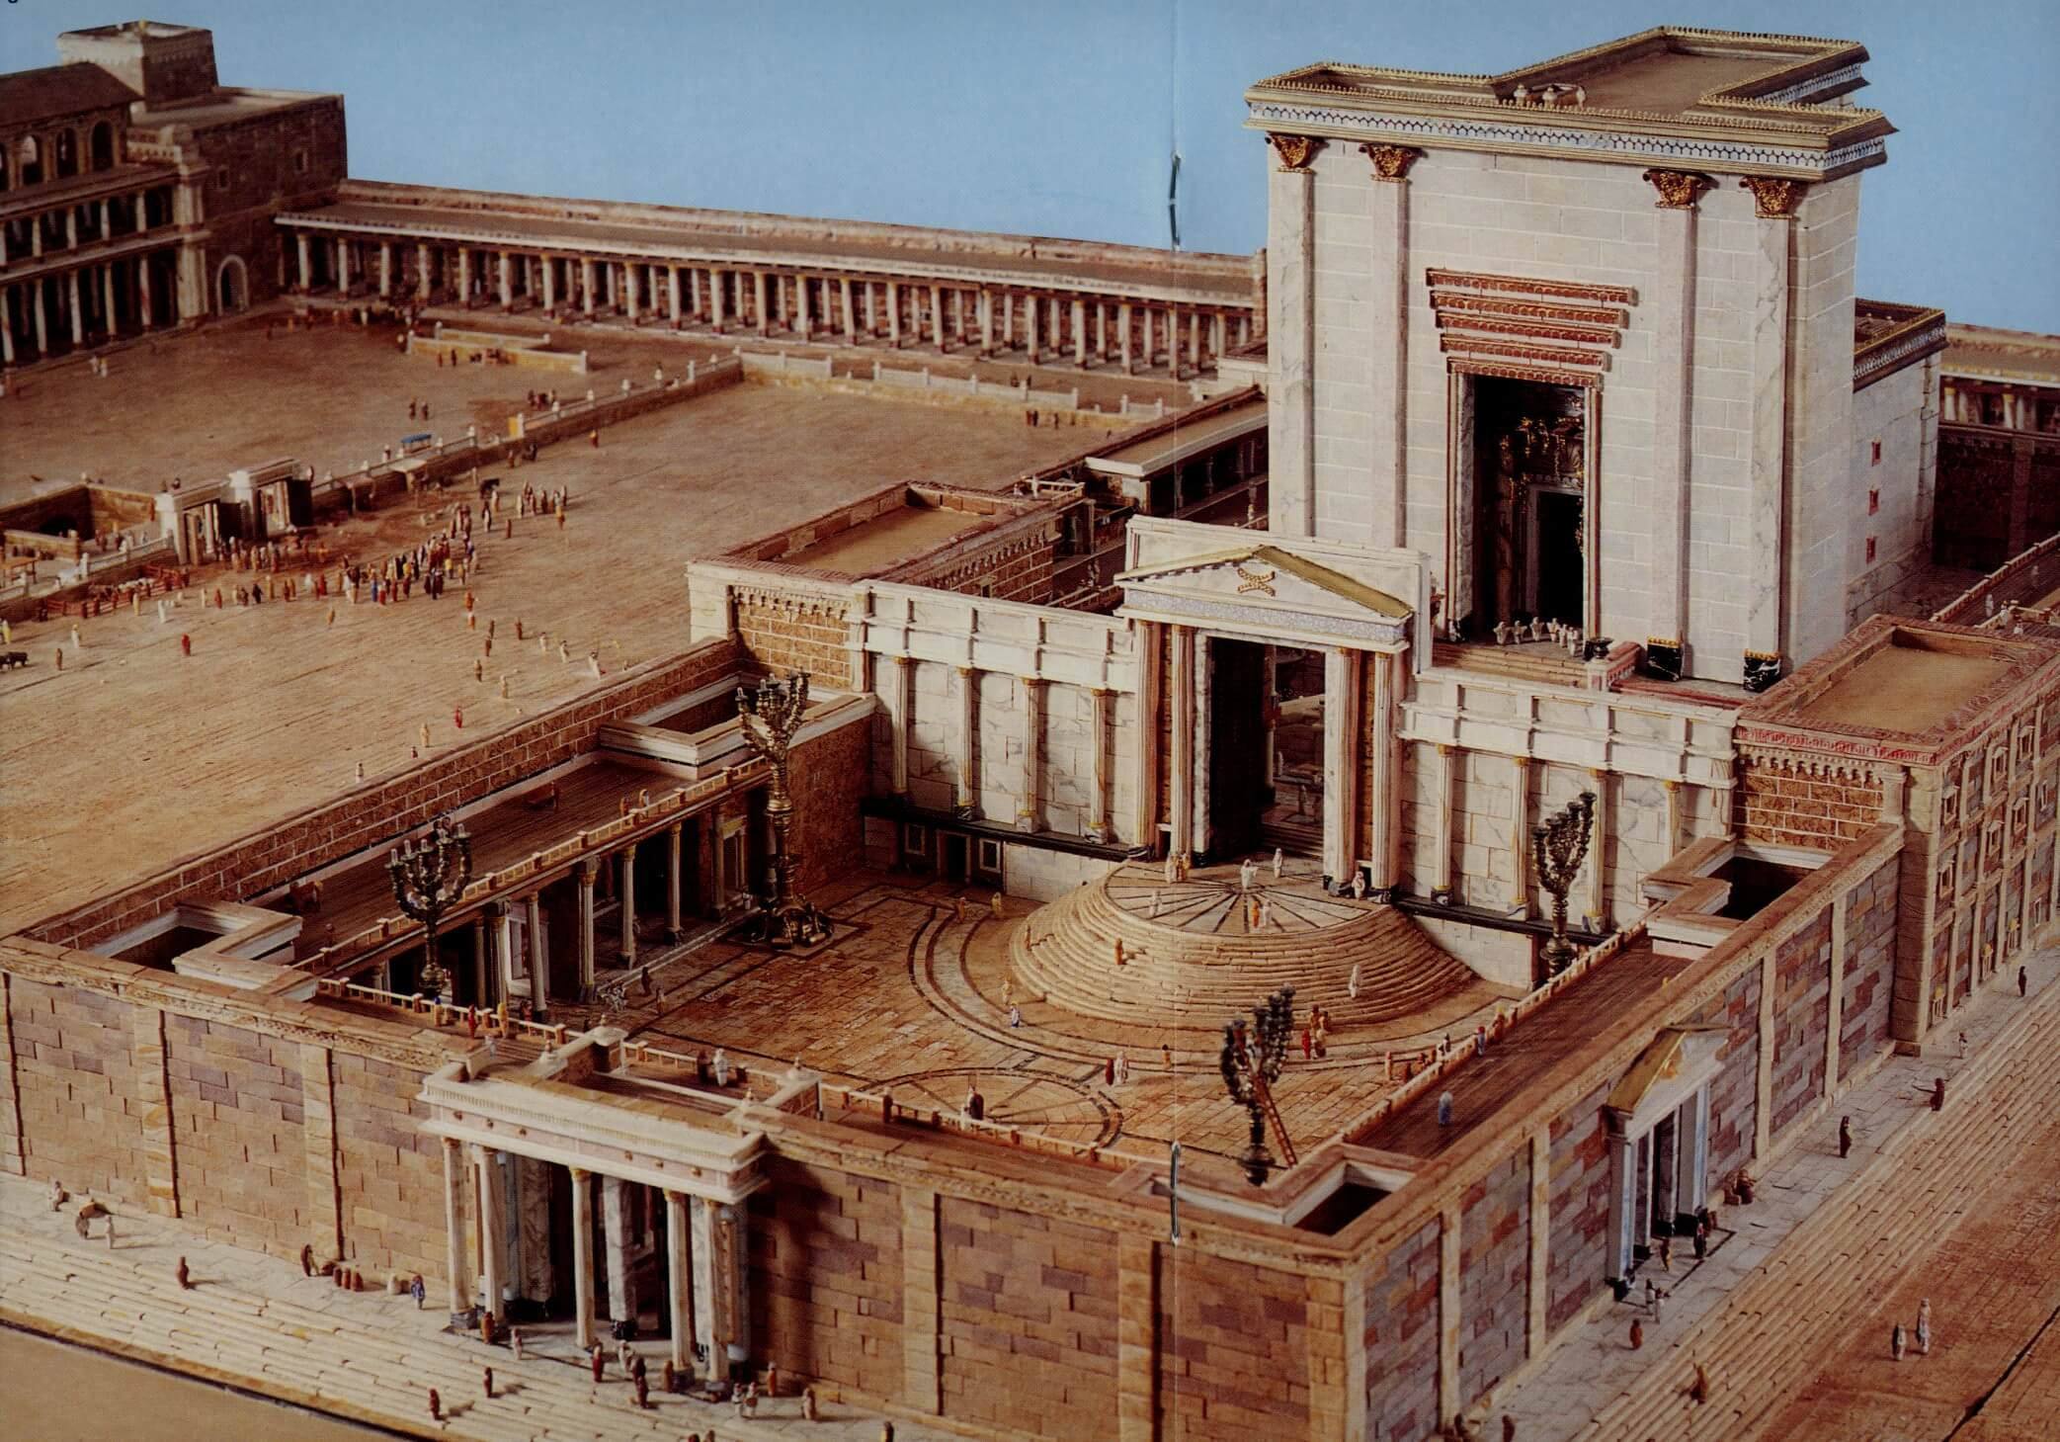

Slide 26
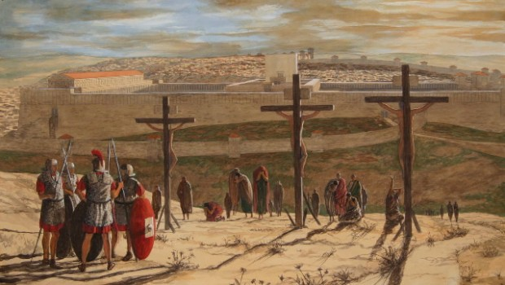

Slide 27
Seven Churches 1:4,11,20; 2 & 3
Seven Seals 5 & 6
Seven Trumpets 8 & 9
Seven Bowls 15; 16; 17:1 & 21:9
Seven Lampstands 1:12, 13, 20 & 2:1
Seven Spirits 1:4; 3:1 & 4:5 & 5:6
Seven Stars 1:16, 20 & 2:1 & 3:1
Seven Lamps 4 & 5
Seven Promises to the Overcomer 2 & 3
Seven Horns 5:6
Seven Eyes 5:6
Seven Angels 8:2,6 & 15:1,6,7,8 & 16:1 & 17:1 & 21:9
Seven Thunders 10:3, 4
Seven Thousand (People) 11:13
Seven Heads 12:3 & 13:1 & 17:3, 7, 9
Seven Crowns 12:3
Seven Plagues 15:1, 6, 8 & 21:9
Seven Mountains 17:9
Seven Kings 17:10,11

Slide 29
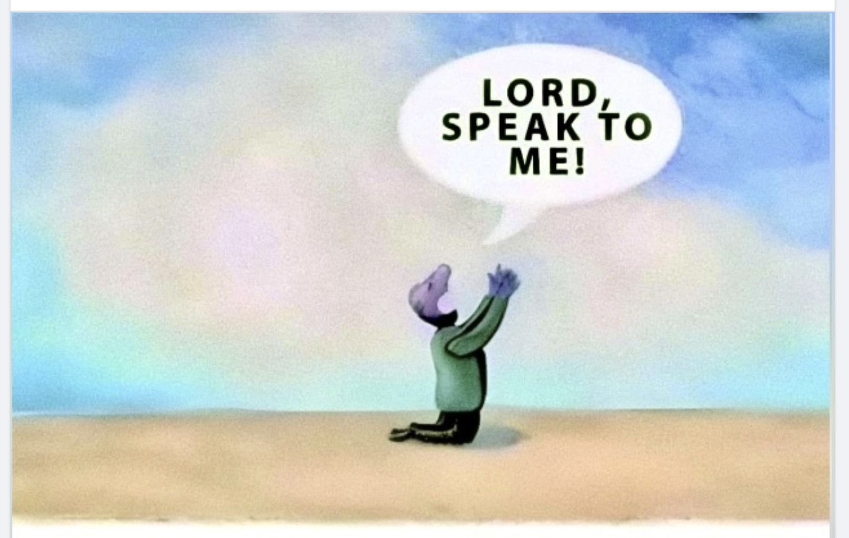

Slide 30
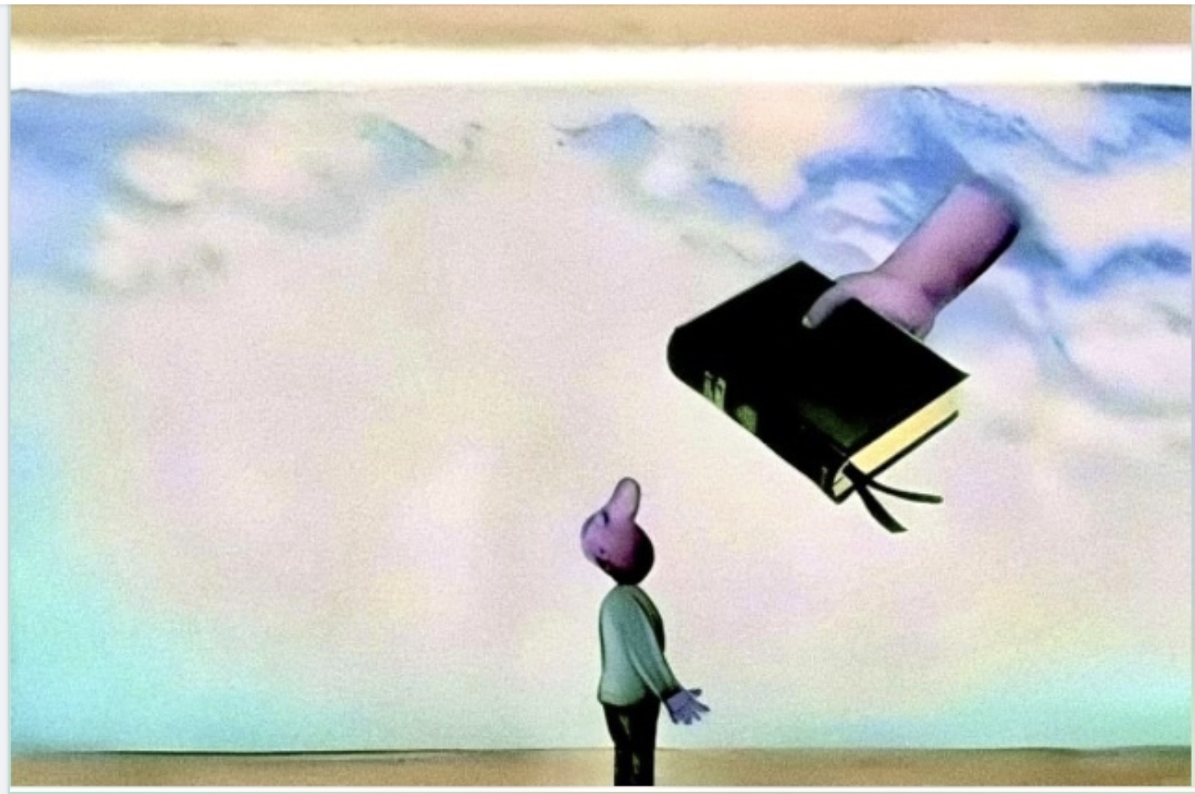

Slide 31
Now the Lord spoke to Moses and Aaron in the land of Egypt, saying, ² “This month shall be your beginning of months; it shall be the first month of the year to you. ³ Speak to all the congregation of Israel, saying: ‘On the tenth of this month every man shall take for himself a lamb …. ⁶Now you shall keep it until the fourteenth day of the same month. Then the whole assembly of the congregation of Israel shall kill it at twilight. Exodus 12:1-3 & 6

Slide 32
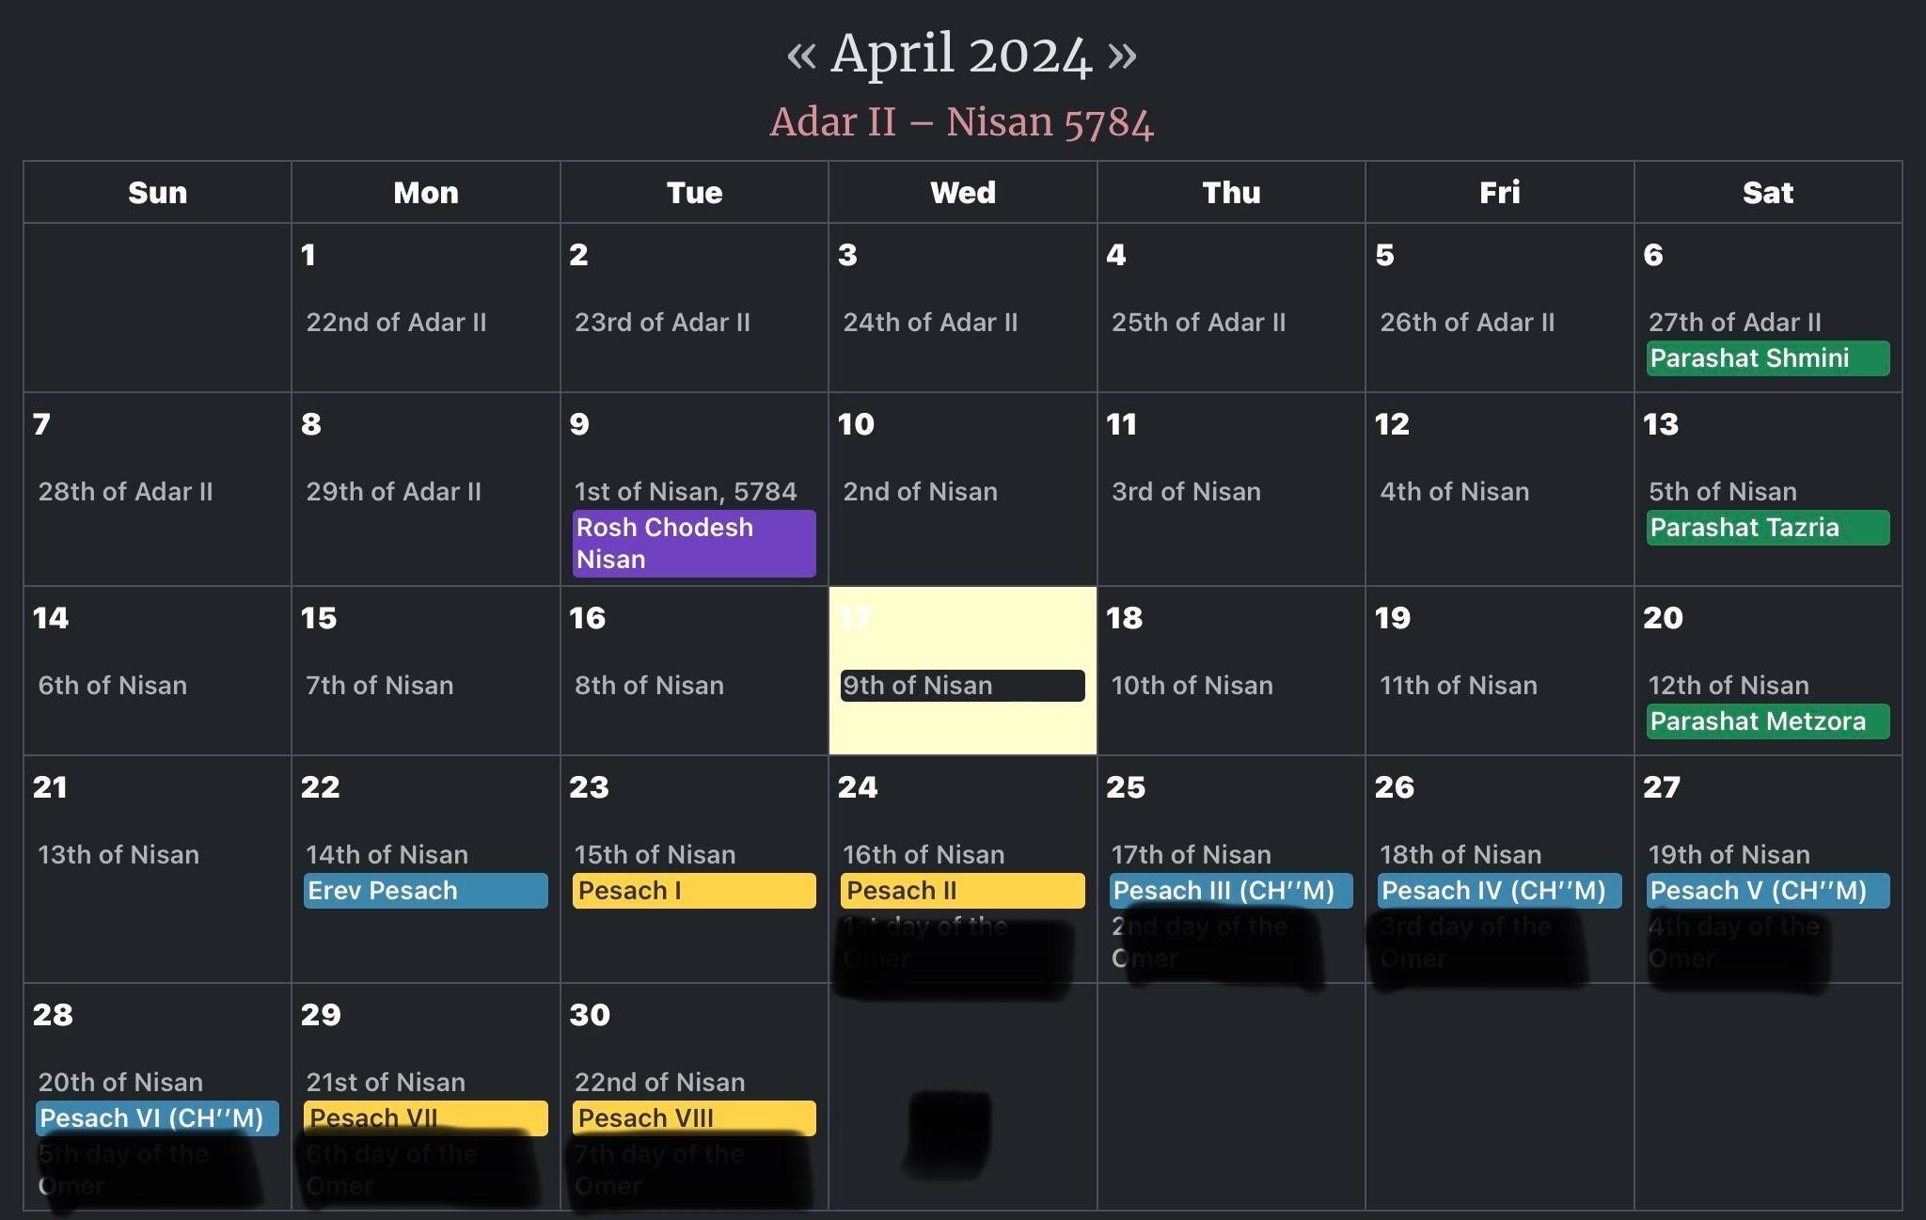

Slide 33
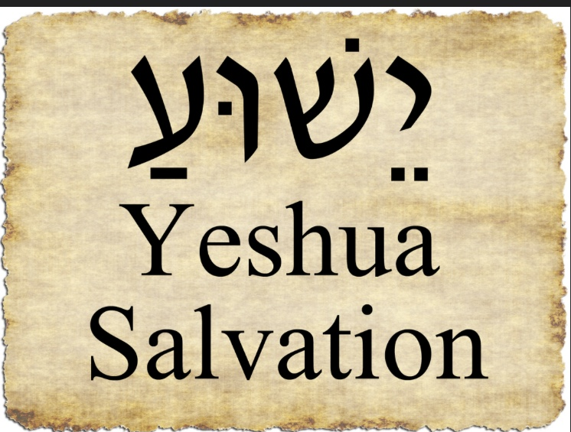

Slide 34
Revelation Chapter 2

Slide 35
Seven Design Elements In Each of the Letters
Name of the Church (& Meaning)
Title of Messiah
Commendation
Concern
Exhortation
Promise to the Overcomer
“He that hath an ear, hear what the Spirit says to the churches.”

Slide 37
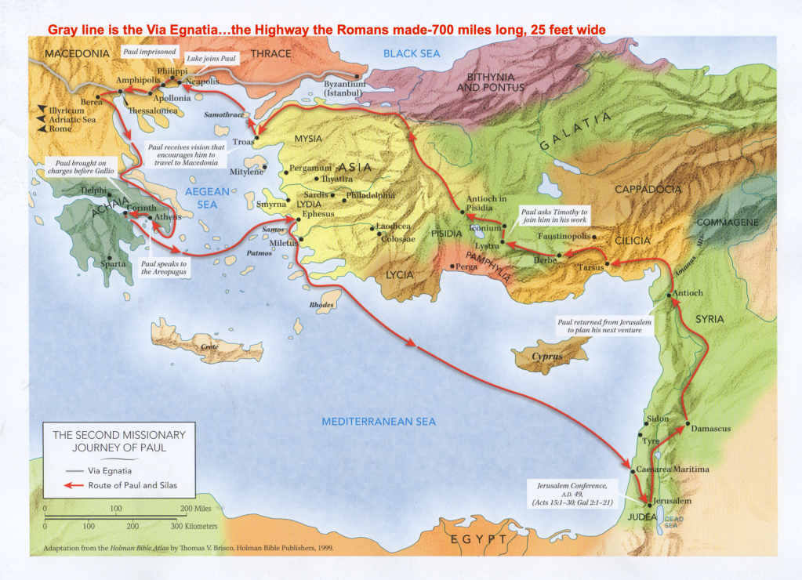
52 AD

Slide 38
Repent

Slide 39
Repent
Greek:
met-an-o-eh’-o “to change one’s mind”

Slide 40
Repent
Greek:
met-an-o-eh’-o “to change one’s mind”
Hebrew:
tshu-vah “to change direction”

Slide 41
Repent
Greek:
met-an-o-eh’-o “to change one’s mind”
Intellect
Hebrew:
tshu-vah “to change direction”
Action

Slide 42
Greek Thought Says:
“What do you believe?”

Slide 43
Greek Thought Says:
“What do you believe?”
“And do not be conformed to this world, but be transformed by the renewing of your mind, that you may prove what is that good and acceptable and perfect will of God.” Romans 12:2

Slide 44
Hebrew Thought Says:
“Who are you?” “What have you done?”

Slide 45
Hebrew Thought Says:
“Who are you?” “What have you done?”
Relationship Action

Slide 46
Hebrew Thought Says:
“Who are you?” “What have you done?”
“And behold, the Lord stood above it and said: “I am the Lord God of Abraham your father and the God of Isaac; the land on which you lie I will give to you and your descendants.” Genesis 28:13

Slide 48
Nicolaitans
Yeshua Hated: Their Deeds (Rev 2:6)
Their Doctrines (Rev 2:15)

Slide 49
Nicolaitans
Yeshua Hated: Their Deeds (Rev 2:6)
Their Doctrines (Rev 2:15)
Nicos (Nike) Victor or Victory
Laity People

Slide 50
Nicolaitans
Yeshua Hated: Their Deeds (Rev 2:6)
Their Doctrines (Rev 2:15)
Nicos (Nike) Victor or Victory
+ over
Laity People

Slide 51
Nicolaitans
Yeshua Hated: Their Deeds (Rev 2:6)
Their Doctrines (Rev 2:15)
Nicos (Nike) Victor or Victory
+ over
Laity People
The Clergy Ruling Over the People

Slide 52
Nicolaitans
Yeshua Hated: Their Deeds (Rev 2:6)
Their Doctrines (Rev 2:15)
Nicos (Nike) Victor or Victory
+ over
Laity People
or Possibly: Nicolas in Acts 6:5 a Proselyte
The Clergy Ruling Over the People

Slide 53
Nicolaitans
Yeshua Hated: Their Deeds (Rev 2:6)
Their Doctrines (Rev 2:15)
Nicos (Nike) Victor or Victory
+ over
Laity People
or Possibly: Nicolas in Acts 6:5 a Proselyte
Pagan Judaism Christianity
The Clergy Ruling Over the People

Slide 54
Nicolaitans
Yeshua Hated: Their Deeds (Rev 2:6)
Their Doctrines (Rev 2:15)
Nicos (Nike) Victor or Victory
+ over
Laity People
or Possibly: Nicolas in Acts 6:5 a Proselyte
Pagan Judaism Christianity
Mixing & Mingling
The Clergy Ruling Over the People

Slide 55
On YouTube:
Day of Discovery: 7 Churches of Revelation

Slide 58
Crowns in the Bible
1) Imperishable Crown I Corinth 9:24-25
“Run in such a way that you may obtain it.”
2) Crown of Rejoicing I Thess 2:19
“In the presence of Yeshua at His coming.”
3) Crown of Righteousness II Timothy 4:8
“To all who have loved His appearing.”
4) Crown of Glory I Peter 5:4
“That does not fade away.”
Crown of Life Revelation 2:10
“Be faithful until death…”

Slide 59
On YouTube:
Day of Discovery: 7 Churches of Revelation
Video #4: Pergamum

Slide 65
Revelation
Chapters 2 & 3

Slide 66
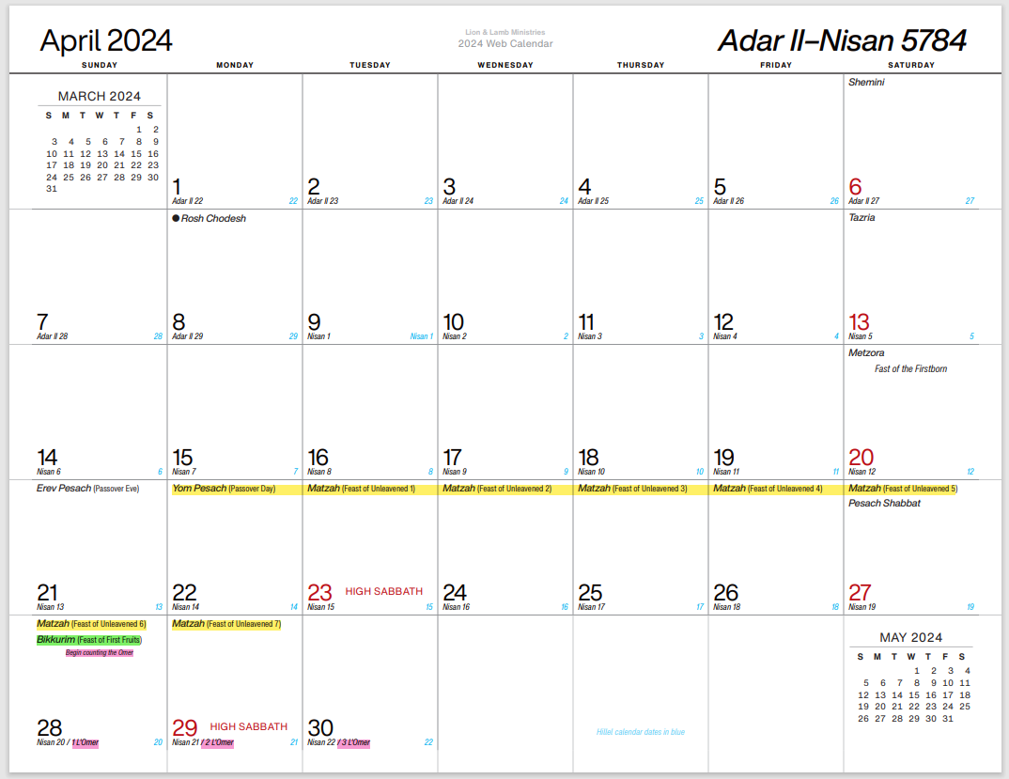

Slide 68
Yeshua’s Final Week
Saturday
10th
Lambs
Chosen
Yeshua’s
Entry
Sun-Mon
11th &12th
Inspect-
ion
Tuesday
13th
Yeshua’s
Last
Supper
Yeshua’s
“Trials”
Wednesday
14th
Passover
Lambs
Killed
Yeshua
Crucified
Night #1
Thursday
15th
1st ULB
High Holy Day
Day #1
Night #2
Friday
16th
Day #2
Night #3
Saturday
17th
Day #3
Sunday
18th
Firstfruits
Yeshua’s
Resur-
rection!!

Slide 69
Should Believers Keep the Feasts?

Slide 70
Should Believers Keep the Feasts?
And the Lord spoke to Moses, saying, “Speak to the children of Israel, and say to them: ‘The feasts of the Lord, which you shall proclaim to be holy convocations, these are My feasts.’” Leviticus 23:1-2

Slide 71
Should Believers Keep the Feasts?
And the Lord spoke to Moses, saying, “Speak to the children of Israel, and say to them: ‘The feasts of the Lord, which you shall proclaim to be holy convocations, these are My feasts.’” Leviticus 23:1-2
Are These Only for Israel?

Slide 72
The Answer is: Yes!!!
And They Are Also for Believers!!
We Are Descendants of Dispersed Tribes
or
We Are Grafted in to Israel Romans 11:13-36
We Are Abraham’s Seed (Children) Galatians 3:26-29

Slide 73
The Answer is: Yes!!!
And They Are Also for Believers!!
We Are Descendants of Dispersed Tribes
or
We ARE Israel
We Are Grafted in to Israel Romans 11:13-36
We Are Abraham’s Seed (Children) Galatians 3:26-29

Slide 74
One of God’s Promises to His Heirs:
And the Lord spoke to Moses, saying, “Speak to the children of Israel, and say to them: ‘The feasts of the Lord, which you shall proclaim to be holy convocations, these are My feasts.’” Leviticus 23:1-2

Slide 75
Two Congregations:
In the Shadow of Pagan Temples:
Ephesus & Pergamos
Nothing Good Said About Them:
Sardis & Laodicea
Nothing Bad Said About Them:
Smyrna & Philadelphia

Slide 76
Two Congregations:
In the Shadow of Pagan Temples:
Ephesus & Pergamos
Nothing Good Said About Them:
Sardis & Laodicea
Nothing Bad Said About Them:
Smyrna & Philadelphia

Slide 77
Yeshua’s Concerns:
^{Ephesus} Lost Focus on God; Mingled with World
^{Smyrna}
^{Pergamos} Balaam’s Doctrine: Mingled with World
^{Thyatira} Jezebel: Allowed Evil to be Taught
^{Sardis} Think They are Alive, but are Dead
^{Philadel}
^{Laodicea} Lukewarm; Self-Sufficient; Closed Door

Slide 78
Yeshua’s Exhortations:
^{Ephesus} Repent or Else Have Lampstand Removed
^{Smyrna} Be Faithful to Death & Receive Crown of Life
^{Pergamos} Repent or Else Yeshua will Fight Against Them
^{Thyatira} Hold Fast to Truth until Yeshua Returns
^{Sardis} Remember What You Have Heard & Repent
^{Philadel} Hold Fast What You Have & Keep Your Crown
^{Laodicea} Repent and be Zealous for God

Slide 79
To him who overcomes I will give to eat from the tree of life, which is in the midst of the Paradise of God. [E]
He who overcomes shall not be hurt by the second death. [Sm]
To him who overcomes I will give some of the hidden manna to eat. And I will give him a white stone, and on the stone a new name written which no one knows except him who receives it. [Pe]
And he who overcomes, and keeps My works until the end, to him I will give power over the nations — ‘He shall rule them with a rod of iron; they shall be dashed to pieces like the potter’s vessels’— as I also have received from My Father; and I will give him the morning star. [T]

Slide 80
He who overcomes shall be clothed in white garments, and I will not blot out his name from the Book of Life; but I will confess his name before My Father and before His angels. [Sa]
He who overcomes, I will make him a pillar in the temple of My God, and he shall go out no more. I will write on him the name of My God and the name of the city of My God, the New Jerusalem, which comes down out of heaven from My God. And I will write on him My new name. [Ph]
To him who overcomes I will grant to sit with Me on My throne, as I also overcame and sat down with My Father on His throne. [L]

Slide 81
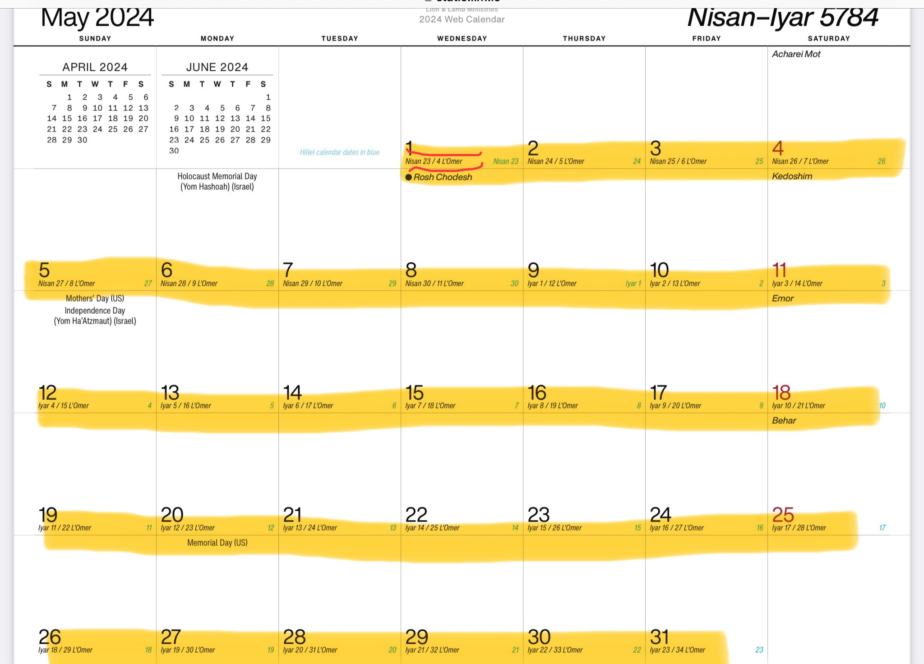

Slide 82
Daniel’s 70 Week’s Prophecy
Artaxerxes Command to “Restore and Rebuild Jerusalem”
(Nehemiah 2:1-8)
Abomination
of
Desolation
Abomination
of
Desolation?
Abomination
of
Desolation?
Rebuild Jerusalem
70 AD
168 BC
33 AD
444 BC
7 Weeks
62 Weeks
1 Week
69 Weeks
483 Years [360 Day]
476 Years [365+ Day]

Slide 83
Daniel’s 70 Week’s Prophecy
Artaxerxes Command to “Restore and Rebuild Jerusalem”
(Nehemiah 2:1-8)
Abomination
of
Desolation
Abomination
of
Desolation?
Abomination
of
Desolation?
Rebuild Jerusalem
“They will not leave in you one stone upon another, because you did not know the time of your visitation”
Luke 19:44
70 AD
168 BC
33 AD
444 BC
7 Weeks
62 Weeks
1 Week
69 Weeks
483 Years [360 Day]
476 Years [365+ Day]

Slide 85
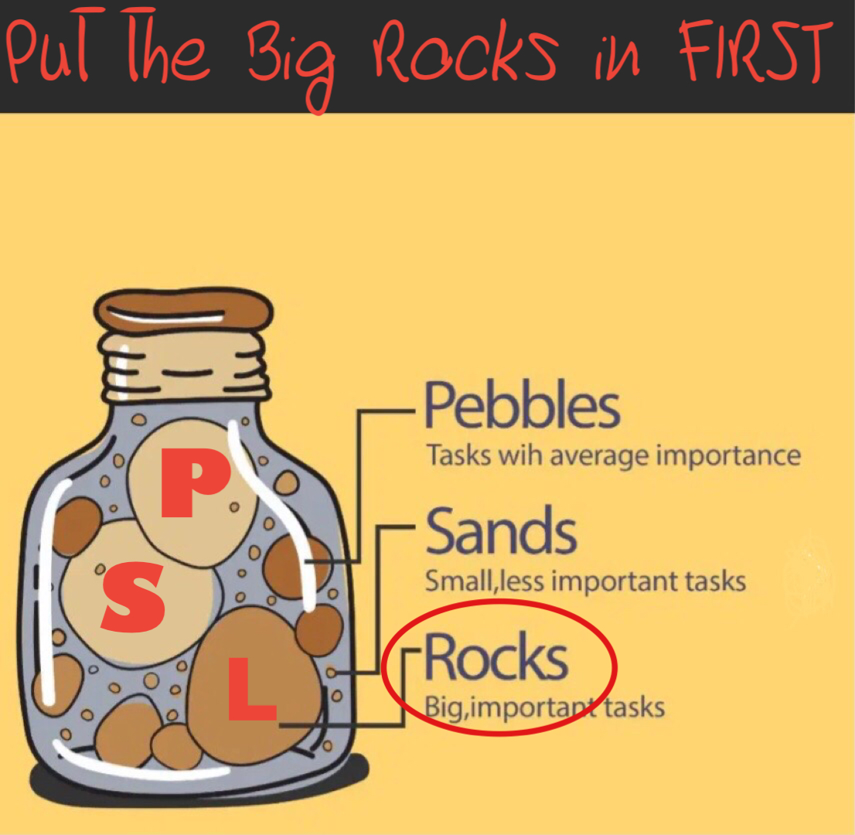

Slide 86
Rev 2:5 “Remember therefore from where you have fallen; repent and do the first works, or else I will come to you quickly and remove your lampstand from its place—unless you repent. [E]
Rev 2:16 “Repent, or else I will come to you quickly and will fight against them with the sword of My mouth. [P]
Rev 2:21 “And I gave her time to repent of her sexual immorality, and she did not repent. [T]
Rev 2:22 “Indeed I will cast her into a sickbed, and those who commit adultery with her into great tribulation, unless they repent of their deeds. [T]
Rev 2:25 But that which ye have already hold fast till I come. [T]
Rev 3:3 “Remember therefore how you have received and heard; hold fast and repent. Therefore, if you will not watch, I will come upon you as a thief, and you will not know what hour I will come upon you. [Sa]
Rev 3:19 “As many as I love, I rebuke and chasten. Therefore, be zealous and repent. [L]

Slide 87
Then God said, “Let there be lights in the firmament of the heavens to divide the day from the night; and let them be for signs and seasons, and for days and years;”
Genesis 1:14

Slide 88
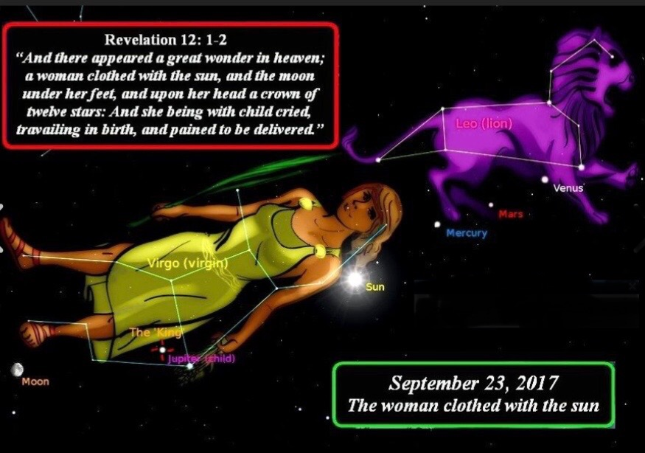

Slide 89
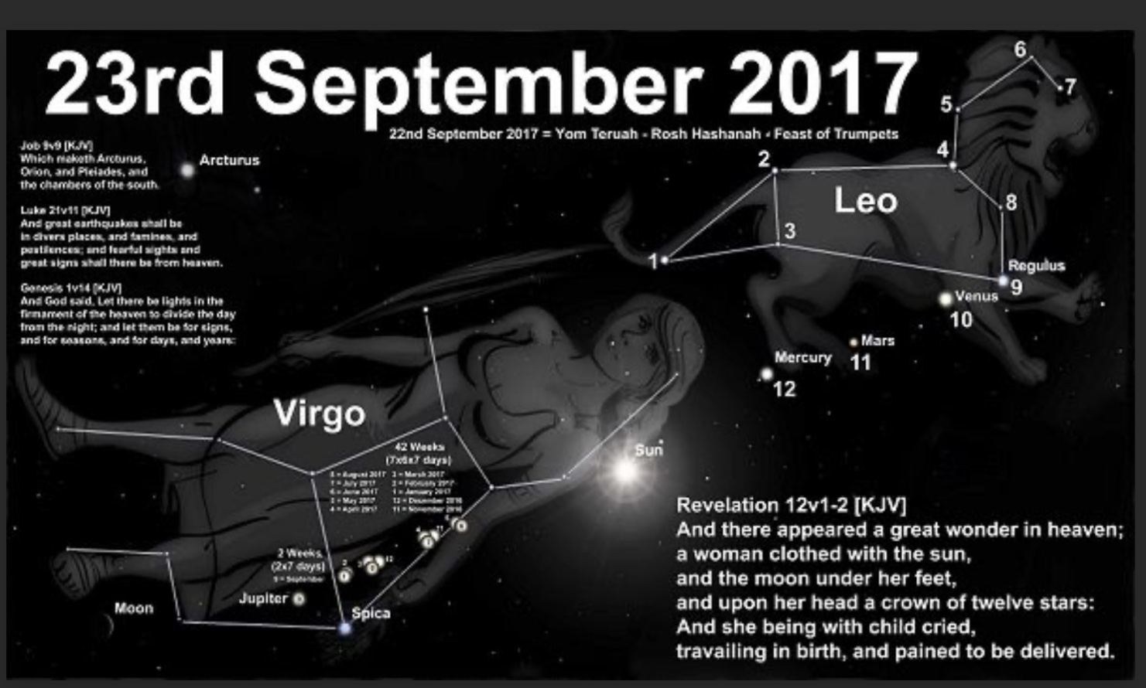

Slide 90
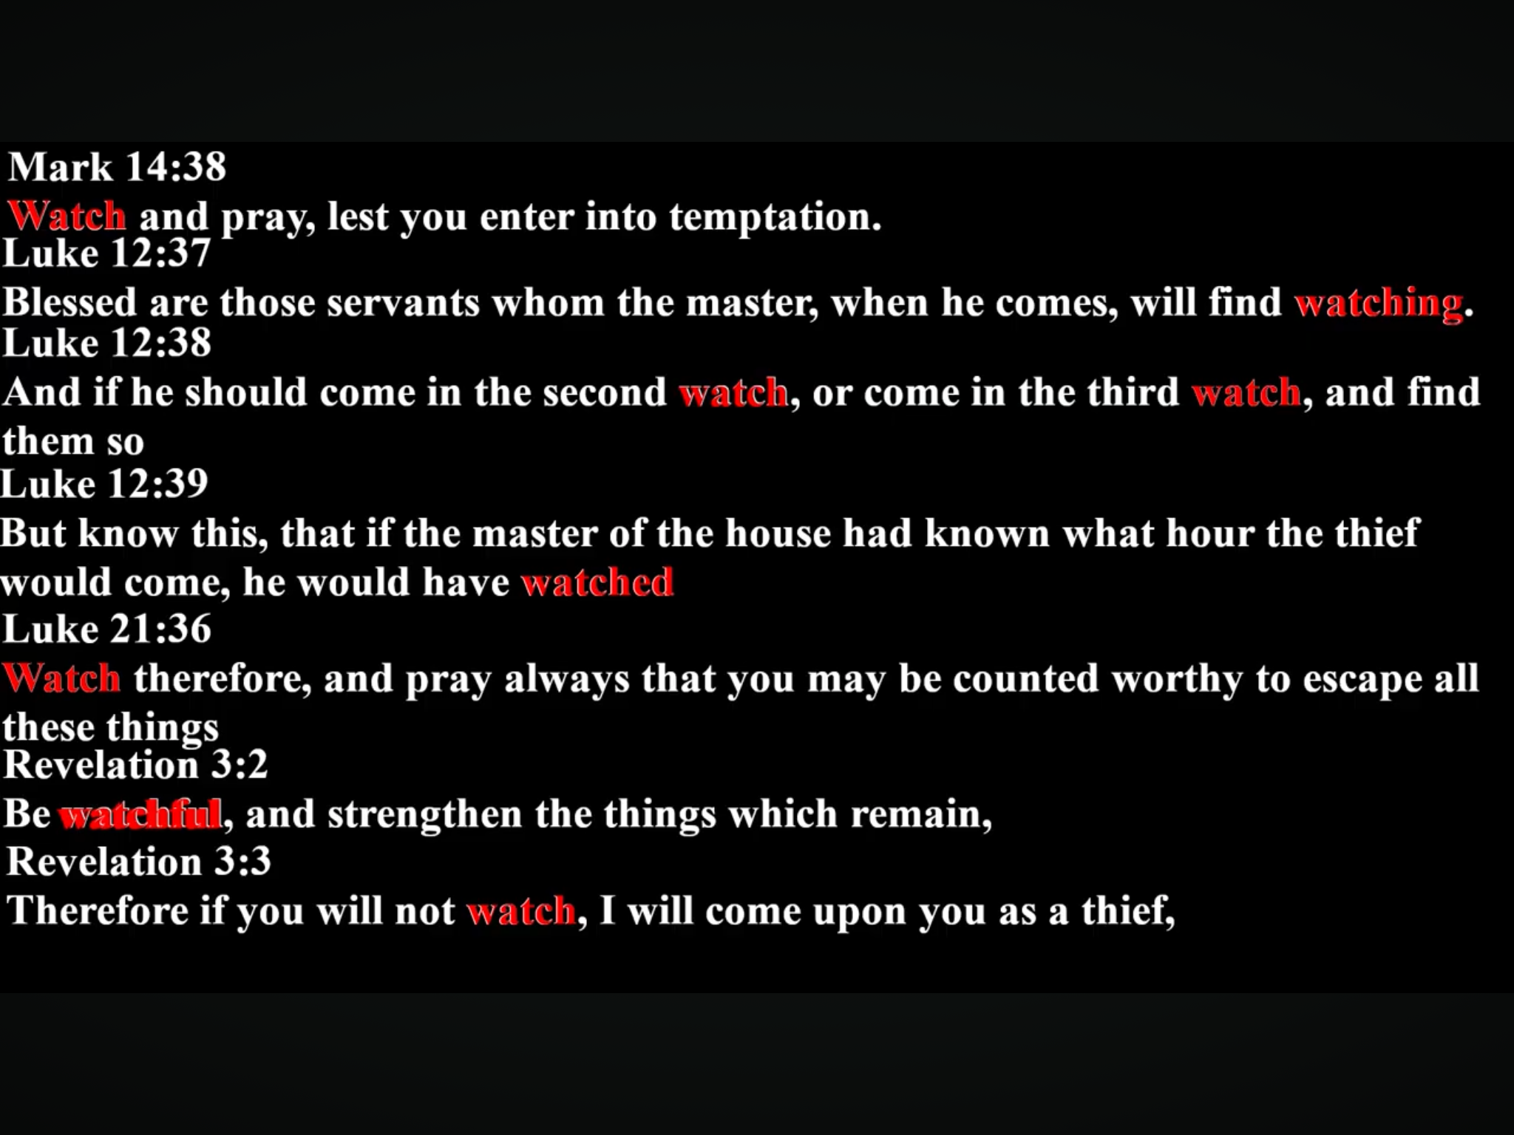

Slide 91
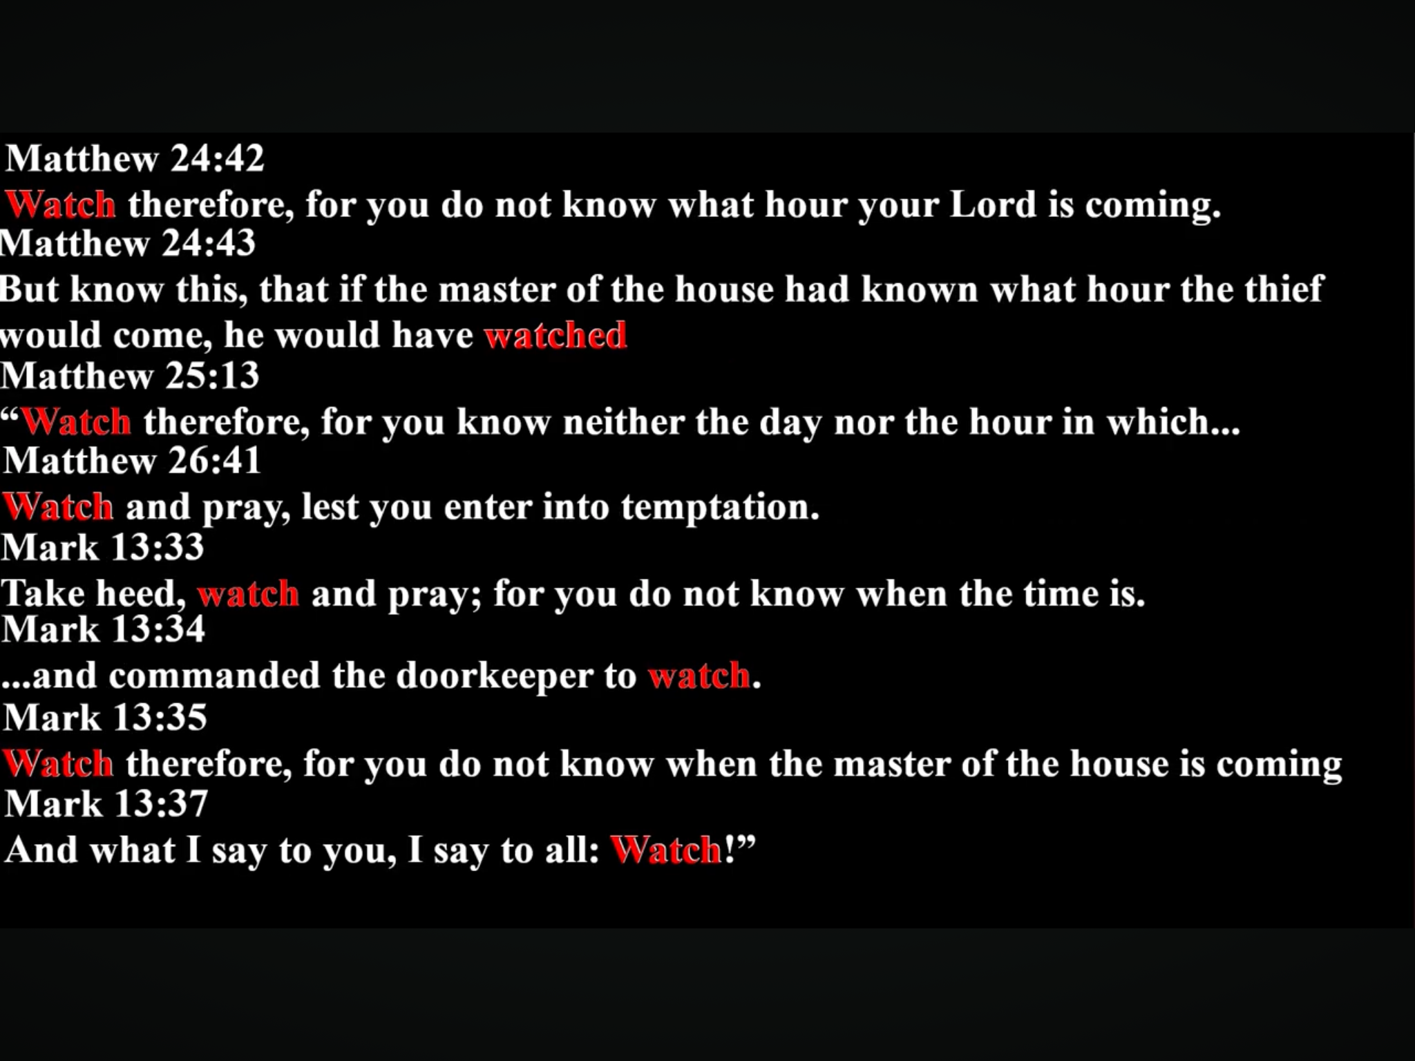

Slide 92
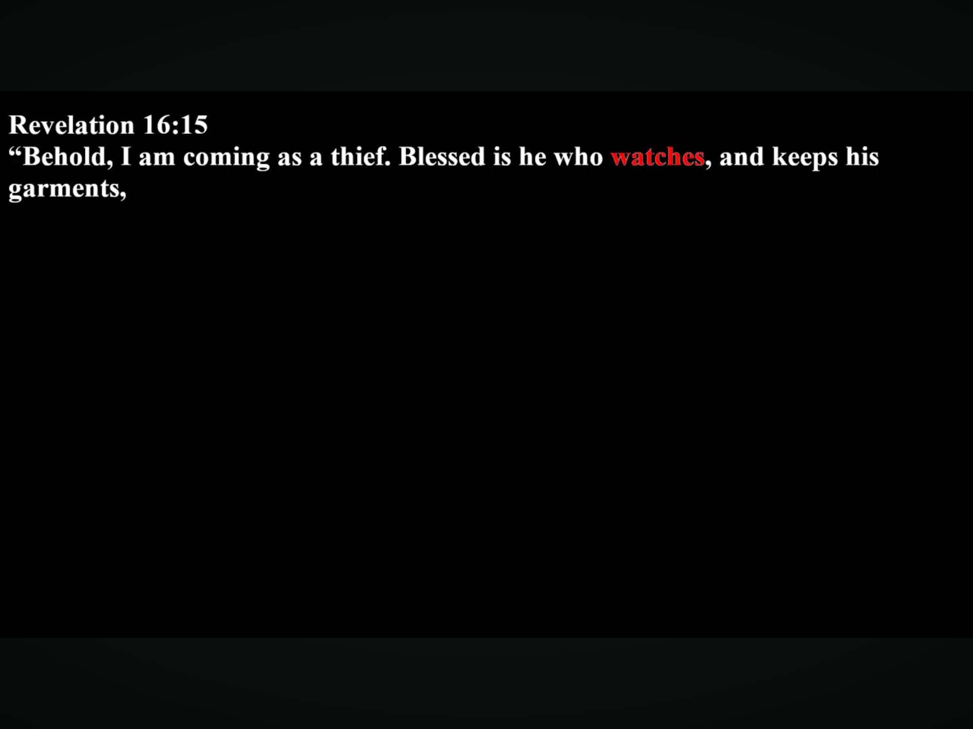

Slide 94
Revelation
Chapters 2 & 3

Slide 96
Yeshua’s Commendations:
^{Ephesus} Tested Evil, Endured Persecution, Rejected Mingling
^{Smyrna} Endured Persecution & Poverty, Rejected Mingling
^{Pergamos} Faithful; Didn’t Deny Faith; Rejected Mingling
^{Thyatira} Love, Service, Faith, & Patience
^{Sardis}
^{Philadel} Kept Their Strength, Didn’t Deny His Name
^{Laodicea}

Slide 97
Yeshua’s Concerns:
Nevertheless I have this against you, that you have left your first love. [E]
But I have a few things against you, because you have there those who hold the doctrine of Balaam, who taught Balak to put a stumbling block before the children of Israel, to eat things sacrificed to idols, and to commit sexual immorality. Thus you also have those who hold the doctrine of the Nicolaitans, which thing I hate. [Pe]
Nevertheless I have a few things against you, because you allow that woman Jezebel, who calls herself a prophetess, to teach and seduce My servants to commit sexual immorality and eat things sacrificed to idols. And I gave her time to repent of her sexual immorality, and she did not repent. Indeed I will cast her into a sickbed, and those who commit adultery with her into great tribulation, unless they repent of their deeds.

Slide 98
I will kill her children with death, and all the churches shall know that I am He who searches the minds and hearts. And I will give to each one of you according to your works. [T]
I know your works, that you have a name that you are alive, but you are dead. Be watchful, and strengthen the things which remain, that are ready to die, for I have not found your works perfect before God. Remember how you have received and heard. [Sa]
I know your works, that you are neither cold nor hot. I could wish you were cold or hot. So then, because you are lukewarm, and neither cold nor hot, I will vomit you out of My mouth. Because you say, ‘I am rich, have become wealthy, and have need of nothing’—and do not know that you are wretched, miserable, poor, blind, and naked— [L]

Slide 99
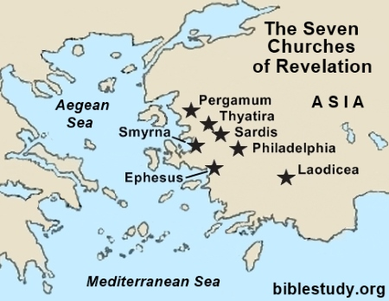
Satan’s Seat

Slide 100
Satan’s Seat
External

Slide 101
Satan’s Seat
Internal

Slide 102
Satan’s Seat
OK

Slide 103
Satan’s Seat
“Come out of her [Babylon], my people, lest you share in her sins, and lest you receive of her plagues.”
Rev 18:4
Outside
OK

Slide 104
Yeshua’s Exhortations:
Remember therefore from where you have fallen; repent and do the first works, or else I will come to you quickly and remove your lampstand from its place—unless you repent. [E]
Do not fear any of those things which you are about to suffer. Indeed, the devil is about to throw some of you into prison, that you may be tested, and you will have tribulation ten days. Be faithful until death, and I will give you the crown of life. [Sm]
Repent, or else I will come to you quickly and will fight against them [Nicolaitans] with the sword of My mouth. [Pe]
Now to you I say, and to the rest in Thyatira, as many as do not have this doctrine [of Jezebel], who have not known the depths of Satan, as they say, I will put on you no other burden. But hold fast what you have till I come. [T]

Slide 105
Yeshua’s Exhortations:
Remember therefore from where you have fallen; repent and do the first works, or else I will come to you quickly and remove your lampstand from its place—unless you repent. [E]
Do not fear any of those things which you are about to suffer. Indeed, the devil is about to throw some of you into prison, that you may be tested, and you will have tribulation ten days. Be faithful until death, and I will give you the crown of life. [Sm]
Repent, or else I will come to you quickly and will fight against them [Nicolaitans] with the sword of My mouth. [Pe]
Now to you I say, and to the rest in Thyatira, as many as do not have this doctrine [of Jezebel], who have not known the depths of Satan, as they say, I will put on you no other burden. But hold fast what you have till I come. [T]
“And they overcame him by the blood of the Lamb and by the word of their testimony, and they did not love their lives to the death.”
Rev 12:11

Slide 106
Hold fast and repent. Therefore if you will not watch, I will come upon you as a thief, and you will not know what hour I will come upon you. You have a few names even in Sardis who have not defiled their garments; and they shall walk with Me in white, for they are worthy. [Sa]
Because you have kept My command to persevere, I also will keep you from the hour of trial which shall come upon the whole world, to test those who dwell on the earth. Behold, I am coming quickly! Hold fast what you have, that no one may take your crown. [Ph]
I counsel you to buy from Me gold refined in the fire, that you may be rich; and white garments, that you may be clothed, that the shame of your nakedness may not be revealed; and anoint your eyes with eye salve, that you may see. As many as I love, I rebuke and chasten. Therefore be zealous and repent. Behold, I stand at the door and knock. If anyone hears My voice and opens the door, I will come in to him and dine with him, and he with Me. [L]

Slide 107
Hold fast and repent. Therefore if you will not watch, I will come upon you as a thief, and you will not know what hour I will come upon you. You have a few names even in Sardis who have not defiled their garments; and they shall walk with Me in white, for they are worthy. [Sa]
Because you have kept My command to persevere, I also will keep you from the hour of trial which shall come upon the whole world, to test those who dwell on the earth. Behold, I am coming quickly! Hold fast what you have, that no one may take your crown. [Ph]
I counsel you to buy from Me gold refined in the fire, that you may be rich; and white garments, that you may be clothed, that the shame of your nakedness may not be revealed; and anoint your eyes with eye salve, that you may see. As many as I love, I rebuke and chasten. Therefore be zealous and repent. Behold, I stand at the door and knock. If anyone hears My voice and opens the door, I will come in to him and dine with him, and he with Me. [L]
“And they overcame him by the blood of the Lamb and by the word of their testimony, and they did not love their lives to the death.”
Rev 12:11

Slide 108
Rev 2:5 “Remember therefore from where you have fallen; repent and do the first works, or else I will come to you quickly and remove your lampstand from its place—unless you repent. [E]
Rev 2:16 “Repent, or else I will come to you quickly and will fight against them with the sword of My mouth. [P]
Rev 2:21 “And I gave her time to repent of her sexual immorality, and she did not repent. [T]
Rev 2:22 “Indeed I will cast her into a sickbed, and those who commit adultery with her into great tribulation, unless they repent of their deeds. [T]
Rev 2:25 But that which ye have already hold fast till I come. [T]
Rev 3:3 “Remember therefore how you have received and heard; hold fast and repent. Therefore, if you will not watch, I will come upon you as a thief, and you will not know what hour I will come upon you. [Sa]
Rev 3:19 “As many as I love, I rebuke and chasten. Therefore, be zealous and repent. [L]

Slide 109
“And they overcame him by the blood of the Lamb and by the word of their testimony, and they did not love their lives to the death.”
Revelation 12:11

Slide 110
Yeshua’s Promises to the Overcomer:
^{Ephesus} Eat from the Tree of Life
^{Smyrna} Shall Not be Hurt by the Second Death
^{Pergamos} Eat Hidden Manna; Receive a New Name
^{Thyatira} Receive Power over Nations & Morning Star
^{Sardis} Have White Garments; Will not be Blotted Out
^{Philadel} Keep You from the Hour of Trial on the Earth
^{Laodicea} Sit with Yeshua on His Throne

Slide 115
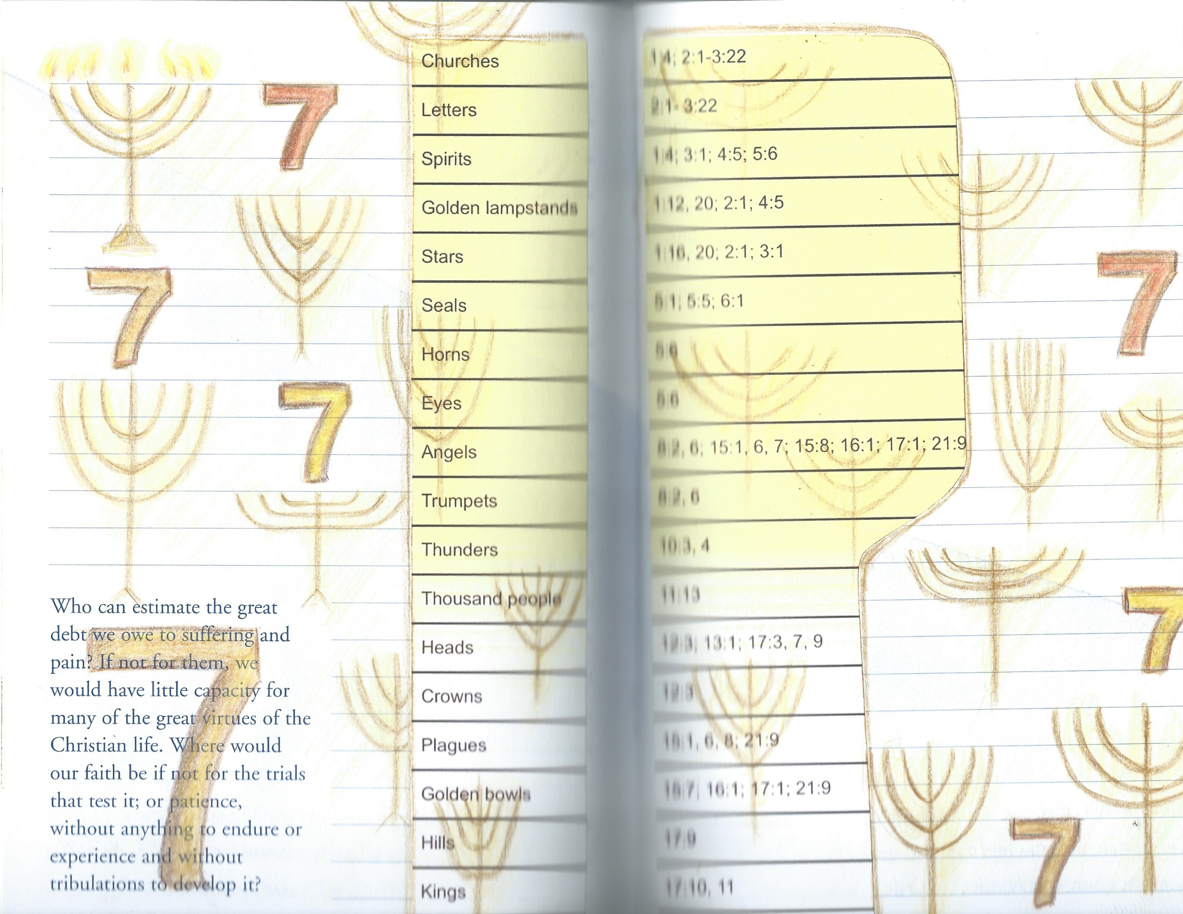

Slide 116
Future
1 2 3 4 5 6 7 8 9 10 11 12 13 14 15 16 17 18 19 20 21 22
Seals
Interlude
Bowls
Conclusion
Interlude
Trumpets
Throne Room

Slide 117
Blessed is the one who reads aloud the words of this prophecy, and blessed are those who hear it and take to heart what is written in it, because the time is near. (Rev 1:3)
Blessed are the dead who die in the Lord from now on. Yes, says the Spirit, they will rest from their labor, for their deeds will follow them. (Rev 14:13)
Blessed is the one who stays awake and remains clothed, so as not to go naked and be shamefully exposed. (Rev 16:15)
Blessed are those who are invited to the wedding supper of the Lamb! These are the true words of God. (Rev 19:9)
Blessed and holy are those who share in the first resurrection. The second death has no power over them, but they will be priests of God and of Christ and will reign with Him for a thousand years. (Rev 20:6)
Blessed is the one who keeps the words of the prophecy written in this scroll. (Rev 22:7)
Blessed are those who wash their robes, that they may have the right to the tree of life and may go through the gates into the city. (Rev 22:14)

Slide 118
Chiasm: ABBA
Matthew 19:30
“But many who are first will be last,
and the last first.”

Slide 119
Chiasm: ABCBA
John 4: 23-24
²³ “But the hour is coming, and now is, when the true worshipers will worship the Father in spirit and truth; for the Father is seeking such to worship Him. ²⁴ God is Spirit, and those who worship Him must worship Him in spirit and truth.”

Slide 120
“But the hour is coming, and now is, when the
true worshipers will worship the Father in spirit
and in truth;
for the Father is seeking such to worship Him.
God is Spirit,
and those who worship Him
must worship Him in spirit and truth.”

Slide 121
“But the hour is coming, and now is, when the
true worshipers will worship the Father in spirit
and in truth;
for the Father is seeking such to worship Him.
God is Spirit,
and those who worship Him
must worship Him in spirit and truth.”

Slide 122
“But the hour is coming, and now is, when the
true worshipers will worship the Father in spirit
and in truth;
for the Father is seeking such to worship Him.
God is Spirit,
and those who worship Him
must worship Him in spirit and truth.”

Slide 123
Jesus Has Come (1:1-20)
Seven Letters (2:3-22)
Seven Seals (4:1 & 8:1)
144,000 Saints & 7 Trumpets (7:11:15-19)
Two Witnesses (11:1-16)
Woman Clothed with the Sun (12:1)
Chiastic
Structure
of
Revelation
Dragon in Heaven (12:4)
Woman Flees to Wilderness (12:6)
Satan Cast Out \ WE OVERCOME! (12:7-13)
Woman Flees to Wilderness (12:14)
Dragon Persecutes the Woman (12:15)
Woman’s Seed Keeps God’s Commandments (12:17)
Two Beasts (13:1 - 18)
144,000 Saints & 7 Angels (14:1:-115:4)
Seven Bowls (15:1,5 – 16:21)
Seven Angels (17:1 – 22:5)
Jesus is Returning (22:6-21)

Slide 124
Psalm 67
God be merciful to us and bless us, and cause His face to shine upon us, Selah
That Your way may be known on earth, Your salvation among all nations.
Let the peoples praise You, O God; let all the peoples praise You.
Oh, let the nations be glad and sing for joy! For You shall judge the people
righteously and govern the nations on earth. Selah
Let the peoples praise You, O God; let all the peoples praise You.
Then the earth shall yield her increase; God, our own God, shall bless us.
God shall bless us, and all the ends of the earth shall fear Him.

