Slide 2
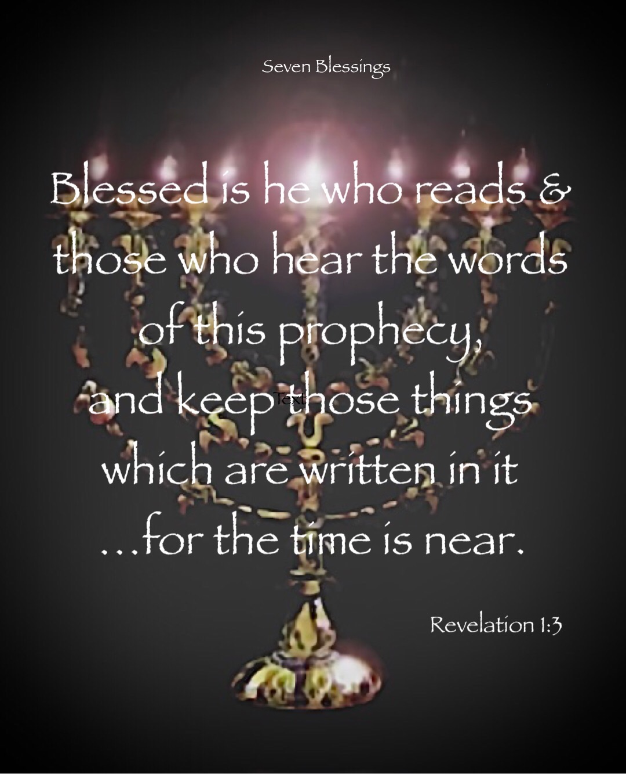

Slide 3
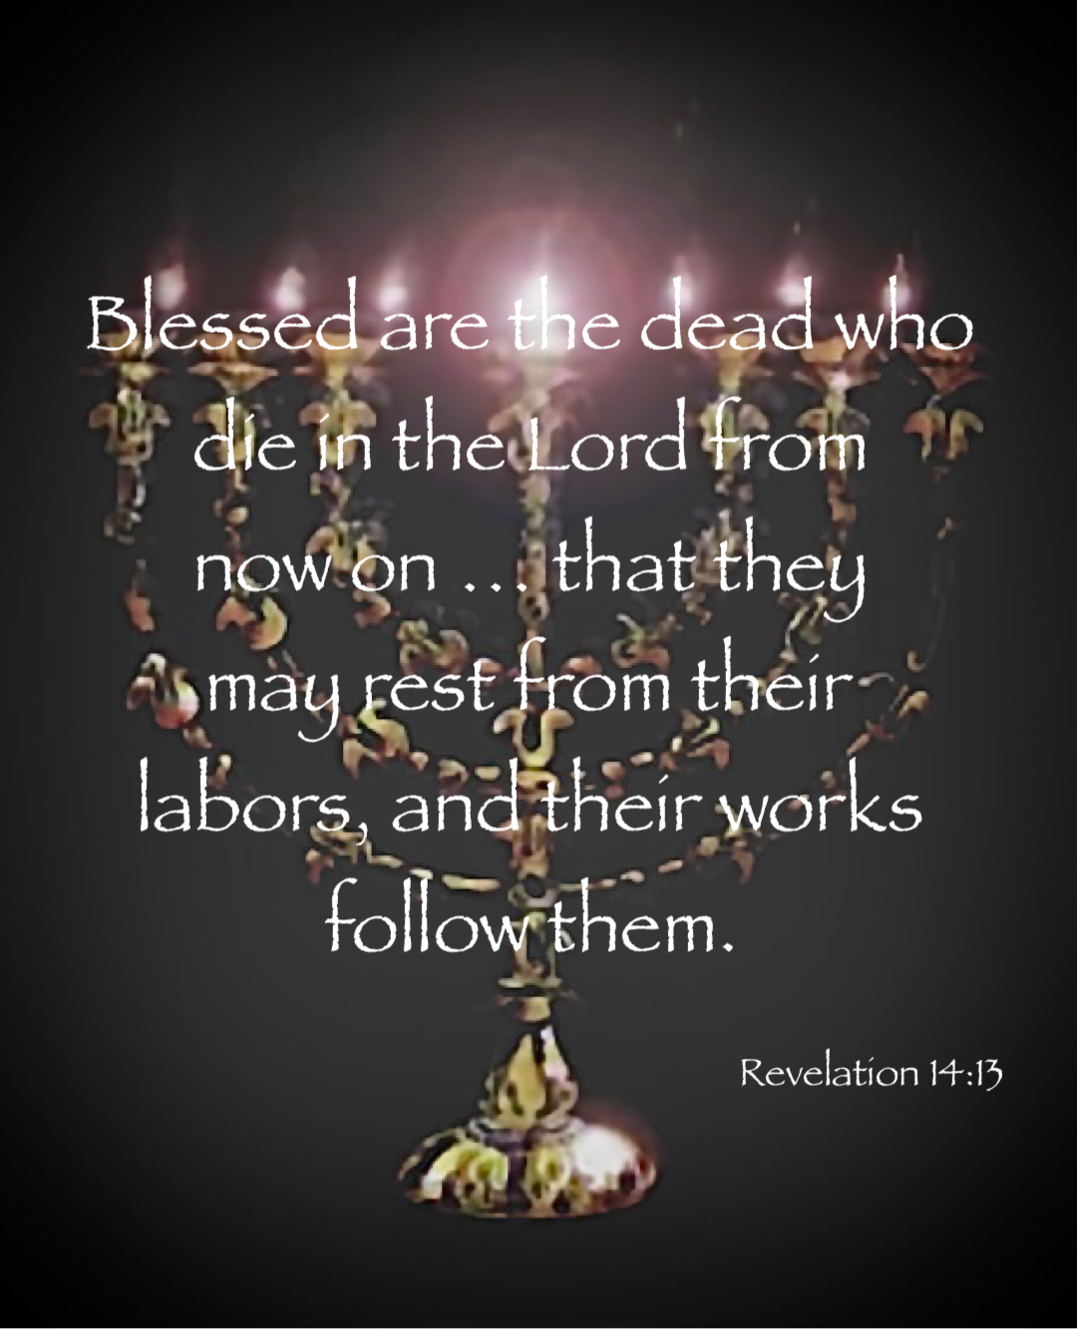

Slide 4
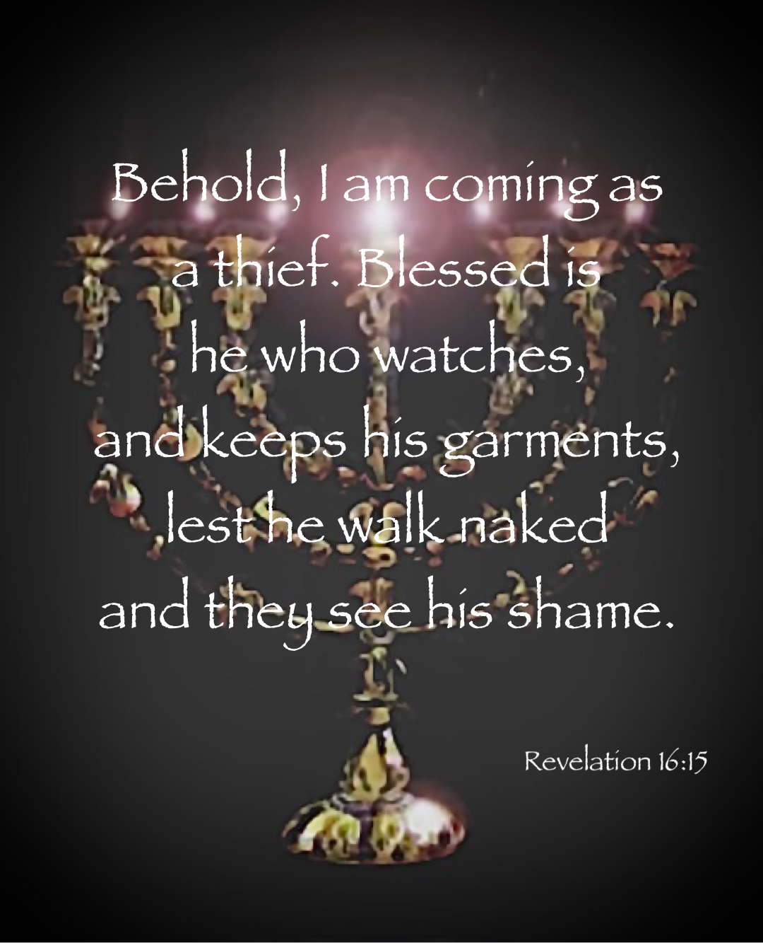

Slide 5
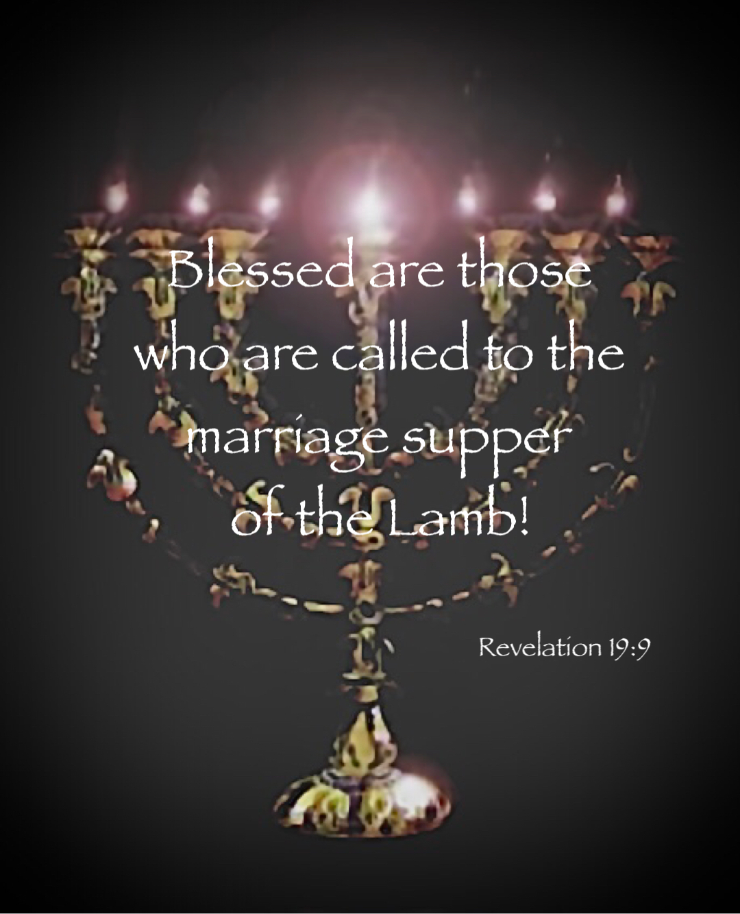

Slide 6
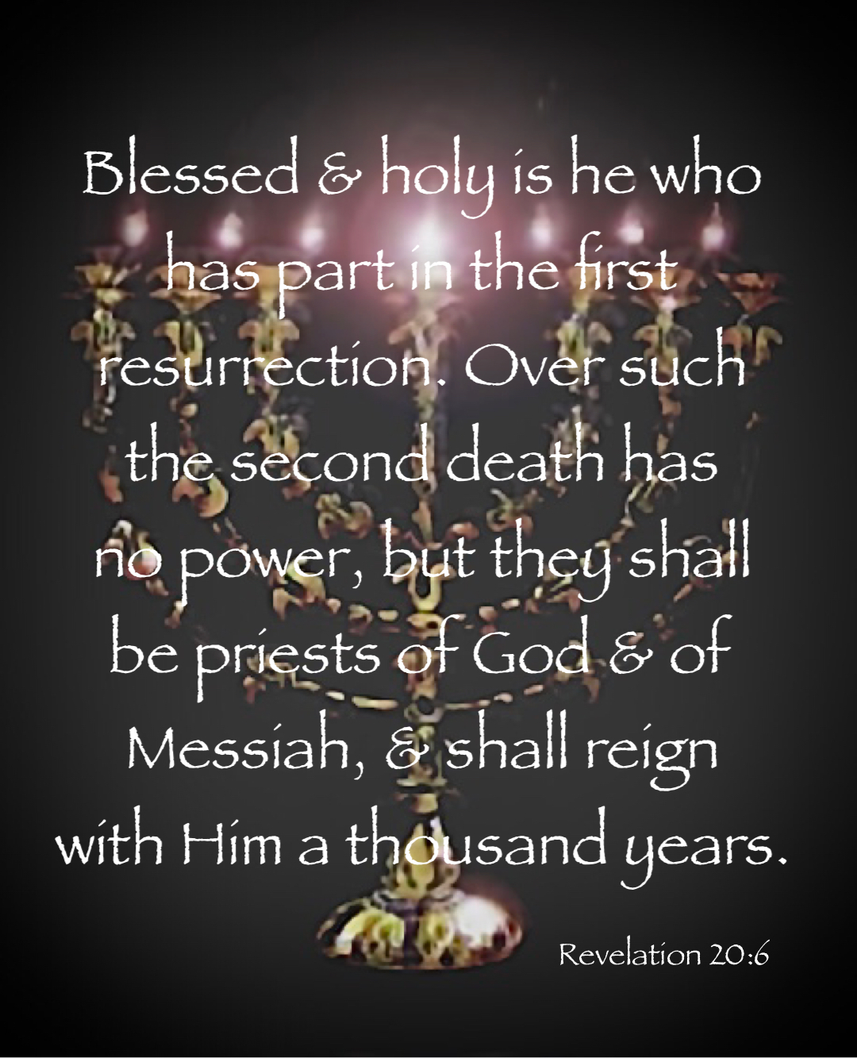

Slide 7
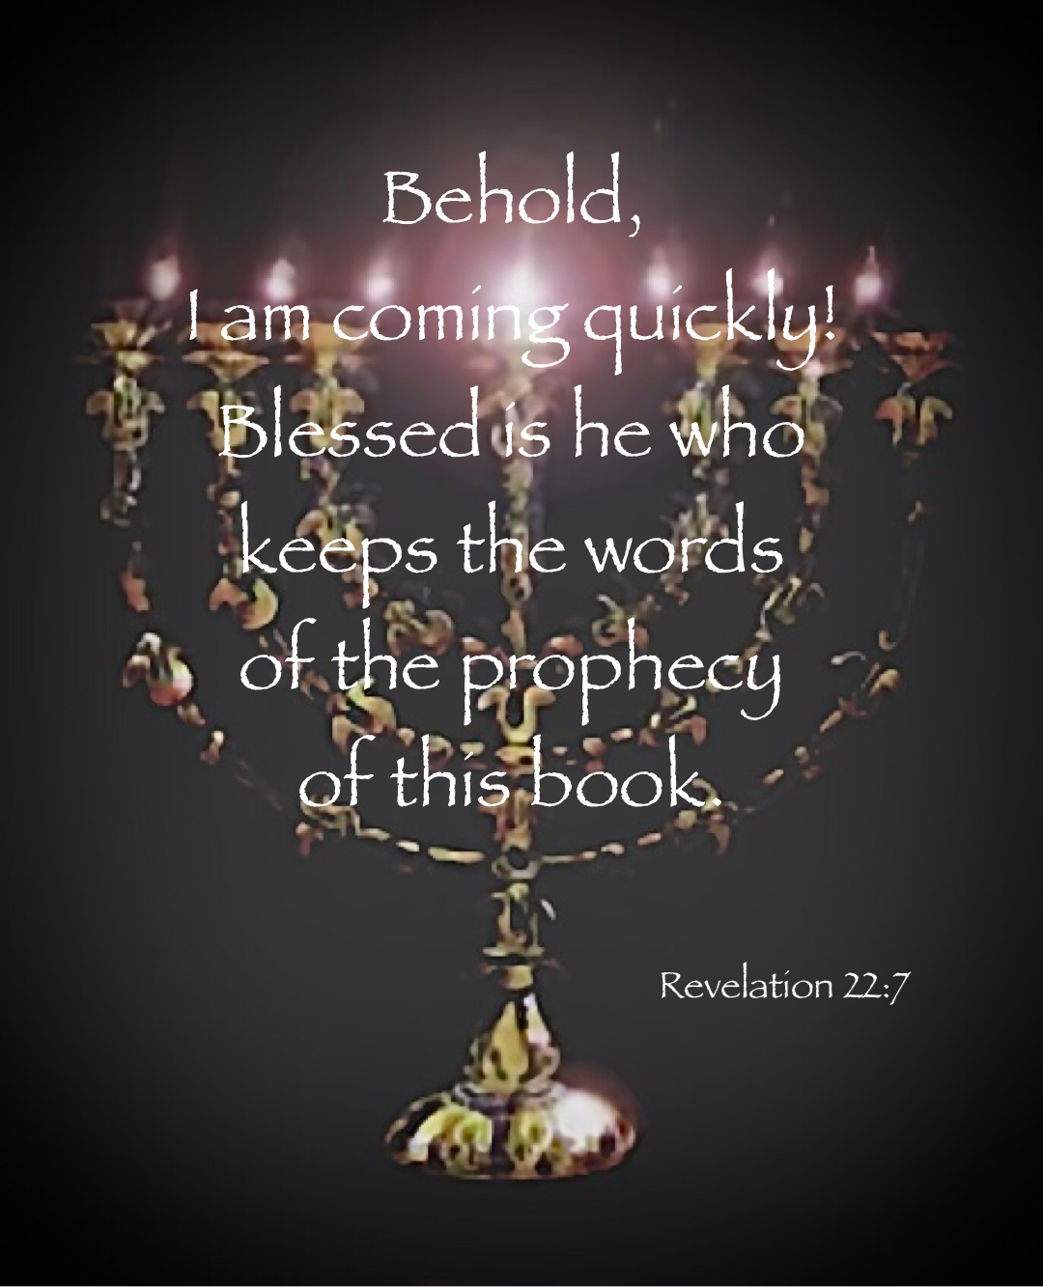

Slide 8
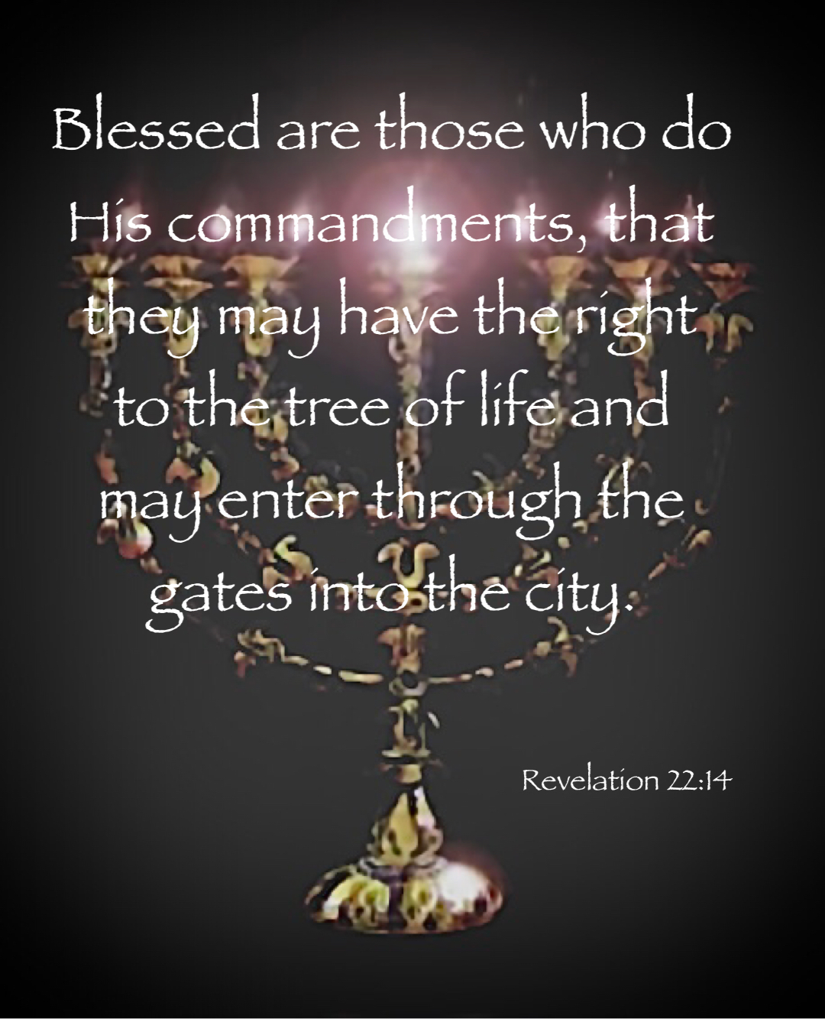

Slide 9
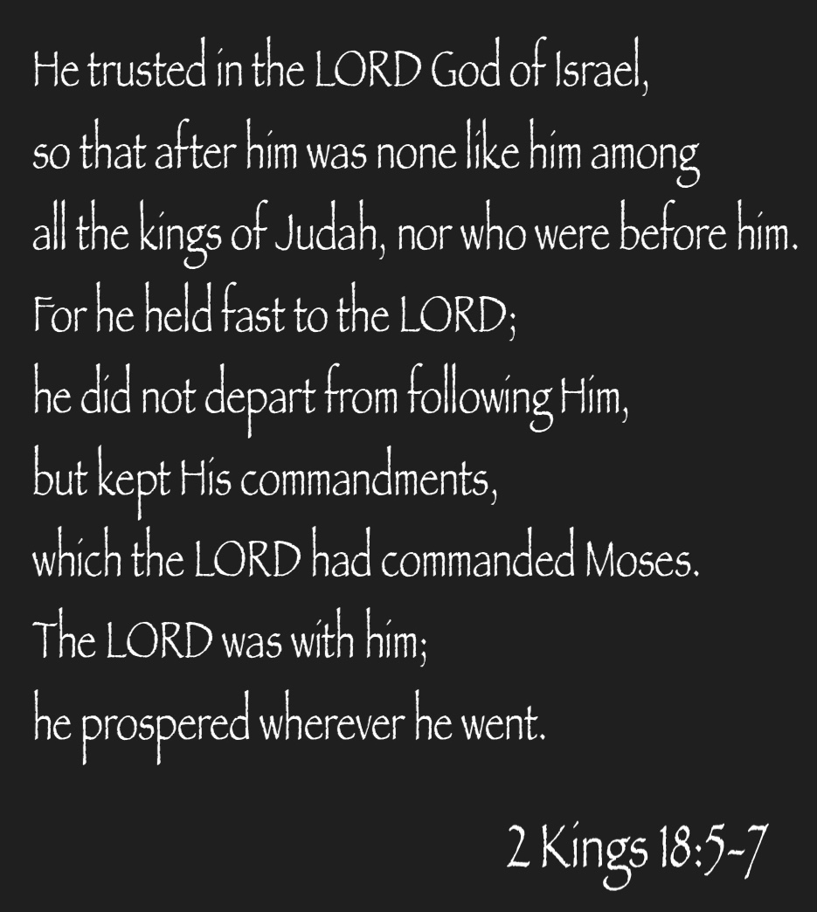

Slide 10
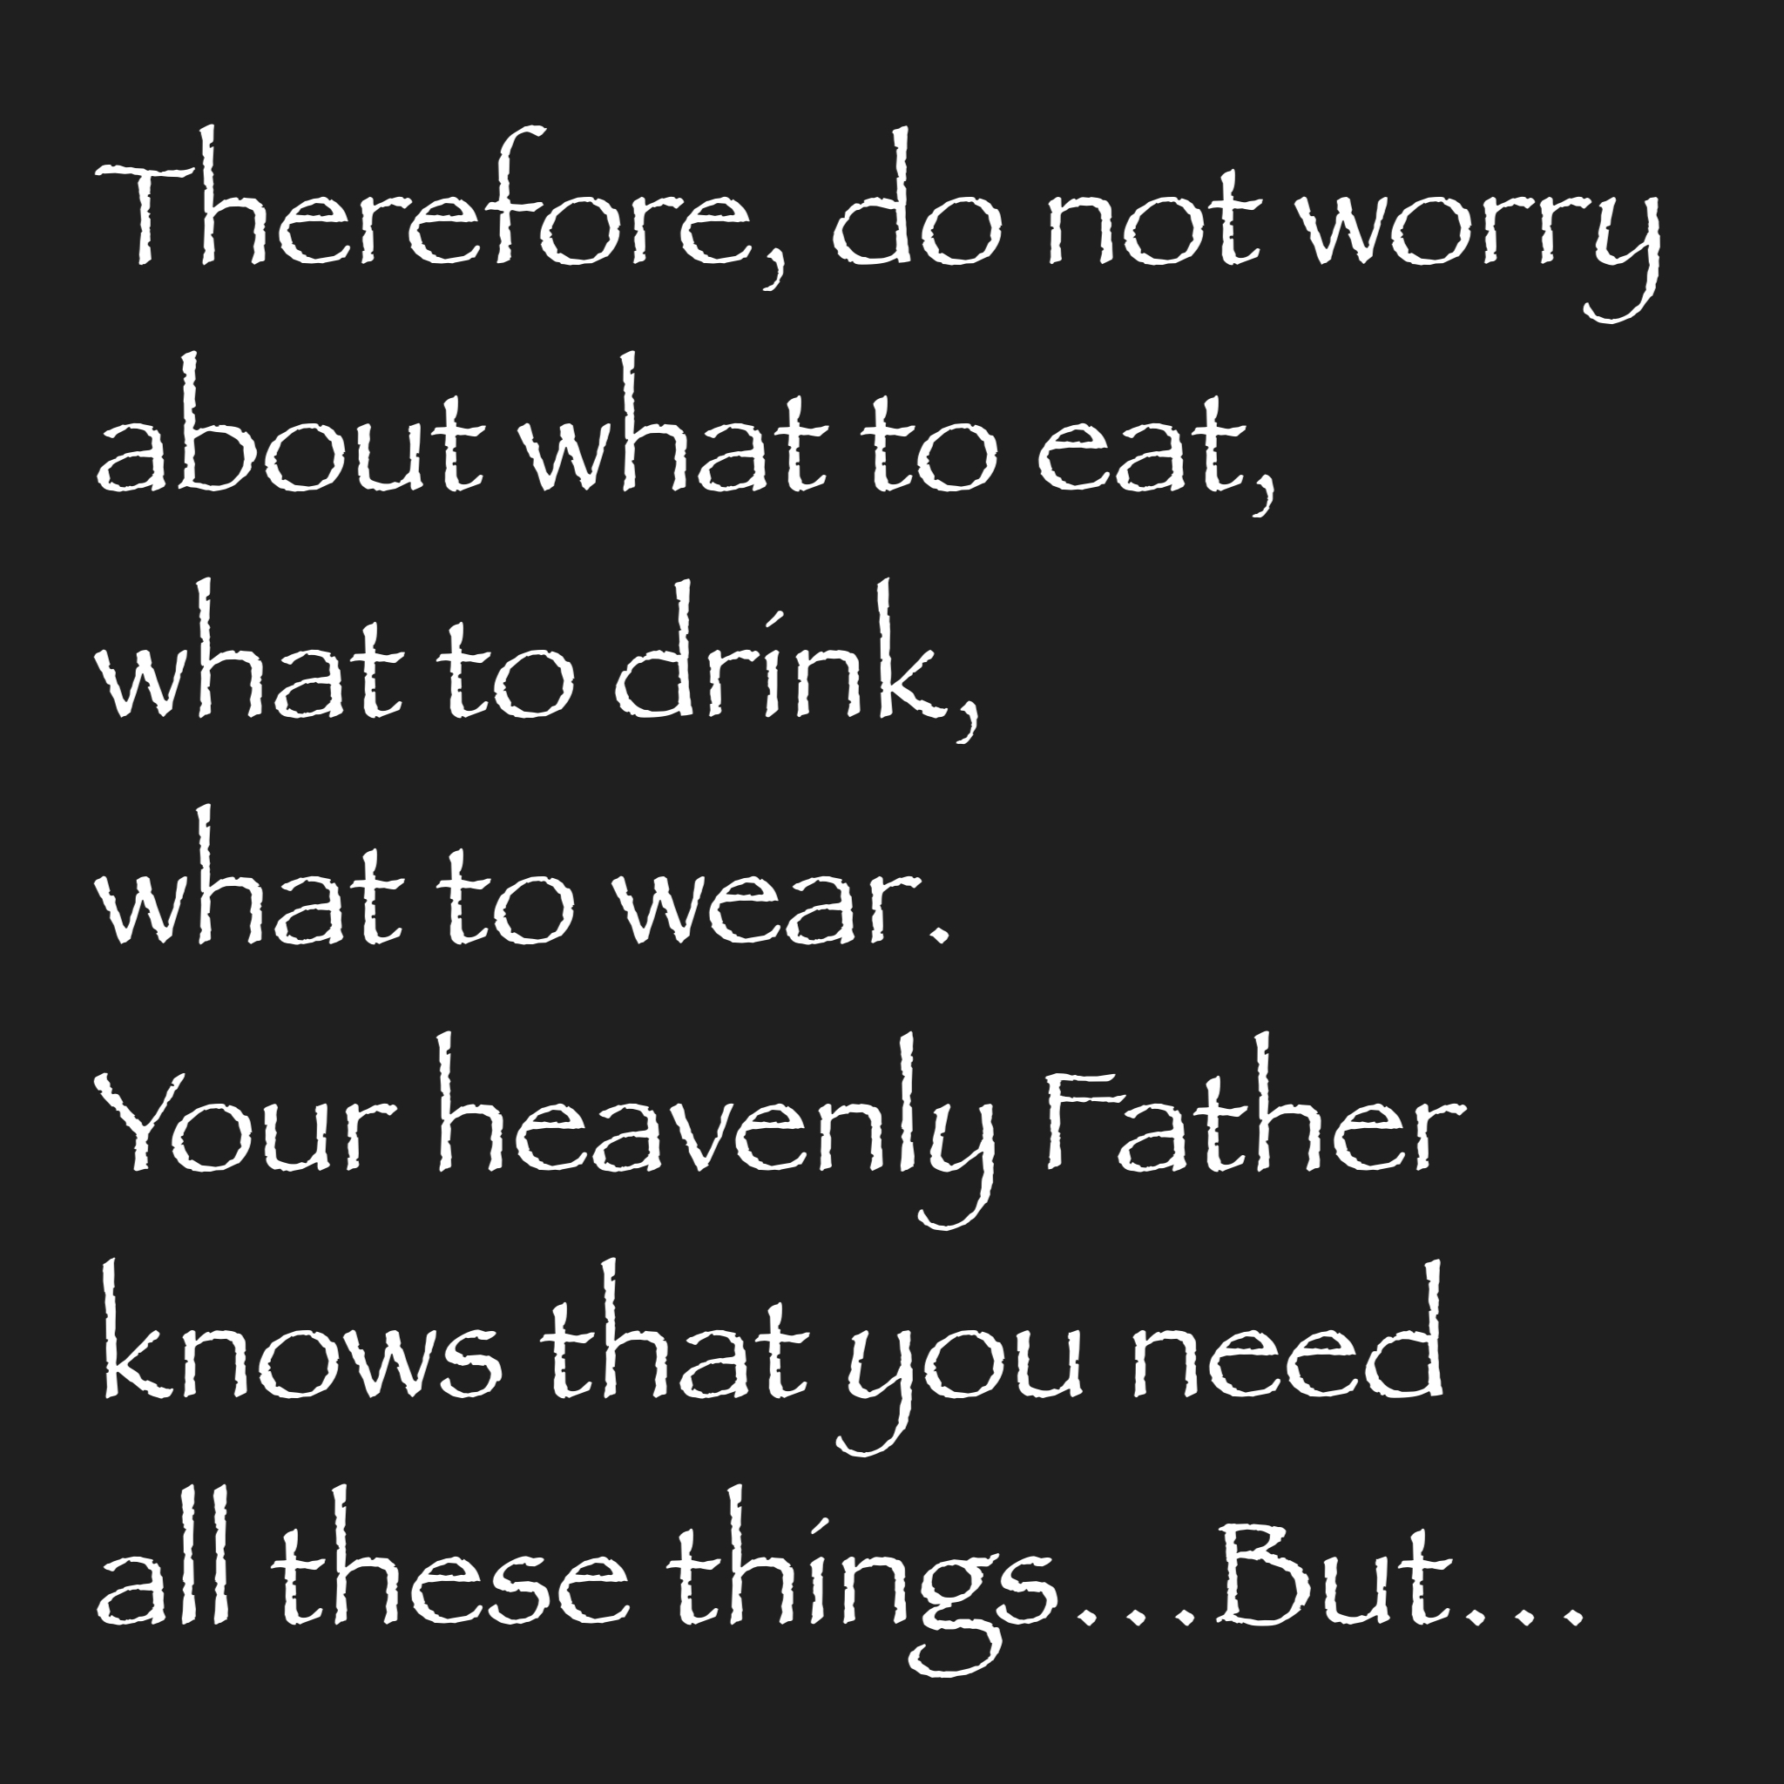

Slide 11
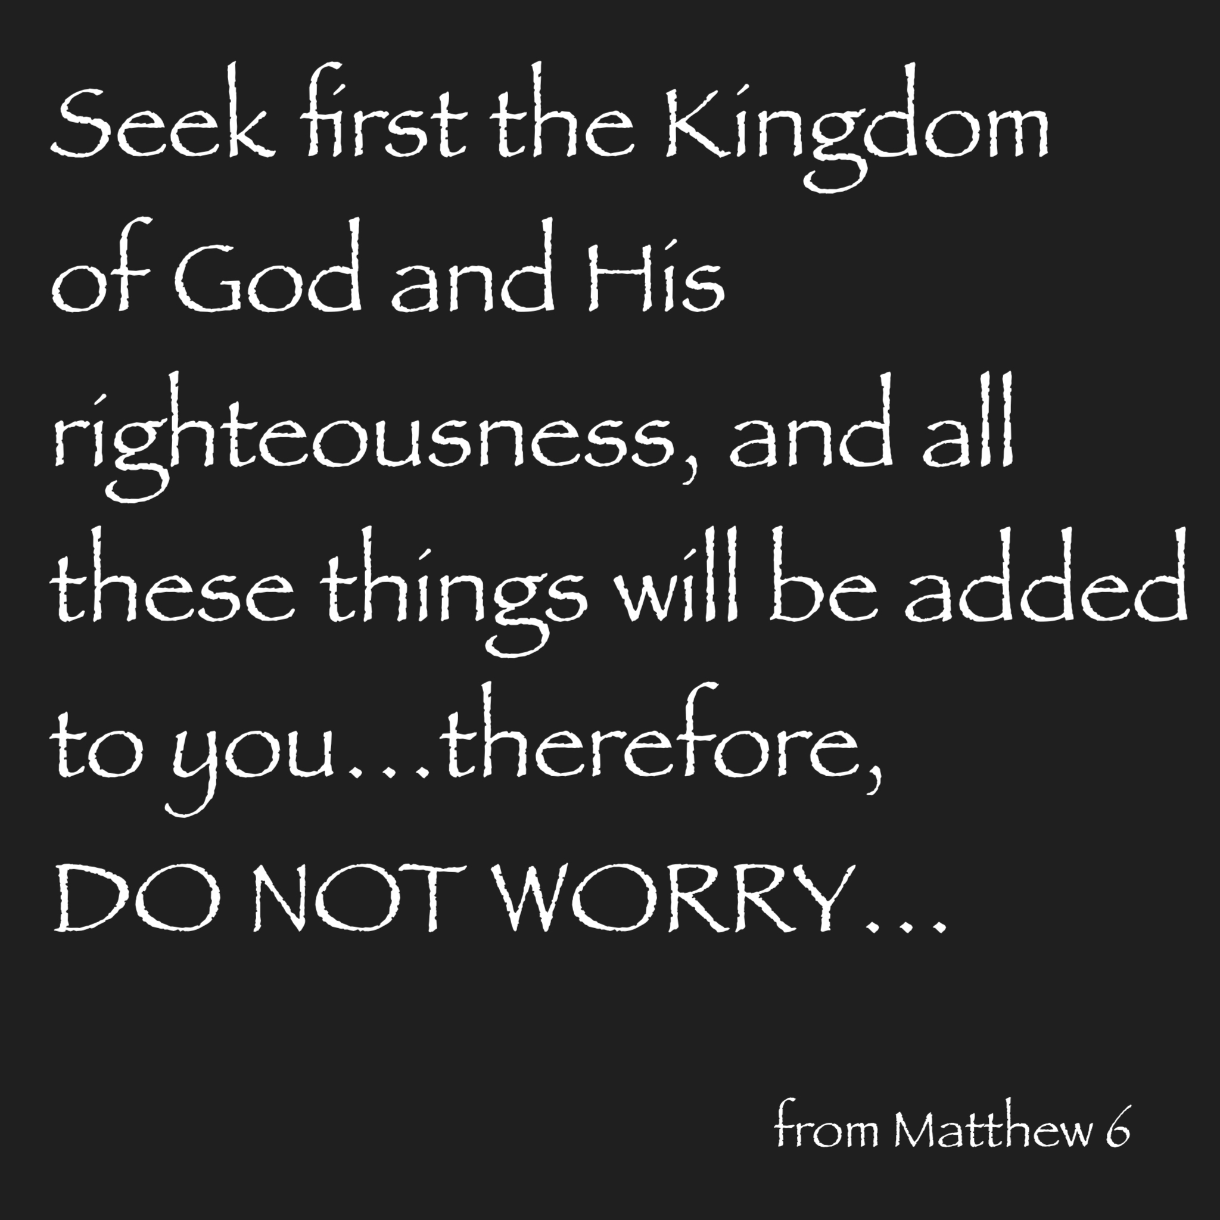

Slide 12
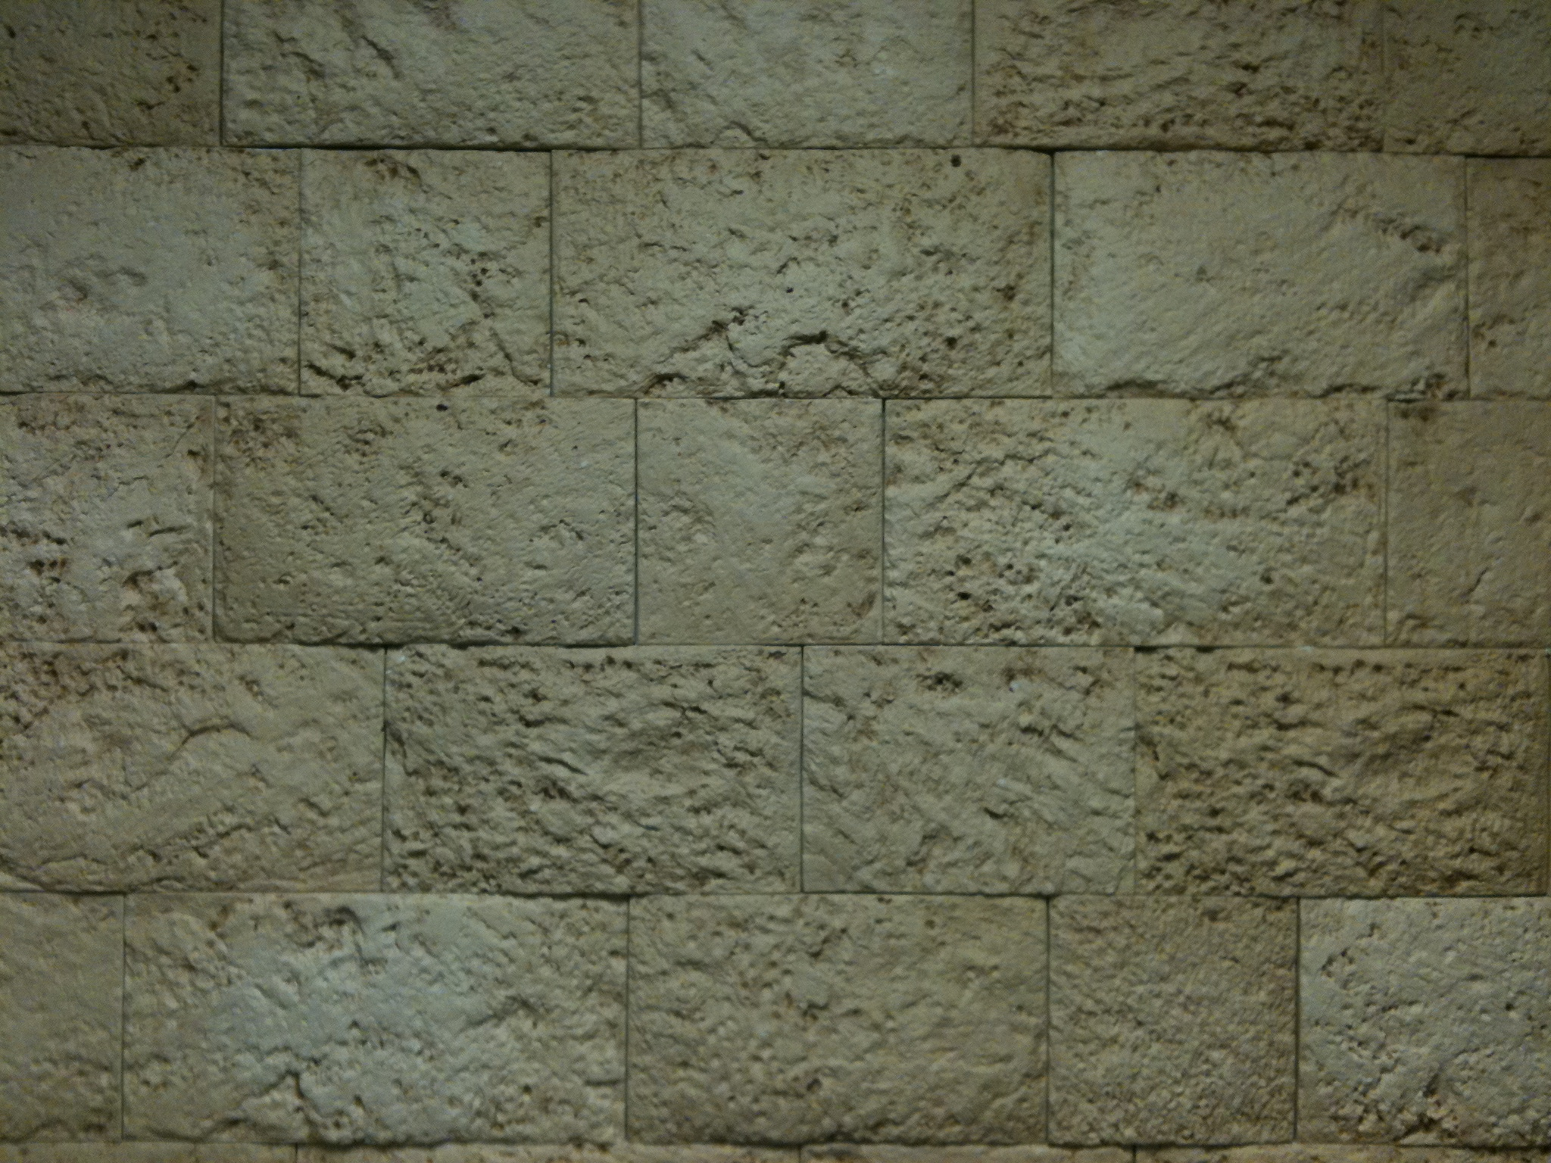
Revelation
Chapter 4

Slide 14
In the Presence of God
John (Throne Room) Revelation 4 & 5
Isaiah (Throne Room) Isaiah 6
Ezekiel (Babylonian Vision) Ezekiel 1
Daniel (Throne Room) Daniel 7

Slide 15
“Beings” in the Throne Room of God
God the Father Ezek 1:26-28
24 Elders Matt 27:50-53
“Living Creatures” Ezek 1:15-21 & 10:9-13 & Ezek 10:15-19
Seraphim “Burning Ones” Isaiah 6:1-5
Cherubim “Ones Who Draw Near” Ezek 1:4-14 & 22-24
& Ezek 10:3-8 & 12-22

Slide 16
“Beings” in the Throne Room of God
Seraphim “Burning Ones” Isaiah 6:1-5
6 Wings
2 Cover Face
2 Cover Feet
2 Flies
Fly Above Throne
Glorify God Rev 4:6-11
6 Wings / 4 Faces

Slide 17
“Beings” in the Throne Room of God
Cherubim “Ones Who Draw Near” Ezek 1:4-28 & 10:1-22
4 Wings
4 Faces
Man
Lion
Ox
Eagle
2 Hands
Fly Beside and Around the Throne
Guard & Protect
Rev 4:6-11
6 Wings / 4 Faces

Slide 18
Dan
Ashar
Naphtali
Numbers 2
Merari
Ephraim
Manasseh
Benjamin
Judah
Issachar
Zebulun
Tabernacle
Ger-shon
Aaron
Kohath
Reuben
Simeon
Gad

Slide 19
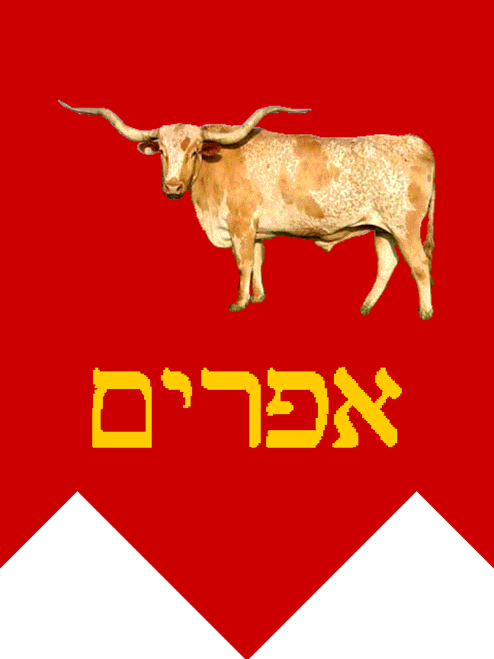
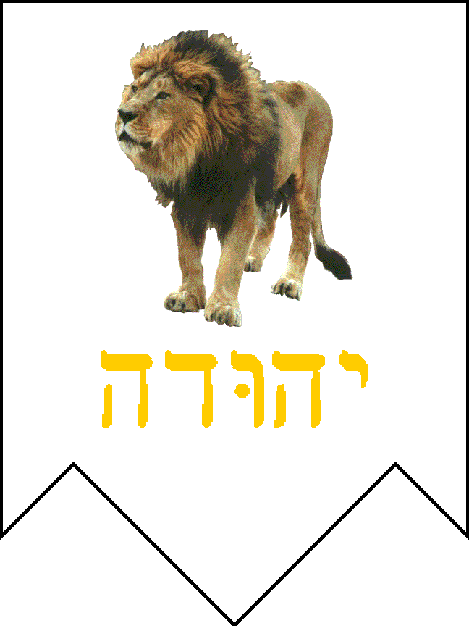
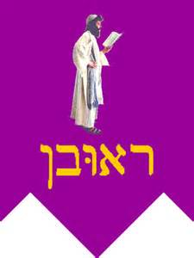
Dan
Ashur
Naphtali
Numbers 2
The first living creature was like a lion, the second living creature like a calf, the third living creature had a face like a man, and the fourth living creature was like a flying eagle.
Rev 4:7
Merari
Ephraim
Manasseh
Benjamin
Judah
Issachar
Zebulun
Tabernacle
Ger-shon
Aaron
Kohath
Reuben
Simeon
Gad

Slide 20
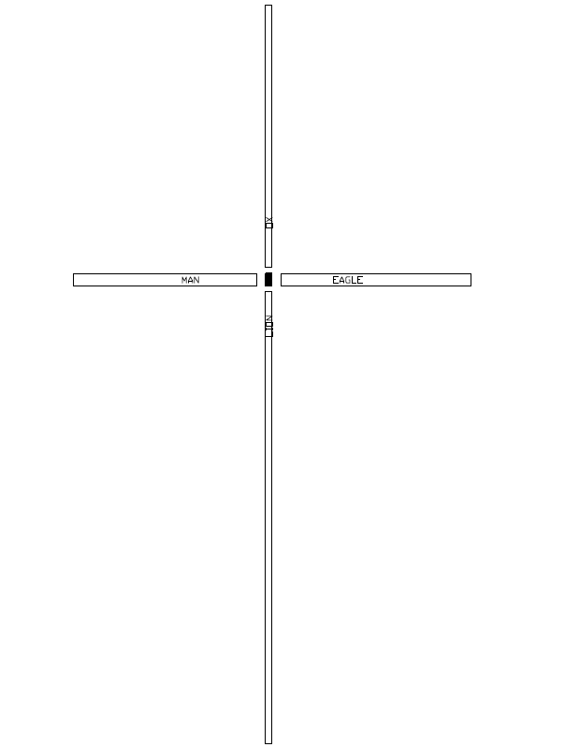

Slide 21
Other Appearances of Cherubim
Entrance to Eden Genesis 3:24
Lucifer Ezekiel 28:12-19
Mercy Seat Exodus 25:17-21

Slide 22
“Beings” in the Throne Room of God
“Living Creatures” Ezek 1:15-21 & 10:9-13
& Ezek 10:15-19
6 Wings
4 Faces
Associated with Cherubim
“Wheels” With Them

Slide 34
Revelation
Chapter 5

Slide 36
“But you, Daniel, shut up the words, and seal the book until the time of the end; many shall run to and fro, and knowledge shall increase.”
Daniel 12:4

Slide 37
“But you, Daniel, shut up the words, and seal the book until the time of the end; many shall run to and fro, and knowledge shall increase.”
Daniel 12:4
Daniel’s Prophecies?
Deed to Planet Earth?
Book of Life?

Slide 38
“And I saw in the right hand of Him who sat on the throne a scroll written inside and on the back, sealed with seven seals.”
Revelation 5:1

Slide 39
“And I saw in the right hand of Him who sat on the throne a scroll written inside and on the back, sealed with seven seals.”
Revelation 5:1
“And I saw in the right hand of Him who sat on the throne a scroll written inside, and on the back sealed with seven seals.”
Revelation 5:1

Slide 40
The Eyes of God
“For who has despised the day of small things? For these seven rejoice to see the plumb line in the hand of Zerubbabel. They are the eyes of the Lord, which scan to and fro throughout the whole earth.” Zechariah 4:10

Slide 41
The Seven Spirits of God
“There shall come forth a Rod from the stem of Jesse,
And a Branch shall grow out of his roots.
The Spirit of the Lord shall rest upon Him,
the Spirit of wisdom and understanding,
the Spirit of counsel and might,
the Spirit of knowledge and of the fear of the Lord.”
Isaiah 11:1-2

Slide 42
Revelation
Chapter 6

Slide 43
The Revelation Judgments
 | 1 | 2 | 3 | 4 | 5 | 6 |  | 7
Reference | Rev 6:1-2 | Rev 6:3-4 | Rev 6:5-6 | Rev 6:7-8 | Rev 6:9-11 | Rev 6:12-17 |  | Rev 8:1-6
Seal Judgments | White Horse Bow Crown (Stephanos) Overcomer THE CHURCH | Red Horse Takes Peace Cause to Kill One Another Great Sword WAR | Black Horse Balance (Yoke) Inflation on Needed Things Not Luxuries ECONOMIC | Pale Horse Death & Hades Power Over 1/4 Sword, Hunger, Death & Beasts FAMINE / PESTILANCE | Martyred Souls Under Altar "How Long?" White Robes Wait for the Remnant | Earthquake Black Sun & Blood Moon Stars Fall Mts & Isles Move Rich Men Hide from God's Wrath |  | Silence in Heaven Angel w/ Censer Noises, Thunderings, Lightnings & Earthquake
Reference | Rev 8:7 | Rev 8:8-9 | Rev 8:10-11 | Rev 8:12-13 | Rev 9:1-12 | Rev 9:13-21 |  | Rev 11:15-19
Trumpet Judgments | Hail & Fire from Heaven Mingled w/ Blood Burn 1/3 of Trees Burn All Grass | Burning Mountain into Sea 1/3 of Sea Creatures Die Destroy 1/3 of Ships | Star Falls on 1/3 of Rivers & Springs Become Bitter Many Men Die | 1/3 of Sun, Moon Stars Dark Day & Night 1/3 Shorter "Woe, Woe, Woe“ to Earth | Star from Heaven with Key to Pit Smoke & Locusts Harm Those Without God's Mark "Woe, Woe" | 4 Angels from Euphrates River Kill 1/3 of Mankind with Fire, Smoke & Brimstone Men Don't Repent 3rd "Woe" |  | Nations to God Elders Worship Noises, Thunderings, Lightnings & Earthquake Temple Opened
Seven Thunders Rev 10:3-4 Sealed Up !!!
Reference | Rev 16:2 | Rev 16:3 | Rev 16:4-7 | Rev 16:8-9 | Rev 16:10-11 | Rev 16:12-16 | Rev 16:17-21
Bowl Judgments | Sores on All Men with Mark of the Beast | Sea Becomes Blood Every Sea Creature Dies | Rivers & Springs Become Blood "True & Righteous are Your Judgments" | Sun Scorches All Men Do Not Repent | Darkness on Beast Kingdom Men Gnaw Tongues in Pain | Euphrates Dries Up 3 Unclean Spirits Gather Entire Earth to Battle at HarMegiddo | Poured on the Air "It is Done" Noises, Thunderings, Lightnings, Earthquake & Hail

Slide 44
The Revelation Judgments
 | 1 | 2 | 3 | 4 | 5 | 6 |  | 7
Reference | Rev 6:1-2 | Rev 6:3-4 | Rev 6:5-6 | Rev 6:7-8 | Rev 6:9-11 | Rev 6:12-17 |  | Rev 8:1-6
Seal Judgments | White Horse Bow Crown (Stephanos) Conquerer THE CHURCH | Red Horse Takes Peace Cause to Kill One Another Great Sword WAR | Black Horse Balance (Yoke) Inflation on Needed Things Not Luxuries ECONOMIC | Pale Horse Death & Hades Power Over 1/4 Sword, Hunger, Death & Beasts FAMINE / PESTILANCE | Martyred Souls Under Altar "How Long?" White Robes Wait for the Remnant | Earthquake Black Sun & Blood Moon Stars Fall Mts & Isles Move Rich Men Hide from God's Wrath |  | Silence in Heaven Angel w/ Censer Noises, Thunderings, Lightnings & Earthquake
Reference | Rev 8:7 | Rev 8:8-9 | Rev 8:10-11 | Rev 8:12-13 | Rev 9:1-12 | Rev 9:13-21 |  | Rev 11:15-19
Trumpet Judgments | Hail & Fire from Heaven Mingled w/ Blood Burn 1/3 of Trees Burn All Grass | Burning Mountain into Sea 1/3 of Sea Creatures Die Destroy 1/3 of Ships | Star Falls on 1/3 of Rivers & Springs Become Bitter Many Men Die | 1/3 of Sun, Moon Stars Dark Day & Night 1/3 Shorter "Woe, Woe, Woe“ to Earth | Star from Heaven with Key to Pit Smoke & Locusts Harm Those Without God's Mark "Woe, Woe" | 4 Angels from Euphrates River Kill 1/3 of Mankind with Fire, Smoke & Brimstone Men Don't Repent 3rd "Woe" |  | Nations to God Elders Worship Noises, Thunderings, Lightnings & Earthquake Temple Opened
Seven Thunders Rev 10:3-4 Sealed Up !!!
Reference | Rev 16:2 | Rev 16:3 | Rev 16:4-7 | Rev 16:8-9 | Rev 16:10-11 | Rev 16:12-16 | Rev 16:17-21
Bowl Judgments | Sores on All Men with Mark of the Beast | Sea Becomes Blood Every Sea Creature Dies | Rivers & Springs Become Blood "True & Righteous are Your Judgments" | Sun Scorches All Men Do Not Repent | Darkness on Beast Kingdom Men Gnaw Tongues in Pain | Euphrates Dries Up 3 Unclean Spirits Gather Entire Earth to Battle at HarMegiddo | Poured on the Air "It is Done" Noises, Thunderings, Lightnings, Earthquake & Hail

Slide 45
The Revelation Judgments
 | 1 | 2 | 3 | 4 | 5 | 6 |  | 7
Reference | Rev 6:1-2 | Rev 6:3-4 | Rev 6:5-6 | Rev 6:7-8 | Rev 6:9-11 | Rev 6:12-17 |  | Rev 8:1-6
Seal Judgments | White Horse Bow Crown (Stephanos) Conquerer THE CHURCH | Red Horse Takes Peace Cause to Kill One Another Great Sword WAR | Black Horse Balance (Yoke) Inflation on Needed Things Not Luxuries ECONOMIC | Pale Horse Death & Hades Power Over 1/4 Sword, Hunger, Death & Beasts FAMINE / PESTILANCE | Martyred Souls Under Altar "How Long?" White Robes Wait for the Remnant | Earthquake Black Sun & Blood Moon Stars Fall Mts & Isles Move Rich Men Hide from God's Wrath |  | Silence in Heaven Angel w/ Censer Noises, Thunderings, Lightnings & Earthquake
Reference | Rev 8:7 | Rev 8:8-9 | Rev 8:10-11 | Rev 8:12-13 | Rev 9:1-12 | Rev 9:13-21 |  | Rev 11:15-19
Trumpet Judgments | Hail & Fire from Heaven Mingled w/ Blood Burn 1/3 of Trees Burn All Grass | Burning Mountain into Sea 1/3 of Sea Creatures Die Destroy 1/3 of Ships | Star Falls on 1/3 of Rivers & Springs Become Bitter Many Men Die | 1/3 of Sun, Moon Stars Dark Day & Night 1/3 Shorter "Woe, Woe, Woe“ to Earth | Star from Heaven with Key to Pit Smoke & Locusts Harm Those Without God's Mark "Woe, Woe" | 4 Angels from Euphrates River Kill 1/3 of Mankind with Fire, Smoke & Brimstone Men Don't Repent 3rd "Woe" |  | Nations to God Elders Worship Noises, Thunderings, Lightnings & Earthquake Temple Opened
Seven Thunders Rev 10:3-4 Sealed Up !!!
Reference | Rev 16:2 | Rev 16:3 | Rev 16:4-7 | Rev 16:8-9 | Rev 16:10-11 | Rev 16:12-16 | Rev 16:17-21
Bowl Judgments | Sores on All Men with Mark of the Beast | Sea Becomes Blood Every Sea Creature Dies | Rivers & Springs Become Blood "True & Righteous are Your Judgments" | Sun Scorches All Men Do Not Repent | Darkness on Beast Kingdom Men Gnaw Tongues in Pain | Euphrates Dries Up 3 Unclean Spirits Gather Entire Earth to Battle at HarMegiddo | Poured on the Air "It is Done" Noises, Thunderings, Lightnings, Earthquake & Hail

Slide 46
The Revelation Judgments
 | 1 | 2 | 3 | 4 | 5 | 6 |  | 7
Reference | Rev 6:1-2 | Rev 6:3-4 | Rev 6:5-6 | Rev 6:7-8 | Rev 6:9-11 | Rev 6:12-17 |  | Rev 8:1-6
Seal Judgments | White Horse Bow Crown (Stephanos) Conquerer Overcomer | Red Horse Takes Peace Cause to Kill One Another Great Sword WAR | Black Horse Balance (Yoke) Inflation on Needed Things Not Luxuries ECONOMIC | Pale Horse Death & Hades Power Over 1/4 Sword, Hunger, Death & Beasts FAMINE / PESTILANCE | Martyred Souls Under Altar "How Long?" White Robes Wait for the Remnant | Earthquake Black Sun & Blood Moon Stars Fall Mts & Isles Move Rich Men Hide from God's Wrath |  | Silence in Heaven Angel w/ Censer Noises, Thunderings, Lightnings & Earthquake
Reference | Rev 8:7 | Rev 8:8-9 | Rev 8:10-11 | Rev 8:12-13 | Rev 9:1-12 | Rev 9:13-21 |  | Rev 11:15-19
Trumpet Judgments | Hail & Fire from Heaven Mingled w/ Blood Burn 1/3 of Trees Burn All Grass | Burning Mountain into Sea 1/3 of Sea Creatures Die Destroy 1/3 of Ships | Star Falls on 1/3 of Rivers & Springs Become Bitter Many Men Die | 1/3 of Sun, Moon Stars Dark Day & Night 1/3 Shorter "Woe, Woe, Woe“ to Earth | Star from Heaven with Key to Pit Smoke & Locusts Harm Those Without God's Mark "Woe, Woe" | 4 Angels from Euphrates River Kill 1/3 of Mankind with Fire, Smoke & Brimstone Men Don't Repent 3rd "Woe" |  | Nations to God Elders Worship Noises, Thunderings, Lightnings & Earthquake Temple Opened
Seven Thunders Rev 10:3-4 Sealed Up !!!
Reference | Rev 16:2 | Rev 16:3 | Rev 16:4-7 | Rev 16:8-9 | Rev 16:10-11 | Rev 16:12-16 | Rev 16:17-21
Bowl Judgments | Sores on All Men with Mark of the Beast | Sea Becomes Blood Every Sea Creature Dies | Rivers & Springs Become Blood "True & Righteous are Your Judgments" | Sun Scorches All Men Do Not Repent | Darkness on Beast Kingdom Men Gnaw Tongues in Pain | Euphrates Dries Up 3 Unclean Spirits Gather Entire Earth to Battle at HarMegiddo | Poured on the Air "It is Done" Noises, Thunderings, Lightnings, Earthquake & Hail

Slide 47
The Revelation Judgments
 | 1 | 2 | 3 | 4 | 5 | 6 |  | 7
Reference | Rev 6:1-2 | Rev 6:3-4 | Rev 6:5-6 | Rev 6:7-8 | Rev 6:9-11 | Rev 6:12-17 |  | Rev 8:1-6
Seal Judgments | White Horse Bow Crown (Stephanos) Overcomer THE CHURCH | Red Horse Takes Peace Cause to Kill One Another Great Sword WAR | Black Horse Balance (Yoke) Inflation on Needed Things Not Luxuries ECONOMIC | Pale Horse Death & Hades Power Over 1/4 Sword, Hunger, Death & Beasts FAMINE / PESTILANCE | Martyred Souls Under Altar "How Long?" White Robes Wait for the Remnant | Earthquake Black Sun & Blood Moon Stars Fall Mts & Isles Move Rich Men Hide from God's Wrath |  | Silence in Heaven Angel w/ Censer Noises, Thunderings, Lightnings & Earthquake
Reference | Rev 8:7 | Rev 8:8-9 | Rev 8:10-11 | Rev 8:12-13 | Rev 9:1-12 | Rev 9:13-21 |  | Rev 11:15-19
Trumpet Judgments | Hail & Fire from Heaven Mingled w/ Blood Burn 1/3 of Trees Burn All Grass | Burning Mountain into Sea 1/3 of Sea Creatures Die Destroy 1/3 of Ships | Star Falls on 1/3 of Rivers & Springs Become Bitter Many Men Die | 1/3 of Sun, Moon Stars Dark Day & Night 1/3 Shorter "Woe, Woe, Woe“ to Earth | Star from Heaven with Key to Pit Smoke & Locusts Harm Those Without God's Mark "Woe, Woe" | 4 Angels from Euphrates River Kill 1/3 of Mankind with Fire, Smoke & Brimstone Men Don't Repent 3rd "Woe" |  | Nations to God Elders Worship Noises, Thunderings, Lightnings & Earthquake Temple Opened
Seven Thunders Rev 10:3-4 Sealed Up !!!
Reference | Rev 16:2 | Rev 16:3 | Rev 16:4-7 | Rev 16:8-9 | Rev 16:10-11 | Rev 16:12-16 | Rev 16:17-21
Bowl Judgments | Sores on All Men with Mark of the Beast | Sea Becomes Blood Every Sea Creature Dies | Rivers & Springs Become Blood "True & Righteous are Your Judgments" | Sun Scorches All Men Do Not Repent | Darkness on Beast Kingdom Men Gnaw Tongues in Pain | Euphrates Dries Up 3 Unclean Spirits Gather Entire Earth to Battle at HarMegiddo | Poured on the Air "It is Done" Noises, Thunderings, Lightnings, Earthquake & Hail

Slide 48
The Revelation Judgments
 | 1 | 2 | 3 | 4 | 5 | 6 |  | 7
Reference | Rev 6:1-2 | Rev 6:3-4 | Rev 6:5-6 | Rev 6:7-8 | Rev 6:9-11 | Rev 6:12-17 |  | Rev 8:1-6
Seal Judgments | White Horse Bow Crown (Stephanos) Overcomer THE CHURCH | Red Horse Takes Peace Cause to Kill One Another Great Sword WAR | Black Horse Balance (Yoke) Inflation on Needed Things Not Luxuries ECONOMIC | Pale Horse Death & Hades Power Over 1/4 Sword, Hunger, Death & Beasts FAMINE / PESTILANCE | Martyred Souls Under Altar "How Long?" White Robes Wait for the Remnant | Earthquake Black Sun & Blood Moon Stars Fall Mts & Isles Move Rich Men Hide from God's Wrath |  | Silence in Heaven Angel w/ Censer Noises, Thunderings, Lightnings & Earthquake
Reference | Rev 8:7 | Rev 8:8-9 | Rev 8:10-11 | Rev 8:12-13 | Rev 9:1-12 | Rev 9:13-21 |  | Rev 11:15-19
Trumpet Judgments | Hail & Fire from Heaven Mingled w/ Blood Burn 1/3 of Trees Burn All Grass | Burning Mountain into Sea 1/3 of Sea Creatures Die Destroy 1/3 of Ships | Star Falls on 1/3 of Rivers & Springs Become Bitter Many Men Die | 1/3 of Sun, Moon Stars Dark Day & Night 1/3 Shorter "Woe, Woe, Woe“ to Earth | Star from Heaven with Key to Pit Smoke & Locusts Harm Those Without God's Mark "Woe, Woe" | 4 Angels from Euphrates River Kill 1/3 of Mankind with Fire, Smoke & Brimstone Men Don't Repent 3rd "Woe" |  | Nations to God Elders Worship Noises, Thunderings, Lightnings & Earthquake Temple Opened
Seven Thunders Rev 10:3-4 Sealed Up !!!
Reference | Rev 16:2 | Rev 16:3 | Rev 16:4-7 | Rev 16:8-9 | Rev 16:10-11 | Rev 16:12-16 | Rev 16:17-21
Bowl Judgments | Sores on All Men with Mark of the Beast | Sea Becomes Blood Every Sea Creature Dies | Rivers & Springs Become Blood "True & Righteous are Your Judgments" | Sun Scorches All Men Do Not Repent | Darkness on Beast Kingdom Men Gnaw Tongues in Pain | Euphrates Dries Up 3 Unclean Spirits Gather Entire Earth to Battle at HarMegiddo | Poured on the Air "It is Done" Noises, Thunderings, Lightnings, Earthquake & Hail

Slide 49
The Revelation Judgments
 | 1 | 2 | 3 | 4 | 5 | 6 |  | 7
Reference | Rev 6:1-2 | Rev 6:3-4 | Rev 6:5-6 | Rev 6:7-8 | Rev 6:9-11 | Rev 6:12-17 |  | Rev 8:1-6
Seal Judgments | White Horse Bow Crown (Stephanos) Overcomer THE CHURCH | Red Horse Takes Peace Cause to Kill One Another Great Sword WAR | Black Horse Balance (Yoke) Inflation on Needed Things Not Luxuries ECONOMIC | Pale Horse Death & Hades Power Over 1/4 Sword, Hunger, Death & Beasts FAMINE / PESTILANCE | Martyred Souls Under Altar "How Long?" White Robes Wait for the Remnant | Earthquake Black Sun & Blood Moon Stars Fall Mts & Isles Move Rich Men Hide from God's Wrath |  | Silence in Heaven Angel w/ Censer Noises, Thunderings, Lightnings & Earthquake
Reference | Rev 8:7 | Rev 8:8-9 | Rev 8:10-11 | Rev 8:12-13 | Rev 9:1-12 | Rev 9:13-21 |  | Rev 11:15-19
Trumpet Judgments | Hail & Fire from Heaven Mingled w/ Blood Burn 1/3 of Trees Burn All Grass | Burning Mountain into Sea 1/3 of Sea Creatures Die Destroy 1/3 of Ships | Star Falls on 1/3 of Rivers & Springs Become Bitter Many Men Die | 1/3 of Sun, Moon Stars Dark Day & Night 1/3 Shorter "Woe, Woe, Woe“ to Earth | Star from Heaven with Key to Pit Smoke & Locusts Harm Those Without God's Mark "Woe, Woe" | 4 Angels from Euphrates River Kill 1/3 of Mankind with Fire, Smoke & Brimstone Men Don't Repent 3rd "Woe" |  | Nations to God Elders Worship Noises, Thunderings, Lightnings & Earthquake Temple Opened
Seven Thunders Rev 10:3-4 Sealed Up !!!
Reference | Rev 16:2 | Rev 16:3 | Rev 16:4-7 | Rev 16:8-9 | Rev 16:10-11 | Rev 16:12-16 | Rev 16:17-21
Bowl Judgments | Sores on All Men with Mark of the Beast | Sea Becomes Blood Every Sea Creature Dies | Rivers & Springs Become Blood "True & Righteous are Your Judgments" | Sun Scorches All Men Do Not Repent | Darkness on Beast Kingdom Men Gnaw Tongues in Pain | Euphrates Dries Up 3 Unclean Spirits Gather Entire Earth to Battle at HarMegiddo | Poured on the Air "It is Done" Noises, Thunderings, Lightnings, Earthquake & Hail

Slide 50
The Revelation Judgments
 | 1 | 2 | 3 | 4 | 5 | 6 |  | 7
Reference | Rev 6:1-2 | Rev 6:3-4 | Rev 6:5-6 | Rev 6:7-8 | Rev 6:9-11 | Rev 6:12-17 |  | Rev 8:1-6
Seal Judgments | White Horse Bow Crown (Stephanos) Overcomer THE CHURCH | Red Horse Takes Peace Cause to Kill One Another Great Sword WAR | Black Horse Balance (Yoke) Inflation on Needed Things Not Luxuries ECONOMIC | Pale Horse Death & Hades Power Over 1/4 Sword, Hunger, Death & Beasts FAMINE / PESTILANCE | Martyred Souls Under Altar "How Long?" White Robes Wait for the Remnant | Earthquake Black Sun & Blood Moon Stars Fall Mts & Isles Move Rich Men Hide from God's Wrath |  | Silence in Heaven Angel w/ Censer Noises, Thunderings, Lightnings & Earthquake
Reference | Rev 8:7 | Rev 8:8-9 | Rev 8:10-11 | Rev 8:12-13 | Rev 9:1-12 | Rev 9:13-21 |  | Rev 11:15-19
Trumpet Judgments | Hail & Fire from Heaven Mingled w/ Blood Burn 1/3 of Trees Burn All Grass | Burning Mountain into Sea 1/3 of Sea Creatures Die Destroy 1/3 of Ships | Star Falls on 1/3 of Rivers & Springs Become Bitter Many Men Die | 1/3 of Sun, Moon Stars Dark Day & Night 1/3 Shorter "Woe, Woe, Woe“ to Earth | Star from Heaven with Key to Pit Smoke & Locusts Harm Those Without God's Mark "Woe, Woe" | 4 Angels from Euphrates River Kill 1/3 of Mankind with Fire, Smoke & Brimstone Men Don't Repent 3rd "Woe" |  | Nations to God Elders Worship Noises, Thunderings, Lightnings & Earthquake Temple Opened
Seven Thunders Rev 10:3-4 Sealed Up !!!
Reference | Rev 16:2 | Rev 16:3 | Rev 16:4-7 | Rev 16:8-9 | Rev 16:10-11 | Rev 16:12-16 | Rev 16:17-21
Bowl Judgments | Sores on All Men with Mark of the Beast | Sea Becomes Blood Every Sea Creature Dies | Rivers & Springs Become Blood "True & Righteous are Your Judgments" | Sun Scorches All Men Do Not Repent | Darkness on Beast Kingdom Men Gnaw Tongues in Pain | Euphrates Dries Up 3 Unclean Spirits Gather Entire Earth to Battle at HarMegiddo | Poured on the Air "It is Done" Noises, Thunderings, Lightnings, Earthquake & Hail

Slide 51
The Revelation Judgments
 | 1 | 2 | 3 | 4 | 5 | 6 |  | 7
Reference | Rev 6:1-2 | Rev 6:3-4 | Rev 6:5-6 | Rev 6:7-8 | Rev 6:9-11 | Rev 6:12-17 |  | Rev 8:1-6
Seal Judgments | White Horse Bow Crown (Stephanos) Overcomer THE CHURCH | Red Horse Takes Peace Cause to Kill One Another Great Sword WAR | Black Horse Balance (Yoke) Inflation on Needed Things Not Luxuries ECONOMIC | Pale Horse Death & Hades Power Over 1/4 Sword, Hunger, Death & Beasts FAMINE / PESTILANCE | Martyred Souls Under Altar "How Long?" White Robes Wait for the Remnant | Earthquake Black Sun & Blood Moon Stars Fall Mts & Isles Move Rich Men Hide from God's Wrath |  | Silence in Heaven Angel w/ Censer Noises, Thunderings, Lightnings & Earthquake
Reference | Rev 8:7 | Rev 8:8-9 | Rev 8:10-11 | Rev 8:12-13 | Rev 9:1-12 | Rev 9:13-21 |  | Rev 11:15-19
Trumpet Judgments | Hail & Fire from Heaven Mingled w/ Blood Burn 1/3 of Trees Burn All Grass | Burning Mountain into Sea 1/3 of Sea Creatures Die Destroy 1/3 of Ships | Star Falls on 1/3 of Rivers & Springs Become Bitter Many Men Die | 1/3 of Sun, Moon Stars Dark Day & Night 1/3 Shorter "Woe, Woe, Woe“ to Earth | Star from Heaven with Key to Pit Smoke & Locusts Harm Those Without God's Mark "Woe, Woe" | 4 Angels from Euphrates River Kill 1/3 of Mankind with Fire, Smoke & Brimstone Men Don't Repent 3rd "Woe" |  | Nations to God Elders Worship Noises, Thunderings, Lightnings & Earthquake Temple Opened
Seven Thunders Rev 10:3-4 Sealed Up !!!
Reference | Rev 16:2 | Rev 16:3 | Rev 16:4-7 | Rev 16:8-9 | Rev 16:10-11 | Rev 16:12-16 | Rev 16:17-21
Bowl Judgments | Sores on All Men with Mark of the Beast | Sea Becomes Blood Every Sea Creature Dies | Rivers & Springs Become Blood "True & Righteous are Your Judgments" | Sun Scorches All Men Do Not Repent | Darkness on Beast Kingdom Men Gnaw Tongues in Pain | Euphrates Dries Up 3 Unclean Spirits Gather Entire Earth to Battle at HarMegiddo | Poured on the Air "It is Done" Noises, Thunderings, Lightnings, Earthquake & Hail

Slide 52
The Revelation Judgments
 | 1 | 2 | 3 | 4 | 5 | 6 |  | 7
Reference | Rev 6:1-2 | Rev 6:3-4 | Rev 6:5-6 | Rev 6:7-8 | Rev 6:9-11 | Rev 6:12-17 |  | Rev 8:1-6
Seal Judgments | White Horse Bow Crown (Stephanos) Overcomer THE CHURCH | Red Horse Takes Peace Cause to Kill One Another Great Sword WAR | Black Horse Balance (Yoke) Inflation on Needed Things Not Luxuries ECONOMIC | Pale Horse Death & Hades Power Over 1/4 Sword, Hunger, Death & Beasts FAMINE / PESTILANCE | Martyred Souls Under Altar "How Long?" White Robes Wait for the Remnant | Earthquake Black Sun & Blood Moon Stars Fall Mts & Isles Move Rich Men Hide from God's Wrath |  | Silence in Heaven Angel w/ Censer Noises, Thunderings, Lightnings & Earthquake
Reference | Rev 8:7 | Rev 8:8-9 | Rev 8:10-11 | Rev 8:12-13 | Rev 9:1-12 | Rev 9:13-21 |  | Rev 11:15-19
Trumpet Judgments | Hail & Fire from Heaven Mingled w/ Blood Burn 1/3 of Trees Burn All Grass | Burning Mountain into Sea 1/3 of Sea Creatures Die Destroy 1/3 of Ships | Star Falls on 1/3 of Rivers & Springs Become Bitter Many Men Die | 1/3 of Sun, Moon Stars Dark Day & Night 1/3 Shorter "Woe, Woe, Woe“ to Earth | Star from Heaven with Key to Pit Smoke & Locusts Harm Those Without God's Mark "Woe, Woe" | 4 Angels from Euphrates River Kill 1/3 of Mankind with Fire, Smoke & Brimstone Men Don't Repent 3rd "Woe" |  | Nations to God Elders Worship Noises, Thunderings, Lightnings & Earthquake Temple Opened
Seven Thunders Rev 10:3-4 Sealed Up !!!
Reference | Rev 16:2 | Rev 16:3 | Rev 16:4-7 | Rev 16:8-9 | Rev 16:10-11 | Rev 16:12-16 | Rev 16:17-21
Bowl Judgments | Sores on All Men with Mark of the Beast | Sea Becomes Blood Every Sea Creature Dies | Rivers & Springs Become Blood "True & Righteous are Your Judgments" | Sun Scorches All Men Do Not Repent | Darkness on Beast Kingdom Men Gnaw Tongues in Pain | Euphrates Dries Up 3 Unclean Spirits Gather Entire Earth to Battle at HarMegiddo | Poured on the Air "It is Done" Noises, Thunderings, Lightnings, Earthquake & Hail

Slide 53
The Revelation Judgments
 | 1 | 2 | 3 | 4 | 5 | 6 |  | 7
Reference | Rev 6:1-2 | Rev 6:3-4 | Rev 6:5-6 | Rev 6:7-8 | Rev 6:9-11 | Rev 6:12-17 |  | Rev 8:1-6
Seal Judgments | White Horse Bow Crown (Stephanos) Overcomer THE CHURCH | Red Horse Takes Peace Cause to Kill One Another Great Sword WAR | Black Horse Balance (Yoke) Inflation on Needed Things Not Luxuries ECONOMIC | Pale Horse Death & Hades Power Over 1/4 Sword, Hunger, Death & Beasts FAMINE / PESTILANCE | Martyred Souls Under Altar "How Long?" White Robes Wait for the Remnant | Earthquake Black Sun & Blood Moon Stars Fall Mts & Isles Move Rich Men Hide from God's Wrath |  | Silence in Heaven Angel w/ Censer Noises, Thunderings, Lightnings & Earthquake
Reference | Rev 8:7 | Rev 8:8-9 | Rev 8:10-11 | Rev 8:12-13 | Rev 9:1-12 | Rev 9:13-21 |  | Rev 11:15-19
Trumpet Judgments | Hail & Fire from Heaven Mingled w/ Blood Burn 1/3 of Trees Burn All Grass | Burning Mountain into Sea 1/3 of Sea Creatures Die Destroy 1/3 of Ships | Star Falls on 1/3 of Rivers & Springs Become Bitter Many Men Die | 1/3 of Sun, Moon Stars Dark Day & Night 1/3 Shorter "Woe, Woe, Woe“ to Earth | Star from Heaven with Key to Pit Smoke & Locusts Harm Those Without God's Mark "Woe, Woe" | 4 Angels from Euphrates River Kill 1/3 of Mankind with Fire, Smoke & Brimstone Men Don't Repent 3rd "Woe" |  | Nations to God Elders Worship Noises, Thunderings, Lightnings & Earthquake Temple Opened
Seven Thunders Rev 10:3-4 Sealed Up !!!
Reference | Rev 16:2 | Rev 16:3 | Rev 16:4-7 | Rev 16:8-9 | Rev 16:10-11 | Rev 16:12-16 | Rev 16:17-21
Bowl Judgments | Sores on All Men with Mark of the Beast | Sea Becomes Blood Every Sea Creature Dies | Rivers & Springs Become Blood "True & Righteous are Your Judgments" | Sun Scorches All Men Do Not Repent | Darkness on Beast Kingdom Men Gnaw Tongues in Pain | Euphrates Dries Up 3 Unclean Spirits Gather Entire Earth to Battle at HarMegiddo | Poured on the Air "It is Done" Noises, Thunderings, Lightnings, Earthquake & Hail

Slide 54
The Revelation Judgments
 | 1 | 2 | 3 | 4 | 5 | 6 |  | 7
Reference | Rev 6:1-2 | Rev 6:3-4 | Rev 6:5-6 | Rev 6:7-8 | Rev 6:9-11 | Rev 6:12-17 |  | Rev 8:1-6
Seal Judgments | White Horse Bow Crown (Stephanos) Overcomer THE CHURCH | Red Horse Takes Peace Cause to Kill One Another Great Sword WAR | Black Horse Balance (Yoke) Inflation on Needed Things Not Luxuries ECONOMIC | Pale Horse Death & Hades Power Over 1/4 Sword, Hunger, Death & Beasts FAMINE / PESTILANCE | Martyred Souls Under Altar "How Long?" White Robes Wait for the Remnant | Earthquake Black Sun & Blood Moon Stars Fall Mts & Isles Move Rich Men Hide from God's Wrath |  | Silence in Heaven Angel w/ Censer Noises, Thunderings, Lightnings & Earthquake
Reference | Rev 8:7 | Rev 8:8-9 | Rev 8:10-11 | Rev 8:12-13 | Rev 9:1-12 | Rev 9:13-21 |  | Rev 11:15-19
Trumpet Judgments | Hail & Fire from Heaven Mingled w/ Blood Burn 1/3 of Trees Burn All Grass | Burning Mountain into Sea 1/3 of Sea Creatures Die Destroy 1/3 of Ships | Star Falls on 1/3 of Rivers & Springs Become Bitter Many Men Die | 1/3 of Sun, Moon Stars Dark Day & Night 1/3 Shorter "Woe, Woe, Woe“ to Earth | Star from Heaven with Key to Pit Smoke & Locusts Harm Those Without God's Mark "Woe, Woe" | 4 Angels from Euphrates River Kill 1/3 of Mankind with Fire, Smoke & Brimstone Men Don't Repent 3rd "Woe" |  | Nations to God Elders Worship Noises, Thunderings, Lightnings & Earthquake Temple Opened
Seven Thunders Rev 10:3-4 Sealed Up !!!
Reference | Rev 16:2 | Rev 16:3 | Rev 16:4-7 | Rev 16:8-9 | Rev 16:10-11 | Rev 16:12-16 | Rev 16:17-21
Bowl Judgments | Sores on All Men with Mark of the Beast | Sea Becomes Blood Every Sea Creature Dies | Rivers & Springs Become Blood "True & Righteous are Your Judgments" | Sun Scorches All Men Do Not Repent | Darkness on Beast Kingdom Men Gnaw Tongues in Pain | Euphrates Dries Up 3 Unclean Spirits Gather Entire Earth to Battle at HarMegiddo | Poured on the Air "It is Done" Noises, Thunderings, Lightnings, Earthquake & Hail

Slide 55
The Revelation Judgments
 | 1 | 2 | 3 | 4 | 5 | 6 |  | 7
Reference | Rev 6:1-2 | Rev 6:3-4 | Rev 6:5-6 | Rev 6:7-8 | Rev 6:9-11 | Rev 6:12-17 |  | Rev 8:1-6
Seal Judgments | White Horse Bow Crown (Stephanos) Overcomer THE CHURCH | Red Horse Takes Peace Cause to Kill One Another Great Sword WAR | Black Horse Balance (Yoke) Inflation on Needed Things Not Luxuries ECONOMIC | Pale Horse Death & Hades Power Over 1/4 Sword, Hunger, Death & Beasts FAMINE / PESTILANCE | Martyred Souls Under Altar "How Long?" White Robes Wait for the Remnant | Earthquake Black Sun & Blood Moon Stars Fall Mts & Isles Move Rich Men Hide from God's Wrath |  | Silence in Heaven Angel w/ Censer Noises, Thunderings, Lightnings & Earthquake
Reference | Rev 8:7 | Rev 8:8-9 | Rev 8:10-11 | Rev 8:12-13 | Rev 9:1-12 | Rev 9:13-21 |  | Rev 11:15-19
Trumpet Judgments | Hail & Fire from Heaven Mingled w/ Blood Burn 1/3 of Trees Burn All Grass | Burning Mountain into Sea 1/3 of Sea Creatures Die Destroy 1/3 of Ships | Star Falls on 1/3 of Rivers & Springs Become Bitter Many Men Die | 1/3 of Sun, Moon Stars Dark Day & Night 1/3 Shorter "Woe, Woe, Woe“ to Earth | Star from Heaven with Key to Pit Smoke & Locusts Harm Those Without God's Mark "Woe, Woe" | 4 Angels from Euphrates River Kill 1/3 of Mankind with Fire, Smoke & Brimstone Men Don't Repent 3rd "Woe" |  | Nations to God Elders Worship Noises, Thunderings, Lightnings & Earthquake Temple Opened
Seven Thunders Rev 10:3-4 Sealed Up !!!
Reference | Rev 16:2 | Rev 16:3 | Rev 16:4-7 | Rev 16:8-9 | Rev 16:10-11 | Rev 16:12-16 | Rev 16:17-21
Bowl Judgments | Sores on All Men with Mark of the Beast | Sea Becomes Blood Every Sea Creature Dies | Rivers & Springs Become Blood "True & Righteous are Your Judgments" | Sun Scorches All Men Do Not Repent | Darkness on Beast Kingdom Men Gnaw Tongues in Pain | Euphrates Dries Up 3 Unclean Spirits Gather Entire Earth to Battle at HarMegiddo | Poured on the Air "It is Done" Noises, Thunderings, Lightnings, Earthquake & Hail

Slide 56
The Revelation Judgments
 | 1 | 2 | 3 | 4 | 5 | 6 |  | 7
Reference | Rev 6:1-2 | Rev 6:3-4 | Rev 6:5-6 | Rev 6:7-8 | Rev 6:9-11 | Rev 6:12-17 |  | Rev 8:1-6
Seal Judgments | White Horse Bow Crown (Stephanos) Overcomer THE CHURCH | Red Horse Takes Peace Cause to Kill One Another Great Sword WAR | Black Horse Balance (Yoke) Inflation on Needed Things Not Luxuries ECONOMIC | Pale Horse Death & Hades Power Over 1/4 Sword, Hunger, Death & Beasts FAMINE / PESTILANCE | Martyred Souls Under Altar "How Long?" White Robes Wait for the Remnant | Earthquake Black Sun & Blood Moon Stars Fall Mts & Isles Move Rich Men Hide from God's Wrath |  | Silence in Heaven Angel w/ Censer Noises, Thunderings, Lightnings & Earthquake
Reference | Rev 8:7 | Rev 8:8-9 | Rev 8:10-11 | Rev 8:12-13 | Rev 9:1-12 | Rev 9:13-21 |  | Rev 11:15-19
Trumpet Judgments | Hail & Fire from Heaven Mingled w/ Blood Burn 1/3 of Trees Burn All Grass | Burning Mountain into Sea 1/3 of Sea Creatures Die Destroy 1/3 of Ships | Star Falls on 1/3 of Rivers & Springs Become Bitter Many Men Die | 1/3 of Sun, Moon Stars Dark Day & Night 1/3 Shorter "Woe, Woe, Woe“ to Earth | Star from Heaven with Key to Pit Smoke & Locusts Harm Those Without God's Mark "Woe, Woe" | 4 Angels from Euphrates River Kill 1/3 of Mankind with Fire, Smoke & Brimstone Men Don't Repent 3rd "Woe" |  | Nations to God Elders Worship Noises, Thunderings, Lightnings & Earthquake Temple Opened
Seven Thunders Rev 10:3-4 Sealed Up !!!
Reference | Rev 16:2 | Rev 16:3 | Rev 16:4-7 | Rev 16:8-9 | Rev 16:10-11 | Rev 16:12-16 | Rev 16:17-21
Bowl Judgments | Sores on All Men with Mark of the Beast | Sea Becomes Blood Every Sea Creature Dies | Rivers & Springs Become Blood "True & Righteous are Your Judgments" | Sun Scorches All Men Do Not Repent | Darkness on Beast Kingdom Men Gnaw Tongues in Pain | Euphrates Dries Up 3 Unclean Spirits Gather Entire Earth to Battle at HarMegiddo | Poured on the Air "It is Done" Noises, Thunderings, Lightnings, Earthquake & Hail
Zechariah
6:1-7

Slide 58
The Revelation Judgments
 | 1 | 2 | 3 | 4 | 5 | 6 |  | 7
Reference | Rev 6:1-2 | Rev 6:3-4 | Rev 6:5-6 | Rev 6:7-8 | Rev 6:9-11 | Rev 6:12-17 |  | Rev 8:1-6
Seal Judgments | White Horse Bow Crown (Stephanos) Overcomer THE CHURCH | Red Horse Takes Peace Cause to Kill One Another Great Sword WAR | Black Horse Balance (Yoke) Inflation on Needed Things Not Luxuries ECONOMIC | Pale Horse Death & Hades Power Over 1/4 Sword, Hunger, Death & Beasts FAMINE / PESTILANCE | Martyred Souls Under Altar "How Long?" White Robes Wait for the Remnant | Earthquake Black Sun & Blood Moon Stars Fall Mts & Isles Move Rich Men Hide from God's Wrath |  | Silence in Heaven Angel w/ Censer Noises, Thunderings, Lightnings & Earthquake
Reference | Rev 8:7 | Rev 8:8-9 | Rev 8:10-11 | Rev 8:12-13 | Rev 9:1-12 | Rev 9:13-21 |  | Rev 11:15-19
Trumpet Judgments | Hail & Fire from Heaven Mingled w/ Blood Burn 1/3 of Trees Burn All Grass | Burning Mountain into Sea 1/3 of Sea Creatures Die Destroy 1/3 of Ships | Star Falls on 1/3 of Rivers & Springs Become Bitter Many Men Die | 1/3 of Sun, Moon Stars Dark Day & Night 1/3 Shorter "Woe, Woe, Woe“ to Earth | Star from Heaven with Key to Pit Smoke & Locusts Harm Those Without God's Mark "Woe, Woe" | 4 Angels from Euphrates River Kill 1/3 of Mankind with Fire, Smoke & Brimstone Men Don't Repent 3rd "Woe" |  | Nations to God Elders Worship Noises, Thunderings, Lightnings & Earthquake Temple Opened
Seven Thunders Rev 10:3-4 Sealed Up !!!
Reference | Rev 16:2 | Rev 16:3 | Rev 16:4-7 | Rev 16:8-9 | Rev 16:10-11 | Rev 16:12-16 | Rev 16:17-21
Bowl Judgments | Sores on All Men with Mark of the Beast | Sea Becomes Blood Every Sea Creature Dies | Rivers & Springs Become Blood "True & Righteous are Your Judgments" | Sun Scorches All Men Do Not Repent | Darkness on Beast Kingdom Men Gnaw Tongues in Pain | Euphrates Dries Up 3 Unclean Spirits Gather Entire Earth to Battle at HarMegiddo | Poured on the Air "It is Done" Noises, Thunderings, Lightnings, Earthquake & Hail

Slide 59
The Revelation Judgments
 | 1 | 2 | 3 | 4 | 5 | 6 |  | 7
Reference | Rev 6:1-2 | Rev 6:3-4 | Rev 6:5-6 | Rev 6:7-8 | Rev 6:9-11 | Rev 6:12-17 |  | Rev 8:1-6
Seal Judgments | White Horse Bow Crown (Stephanos) Overcomer THE CHURCH | Red Horse Takes Peace Cause to Kill One Another Great Sword WAR | Black Horse Balance (Yoke) Inflation on Needed Things Not Luxuries ECONOMIC | Pale Horse Death & Hades Power Over 1/4 Sword, Hunger, Death & Beasts FAMINE / PESTILANCE | Martyred Souls Under Altar "How Long?" White Robes Wait for the Remnant | Earthquake Black Sun & Blood Moon Stars Fall Mts & Isles Move Rich Men Hide from God's Wrath |  | Silence in Heaven Angel w/ Censer Noises, Thunderings, Lightnings & Earthquake
Reference | Rev 8:7 | Rev 8:8-9 | Rev 8:10-11 | Rev 8:12-13 | Rev 9:1-12 | Rev 9:13-21 |  | Rev 11:15-19
Trumpet Judgments | Hail & Fire from Heaven Mingled w/ Blood Burn 1/3 of Trees Burn All Grass | Burning Mountain into Sea 1/3 of Sea Creatures Die Destroy 1/3 of Ships | Star Falls on 1/3 of Rivers & Springs Become Bitter Many Men Die | 1/3 of Sun, Moon Stars Dark Day & Night 1/3 Shorter "Woe, Woe, Woe“ to Earth | Star from Heaven with Key to Pit Smoke & Locusts Harm Those Without God's Mark "Woe, Woe" | 4 Angels from Euphrates River Kill 1/3 of Mankind with Fire, Smoke & Brimstone Men Don't Repent 3rd "Woe" |  | Nations to God Elders Worship Noises, Thunderings, Lightnings & Earthquake Temple Opened
Seven Thunders Rev 10:3-4 Sealed Up !!!
Reference | Rev 16:2 | Rev 16:3 | Rev 16:4-7 | Rev 16:8-9 | Rev 16:10-11 | Rev 16:12-16 | Rev 16:17-21
Bowl Judgments | Sores on All Men with Mark of the Beast | Sea Becomes Blood Every Sea Creature Dies | Rivers & Springs Become Blood "True & Righteous are Your Judgments" | Sun Scorches All Men Do Not Repent | Darkness on Beast Kingdom Men Gnaw Tongues in Pain | Euphrates Dries Up 3 Unclean Spirits Gather Entire Earth to Battle at HarMegiddo | Poured on the Air "It is Done" Noises, Thunderings, Lightnings, Earthquake & Hail

