Slide 1
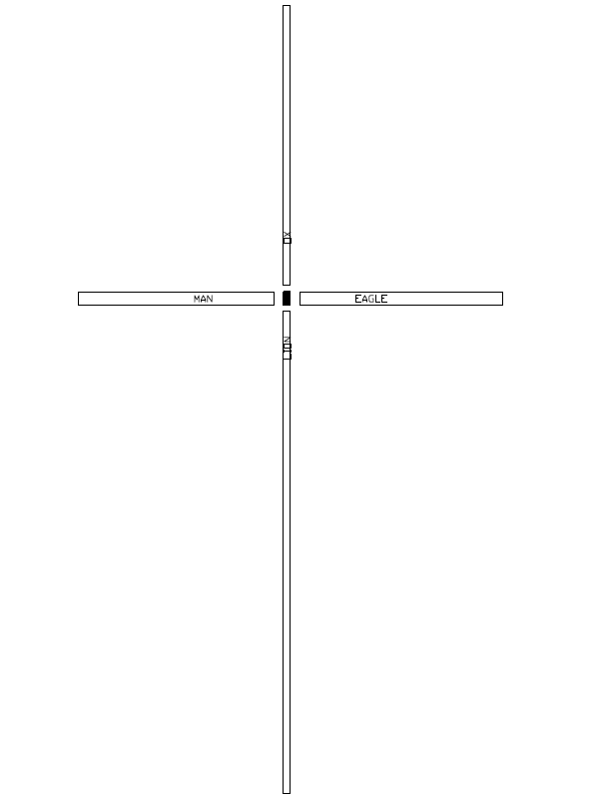

Slide 3
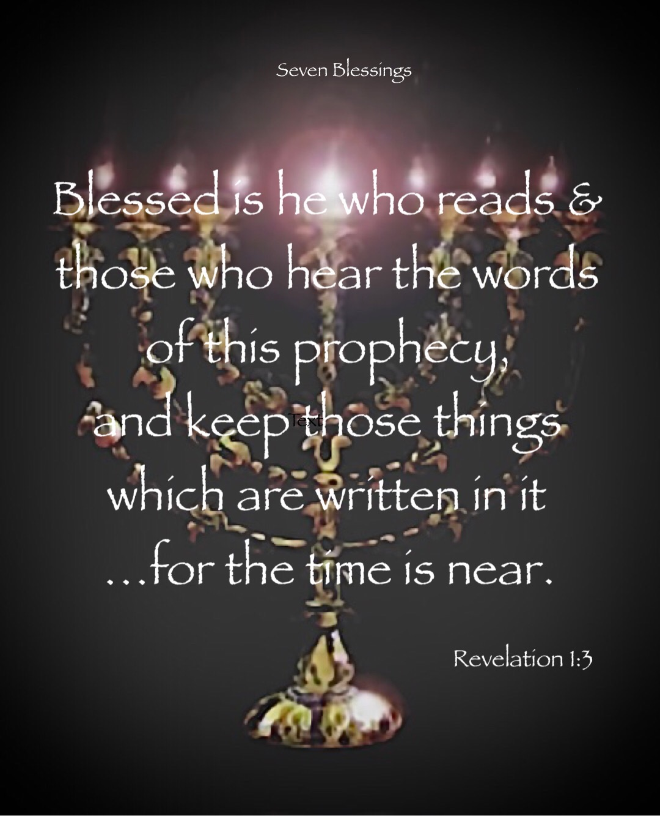

Slide 4
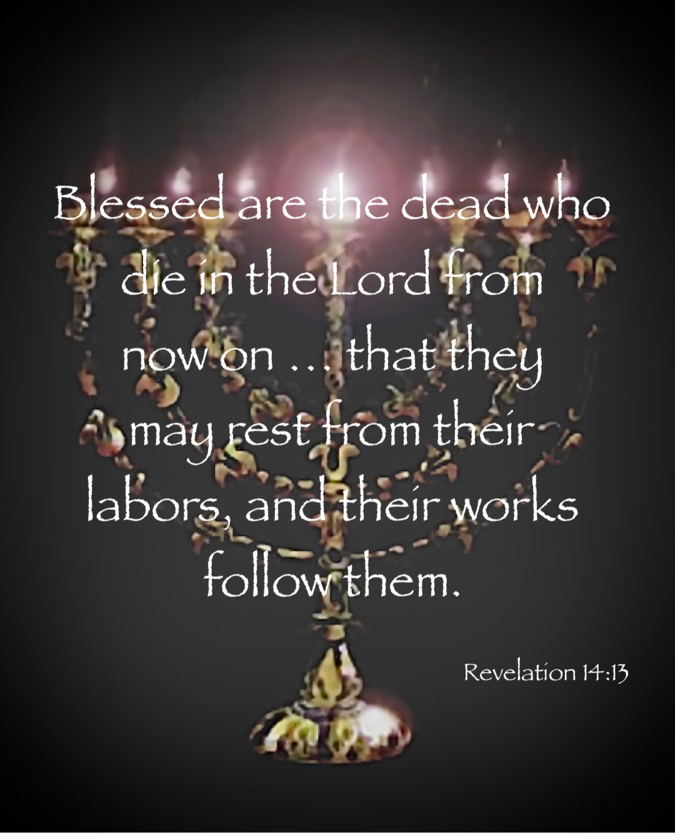

Slide 5
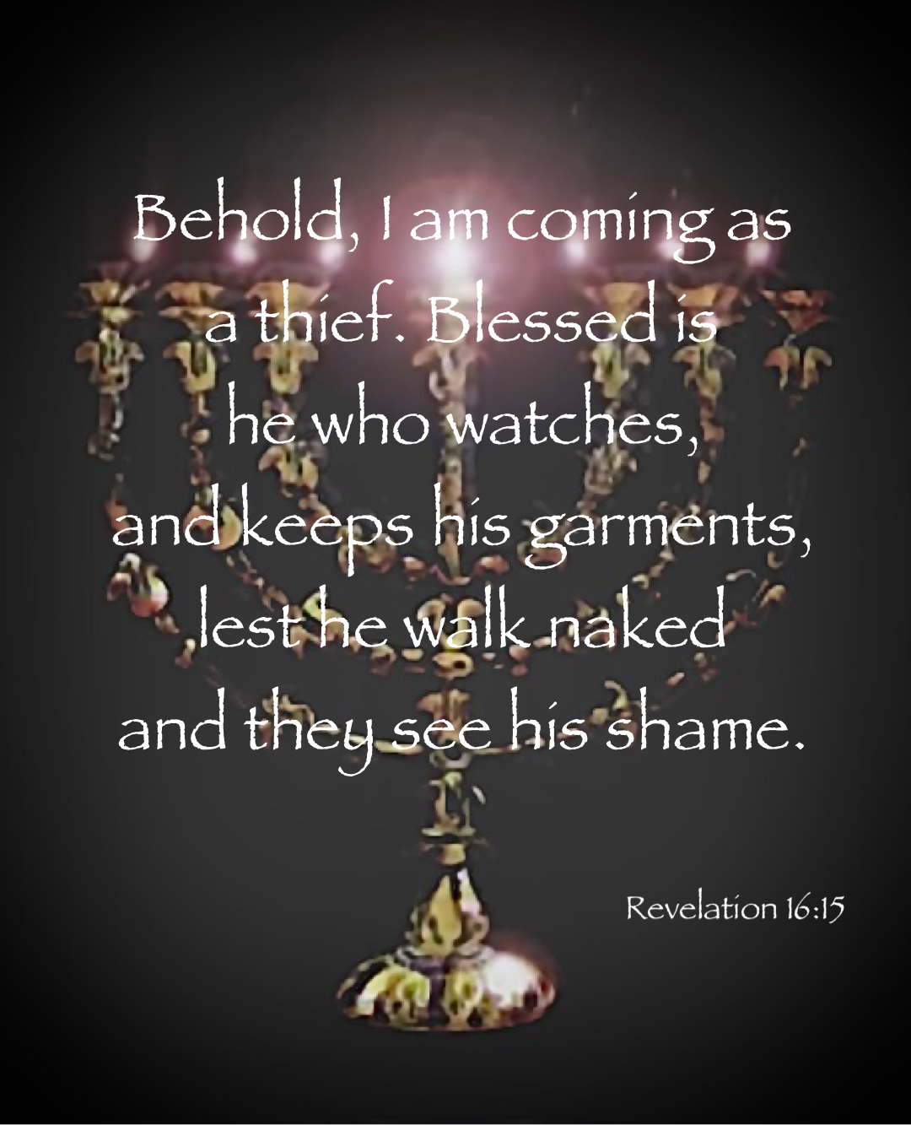

Slide 6
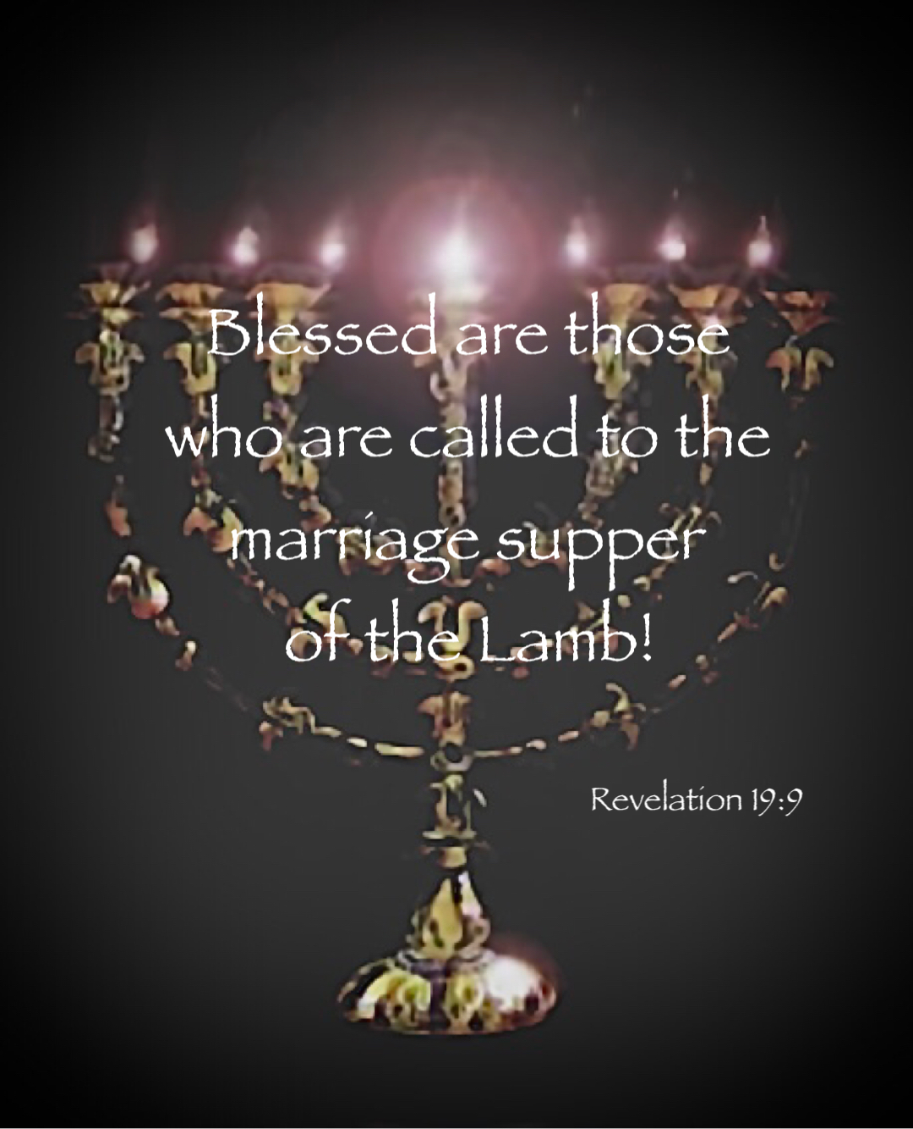

Slide 7
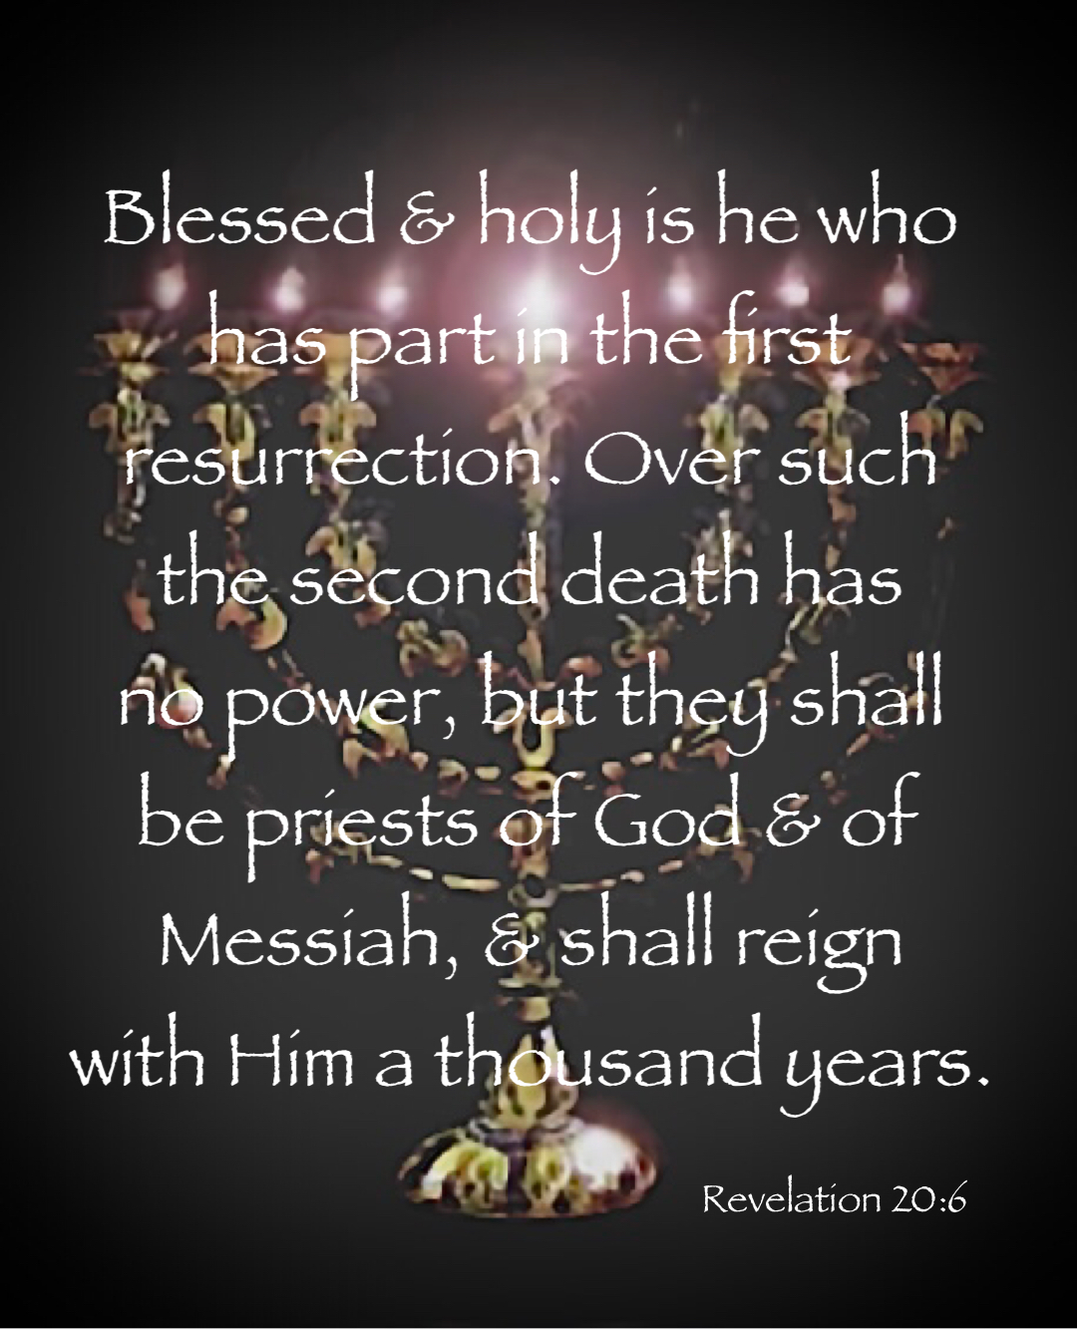

Slide 8
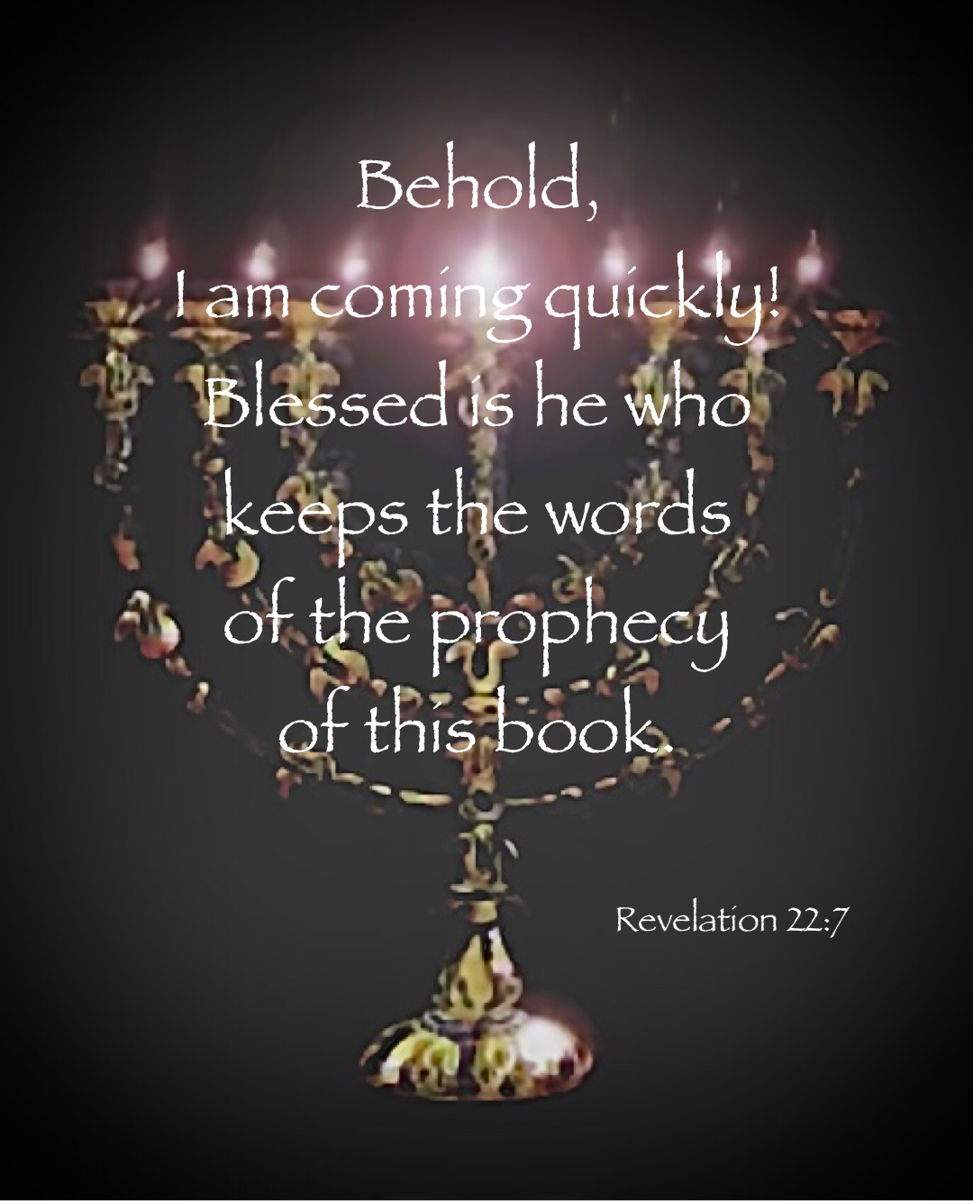

Slide 9
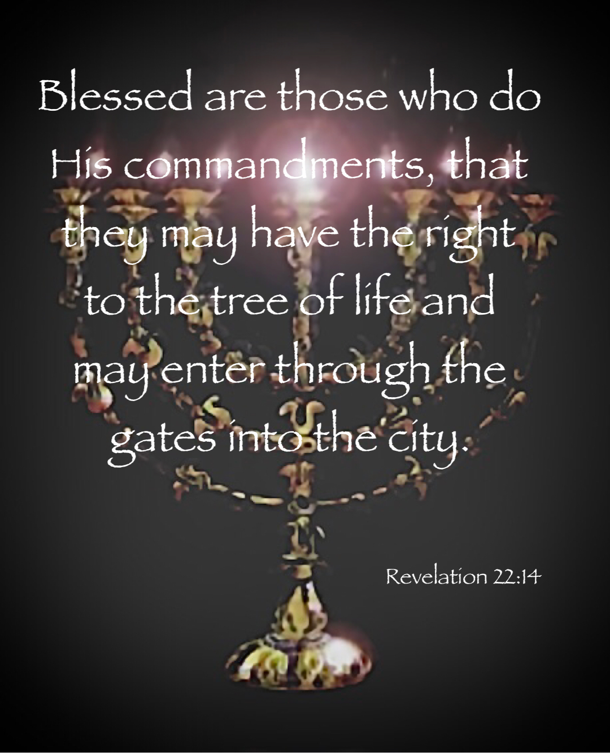

Slide 10
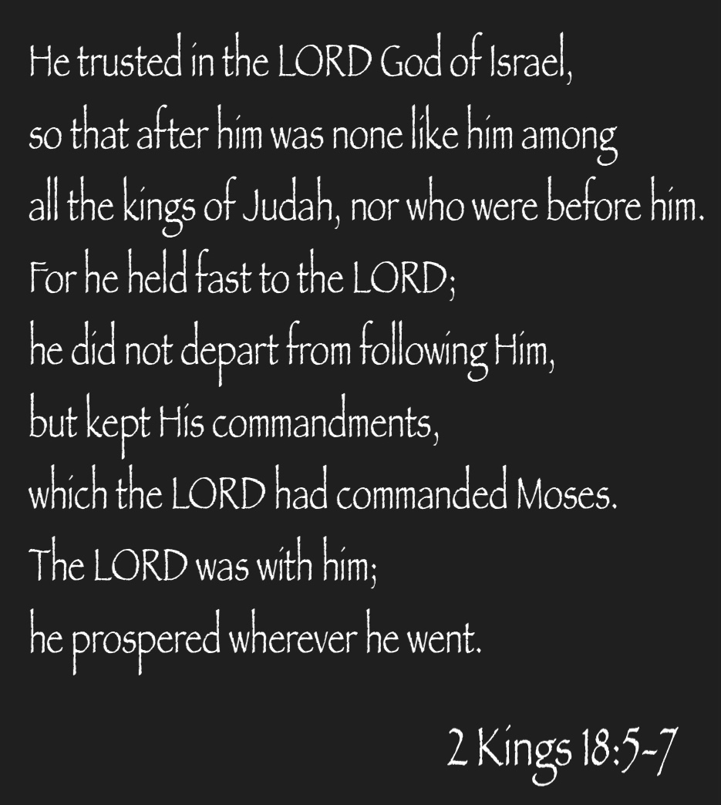

Slide 11
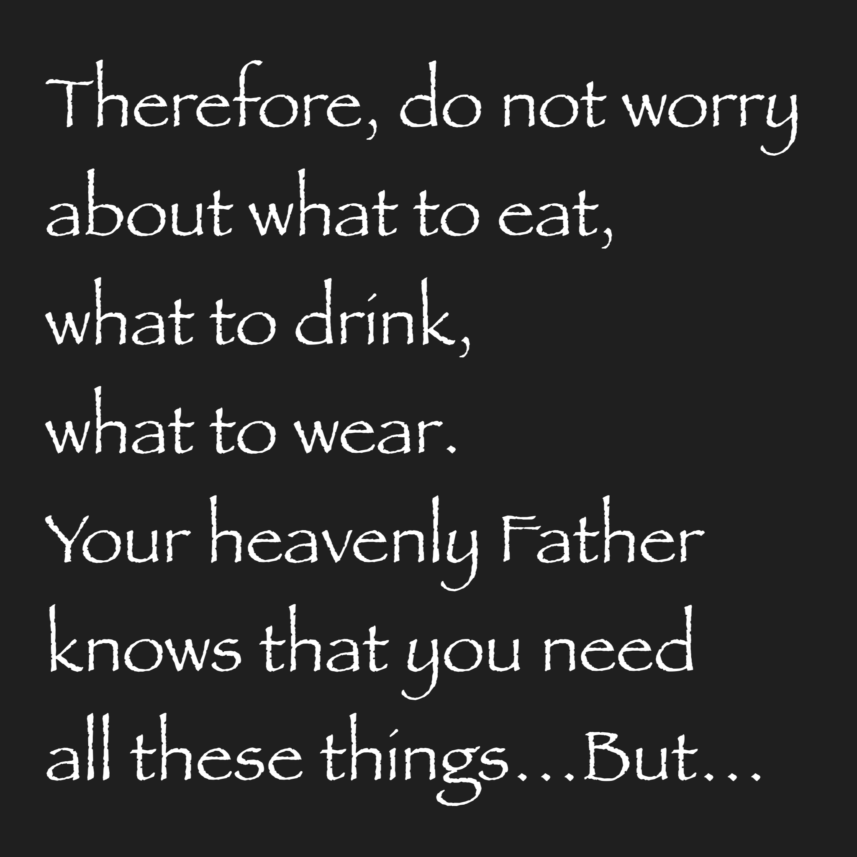

Slide 12
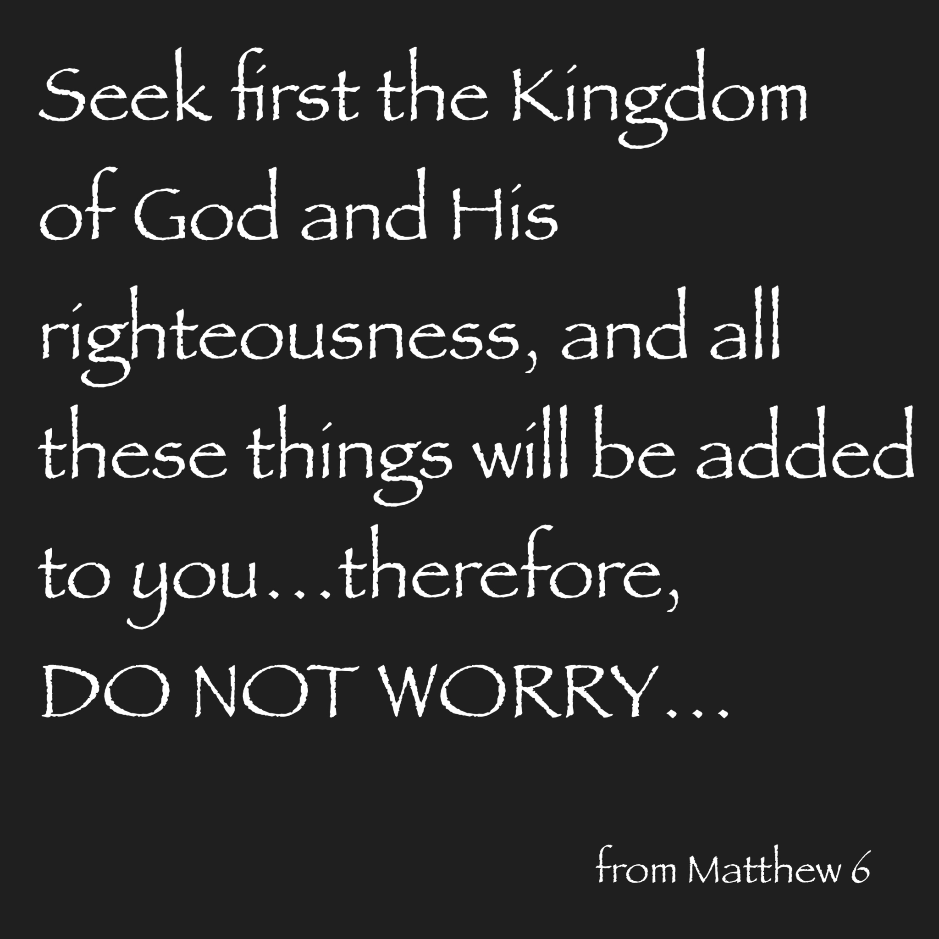

Slide 13
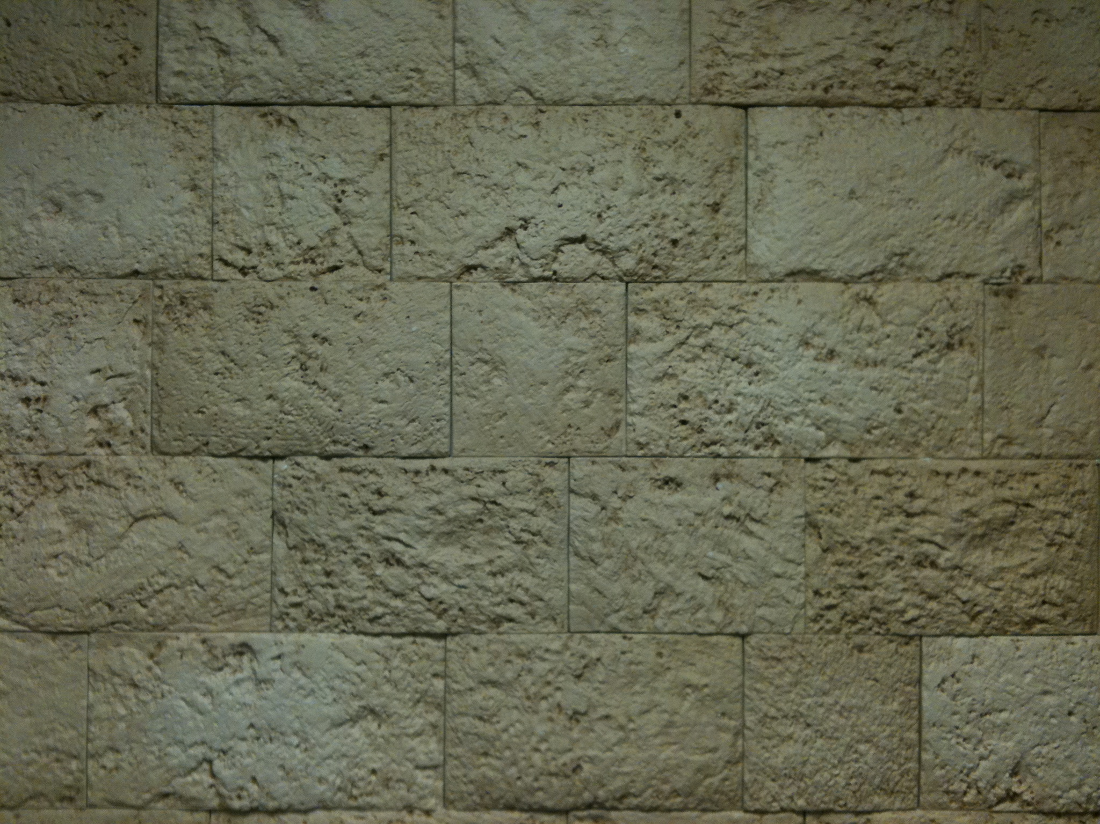
Revelation
Chapter 6

Slide 15
The Revelation Judgments
 | 1 | 2 | 3 | 4 | 5 | 6 |  | 7
Reference | Rev 6:1-2 | Rev 6:3-4 | Rev 6:5-6 | Rev 6:7-8 | Rev 6:9-11 | Rev 6:12-17 |  | Rev 8:1-6
Seal Judgments | White Horse Bow Crown (Stephanos) Overcomer THE CHURCH | Red Horse Takes Peace Cause to Kill One Another Great Sword WAR | Black Horse Balance (Yoke) Inflation on Needed Things Not Luxuries ECONOMIC | Pale Horse Death & Hades Power Over 1/4 Sword, Hunger, Death & Beasts FAMINE / PESTILANCE | Martyred Souls Under Altar "How Long?" White Robes Wait for the Remnant | Earthquake Black Sun & Blood Moon Stars Fall Mts & Isles Move Rich Men Hide from God's Wrath |  | Silence in Heaven Angel w/ Censer Noises, Thunderings, Lightnings & Earthquake
Reference | Rev 8:7 | Rev 8:8-9 | Rev 8:10-11 | Rev 8:12-13 | Rev 9:1-12 | Rev 9:13-21 |  | Rev 11:15-19
Trumpet Judgments | Hail & Fire from Heaven Mingled w/ Blood Burn 1/3 of Trees Burn All Grass | Burning Mountain into Sea 1/3 of Sea Creatures Die Destroy 1/3 of Ships | Star Falls on 1/3 of Rivers & Springs Become Bitter Many Men Die | 1/3 of Sun, Moon Stars Dark Day & Night 1/3 Shorter "Woe, Woe, Woe“ to Earth | Star from Heaven with Key to Pit Smoke & Locusts Harm Those Without God's Mark "Woe, Woe" | 4 Angels from Euphrates River Kill 1/3 of Mankind with Fire, Smoke & Brimstone Men Don't Repent 3rd "Woe" |  | Nations to God Elders Worship Noises, Thunderings, Lightnings & Earthquake Temple Opened
Seven Thunders Rev 10:3-4 Sealed Up !!!
Reference | Rev 16:2 | Rev 16:3 | Rev 16:4-7 | Rev 16:8-9 | Rev 16:10-11 | Rev 16:12-16 | Rev 16:17-21
Bowl Judgments | Sores on All Men with Mark of the Beast | Sea Becomes Blood Every Sea Creature Dies | Rivers & Springs Become Blood "True & Righteous are Your Judgments" | Sun Scorches All Men Do Not Repent | Darkness on Beast Kingdom Men Gnaw Tongues in Pain | Euphrates Dries Up 3 Unclean Spirits Gather Entire Earth to Battle at HarMegiddo | Poured on the Air "It is Done" Noises, Thunderings, Lightnings, Earthquake & Hail

Slide 16
The Revelation Judgments
 | 1 | 2 | 3 | 4 | 5 | 6 |  | 7
Reference | Rev 6:1-2 | Rev 6:3-4 | Rev 6:5-6 | Rev 6:7-8 | Rev 6:9-11 | Rev 6:12-17 |  | Rev 8:1-6
Seal Judgments | White Horse Bow Crown (Stephanos) Conquerer THE CHURCH | Red Horse Takes Peace Cause to Kill One Another Great Sword WAR | Black Horse Balance (Yoke) Inflation on Needed Things Not Luxuries ECONOMIC | Pale Horse Death & Hades Power Over 1/4 Sword, Hunger, Death & Beasts FAMINE / PESTILANCE | Martyred Souls Under Altar "How Long?" White Robes Wait for the Remnant | Earthquake Black Sun & Blood Moon Stars Fall Mts & Isles Move Rich Men Hide from God's Wrath |  | Silence in Heaven Angel w/ Censer Noises, Thunderings, Lightnings & Earthquake
Reference | Rev 8:7 | Rev 8:8-9 | Rev 8:10-11 | Rev 8:12-13 | Rev 9:1-12 | Rev 9:13-21 |  | Rev 11:15-19
Trumpet Judgments | Hail & Fire from Heaven Mingled w/ Blood Burn 1/3 of Trees Burn All Grass | Burning Mountain into Sea 1/3 of Sea Creatures Die Destroy 1/3 of Ships | Star Falls on 1/3 of Rivers & Springs Become Bitter Many Men Die | 1/3 of Sun, Moon Stars Dark Day & Night 1/3 Shorter "Woe, Woe, Woe“ to Earth | Star from Heaven with Key to Pit Smoke & Locusts Harm Those Without God's Mark "Woe, Woe" | 4 Angels from Euphrates River Kill 1/3 of Mankind with Fire, Smoke & Brimstone Men Don't Repent 3rd "Woe" |  | Nations to God Elders Worship Noises, Thunderings, Lightnings & Earthquake Temple Opened
Seven Thunders Rev 10:3-4 Sealed Up !!!
Reference | Rev 16:2 | Rev 16:3 | Rev 16:4-7 | Rev 16:8-9 | Rev 16:10-11 | Rev 16:12-16 | Rev 16:17-21
Bowl Judgments | Sores on All Men with Mark of the Beast | Sea Becomes Blood Every Sea Creature Dies | Rivers & Springs Become Blood "True & Righteous are Your Judgments" | Sun Scorches All Men Do Not Repent | Darkness on Beast Kingdom Men Gnaw Tongues in Pain | Euphrates Dries Up 3 Unclean Spirits Gather Entire Earth to Battle at HarMegiddo | Poured on the Air "It is Done" Noises, Thunderings, Lightnings, Earthquake & Hail

Slide 17
The Revelation Judgments
 | 1 | 2 | 3 | 4 | 5 | 6 |  | 7
Reference | Rev 6:1-2 | Rev 6:3-4 | Rev 6:5-6 | Rev 6:7-8 | Rev 6:9-11 | Rev 6:12-17 |  | Rev 8:1-6
Seal Judgments | White Horse Bow Crown (Stephanos) Conquerer THE CHURCH | Red Horse Takes Peace Cause to Kill One Another Great Sword WAR | Black Horse Balance (Yoke) Inflation on Needed Things Not Luxuries ECONOMIC | Pale Horse Death & Hades Power Over 1/4 Sword, Hunger, Death & Beasts FAMINE / PESTILANCE | Martyred Souls Under Altar "How Long?" White Robes Wait for the Remnant | Earthquake Black Sun & Blood Moon Stars Fall Mts & Isles Move Rich Men Hide from God's Wrath |  | Silence in Heaven Angel w/ Censer Noises, Thunderings, Lightnings & Earthquake
Reference | Rev 8:7 | Rev 8:8-9 | Rev 8:10-11 | Rev 8:12-13 | Rev 9:1-12 | Rev 9:13-21 |  | Rev 11:15-19
Trumpet Judgments | Hail & Fire from Heaven Mingled w/ Blood Burn 1/3 of Trees Burn All Grass | Burning Mountain into Sea 1/3 of Sea Creatures Die Destroy 1/3 of Ships | Star Falls on 1/3 of Rivers & Springs Become Bitter Many Men Die | 1/3 of Sun, Moon Stars Dark Day & Night 1/3 Shorter "Woe, Woe, Woe“ to Earth | Star from Heaven with Key to Pit Smoke & Locusts Harm Those Without God's Mark "Woe, Woe" | 4 Angels from Euphrates River Kill 1/3 of Mankind with Fire, Smoke & Brimstone Men Don't Repent 3rd "Woe" |  | Nations to God Elders Worship Noises, Thunderings, Lightnings & Earthquake Temple Opened
Seven Thunders Rev 10:3-4 Sealed Up !!!
Reference | Rev 16:2 | Rev 16:3 | Rev 16:4-7 | Rev 16:8-9 | Rev 16:10-11 | Rev 16:12-16 | Rev 16:17-21
Bowl Judgments | Sores on All Men with Mark of the Beast | Sea Becomes Blood Every Sea Creature Dies | Rivers & Springs Become Blood "True & Righteous are Your Judgments" | Sun Scorches All Men Do Not Repent | Darkness on Beast Kingdom Men Gnaw Tongues in Pain | Euphrates Dries Up 3 Unclean Spirits Gather Entire Earth to Battle at HarMegiddo | Poured on the Air "It is Done" Noises, Thunderings, Lightnings, Earthquake & Hail

Slide 18
The Revelation Judgments
 | 1 | 2 | 3 | 4 | 5 | 6 |  | 7
Reference | Rev 6:1-2 | Rev 6:3-4 | Rev 6:5-6 | Rev 6:7-8 | Rev 6:9-11 | Rev 6:12-17 |  | Rev 8:1-6
Seal Judgments | White Horse Bow Crown (Stephanos) Conquerer Overcomer | Red Horse Takes Peace Cause to Kill One Another Great Sword WAR | Black Horse Balance (Yoke) Inflation on Needed Things Not Luxuries ECONOMIC | Pale Horse Death & Hades Power Over 1/4 Sword, Hunger, Death & Beasts FAMINE / PESTILANCE | Martyred Souls Under Altar "How Long?" White Robes Wait for the Remnant | Earthquake Black Sun & Blood Moon Stars Fall Mts & Isles Move Rich Men Hide from God's Wrath |  | Silence in Heaven Angel w/ Censer Noises, Thunderings, Lightnings & Earthquake
Reference | Rev 8:7 | Rev 8:8-9 | Rev 8:10-11 | Rev 8:12-13 | Rev 9:1-12 | Rev 9:13-21 |  | Rev 11:15-19
Trumpet Judgments | Hail & Fire from Heaven Mingled w/ Blood Burn 1/3 of Trees Burn All Grass | Burning Mountain into Sea 1/3 of Sea Creatures Die Destroy 1/3 of Ships | Star Falls on 1/3 of Rivers & Springs Become Bitter Many Men Die | 1/3 of Sun, Moon Stars Dark Day & Night 1/3 Shorter "Woe, Woe, Woe“ to Earth | Star from Heaven with Key to Pit Smoke & Locusts Harm Those Without God's Mark "Woe, Woe" | 4 Angels from Euphrates River Kill 1/3 of Mankind with Fire, Smoke & Brimstone Men Don't Repent 3rd "Woe" |  | Nations to God Elders Worship Noises, Thunderings, Lightnings & Earthquake Temple Opened
Seven Thunders Rev 10:3-4 Sealed Up !!!
Reference | Rev 16:2 | Rev 16:3 | Rev 16:4-7 | Rev 16:8-9 | Rev 16:10-11 | Rev 16:12-16 | Rev 16:17-21
Bowl Judgments | Sores on All Men with Mark of the Beast | Sea Becomes Blood Every Sea Creature Dies | Rivers & Springs Become Blood "True & Righteous are Your Judgments" | Sun Scorches All Men Do Not Repent | Darkness on Beast Kingdom Men Gnaw Tongues in Pain | Euphrates Dries Up 3 Unclean Spirits Gather Entire Earth to Battle at HarMegiddo | Poured on the Air "It is Done" Noises, Thunderings, Lightnings, Earthquake & Hail

Slide 19
The Revelation Judgments
 | 1 | 2 | 3 | 4 | 5 | 6 |  | 7
Reference | Rev 6:1-2 | Rev 6:3-4 | Rev 6:5-6 | Rev 6:7-8 | Rev 6:9-11 | Rev 6:12-17 |  | Rev 8:1-6
Seal Judgments | White Horse Bow Crown (Stephanos) Overcomer THE CHURCH | Red Horse Takes Peace Cause to Kill One Another Great Sword WAR | Black Horse Balance (Yoke) Inflation on Needed Things Not Luxuries ECONOMIC | Pale Horse Death & Hades Power Over 1/4 Sword, Hunger, Death & Beasts FAMINE / PESTILANCE | Martyred Souls Under Altar "How Long?" White Robes Wait for the Remnant | Earthquake Black Sun & Blood Moon Stars Fall Mts & Isles Move Rich Men Hide from God's Wrath |  | Silence in Heaven Angel w/ Censer Noises, Thunderings, Lightnings & Earthquake
Reference | Rev 8:7 | Rev 8:8-9 | Rev 8:10-11 | Rev 8:12-13 | Rev 9:1-12 | Rev 9:13-21 |  | Rev 11:15-19
Trumpet Judgments | Hail & Fire from Heaven Mingled w/ Blood Burn 1/3 of Trees Burn All Grass | Burning Mountain into Sea 1/3 of Sea Creatures Die Destroy 1/3 of Ships | Star Falls on 1/3 of Rivers & Springs Become Bitter Many Men Die | 1/3 of Sun, Moon Stars Dark Day & Night 1/3 Shorter "Woe, Woe, Woe“ to Earth | Star from Heaven with Key to Pit Smoke & Locusts Harm Those Without God's Mark "Woe, Woe" | 4 Angels from Euphrates River Kill 1/3 of Mankind with Fire, Smoke & Brimstone Men Don't Repent 3rd "Woe" |  | Nations to God Elders Worship Noises, Thunderings, Lightnings & Earthquake Temple Opened
Seven Thunders Rev 10:3-4 Sealed Up !!!
Reference | Rev 16:2 | Rev 16:3 | Rev 16:4-7 | Rev 16:8-9 | Rev 16:10-11 | Rev 16:12-16 | Rev 16:17-21
Bowl Judgments | Sores on All Men with Mark of the Beast | Sea Becomes Blood Every Sea Creature Dies | Rivers & Springs Become Blood "True & Righteous are Your Judgments" | Sun Scorches All Men Do Not Repent | Darkness on Beast Kingdom Men Gnaw Tongues in Pain | Euphrates Dries Up 3 Unclean Spirits Gather Entire Earth to Battle at HarMegiddo | Poured on the Air "It is Done" Noises, Thunderings, Lightnings, Earthquake & Hail

Slide 20
The Revelation Judgments
 | 1 | 2 | 3 | 4 | 5 | 6 |  | 7
Reference | Rev 6:1-2 | Rev 6:3-4 | Rev 6:5-6 | Rev 6:7-8 | Rev 6:9-11 | Rev 6:12-17 |  | Rev 8:1-6
Seal Judgments | White Horse Bow Crown (Stephanos) Overcomer THE CHURCH | Red Horse Takes Peace Cause to Kill One Another Great Sword WAR | Black Horse Balance (Yoke) Inflation on Needed Things Not Luxuries ECONOMIC | Pale Horse Death & Hades Power Over 1/4 Sword, Hunger, Death & Beasts FAMINE / PESTILANCE | Martyred Souls Under Altar "How Long?" White Robes Wait for the Remnant | Earthquake Black Sun & Blood Moon Stars Fall Mts & Isles Move Rich Men Hide from God's Wrath |  | Silence in Heaven Angel w/ Censer Noises, Thunderings, Lightnings & Earthquake
Reference | Rev 8:7 | Rev 8:8-9 | Rev 8:10-11 | Rev 8:12-13 | Rev 9:1-12 | Rev 9:13-21 |  | Rev 11:15-19
Trumpet Judgments | Hail & Fire from Heaven Mingled w/ Blood Burn 1/3 of Trees Burn All Grass | Burning Mountain into Sea 1/3 of Sea Creatures Die Destroy 1/3 of Ships | Star Falls on 1/3 of Rivers & Springs Become Bitter Many Men Die | 1/3 of Sun, Moon Stars Dark Day & Night 1/3 Shorter "Woe, Woe, Woe“ to Earth | Star from Heaven with Key to Pit Smoke & Locusts Harm Those Without God's Mark "Woe, Woe" | 4 Angels from Euphrates River Kill 1/3 of Mankind with Fire, Smoke & Brimstone Men Don't Repent 3rd "Woe" |  | Nations to God Elders Worship Noises, Thunderings, Lightnings & Earthquake Temple Opened
Seven Thunders Rev 10:3-4 Sealed Up !!!
Reference | Rev 16:2 | Rev 16:3 | Rev 16:4-7 | Rev 16:8-9 | Rev 16:10-11 | Rev 16:12-16 | Rev 16:17-21
Bowl Judgments | Sores on All Men with Mark of the Beast | Sea Becomes Blood Every Sea Creature Dies | Rivers & Springs Become Blood "True & Righteous are Your Judgments" | Sun Scorches All Men Do Not Repent | Darkness on Beast Kingdom Men Gnaw Tongues in Pain | Euphrates Dries Up 3 Unclean Spirits Gather Entire Earth to Battle at HarMegiddo | Poured on the Air "It is Done" Noises, Thunderings, Lightnings, Earthquake & Hail

Slide 21
The Revelation Judgments
 | 1 | 2 | 3 | 4 | 5 | 6 |  | 7
Reference | Rev 6:1-2 | Rev 6:3-4 | Rev 6:5-6 | Rev 6:7-8 | Rev 6:9-11 | Rev 6:12-17 |  | Rev 8:1-6
Seal Judgments | White Horse Bow Crown (Stephanos) Overcomer THE CHURCH | Red Horse Takes Peace Cause to Kill One Another Great Sword WAR | Black Horse Balance (Yoke) Inflation on Needed Things Not Luxuries ECONOMIC | Pale Horse Death & Hades Power Over 1/4 Sword, Hunger, Death & Beasts FAMINE / PESTILANCE | Martyred Souls Under Altar "How Long?" White Robes Wait for the Remnant | Earthquake Black Sun & Blood Moon Stars Fall Mts & Isles Move Rich Men Hide from God's Wrath |  | Silence in Heaven Angel w/ Censer Noises, Thunderings, Lightnings & Earthquake
Reference | Rev 8:7 | Rev 8:8-9 | Rev 8:10-11 | Rev 8:12-13 | Rev 9:1-12 | Rev 9:13-21 |  | Rev 11:15-19
Trumpet Judgments | Hail & Fire from Heaven Mingled w/ Blood Burn 1/3 of Trees Burn All Grass | Burning Mountain into Sea 1/3 of Sea Creatures Die Destroy 1/3 of Ships | Star Falls on 1/3 of Rivers & Springs Become Bitter Many Men Die | 1/3 of Sun, Moon Stars Dark Day & Night 1/3 Shorter "Woe, Woe, Woe“ to Earth | Star from Heaven with Key to Pit Smoke & Locusts Harm Those Without God's Mark "Woe, Woe" | 4 Angels from Euphrates River Kill 1/3 of Mankind with Fire, Smoke & Brimstone Men Don't Repent 3rd "Woe" |  | Nations to God Elders Worship Noises, Thunderings, Lightnings & Earthquake Temple Opened
Seven Thunders Rev 10:3-4 Sealed Up !!!
Reference | Rev 16:2 | Rev 16:3 | Rev 16:4-7 | Rev 16:8-9 | Rev 16:10-11 | Rev 16:12-16 | Rev 16:17-21
Bowl Judgments | Sores on All Men with Mark of the Beast | Sea Becomes Blood Every Sea Creature Dies | Rivers & Springs Become Blood "True & Righteous are Your Judgments" | Sun Scorches All Men Do Not Repent | Darkness on Beast Kingdom Men Gnaw Tongues in Pain | Euphrates Dries Up 3 Unclean Spirits Gather Entire Earth to Battle at HarMegiddo | Poured on the Air "It is Done" Noises, Thunderings, Lightnings, Earthquake & Hail

Slide 22
The Revelation Judgments
 | 1 | 2 | 3 | 4 | 5 | 6 |  | 7
Reference | Rev 6:1-2 | Rev 6:3-4 | Rev 6:5-6 | Rev 6:7-8 | Rev 6:9-11 | Rev 6:12-17 |  | Rev 8:1-6
Seal Judgments | White Horse Bow Crown (Stephanos) Overcomer THE CHURCH | Red Horse Takes Peace Cause to Kill One Another Great Sword WAR | Black Horse Balance (Yoke) Inflation on Needed Things Not Luxuries ECONOMIC | Pale Horse Death & Hades Power Over 1/4 Sword, Hunger, Death & Beasts FAMINE / PESTILANCE | Martyred Souls Under Altar "How Long?" White Robes Wait for the Remnant | Earthquake Black Sun & Blood Moon Stars Fall Mts & Isles Move Rich Men Hide from God's Wrath |  | Silence in Heaven Angel w/ Censer Noises, Thunderings, Lightnings & Earthquake
Reference | Rev 8:7 | Rev 8:8-9 | Rev 8:10-11 | Rev 8:12-13 | Rev 9:1-12 | Rev 9:13-21 |  | Rev 11:15-19
Trumpet Judgments | Hail & Fire from Heaven Mingled w/ Blood Burn 1/3 of Trees Burn All Grass | Burning Mountain into Sea 1/3 of Sea Creatures Die Destroy 1/3 of Ships | Star Falls on 1/3 of Rivers & Springs Become Bitter Many Men Die | 1/3 of Sun, Moon Stars Dark Day & Night 1/3 Shorter "Woe, Woe, Woe“ to Earth | Star from Heaven with Key to Pit Smoke & Locusts Harm Those Without God's Mark "Woe, Woe" | 4 Angels from Euphrates River Kill 1/3 of Mankind with Fire, Smoke & Brimstone Men Don't Repent 3rd "Woe" |  | Nations to God Elders Worship Noises, Thunderings, Lightnings & Earthquake Temple Opened
Seven Thunders Rev 10:3-4 Sealed Up !!!
Reference | Rev 16:2 | Rev 16:3 | Rev 16:4-7 | Rev 16:8-9 | Rev 16:10-11 | Rev 16:12-16 | Rev 16:17-21
Bowl Judgments | Sores on All Men with Mark of the Beast | Sea Becomes Blood Every Sea Creature Dies | Rivers & Springs Become Blood "True & Righteous are Your Judgments" | Sun Scorches All Men Do Not Repent | Darkness on Beast Kingdom Men Gnaw Tongues in Pain | Euphrates Dries Up 3 Unclean Spirits Gather Entire Earth to Battle at HarMegiddo | Poured on the Air "It is Done" Noises, Thunderings, Lightnings, Earthquake & Hail

Slide 23
The Revelation Judgments
 | 1 | 2 | 3 | 4 | 5 | 6 |  | 7
Reference | Rev 6:1-2 | Rev 6:3-4 | Rev 6:5-6 | Rev 6:7-8 | Rev 6:9-11 | Rev 6:12-17 |  | Rev 8:1-6
Seal Judgments | White Horse Bow Crown (Stephanos) Overcomer THE CHURCH | Red Horse Takes Peace Cause to Kill One Another Great Sword WAR | Black Horse Balance (Yoke) Inflation on Needed Things Not Luxuries ECONOMIC | Pale Horse Death & Hades Power Over 1/4 Sword, Hunger, Death & Beasts FAMINE / PESTILANCE | Martyred Souls Under Altar "How Long?" White Robes Wait for the Remnant | Earthquake Black Sun & Blood Moon Stars Fall Mts & Isles Move Rich Men Hide from God's Wrath |  | Silence in Heaven Angel w/ Censer Noises, Thunderings, Lightnings & Earthquake
Reference | Rev 8:7 | Rev 8:8-9 | Rev 8:10-11 | Rev 8:12-13 | Rev 9:1-12 | Rev 9:13-21 |  | Rev 11:15-19
Trumpet Judgments | Hail & Fire from Heaven Mingled w/ Blood Burn 1/3 of Trees Burn All Grass | Burning Mountain into Sea 1/3 of Sea Creatures Die Destroy 1/3 of Ships | Star Falls on 1/3 of Rivers & Springs Become Bitter Many Men Die | 1/3 of Sun, Moon Stars Dark Day & Night 1/3 Shorter "Woe, Woe, Woe“ to Earth | Star from Heaven with Key to Pit Smoke & Locusts Harm Those Without God's Mark "Woe, Woe" | 4 Angels from Euphrates River Kill 1/3 of Mankind with Fire, Smoke & Brimstone Men Don't Repent 3rd "Woe" |  | Nations to God Elders Worship Noises, Thunderings, Lightnings & Earthquake Temple Opened
Seven Thunders Rev 10:3-4 Sealed Up !!!
Reference | Rev 16:2 | Rev 16:3 | Rev 16:4-7 | Rev 16:8-9 | Rev 16:10-11 | Rev 16:12-16 | Rev 16:17-21
Bowl Judgments | Sores on All Men with Mark of the Beast | Sea Becomes Blood Every Sea Creature Dies | Rivers & Springs Become Blood "True & Righteous are Your Judgments" | Sun Scorches All Men Do Not Repent | Darkness on Beast Kingdom Men Gnaw Tongues in Pain | Euphrates Dries Up 3 Unclean Spirits Gather Entire Earth to Battle at HarMegiddo | Poured on the Air "It is Done" Noises, Thunderings, Lightnings, Earthquake & Hail

Slide 24
The Revelation Judgments
 | 1 | 2 | 3 | 4 | 5 | 6 |  | 7
Reference | Rev 6:1-2 | Rev 6:3-4 | Rev 6:5-6 | Rev 6:7-8 | Rev 6:9-11 | Rev 6:12-17 |  | Rev 8:1-6
Seal Judgments | White Horse Bow Crown (Stephanos) Overcomer THE CHURCH | Red Horse Takes Peace Cause to Kill One Another Great Sword WAR | Black Horse Balance (Yoke) Inflation on Needed Things Not Luxuries ECONOMIC | Pale Horse Death & Hades Power Over 1/4 Sword, Hunger, Death & Beasts FAMINE / PESTILANCE | Martyred Souls Under Altar "How Long?" White Robes Wait for the Remnant | Earthquake Black Sun & Blood Moon Stars Fall Mts & Isles Move Rich Men Hide from God's Wrath |  | Silence in Heaven Angel w/ Censer Noises, Thunderings, Lightnings & Earthquake
Reference | Rev 8:7 | Rev 8:8-9 | Rev 8:10-11 | Rev 8:12-13 | Rev 9:1-12 | Rev 9:13-21 |  | Rev 11:15-19
Trumpet Judgments | Hail & Fire from Heaven Mingled w/ Blood Burn 1/3 of Trees Burn All Grass | Burning Mountain into Sea 1/3 of Sea Creatures Die Destroy 1/3 of Ships | Star Falls on 1/3 of Rivers & Springs Become Bitter Many Men Die | 1/3 of Sun, Moon Stars Dark Day & Night 1/3 Shorter "Woe, Woe, Woe“ to Earth | Star from Heaven with Key to Pit Smoke & Locusts Harm Those Without God's Mark "Woe, Woe" | 4 Angels from Euphrates River Kill 1/3 of Mankind with Fire, Smoke & Brimstone Men Don't Repent 3rd "Woe" |  | Nations to God Elders Worship Noises, Thunderings, Lightnings & Earthquake Temple Opened
Seven Thunders Rev 10:3-4 Sealed Up !!!
Reference | Rev 16:2 | Rev 16:3 | Rev 16:4-7 | Rev 16:8-9 | Rev 16:10-11 | Rev 16:12-16 | Rev 16:17-21
Bowl Judgments | Sores on All Men with Mark of the Beast | Sea Becomes Blood Every Sea Creature Dies | Rivers & Springs Become Blood "True & Righteous are Your Judgments" | Sun Scorches All Men Do Not Repent | Darkness on Beast Kingdom Men Gnaw Tongues in Pain | Euphrates Dries Up 3 Unclean Spirits Gather Entire Earth to Battle at HarMegiddo | Poured on the Air "It is Done" Noises, Thunderings, Lightnings, Earthquake & Hail

Slide 26
Revelation
Chapter 6

Slide 27
The Revelation Judgments
 | 1 | 2 | 3 | 4 | 5 | 6 |  | 7
Reference | Rev 6:1-2 | Rev 6:3-4 | Rev 6:5-6 | Rev 6:7-8 | Rev 6:9-11 | Rev 6:12-17 |  | Rev 8:1-6
Seal Judgments | White Horse Bow Crown (Stephanos) Overcomer THE CHURCH | Red Horse Takes Peace Cause to Kill One Another Great Sword WAR | Black Horse Balance (Yoke) Inflation on Needed Things Not Luxuries ECONOMIC | Pale Horse Death & Hades Power Over 1/4 Sword, Hunger, Death & Beasts FAMINE / PESTILANCE | Martyred Souls Under Altar "How Long?" White Robes Wait for the Remnant | Earthquake Black Sun & Blood Moon Stars Fall Mts & Isles Move Rich Men Hide from God's Wrath |  | Silence in Heaven Angel w/ Censer Noises, Thunderings, Lightnings & Earthquake
Reference | Rev 8:7 | Rev 8:8-9 | Rev 8:10-11 | Rev 8:12-13 | Rev 9:1-12 | Rev 9:13-21 |  | Rev 11:15-19
Trumpet Judgments | Hail & Fire from Heaven Mingled w/ Blood Burn 1/3 of Trees Burn All Grass | Burning Mountain into Sea 1/3 of Sea Creatures Die Destroy 1/3 of Ships | Star Falls on 1/3 of Rivers & Springs Become Bitter Many Men Die | 1/3 of Sun, Moon Stars Dark Day & Night 1/3 Shorter "Woe, Woe, Woe“ to Earth | Star from Heaven with Key to Pit Smoke & Locusts Harm Those Without God's Mark "Woe, Woe" | 4 Angels from Euphrates River Kill 1/3 of Mankind with Fire, Smoke & Brimstone Men Don't Repent 3rd "Woe" |  | Nations to God Elders Worship Noises, Thunderings, Lightnings & Earthquake Temple Opened
Seven Thunders Rev 10:3-4 Sealed Up !!!
Reference | Rev 16:2 | Rev 16:3 | Rev 16:4-7 | Rev 16:8-9 | Rev 16:10-11 | Rev 16:12-16 | Rev 16:17-21
Bowl Judgments | Sores on All Men with Mark of the Beast | Sea Becomes Blood Every Sea Creature Dies | Rivers & Springs Become Blood "True & Righteous are Your Judgments" | Sun Scorches All Men Do Not Repent | Darkness on Beast Kingdom Men Gnaw Tongues in Pain | Euphrates Dries Up 3 Unclean Spirits Gather Entire Earth to Battle at HarMegiddo | Poured on the Air "It is Done" Noises, Thunderings, Lightnings, Earthquake & Hail

Slide 28
The Revelation Judgments
 | 1 | 2 | 3 | 4 | 5 | 6 |  | 7
Reference | Rev 6:1-2 | Rev 6:3-4 | Rev 6:5-6 | Rev 6:7-8 | Rev 6:9-11 | Rev 6:12-17 |  | Rev 8:1-6
Seal Judgments | White Horse Bow Crown (Stephanos) Overcomer THE CHURCH | Red Horse Takes Peace Cause to Kill One Another Great Sword WAR | Black Horse Balance (Yoke) Inflation on Needed Things Not Luxuries ECONOMIC | Pale Horse Death & Hades Power Over 1/4 Sword, Hunger, Death & Beasts FAMINE / PESTILANCE | Martyred Souls Under Altar "How Long?" White Robes Wait for the Remnant | Earthquake Black Sun & Blood Moon Stars Fall Mts & Isles Move Rich Men Hide from God's Wrath |  | Silence in Heaven Angel w/ Censer Noises, Thunderings, Lightnings & Earthquake
Reference | Rev 8:7 | Rev 8:8-9 | Rev 8:10-11 | Rev 8:12-13 | Rev 9:1-12 | Rev 9:13-21 |  | Rev 11:15-19
Trumpet Judgments | Hail & Fire from Heaven Mingled w/ Blood Burn 1/3 of Trees Burn All Grass | Burning Mountain into Sea 1/3 of Sea Creatures Die Destroy 1/3 of Ships | Star Falls on 1/3 of Rivers & Springs Become Bitter Many Men Die | 1/3 of Sun, Moon Stars Dark Day & Night 1/3 Shorter "Woe, Woe, Woe“ to Earth | Star from Heaven with Key to Pit Smoke & Locusts Harm Those Without God's Mark "Woe, Woe" | 4 Angels from Euphrates River Kill 1/3 of Mankind with Fire, Smoke & Brimstone Men Don't Repent 3rd "Woe" |  | Nations to God Elders Worship Noises, Thunderings, Lightnings & Earthquake Temple Opened
Seven Thunders Rev 10:3-4 Sealed Up !!!
Reference | Rev 16:2 | Rev 16:3 | Rev 16:4-7 | Rev 16:8-9 | Rev 16:10-11 | Rev 16:12-16 | Rev 16:17-21
Bowl Judgments | Sores on All Men with Mark of the Beast | Sea Becomes Blood Every Sea Creature Dies | Rivers & Springs Become Blood "True & Righteous are Your Judgments" | Sun Scorches All Men Do Not Repent | Darkness on Beast Kingdom Men Gnaw Tongues in Pain | Euphrates Dries Up 3 Unclean Spirits Gather Entire Earth to Battle at HarMegiddo | Poured on the Air "It is Done" Noises, Thunderings, Lightnings, Earthquake & Hail

Slide 29
Revelation
Chapter 6

Slide 33
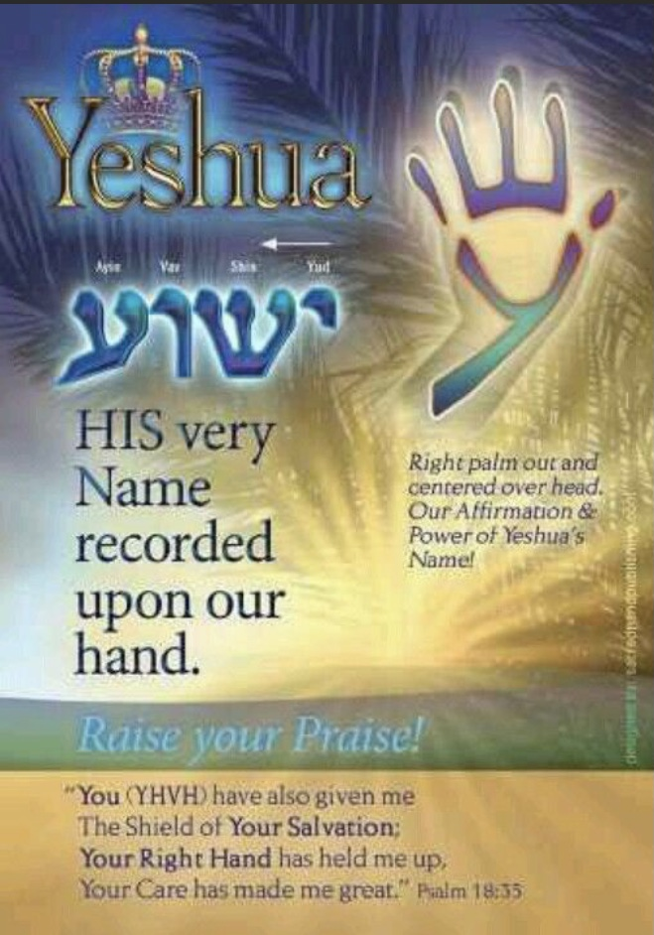

Slide 34
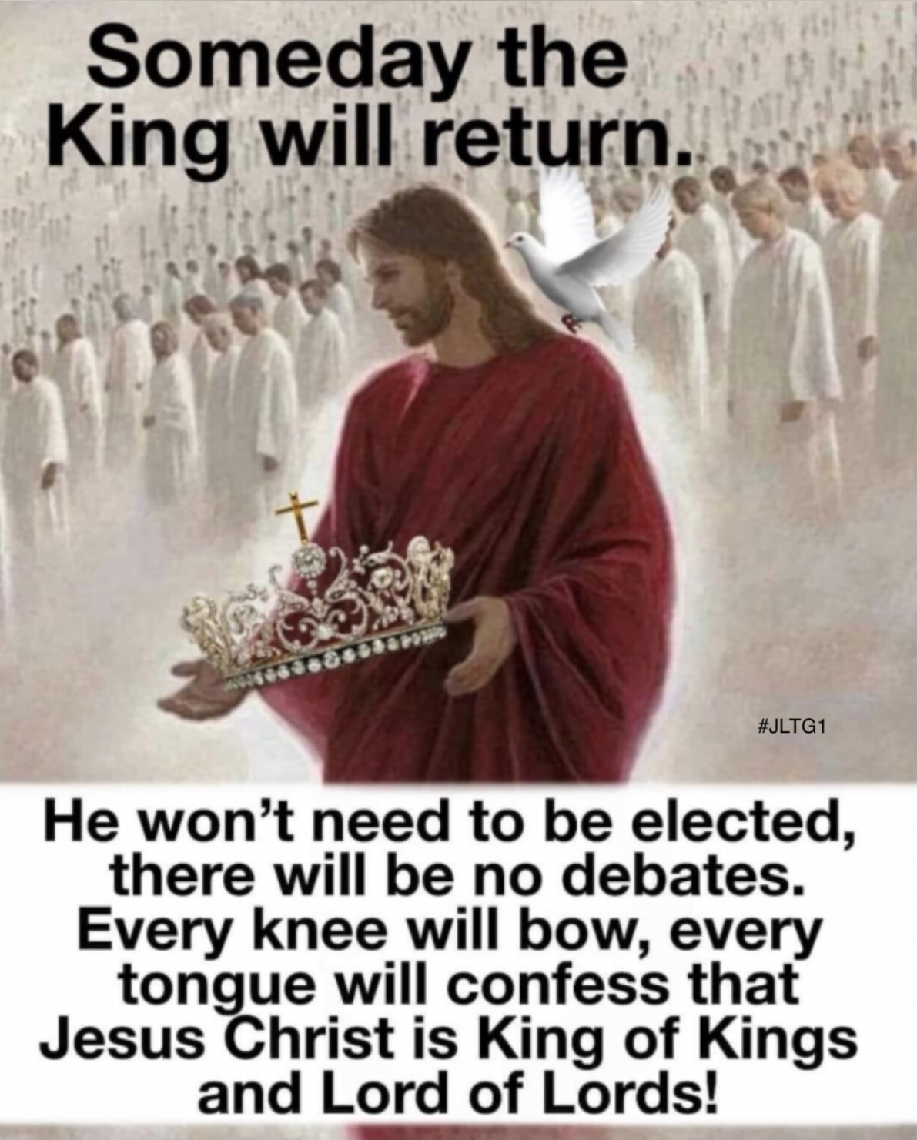

Slide 36
The Revelation Judgments
 | 1 | 2 | 3 | 4 | 5 | 6 |  | 7
Reference | Rev 6:1-2 | Rev 6:3-4 | Rev 6:5-6 | Rev 6:7-8 | Rev 6:9-11 | Rev 6:12-17 |  | Rev 8:1-6
Seal Judgments | White Horse Bow Crown (Stephanos) Overcomer THE CHURCH | Red Horse Takes Peace Cause to Kill One Another Great Sword WAR | Black Horse Balance (Yoke) Inflation on Needed Things Not Luxuries ECONOMIC | Pale Horse Death & Hades Power Over 1/4 Sword, Hunger, Death & Beasts FAMINE / PESTILANCE | Martyred Souls Under Altar "How Long?" White Robes Wait for the Remnant | Earthquake Black Sun & Blood Moon Stars Fall Mts & Isles Move Rich Men Hide from God's Wrath |  | Silence in Heaven Angel w/ Censer Noises, Thunderings, Lightnings & Earthquake
Reference | Rev 8:7 | Rev 8:8-9 | Rev 8:10-11 | Rev 8:12-13 | Rev 9:1-12 | Rev 9:13-21 |  | Rev 11:15-19
Trumpet Judgments | Hail & Fire from Heaven Mingled w/ Blood Burn 1/3 of Trees Burn All Grass | Burning Mountain into Sea 1/3 of Sea Creatures Die Destroy 1/3 of Ships | Star Falls on 1/3 of Rivers & Springs Become Bitter Many Men Die | 1/3 of Sun, Moon Stars Dark Day & Night 1/3 Shorter "Woe, Woe, Woe“ to Earth | Star from Heaven with Key to Pit Smoke & Locusts Harm Those Without God's Mark "Woe, Woe" | 4 Angels from Euphrates River Kill 1/3 of Mankind with Fire, Smoke & Brimstone Men Don't Repent 3rd "Woe" |  | Nations to God Elders Worship Noises, Thunderings, Lightnings & Earthquake Temple Opened
Seven Thunders Rev 10:3-4 Sealed Up !!!
Reference | Rev 16:2 | Rev 16:3 | Rev 16:4-7 | Rev 16:8-9 | Rev 16:10-11 | Rev 16:12-16 | Rev 16:17-21
Bowl Judgments | Sores on All Men with Mark of the Beast | Sea Becomes Blood Every Sea Creature Dies | Rivers & Springs Become Blood "True & Righteous are Your Judgments" | Sun Scorches All Men Do Not Repent | Darkness on Beast Kingdom Men Gnaw Tongues in Pain | Euphrates Dries Up 3 Unclean Spirits Gather Entire Earth to Battle at HarMegiddo | Poured on the Air "It is Done" Noises, Thunderings, Lightnings, Earthquake & Hail

Slide 37
The Revelation Judgments
 | 1 | 2 | 3 | 4 | 5 | 6 |  | 7
Reference | Rev 6:1-2 | Rev 6:3-4 | Rev 6:5-6 | Rev 6:7-8 | Rev 6:9-11 | Rev 6:12-17 |  | Rev 8:1-6
Seal Judgments | White Horse Bow Crown (Stephanos) Overcomer THE CHURCH | Red Horse Takes Peace Cause to Kill One Another Great Sword WAR | Black Horse Balance (Yoke) Inflation on Needed Things Not Luxuries ECONOMIC | Pale Horse Death & Hades Power Over 1/4 Sword, Hunger, Death & Beasts FAMINE / PESTILANCE | Martyred Souls Under Altar "How Long?" White Robes Wait for the Remnant | Earthquake Black Sun & Blood Moon Stars Fall Mts & Isles Move Rich Men Hide from God's Wrath |  | Silence in Heaven Angel w/ Censer Noises, Thunderings, Lightnings & Earthquake
Reference | Rev 8:7 | Rev 8:8-9 | Rev 8:10-11 | Rev 8:12-13 | Rev 9:1-12 | Rev 9:13-21 |  | Rev 11:15-19
Trumpet Judgments | Hail & Fire from Heaven Mingled w/ Blood Burn 1/3 of Trees Burn All Grass | Burning Mountain into Sea 1/3 of Sea Creatures Die Destroy 1/3 of Ships | Star Falls on 1/3 of Rivers & Springs Become Bitter Many Men Die | 1/3 of Sun, Moon Stars Dark Day & Night 1/3 Shorter "Woe, Woe, Woe“ to Earth | Star from Heaven with Key to Pit Smoke & Locusts Harm Those Without God's Mark "Woe, Woe" | 4 Angels from Euphrates River Kill 1/3 of Mankind with Fire, Smoke & Brimstone Men Don't Repent 3rd "Woe" |  | Nations to God Elders Worship Noises, Thunderings, Lightnings & Earthquake Temple Opened
Seven Thunders Rev 10:3-4 Sealed Up !!!
Reference | Rev 16:2 | Rev 16:3 | Rev 16:4-7 | Rev 16:8-9 | Rev 16:10-11 | Rev 16:12-16 | Rev 16:17-21
Bowl Judgments | Sores on All Men with Mark of the Beast | Sea Becomes Blood Every Sea Creature Dies | Rivers & Springs Become Blood "True & Righteous are Your Judgments" | Sun Scorches All Men Do Not Repent | Darkness on Beast Kingdom Men Gnaw Tongues in Pain | Euphrates Dries Up 3 Unclean Spirits Gather Entire Earth to Battle at HarMegiddo | Poured on the Air "It is Done" Noises, Thunderings, Lightnings, Earthquake & Hail
Zechariah
6:1-7

Slide 38
The Revelation Judgments
 | 1 | 2 | 3 | 4 | 5 | 6 |  | 7
Reference | Rev 6:1-2 | Rev 6:3-4 | Rev 6:5-6 | Rev 6:7-8 | Rev 6:9-11 | Rev 6:12-17 |  | Rev 8:1-6
Seal Judgments | White Horse Bow Crown (Stephanos) Overcomer THE CHURCH | Red Horse Takes Peace Cause to Kill One Another Great Sword WAR | Black Horse Balance (Yoke) Inflation on Needed Things Not Luxuries ECONOMIC | Pale Horse Death & Hades Power Over 1/4 Sword, Hunger, Death & Beasts FAMINE / PESTILANCE | Martyred Souls Under Altar "How Long?" White Robes Wait for the Remnant | Earthquake Black Sun & Blood Moon Stars Fall Mts & Isles Move Rich Men Hide from God's Wrath |  | Silence in Heaven Angel w/ Censer Noises, Thunderings, Lightnings & Earthquake
Reference | Rev 8:7 | Rev 8:8-9 | Rev 8:10-11 | Rev 8:12-13 | Rev 9:1-12 | Rev 9:13-21 |  | Rev 11:15-19
Trumpet Judgments | Hail & Fire from Heaven Mingled w/ Blood Burn 1/3 of Trees Burn All Grass | Burning Mountain into Sea 1/3 of Sea Creatures Die Destroy 1/3 of Ships | Star Falls on 1/3 of Rivers & Springs Become Bitter Many Men Die | 1/3 of Sun, Moon Stars Dark Day & Night 1/3 Shorter "Woe, Woe, Woe“ to Earth | Star from Heaven with Key to Pit Smoke & Locusts Harm Those Without God's Mark "Woe, Woe" | 4 Angels from Euphrates River Kill 1/3 of Mankind with Fire, Smoke & Brimstone Men Don't Repent 3rd "Woe" |  | Nations to God Elders Worship Noises, Thunderings, Lightnings & Earthquake Temple Opened
Seven Thunders Rev 10:3-4 Sealed Up !!!
Reference | Rev 16:2 | Rev 16:3 | Rev 16:4-7 | Rev 16:8-9 | Rev 16:10-11 | Rev 16:12-16 | Rev 16:17-21
Bowl Judgments | Sores on All Men with Mark of the Beast | Sea Becomes Blood Every Sea Creature Dies | Rivers & Springs Become Blood "True & Righteous are Your Judgments" | Sun Scorches All Men Do Not Repent | Darkness on Beast Kingdom Men Gnaw Tongues in Pain | Euphrates Dries Up 3 Unclean Spirits Gather Entire Earth to Battle at HarMegiddo | Poured on the Air "It is Done" Noises, Thunderings, Lightnings, Earthquake & Hail

Slide 39
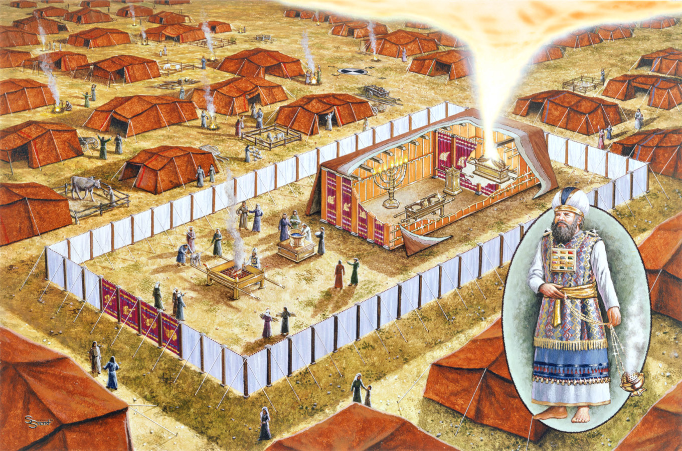
Incense Altar
Brazen Altar

Slide 40
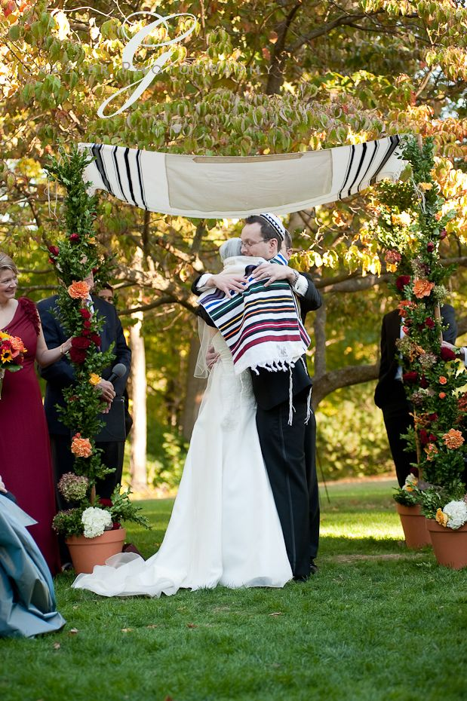

Slide 41
The Revelation Judgments
 | 1 | 2 | 3 | 4 | 5 | 6 |  | 7
Reference | Rev 6:1-2 | Rev 6:3-4 | Rev 6:5-6 | Rev 6:7-8 | Rev 6:9-11 | Rev 6:12-17 |  | Rev 8:1-6
Seal Judgments | White Horse Bow Crown (Stephanos) Overcomer THE CHURCH | Red Horse Takes Peace Cause to Kill One Another Great Sword WAR | Black Horse Balance (Yoke) Inflation on Needed Things Not Luxuries ECONOMIC | Pale Horse Death & Hades Power Over 1/4 Sword, Hunger, Death & Beasts FAMINE / PESTILANCE | Martyred Souls Under Altar "How Long?" White Robes Wait for the Remnant | Earthquake Black Sun & Blood Moon Stars Fall Mts & Isles Move Rich Men Hide from God's Wrath |  | Silence in Heaven Angel w/ Censer Noises, Thunderings, Lightnings & Earthquake
Reference | Rev 8:7 | Rev 8:8-9 | Rev 8:10-11 | Rev 8:12-13 | Rev 9:1-12 | Rev 9:13-21 |  | Rev 11:15-19
Trumpet Judgments | Hail & Fire from Heaven Mingled w/ Blood Burn 1/3 of Trees Burn All Grass | Burning Mountain into Sea 1/3 of Sea Creatures Die Destroy 1/3 of Ships | Star Falls on 1/3 of Rivers & Springs Become Bitter Many Men Die | 1/3 of Sun, Moon Stars Dark Day & Night 1/3 Shorter "Woe, Woe, Woe“ to Earth | Star from Heaven with Key to Pit Smoke & Locusts Harm Those Without God's Mark "Woe, Woe" | 4 Angels from Euphrates River Kill 1/3 of Mankind with Fire, Smoke & Brimstone Men Don't Repent 3rd "Woe" |  | Nations to God Elders Worship Noises, Thunderings, Lightnings & Earthquake Temple Opened
Seven Thunders Rev 10:3-4 Sealed Up !!!
Reference | Rev 16:2 | Rev 16:3 | Rev 16:4-7 | Rev 16:8-9 | Rev 16:10-11 | Rev 16:12-16 | Rev 16:17-21
Bowl Judgments | Sores on All Men with Mark of the Beast | Sea Becomes Blood Every Sea Creature Dies | Rivers & Springs Become Blood "True & Righteous are Your Judgments" | Sun Scorches All Men Do Not Repent | Darkness on Beast Kingdom Men Gnaw Tongues in Pain | Euphrates Dries Up 3 Unclean Spirits Gather Entire Earth to Battle at HarMegiddo | Poured on the Air "It is Done" Noises, Thunderings, Lightnings, Earthquake & Hail

Slide 42
The Revelation Judgments
 | 1 | 2 | 3 | 4 | 5 | 6 |  | 7
Reference | Rev 6:1-2 | Rev 6:3-4 | Rev 6:5-6 | Rev 6:7-8 | Rev 6:9-11 | Rev 6:12-17 |  | Rev 8:1-6
Seal Judgments | White Horse Bow Crown (Stephanos) Overcomer THE CHURCH | Red Horse Takes Peace Cause to Kill One Another Great Sword WAR | Black Horse Balance (Yoke) Inflation on Needed Things Not Luxuries ECONOMIC | Pale Horse Death & Hades Power Over 1/4 Sword, Hunger, Death & Beasts FAMINE / PESTILANCE | Martyred Souls Under Altar "How Long?" White Robes Wait for the Remnant | Earthquake Black Sun & Blood Moon Stars Fall Mts & Isles Move Rich Men Hide from God's Wrath |  | Silence in Heaven Angel w/ Censer Noises, Thunderings, Lightnings & Earthquake
Reference | Rev 8:7 | Rev 8:8-9 | Rev 8:10-11 | Rev 8:12-13 | Rev 9:1-12 | Rev 9:13-21 |  | Rev 11:15-19
Trumpet Judgments | Hail & Fire from Heaven Mingled w/ Blood Burn 1/3 of Trees Burn All Grass | Burning Mountain into Sea 1/3 of Sea Creatures Die Destroy 1/3 of Ships | Star Falls on 1/3 of Rivers & Springs Become Bitter Many Men Die | 1/3 of Sun, Moon Stars Dark Day & Night 1/3 Shorter "Woe, Woe, Woe“ to Earth | Star from Heaven with Key to Pit Smoke & Locusts Harm Those Without God's Mark "Woe, Woe" | 4 Angels from Euphrates River Kill 1/3 of Mankind with Fire, Smoke & Brimstone Men Don't Repent 3rd "Woe" |  | Nations to God Elders Worship Noises, Thunderings, Lightnings & Earthquake Temple Opened
Seven Thunders Rev 10:3-4 Sealed Up !!!
Reference | Rev 16:2 | Rev 16:3 | Rev 16:4-7 | Rev 16:8-9 | Rev 16:10-11 | Rev 16:12-16 | Rev 16:17-21
Bowl Judgments | Sores on All Men with Mark of the Beast | Sea Becomes Blood Every Sea Creature Dies | Rivers & Springs Become Blood "True & Righteous are Your Judgments" | Sun Scorches All Men Do Not Repent | Darkness on Beast Kingdom Men Gnaw Tongues in Pain | Euphrates Dries Up 3 Unclean Spirits Gather Entire Earth to Battle at HarMegiddo | Poured on the Air "It is Done" Noises, Thunderings, Lightnings, Earthquake & Hail
“Fullness of the Gentiles”
Romans 11:25

Slide 43
Times of the Gentiles Luke 21:24
Period of Time:
Babylon Exile to Yeshua’s Return
Fullness of the Gentiles (Nations) Romans 11:25
A Number:
Gentiles = All “Nations” Except Israel
When the Last Person (Hebrew or Not)
Accepts Yeshua

Slide 44
Times of the Gentiles Luke 21:24
Period of Time:
From Babylonian Exile to Yeshua’s Return
Fullness of the Gentiles (Nations) Romans 11:25
A Number:
Gentiles = All “Nations” Except Israel
When the Last Person (Hebrew or Not)
Accepts Yeshua

Slide 45
Times of the Gentiles Luke 21:24
Period of Time:
From Babylonian Exile to Yeshua’s Return
Fullness of the Gentiles Romans 11:25
A Number
Gentiles = Nations (All Except Israel)
“Multitude of Nations” Genesis 48:19
When the Last Person (of Ephraim’s
Descendants) Comes to Yeshua

Slide 46
The Revelation Judgments
 | 1 | 2 | 3 | 4 | 5 | 6 |  | 7
Reference | Rev 6:1-2 | Rev 6:3-4 | Rev 6:5-6 | Rev 6:7-8 | Rev 6:9-11 | Rev 6:12-17 |  | Rev 8:1-6
Seal Judgments | White Horse Bow Crown (Stephanos) Overcomer THE CHURCH | Red Horse Takes Peace Cause to Kill One Another Great Sword WAR | Black Horse Balance (Yoke) Inflation on Needed Things Not Luxuries ECONOMIC | Pale Horse Death & Hades Power Over 1/4 Sword, Hunger, Death & Beasts FAMINE / PESTILANCE | Martyred Souls Under Altar "How Long?" White Robes Wait for the Remnant | Earthquake Black Sun & Blood Moon Stars Fall Mts & Isles Move Rich Men Hide from God's Wrath |  | Silence in Heaven Angel w/ Censer Noises, Thunderings, Lightnings & Earthquake
Reference | Rev 8:7 | Rev 8:8-9 | Rev 8:10-11 | Rev 8:12-13 | Rev 9:1-12 | Rev 9:13-21 |  | Rev 11:15-19
Trumpet Judgments | Hail & Fire from Heaven Mingled w/ Blood Burn 1/3 of Trees Burn All Grass | Burning Mountain into Sea 1/3 of Sea Creatures Die Destroy 1/3 of Ships | Star Falls on 1/3 of Rivers & Springs Become Bitter Many Men Die | 1/3 of Sun, Moon Stars Dark Day & Night 1/3 Shorter "Woe, Woe, Woe“ to Earth | Star from Heaven with Key to Pit Smoke & Locusts Harm Those Without God's Mark "Woe, Woe" | 4 Angels from Euphrates River Kill 1/3 of Mankind with Fire, Smoke & Brimstone Men Don't Repent 3rd "Woe" |  | Nations to God Elders Worship Noises, Thunderings, Lightnings & Earthquake Temple Opened
Seven Thunders Rev 10:3-4 Sealed Up !!!
Reference | Rev 16:2 | Rev 16:3 | Rev 16:4-7 | Rev 16:8-9 | Rev 16:10-11 | Rev 16:12-16 | Rev 16:17-21
Bowl Judgments | Sores on All Men with Mark of the Beast | Sea Becomes Blood Every Sea Creature Dies | Rivers & Springs Become Blood "True & Righteous are Your Judgments" | Sun Scorches All Men Do Not Repent | Darkness on Beast Kingdom Men Gnaw Tongues in Pain | Euphrates Dries Up 3 Unclean Spirits Gather Entire Earth to Battle at HarMegiddo | Poured on the Air "It is Done" Noises, Thunderings, Lightnings, Earthquake & Hail

Slide 47
The Revelation Judgments
 | 1 | 2 | 3 | 4 | 5 | 6 |  | 7
Reference | Rev 6:1-2 | Rev 6:3-4 | Rev 6:5-6 | Rev 6:7-8 | Rev 6:9-11 | Rev 6:12-17 |  | Rev 8:1-6
Seal Judgments | White Horse Bow Crown (Stephanos) Overcomer THE CHURCH | Red Horse Takes Peace Cause to Kill One Another Great Sword WAR | Black Horse Balance (Yoke) Inflation on Needed Things Not Luxuries ECONOMIC | Pale Horse Death & Hades Power Over 1/4 Sword, Hunger, Death & Beasts FAMINE / PESTILANCE | Martyred Souls Under Altar "How Long?" White Robes Wait for the Remnant | Earthquake Black Sun & Blood Moon Stars Fall Mts & Isles Move Rich Men Hide from God’s Coming Wrath |  | Silence in Heaven Angel w/ Censer Noises, Thunderings, Lightnings & Earthquake
Reference | Rev 8:7 | Rev 8:8-9 | Rev 8:10-11 | Rev 8:12-13 | Rev 9:1-12 | Rev 9:13-21 |  | Rev 11:15-19
Trumpet Judgments | Hail & Fire from Heaven Mingled w/ Blood Burn 1/3 of Trees Burn All Grass | Burning Mountain into Sea 1/3 of Sea Creatures Die Destroy 1/3 of Ships | Star Falls on 1/3 of Rivers & Springs Become Bitter Many Men Die | 1/3 of Sun, Moon Stars Dark Day & Night 1/3 Shorter "Woe, Woe, Woe“ to Earth | Star from Heaven with Key to Pit Smoke & Locusts Harm Those Without God's Mark "Woe, Woe" | 4 Angels from Euphrates River Kill 1/3 of Mankind with Fire, Smoke & Brimstone Men Don't Repent 3rd "Woe" |  | Nations to God Elders Worship Noises, Thunderings, Lightnings & Earthquake Temple Opened
Seven Thunders Rev 10:3-4 Sealed Up !!!
Reference | Rev 16:2 | Rev 16:3 | Rev 16:4-7 | Rev 16:8-9 | Rev 16:10-11 | Rev 16:12-16 | Rev 16:17-21
Bowl Judgments | Sores on All Men with Mark of the Beast | Sea Becomes Blood Every Sea Creature Dies | Rivers & Springs Become Blood "True & Righteous are Your Judgments" | Sun Scorches All Men Do Not Repent | Darkness on Beast Kingdom Men Gnaw Tongues in Pain | Euphrates Dries Up 3 Unclean Spirits Gather Entire Earth to Battle at HarMegiddo | Poured on the Air "It is Done" Noises, Thunderings, Lightnings, Earthquake & Hail

Slide 48
Watch!!
1) The Sign of the Woman Clothed with Sun Rev 12:1-2
2) Perplexity & Disasters on Earth Luke 21:25-26
3) War in Heaven Rev 12:7-8
4) Satan Cast From Heaven to Earth Rev 12:9a
5) Stars (Angels) Fall from Heaven Rev 12:9b
6) Beasts from the Sea & the Earth Rev 13
7) Wrath of God Rev 16
8) Return of Yeshua Rev 19

Slide 49
The Revelation Judgments
 | 1 | 2 | 3 | 4 | 5 | 6 |  | 7
Reference | Rev 6:1-2 | Rev 6:3-4 | Rev 6:5-6 | Rev 6:7-8 | Rev 6:9-11 | Rev 6:12-17 |  | Rev 8:1-6
Seal Judgments | White Horse Bow Crown (Stephanos) Overcomer THE CHURCH | Red Horse Takes Peace Cause to Kill One Another Great Sword WAR | Black Horse Balance (Yoke) Inflation on Needed Things Not Luxuries ECONOMIC | Pale Horse Death & Hades Power Over 1/4 Sword, Hunger, Death & Beasts FAMINE / PESTILANCE | Martyred Souls Under Altar "How Long?" White Robes Wait for the Remnant | Earthquake Black Sun & Blood Moon Stars Fall Mts & Isles Move Rich Men Hide from God’s Coming Wrath |  | Silence in Heaven Angel w/ Censer Noises, Thunderings, Lightnings & Earthquake
Reference | Rev 8:7 | Rev 8:8-9 | Rev 8:10-11 | Rev 8:12-13 | Rev 9:1-12 | Rev 9:13-21 |  | Rev 11:15-19
Trumpet Judgments | Hail & Fire from Heaven Mingled w/ Blood Burn 1/3 of Trees Burn All Grass | Burning Mountain into Sea 1/3 of Sea Creatures Die Destroy 1/3 of Ships | Star Falls on 1/3 of Rivers & Springs Become Bitter Many Men Die | 1/3 of Sun, Moon Stars Dark Day & Night 1/3 Shorter "Woe, Woe, Woe“ to Earth | Star from Heaven with Key to Pit Smoke & Locusts Harm Those Without God's Mark "Woe, Woe" | 4 Angels from Euphrates River Kill 1/3 of Mankind with Fire, Smoke & Brimstone Men Don't Repent 3rd "Woe" |  | Nations to God Elders Worship Noises, Thunderings, Lightnings & Earthquake Temple Opened
Seven Thunders Rev 10:3-4 Sealed Up !!!
Reference | Rev 16:2 | Rev 16:3 | Rev 16:4-7 | Rev 16:8-9 | Rev 16:10-11 | Rev 16:12-16 | Rev 16:17-21
Bowl Judgments | Sores on All Men with Mark of the Beast | Sea Becomes Blood Every Sea Creature Dies | Rivers & Springs Become Blood "True & Righteous are Your Judgments" | Sun Scorches All Men Do Not Repent | Darkness on Beast Kingdom Men Gnaw Tongues in Pain | Euphrates Dries Up 3 Unclean Spirits Gather Entire Earth to Battle at HarMegiddo | Poured on the Air "It is Done" Noises, Thunderings, Lightnings, Earthquake & Hail

Slide 50
Revelation 7:
vv 1-8: Sealing of the 144,000
vv 9-17: Multitude Couldn’t Be Numbered
Nations ethnos Ethnic Group
Tribes phlye Clan
Peoples laos Of Same Stock & Customs
Tongues glossa Unique Language

Slide 51
Revelation 7:
vv 1-8: Sealing of the 144,000
vv 9-17: Multitude Couldn’t Be Numbered
Nations ethnos Ethnic Group
Tribes phlye Clan
Peoples laos Same Stock & Customs
Tongues glossa Same Language

Slide 52
Resurrection of Messiah Yeshua Matt 28:1-6
Resurrection of OT Saints after Resurrection Matt 27:52–53
Resurrection of NT Saints and Martyrs Rev 7:9-17 & 20:4
Resurrection of the Two Witnesses Rev 11:7–11
Resurrection of those Alive & Remain 1 Thess 4:13-18; 1 Cor 15:23
Resurrection of the Wicked Revelation 20:5

Slide 53
Resurrection of Messiah Yeshua Matt 28:1-6
Resurrection of OT Saints after Resurrection Matt 27:52–53
Resurrection of NT Saints and Martyrs Rev 7:9-17 & 20:4
Resurrection of the Two Witnesses Rev 11:7–11
Resurrection of those Alive & Remain 1 Thess 4:13-18; 1 Cor 15:23
Resurrection of the Wicked Revelation 20:5

Slide 54
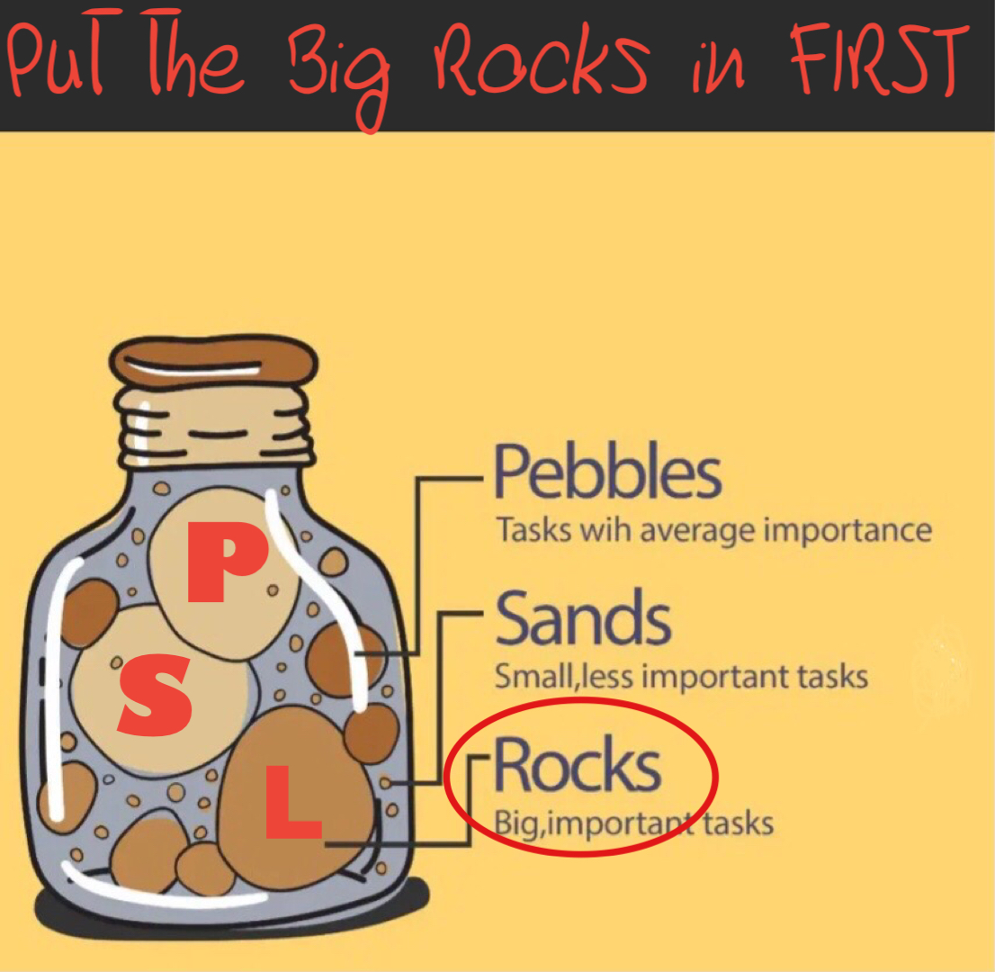

Slide 55
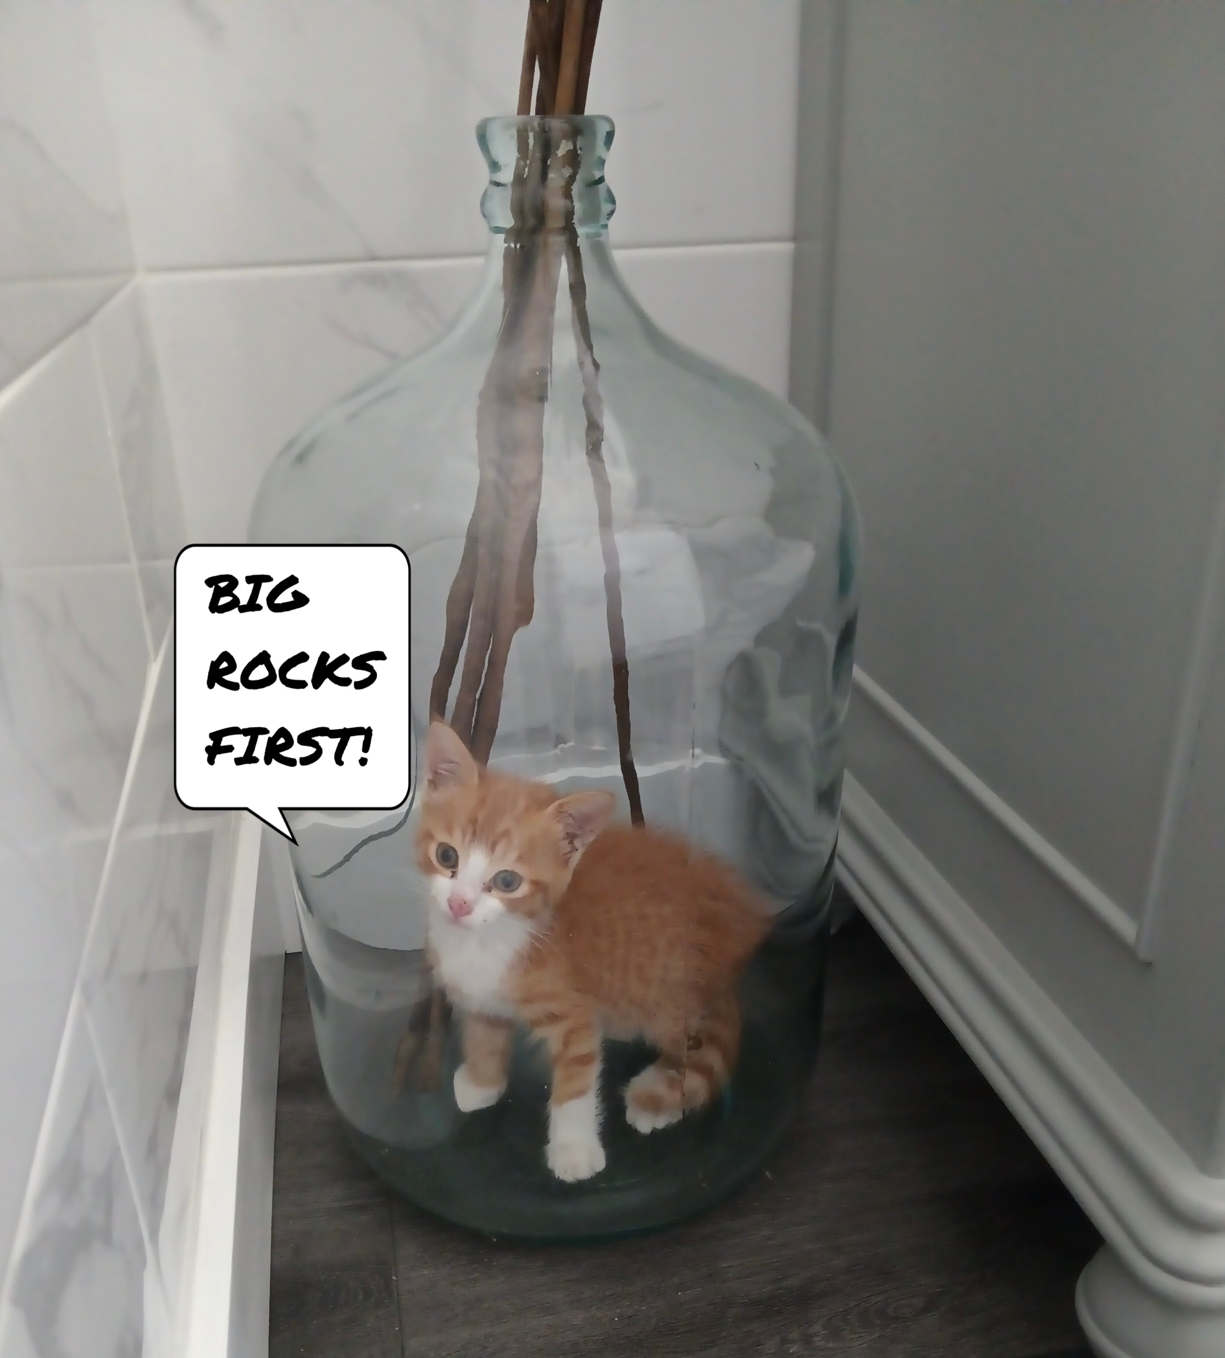

Slide 56
Revelation
Chapter 7 - 9

Slide 57
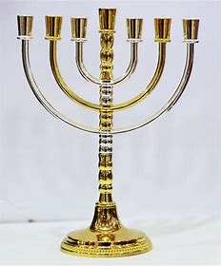
The Menorah Design in the Bible
7 Feasts of Yehovah
7 Spirits of Elohim
7 Churches
7 Days of Creation

Slide 58
The Menorah Design in the Bible
7 Feasts of Yehovah
7 Spirits of Elohim
7 Churches
7 Days of Creation

Slide 59
Pentecost
The LORD
Thyatira
Sun, Moon & Stars
Passover
Knowledge
Ephesus
Light from Darkness
Unleavened Bread
Council
Smyrna
Waters from Waters
First Fruits
Wisdom
Pergamos
Earth, Fruit & Seeds
Trumpets
Under-
standing
Sardis
Birds & Fish
Atonement
Might
Philadelphia
Man & Beasts
Tabernacles
Fear of the LORD
Laodicea
Shabbat

Slide 60
Pentecost
The LORD
Thyatira
n, Moon & Starsqqqqqqqqqqqqqqqqqqqqq
Passover
Knowledge
Ephesus
Light from Darkness
Unleavened Bread
Council
Smyrna
Waters from Waters
First Fruits
Wisdom
Pergamos
Earth, Fruit & Seeds
Trumpets
Under-
standing
Sardis
Birds & Fish
Atonement
Might
Philadelphia
Man & Beasts
Tabernacles
Fear of the LORD
Laodicea
Shabbat
50 Days

Slide 61
Therefore, when they had come together, they asked Him, saying, “Lord, will You at this time restore the kingdom to Israel?” And He said to them, “It is not for you to know times or seasons which the Father has put in His own authority. But you shall receive power when the Holy Spirit has come upon you; and you shall be witnesses to Me in Jerusalem, and in all Judea and Samaria, and to the end of the earth.” Acts 1:14-19

Slide 62
Pentecost
The LORD
Thyatira
Sun, Moon & Stars
Passover
Knowledge
Ephesus
Light from Darkness
Unleavened Bread
Council
Smyrna
Waters from Waters
First Fruits
Wisdom
Pergamos
Earth, Fruit & Seeds
Trumpets
Under-
standing
Sardis
Birds & Fish
Atonement
Might
Philadelphia
Man & Beasts
Tabernacles
Fear of the LORD
Laodicea
Shabbat
10 Days
50 Days

Slide 63
Pentecost
The LORD
Thyatira
Sun, Moon & Stars
Passover
Wisdom
Ephesus
Light from Darkness
Unleavened Bread
Under-standing
Smyrna
Waters from Waters
First Fruits
Counsel
Pergamos
Earth, Fruit & Seeds
Trumpets
Power
Sardis
Birds & Fish
Atonement
Knowledge
Philadelphia
Man & Beasts
Tabernacles
Fear of the LORD
Laodicea
Shabbat

Slide 64
Pentecost
The LORD
Thyatira
Sun, Moon & Stars
Passover
Wisdom
Ephesus
Light from Darkness
Unleavened Bread
Under-standing
Smyrna
Waters from Waters
First Fruits
Counsel
Pergamos
Earth, Fruit & Seeds
Trumpets
Power
Sardis
Birds & Fish
Atonement
Knowledge
Philadelphia
Man & Beasts
Tabernacles
Fear of the LORD
Laodicea
Shabbat

Slide 65
Pentecost
The LORD
Thyatira
Sun, Moon & Stars
Passover
Wisdom
Ephesus
Light from Darkness
Unleavened Bread
Under-standing
Smyrna
Waters from Waters
First Fruits
Counsel
Pergamos
Earth, Fruit & Seeds
Trumpets
Power
Sardis
Birds & Fish
Atonement
Knowledge
Philadelphia
Beasts & Man
Tabernacles
Fear of the LORD
Laodicea
Shabbat

Slide 66
Then God said, “Let there be lights in the firmament of the heavens to divide the day from the night; and let them be for signs and seasons, and for days and years; and let them be for lights in the firmament of the heavens to give light on the earth”; and it was so. Then God made two great lights: the greater light to rule the day, and the lesser light to rule the night. He made the stars also. God set them in the firmament of the heavens to give light on the earth, and to rule over the day and over the night, and to divide the light from the darkness. And God saw that it was good. So, the evening and the morning were the fourth day. Gen 1:14-19

Slide 67
Then God said, “Let there be lights in the firmament of the heavens to divide the day from the night; and let them be for signs and seasons, and for days and years; and let them be for lights in the firmament of the heavens to give light on the earth”; and it was so. Then God made two great lights: the greater light to rule the day, and the lesser light to rule the night. He made the stars also. God set them in the firmament of the heavens to give light on the earth, and to rule over the day and over the night, and to divide the light from the darkness. And God saw that it was good. So, the evening and the morning were the fourth day. Gen 1:14-19

Slide 68
Pentecost
The LORD
Thyatira
Sun, Moon & Stars
Passover
Wisdom
Ephesus
Light from Darkness
Unleavened Bread
Under-standing
Smyrna
Waters from Waters
First Fruits
Council
Pergamos
Earth, Fruit & Seeds
Trumpets
Power
Sardis
Birds & Fish
Atonement
Knowledge
Philadelphia
Beasts & Man
Tabernacles
Fear of the LORD
Laodicea
Shabbat

Slide 69
“And to the angel of the church in Thyatira write … Nevertheless I have a few things against you, because you allow that woman Jezebel, who calls herself a prophetess, to teach and seduce My servants to commit sexual immorality and eat things sacrificed to idols.” Rev 2:18 & 20

Slide 70
The Revelation Judgments
 | 1 | 2 | 3 | 4 | 5 | 6 |  | 7
Reference | Rev 6:1-2 | Rev 6:3-4 | Rev 6:5-6 | Rev 6:7-8 | Rev 6:9-11 | Rev 6:12-17 |  | Rev 8:1-6
Seal Judgments | White Horse Bow Crown (Stephanos) Overcomer THE CHURCH | Red Horse Takes Peace Cause to Kill One Another Great Sword WAR | Black Horse Balance (Yoke) Inflation on Needed Things Not Luxuries ECONOMIC | Pale Horse Death & Hades Power Over 1/4 Sword, Hunger, Death & Beasts FAMINE / PESTILANCE | Martyred Souls Under Altar "How Long?" White Robes Wait for the Remnant | Earthquake Black Sun & Blood Moon Stars Fall Mts & Isles Move Rich Men Hide from God’s Coming Wrath |  | Silence in Heaven Angel w/ Censer Noises, Thunderings, Lightnings & Earthquake
Reference | Rev 8:7 | Rev 8:8-9 | Rev 8:10-11 | Rev 8:12-13 | Rev 9:1-12 | Rev 9:13-21 |  | Rev 11:15-19
Trumpet Judgments | Hail & Fire from Heaven Mingled w/ Blood Burn 1/3 of Trees Burn All Grass | Burning Mountain into Sea 1/3 of Sea Creatures Die Destroy 1/3 of Ships | Star Falls on 1/3 of Rivers & Springs Become Bitter Many Men Die | 1/3 of Sun, Moon Stars Dark Day & Night 1/3 Shorter "Woe, Woe, Woe“ to Earth | Star from Heaven with Key to Pit Smoke & Locusts Harm Those Without God's Mark "Woe, Woe" | 4 Angels from Euphrates River Kill 1/3 of Mankind with Fire, Smoke & Brimstone Men Don't Repent 3rd "Woe" |  | Nations to God Elders Worship Noises, Thunderings, Lightnings & Earthquake Temple Opened
Seven Thunders Rev 10:3-4 Sealed Up !!!
Reference | Rev 16:2 | Rev 16:3 | Rev 16:4-7 | Rev 16:8-9 | Rev 16:10-11 | Rev 16:12-16 | Rev 16:17-21
Bowl Judgments | Sores on All Men with Mark of the Beast | Sea Becomes Blood Every Sea Creature Dies | Rivers & Springs Become Blood "True & Righteous are Your Judgments" | Sun Scorches All Men Do Not Repent | Darkness on Beast Kingdom Men Gnaw Tongues in Pain | Euphrates Dries Up 3 Unclean Spirits Gather Entire Earth to Battle at HarMegiddo | Poured on the Air "It is Done" Noises, Thunderings, Lightnings, Earthquake & Hail

Slide 71
Revelation 7:
vv 1-8: Sealing of the 144,000
vv 9-17: Multitude Couldn’t Be Numbered
Nations ethnos Ethnic Group
Tribes phlye Clan
Peoples laos Of Same Stock & Customs
Tongues glossa Unique Language

Slide 72
Revelation 7:
vv 1-8: Sealing of the 144,000
vv 9-17: Multitude Couldn’t Be Numbered
Nations ethnos Ethnic Group
Tribes phlye Clan
Peoples laos Of Same Stock & Customs
Tongues glossa Unique Language

Slide 73
Jacob’s 12 Sons
Jacob
Reuben
Simeon
Levi
Judah
Dan
Naphtali
Gad
Asher
Issachar
Zebulun
Joseph
Benjamin

Slide 74
Israel’s 13 Tribes
Jacob
Reuben
Simeon
Levi
Judah
Dan
Naphtali
Gad
Asher
Issachar
Zebulun
Benjamin
Ephraim
Manasseh
Genesis 48:19

Slide 75
Israel’s 13 Tribes
Jacob
Reuben
Simeon
Levi
Judah
Dan
Naphtali
Gad
Asher
Issachar
Zebulun
Benjamin
Ephraim
Manasseh
Joseph
Ephraim
Manasseh
Genesis 48:19

Slide 76
Israel’s 13 Tribes
Jacob
Reuben
Simeon
Levi
Judah
Dan
Naphtali
Gad
Asher
Issachar
Zebulun
Benjamin
Ephraim
Manasseh
Joseph
Ephraim
Manasseh
Genesis 48:19
Ephraim
Joseph
Manasseh

Slide 77
Sealed with The Spirit
“Now He who establishes us with you in Messiah and has anointed us is God, who also has sealed us and given us the Spirit in our hearts as a guarantee.” II Corinth 1:21-22
“In Him you also trusted, after you heard the word of truth, the gospel of your salvation; in whom also, having believed, you were sealed with the Holy Spirit of promise, who is the guarantee of our inheritance until the redemption of the purchased possession, to the praise of His glory.” Ephesians 1:13-14
“And do not grieve the Holy Spirit of God, by whom you were sealed for the day of redemption.” Ephesians 4:30

Slide 78
Sealed with the Mark of God
“Therefore the children of Israel shall keep the Sabbath, to observe the Sabbath throughout their generations as a perpetual covenant. It is a sign between Me and the children of Israel forever; for in six days the Lord made the heavens and the earth, and on the seventh day He rested and was refreshed.” Exodus 31:16-17
“And Moses said to the people: “Remember this day in which you went out of Egypt … It shall be as a sign to you … Unleavened bread shall be eaten seven days … for with a strong hand the Lord has brought you out of Egypt.” Exodus 13:3, 8-10

Slide 79
Sealed with the Mark of God
“And these words which I command you today shall be in your heart. You shall teach them diligently to your children, and shall talk of them when you sit in your house, when you walk by the way, when you lie down, and when you rise up. You shall bind them as a sign on your hand, and they shall be as frontlets between your eyes. You shall write them on the doorposts of your house and on your gates. Deuteronomy 6:6-9

Slide 80
Sealed with the Mark of God
“And these words which I command you today shall be in your heart. You shall teach them diligently to your children, and shall talk of them when you sit in your house, when you walk by the way, when you lie down, and when you rise up. You shall bind them as a sign on your hand, and they shall be as frontlets between your eyes. You shall write them on the doorposts of your house and on your gates. Deuteronomy 6:6-9
Keep Shabbat
Keep the Feasts of the LORD
Keep God’s Commandments

Slide 81
The Revelation Judgments
 | 1 | 2 | 3 | 4 | 5 | 6 |  | 7
Reference | Rev 6:1-2 | Rev 6:3-4 | Rev 6:5-6 | Rev 6:7-8 | Rev 6:9-11 | Rev 6:12-17 |  | Rev 8:1-6
Seal Judgments | White Horse Bow Crown (Stephanos) Overcomer THE CHURCH | Red Horse Takes Peace Cause to Kill One Another Great Sword WAR | Black Horse Balance (Yoke) Inflation on Needed Things Not Luxuries ECONOMIC | Pale Horse Death & Hades Power Over 1/4 Sword, Hunger, Death & Beasts FAMINE / PESTILANCE | Martyred Souls Under Altar "How Long?" White Robes Wait for the Remnant | Earthquake Black Sun & Blood Moon Stars Fall Mts & Isles Move Rich Men Hide from God’s Coming Wrath |  | Silence in Heaven Angel w/ Censer Noises, Thunderings, Lightnings & Earthquake
Reference | Rev 8:7 | Rev 8:8-9 | Rev 8:10-11 | Rev 8:12-13 | Rev 9:1-12 | Rev 9:13-21 |  | Rev 11:15-19
Trumpet Judgments | Hail & Fire from Heaven Mingled w/ Blood Burn 1/3 of Trees Burn All Grass | Burning Mountain into Sea 1/3 of Sea Creatures Die Destroy 1/3 of Ships | Star Falls on 1/3 of Rivers & Springs Become Bitter Many Men Die | 1/3 of Sun, Moon Stars Dark Day & Night 1/3 Shorter "Woe, Woe, Woe“ to Earth | Star from Heaven with Key to Pit Smoke & Locusts Harm Those Without God's Mark "Woe, Woe" | 4 Angels from Euphrates River Kill 1/3 of Mankind with Fire, Smoke & Brimstone Men Don't Repent 3rd "Woe" |  | Nations to God Elders Worship Noises, Thunderings, Lightnings & Earthquake Temple Opened
Seven Thunders Rev 10:3-4 Sealed Up !!!
Reference | Rev 16:2 | Rev 16:3 | Rev 16:4-7 | Rev 16:8-9 | Rev 16:10-11 | Rev 16:12-16 | Rev 16:17-21
Bowl Judgments | Sores on All Men with Mark of the Beast | Sea Becomes Blood Every Sea Creature Dies | Rivers & Springs Become Blood "True & Righteous are Your Judgments" | Sun Scorches All Men Do Not Repent | Darkness on Beast Kingdom Men Gnaw Tongues in Pain | Euphrates Dries Up 3 Unclean Spirits Gather Entire Earth to Battle at HarMegiddo | Poured on the Air "It is Done" Noises, Thunderings, Lightnings, Earthquake & Hail

Slide 83
The Revelation Judgments
 | 1 | 2 | 3 | 4 | 5 | 6 |  | 7
Reference | Rev 6:1-2 | Rev 6:3-4 | Rev 6:5-6 | Rev 6:7-8 | Rev 6:9-11 | Rev 6:12-17 |  | Rev 8:1-6
Seal Judgments | White Horse Bow Crown (Stephanos) Overcomer THE CHURCH | Red Horse Takes Peace Cause to Kill One Another Great Sword WAR | Black Horse Balance (Yoke) Inflation on Needed Things Not Luxuries ECONOMIC | Pale Horse Death & Hades Power Over 1/4 Sword, Hunger, Death & Beasts FAMINE / PESTILANCE | Martyred Souls Under Altar "How Long?" White Robes Wait for the Remnant | Earthquake Black Sun & Blood Moon Stars Fall Mts & Isles Move Rich Men Hide from God’s Coming Wrath |  | Silence in Heaven Angel w/ Censer Noises, Thunderings, Lightnings & Earthquake
Reference | Rev 8:7 | Rev 8:8-9 | Rev 8:10-11 | Rev 8:12-13 | Rev 9:1-12 | Rev 9:13-21 |  | Rev 11:15-19
Trumpet Judgments | Hail & Fire from Heaven Mingled w/ Blood Burn 1/3 of Trees Burn All Grass | Burning Mountain into Sea 1/3 of Sea Creatures Die Destroy 1/3 of Ships | Star Falls on 1/3 of Rivers & Springs Become Bitter Many Men Die | 1/3 of Sun, Moon Stars Dark Day & Night 1/3 Shorter "Woe, Woe, Woe“ to Earth | Star from Heaven with Key to Pit Smoke & Locusts Harm Those Without God's Mark "Woe, Woe" | 4 Angels from Euphrates River Kill 1/3 of Mankind with Fire, Smoke & Brimstone Men Don't Repent 3rd "Woe" |  | Nations to God Elders Worship Noises, Thunderings, Lightnings & Earthquake Temple Opened
Seven Thunders Rev 10:3-4 Sealed Up !!!
Reference | Rev 16:2 | Rev 16:3 | Rev 16:4-7 | Rev 16:8-9 | Rev 16:10-11 | Rev 16:12-16 | Rev 16:17-21
Bowl Judgments | Sores on All Men with Mark of the Beast | Sea Becomes Blood Every Sea Creature Dies | Rivers & Springs Become Blood "True & Righteous are Your Judgments" | Sun Scorches All Men Do Not Repent | Darkness on Beast Kingdom Men Gnaw Tongues in Pain | Euphrates Dries Up 3 Unclean Spirits Gather Entire Earth to Battle at HarMegiddo | Poured on the Air "It is Done" Noises, Thunderings, Lightnings, Earthquake & Hail

Slide 84
The Revelation Judgments
 | 1 | 2 | 3 | 4 | 5 | 6 |  | 7
Reference | Rev 6:1-2 | Rev 6:3-4 | Rev 6:5-6 | Rev 6:7-8 | Rev 6:9-11 | Rev 6:12-17 |  | Rev 8:1-6
Seal Judgments | White Horse Bow Crown (Stephanos) Overcomer THE CHURCH | Red Horse Takes Peace Cause to Kill One Another Great Sword WAR | Black Horse Balance (Yoke) Inflation on Needed Things Not Luxuries ECONOMIC | Pale Horse Death & Hades Power Over 1/4 Sword, Hunger, Death & Beasts FAMINE / PESTILANCE | Martyred Souls Under Altar "How Long?" White Robes Wait for the Remnant | Earthquake Black Sun & Blood Moon Stars Fall Mts & Isles Move Rich Men Hide from God’s Coming Wrath |  | Silence in Heaven Angel w/ Censer Noises, Thunderings, Lightnings & Earthquake
Reference | Rev 8:7 | Rev 8:8-9 | Rev 8:10-11 | Rev 8:12-13 | Rev 9:1-12 | Rev 9:13-21 |  | Rev 11:15-19
Trumpet Judgments | Hail & Fire from Heaven Mingled w/ Blood Burn 1/3 of Trees Burn All Grass | Burning Mountain into Sea 1/3 of Sea Creatures Die Destroy 1/3 of Ships | Star Falls on 1/3 of Rivers & Springs Become Bitter Many Men Die | 1/3 of Sun, Moon Stars Dark Day & Night 1/3 Shorter "Woe, Woe, Woe“ to Earth | Star from Heaven with Key to Pit Smoke & Locusts Harm Those Without God's Mark "Woe, Woe" | 4 Angels from Euphrates River Kill 1/3 of Mankind with Fire, Smoke & Brimstone Men Don't Repent 3rd "Woe" |  | Nations to God Elders Worship Noises, Thunderings, Lightnings & Earthquake Temple Opened
Seven Thunders Rev 10:3-4 Sealed Up !!!
Reference | Rev 16:2 | Rev 16:3 | Rev 16:4-7 | Rev 16:8-9 | Rev 16:10-11 | Rev 16:12-16 | Rev 16:17-21
Bowl Judgments | Sores on All Men with Mark of the Beast | Sea Becomes Blood Every Sea Creature Dies | Rivers & Springs Become Blood "True & Righteous are Your Judgments" | Sun Scorches All Men Do Not Repent | Darkness on Beast Kingdom Men Gnaw Tongues in Pain | Euphrates Dries Up 3 Unclean Spirits Gather Entire Earth to Battle at HarMegiddo | Poured on the Air "It is Done" Noises, Thunderings, Lightnings, Earthquake & Hail

Slide 85
The Revelation Judgments
 | 1 | 2 | 3 | 4 | 5 | 6 |  | 7
Reference | Rev 6:1-2 | Rev 6:3-4 | Rev 6:5-6 | Rev 6:7-8 | Rev 6:9-11 | Rev 6:12-17 |  | Rev 8:1-6
Seal Judgments | White Horse Bow Crown (Stephanos) Overcomer THE CHURCH | Red Horse Takes Peace Cause to Kill One Another Great Sword WAR | Black Horse Balance (Yoke) Inflation on Needed Things Not Luxuries ECONOMIC | Pale Horse Death & Hades Power Over 1/4 Sword, Hunger, Death & Beasts FAMINE / PESTILANCE | Martyred Souls Under Altar "How Long?" White Robes Wait for the Remnant | Earthquake Black Sun & Blood Moon Stars Fall Mts & Isles Move Rich Men Hide from God’s Coming Wrath |  | Silence in Heaven Angel w/ Censer Noises, Thunderings, Lightnings & Earthquake
Reference | Rev 8:7 | Rev 8:8-9 | Rev 8:10-11 | Rev 8:12-13 | Rev 9:1-12 | Rev 9:13-21 |  | Rev 11:15-19
Trumpet Judgments | Hail & Fire from Heaven Mingled w/ Blood Burn 1/3 of Trees Burn All Grass | Burning Mountain into Sea 1/3 of Sea Creatures Die Destroy 1/3 of Ships | Star Falls on 1/3 of Rivers & Springs Become Bitter Many Men Die | 1/3 of Sun, Moon Stars Dark Day & Night 1/3 Shorter "Woe, Woe, Woe“ to Earth | Star from Heaven with Key to Pit Smoke & Locusts Harm Those Without God's Mark "Woe, Woe" | 4 Angels from Euphrates River Kill 1/3 of Mankind with Fire, Smoke & Brimstone Men Don't Repent 3rd "Woe" |  | Nations to God Elders Worship Noises, Thunderings, Lightnings & Earthquake Temple Opened
Seven Thunders Rev 10:3-4 Sealed Up !!!
Reference | Rev 16:2 | Rev 16:3 | Rev 16:4-7 | Rev 16:8-9 | Rev 16:10-11 | Rev 16:12-16 | Rev 16:17-21
Bowl Judgments | Sores on All Men with Mark of the Beast | Sea Becomes Blood Every Sea Creature Dies | Rivers & Springs Become Blood "True & Righteous are Your Judgments" | Sun Scorches All Men Do Not Repent | Darkness on Beast Kingdom Men Gnaw Tongues in Pain | Euphrates Dries Up 3 Unclean Spirits Gather Entire Earth to Battle at HarMegiddo | Poured on the Air "It is Done" Noises, Thunderings, Lightnings, Earthquake & Hail

Slide 86
The Revelation Judgments
 | 1 | 2 | 3 | 4 | 5 | 6 |  | 7
Reference | Rev 6:1-2 | Rev 6:3-4 | Rev 6:5-6 | Rev 6:7-8 | Rev 6:9-11 | Rev 6:12-17 |  | Rev 8:1-6
Seal Judgments | White Horse Bow Crown (Stephanos) Overcomer THE CHURCH | Red Horse Takes Peace Cause to Kill One Another Great Sword WAR | Black Horse Balance (Yoke) Inflation on Needed Things Not Luxuries ECONOMIC | Pale Horse Death & Hades Power Over 1/4 Sword, Hunger, Death & Beasts FAMINE / PESTILANCE | Martyred Souls Under Altar "How Long?" White Robes Wait for the Remnant | Earthquake Black Sun & Blood Moon Stars Fall Mts & Isles Move Rich Men Hide from God’s Coming Wrath |  | Silence in Heaven Angel w/ Censer Noises, Thunderings, Lightnings & Earthquake
Reference | Rev 8:7 | Rev 8:8-9 | Rev 8:10-11 | Rev 8:12-13 | Rev 9:1-12 | Rev 9:13-21 |  | Rev 11:15-19
Trumpet Judgments | Hail & Fire from Heaven Mingled w/ Blood Burn 1/3 of Trees Burn All Grass | Burning Mountain into Sea 1/3 of Sea Creatures Die Destroy 1/3 of Ships | Star Falls on 1/3 of Rivers & Springs Become Bitter Many Men Die | 1/3 of Sun, Moon Stars Dark Day & Night 1/3 Shorter "Woe, Woe, Woe“ to Earth | Star from Heaven with Key to Pit Smoke & Locusts Harm Those Without God's Mark "Woe, Woe" | 4 Angels from Euphrates River Kill 1/3 of Mankind with Fire, Smoke & Brimstone Men Don't Repent 3rd "Woe" |  | Nations to God Elders Worship Noises, Thunderings, Lightnings & Earthquake Temple Opened
Seven Thunders Rev 10:3-4 Sealed Up !!!
Reference | Rev 16:2 | Rev 16:3 | Rev 16:4-7 | Rev 16:8-9 | Rev 16:10-11 | Rev 16:12-16 | Rev 16:17-21
Bowl Judgments | Sores on All Men with Mark of the Beast | Sea Becomes Blood Every Sea Creature Dies | Rivers & Springs Become Blood "True & Righteous are Your Judgments" | Sun Scorches All Men Do Not Repent | Darkness on Beast Kingdom Men Gnaw Tongues in Pain | Euphrates Dries Up 3 Unclean Spirits Gather Entire Earth to Battle at HarMegiddo | Poured on the Air "It is Done" Noises, Thunderings, Lightnings, Earthquake & Hail

Slide 87
The Revelation Judgments
 | 1 | 2 | 3 | 4 | 5 | 6 |  | 7
Reference | Rev 6:1-2 | Rev 6:3-4 | Rev 6:5-6 | Rev 6:7-8 | Rev 6:9-11 | Rev 6:12-17 |  | Rev 8:1-6
Seal Judgments | White Horse Bow Crown (Stephanos) Overcomer THE CHURCH | Red Horse Takes Peace Cause to Kill One Another Great Sword WAR | Black Horse Balance (Yoke) Inflation on Needed Things Not Luxuries ECONOMIC | Pale Horse Death & Hades Power Over 1/4 Sword, Hunger, Death & Beasts FAMINE / PESTILANCE | Martyred Souls Under Altar "How Long?" White Robes Wait for the Remnant | Earthquake Black Sun & Blood Moon Stars Fall Mts & Isles Move Rich Men Hide from God’s Coming Wrath |  | Silence in Heaven Angel w/ Censer Noises, Thunderings, Lightnings & Earthquake
Reference | Rev 8:7 | Rev 8:8-9 | Rev 8:10-11 | Rev 8:12-13 | Rev 9:1-12 | Rev 9:13-21 |  | Rev 11:15-19
Trumpet Judgments | Hail & Fire from Heaven Mingled w/ Blood Burn 1/3 of Trees Burn All Grass | Burning Mountain into Sea 1/3 of Sea Creatures Die Destroy 1/3 of Ships | Star Falls on 1/3 of Rivers & Springs Become Bitter Many Men Die | 1/3 of Sun, Moon Stars Dark Day & Night 1/3 Shorter "Woe, Woe, Woe“ to Earth | Star from Heaven with Key to Pit Smoke & Locusts Harm Those Without God's Mark "Woe, Woe" | 4 Angels from Euphrates River Kill 1/3 of Mankind with Fire, Smoke & Brimstone Men Don't Repent 3rd "Woe" |  | Nations to God Elders Worship Noises, Thunderings, Lightnings & Earthquake Temple Opened
Seven Thunders Rev 10:3-4 Sealed Up !!!
Reference | Rev 16:2 | Rev 16:3 | Rev 16:4-7 | Rev 16:8-9 | Rev 16:10-11 | Rev 16:12-16 | Rev 16:17-21
Bowl Judgments | Sores on All Men with Mark of the Beast | Sea Becomes Blood Every Sea Creature Dies | Rivers & Springs Become Blood "True & Righteous are Your Judgments" | Sun Scorches All Men Do Not Repent | Darkness on Beast Kingdom Men Gnaw Tongues in Pain | Euphrates Dries Up 3 Unclean Spirits Gather Entire Earth to Battle at HarMegiddo | Poured on the Air "It is Done" Noises, Thunderings, Lightnings, Earthquake & Hail

Slide 88
The Revelation Judgments
 | 1 | 2 | 3 | 4 | 5 | 6 |  | 7
Reference | Rev 6:1-2 | Rev 6:3-4 | Rev 6:5-6 | Rev 6:7-8 | Rev 6:9-11 | Rev 6:12-17 |  | Rev 8:1-6
Seal Judgments | White Horse Bow Crown (Stephanos) Overcomer THE CHURCH | Red Horse Takes Peace Cause to Kill One Another Great Sword WAR | Black Horse Balance (Yoke) Inflation on Needed Things Not Luxuries ECONOMIC | Pale Horse Death & Hades Power Over 1/4 Sword, Hunger, Death & Beasts FAMINE / PESTILANCE | Martyred Souls Under Altar "How Long?" White Robes Wait for the Remnant | Earthquake Black Sun & Blood Moon Stars Fall Mts & Isles Move Rich Men Hide from God’s Coming Wrath |  | Silence in Heaven Angel w/ Censer Noises, Thunderings, Lightnings & Earthquake
Reference | Rev 8:7 | Rev 8:8-9 | Rev 8:10-11 | Rev 8:12-13 | Rev 9:1-12 | Rev 9:13-21 |  | Rev 11:15-19
Trumpet Judgments | Hail & Fire from Heaven Mingled w/ Blood Burn 1/3 of Trees Burn All Grass | Burning Mountain into Sea 1/3 of Sea Creatures Die Destroy 1/3 of Ships | Star Falls on 1/3 of Rivers & Springs Become Bitter Many Men Die | 1/3 of Sun, Moon Stars Dark Day & Night 1/3 Shorter "Woe, Woe, Woe“ to Earth | Star from Heaven with Key to Pit Smoke & Locusts Harm Those w/out God's Mark 5 Mo. "Woe, Woe" | 4 Angels from Euphrates River Kill 1/3 of Mankind with Fire, Smoke & Brimstone Men Don't Repent 3rd "Woe" |  | Nations to God Elders Worship Noises, Thunderings, Lightnings & Earthquake Temple Opened
Seven Thunders Rev 10:3-4 Sealed Up !!!
Reference | Rev 16:2 | Rev 16:3 | Rev 16:4-7 | Rev 16:8-9 | Rev 16:10-11 | Rev 16:12-16 | Rev 16:17-21
Bowl Judgments | Sores on All Men with Mark of the Beast | Sea Becomes Blood Every Sea Creature Dies | Rivers & Springs Become Blood "True & Righteous are Your Judgments" | Sun Scorches All Men Do Not Repent | Darkness on Beast Kingdom Men Gnaw Tongues in Pain | Euphrates Dries Up 3 Unclean Spirits Gather Entire Earth to Battle at HarMegiddo | Poured on the Air "It is Done" Noises, Thunderings, Lightnings, Earthquake & Hail

Slide 89
The Revelation Judgments
 | 1 | 2 | 3 | 4 | 5 | 6 |  | 7
Reference | Rev 6:1-2 | Rev 6:3-4 | Rev 6:5-6 | Rev 6:7-8 | Rev 6:9-11 | Rev 6:12-17 |  | Rev 8:1-6
Seal Judgments | White Horse Bow Crown (Stephanos) Overcomer THE CHURCH | Red Horse Takes Peace Cause to Kill One Another Great Sword WAR | Black Horse Balance (Yoke) Inflation on Needed Things Not Luxuries ECONOMIC | Pale Horse Death & Hades Power Over 1/4 Sword, Hunger, Death & Beasts FAMINE / PESTILANCE | Martyred Souls Under Altar "How Long?" White Robes Wait for the Remnant | Earthquake Black Sun & Blood Moon Stars Fall Mts & Isles Move Rich Men Hide from God’s Coming Wrath |  | Silence in Heaven Angel w/ Censer Noises, Thunderings, Lightnings & Earthquake
Reference | Rev 8:7 | Rev 8:8-9 | Rev 8:10-11 | Rev 8:12-13 | Rev 9:1-12 | Rev 9:13-21 |  | Rev 11:15-19
Trumpet Judgments | Hail & Fire from Heaven Mingled w/ Blood Burn 1/3 of Trees Burn All Grass | Burning Mountain into Sea 1/3 of Sea Creatures Die Destroy 1/3 of Ships | Star Falls on 1/3 of Rivers & Springs Become Bitter Many Men Die | 1/3 of Sun, Moon Stars Dark Day & Night 1/3 Shorter "Woe, Woe, Woe“ to Earth | Star from Heaven with Key to Pit Smoke & Locusts Harm Those w/out God's Mark 5 Mo. "Woe, Woe" | 4 Angels from Euphrates River Kill 1/3 of Mankind with Fire, Smoke & Brimstone Men Don't Repent 3rd "Woe" |  | Nations to God Elders Worship Noises, Thunderings, Lightnings & Earthquake Temple Opened
Seven Thunders Rev 10:3-4 Sealed Up !!!
Reference | Rev 16:2 | Rev 16:3 | Rev 16:4-7 | Rev 16:8-9 | Rev 16:10-11 | Rev 16:12-16 | Rev 16:17-21
Bowl Judgments | Sores on All Men with Mark of the Beast | Sea Becomes Blood Every Sea Creature Dies | Rivers & Springs Become Blood "True & Righteous are Your Judgments" | Sun Scorches All Men Do Not Repent | Darkness on Beast Kingdom Men Gnaw Tongues in Pain | Euphrates Dries Up 3 Unclean Spirits Gather Entire Earth to Battle at HarMegiddo | Poured on the Air "It is Done" Noises, Thunderings, Lightnings, Earthquake & Hail

Slide 90
The Revelation Judgments
 | 1 | 2 | 3 | 4 | 5 | 6 |  | 7
Reference | Rev 6:1-2 | Rev 6:3-4 | Rev 6:5-6 | Rev 6:7-8 | Rev 6:9-11 | Rev 6:12-17 |  | Rev 8:1-6
Seal Judgments | White Horse Bow Crown (Stephanos) Overcomer THE CHURCH | Red Horse Takes Peace Cause to Kill One Another Great Sword WAR | Black Horse Balance (Yoke) Inflation on Needed Things Not Luxuries ECONOMIC | Pale Horse Death & Hades Power Over 1/4 Sword, Hunger, Death & Beasts FAMINE / PESTILANCE | Martyred Souls Under Altar "How Long?" White Robes Wait for the Remnant | Earthquake Black Sun & Blood Moon Stars Fall Mts & Isles Move Rich Men Hide from God’s Coming Wrath |  | Silence in Heaven Angel w/ Censer Noises, Thunderings, Lightnings & Earthquake
Reference | Rev 8:7 | Rev 8:8-9 | Rev 8:10-11 | Rev 8:12-13 | Rev 9:1-12 | Rev 9:13-21 |  | Rev 11:15-19
Trumpet Judgments | Hail & Fire from Heaven Mingled w/ Blood Burn 1/3 of Trees Burn All Grass | Burning Mountain into Sea 1/3 of Sea Creatures Die Destroy 1/3 of Ships | Star Falls on 1/3 of Rivers & Springs Become Bitter Many Men Die | 1/3 of Sun, Moon Stars Dark Day & Night 1/3 Shorter "Woe, Woe, Woe“ to Earth | Star from Heaven with Key to Pit Smoke & Locusts Harm Those w/out God's Mark 5 Mo. "Woe, Woe" | 4 Angels from Euphrates River Kill 1/3 of Mankind with Fire, Smoke & Brimstone Men Don't Repent 3rd "Woe" |  | Nations to God Elders Worship Noises, Thunderings, Lightnings & Earthquake Temple Opened
Seven Thunders Rev 10:3-4 Sealed Up !!!
Reference | Rev 16:2 | Rev 16:3 | Rev 16:4-7 | Rev 16:8-9 | Rev 16:10-11 | Rev 16:12-16 | Rev 16:17-21
Bowl Judgments | Sores on All Men with Mark of the Beast | Sea Becomes Blood Every Sea Creature Dies | Rivers & Springs Become Blood "True & Righteous are Your Judgments" | Sun Scorches All Men Do Not Repent | Darkness on Beast Kingdom Men Gnaw Tongues in Pain | Euphrates Dries Up 3 Unclean Spirits Gather Entire Earth to Battle at HarMegiddo | Poured on the Air "It is Done" Noises, Thunderings, Lightnings, Earthquake & Hail

Slide 92
The Revelation Judgments
 | 1 | 2 | 3 | 4 | 5 | 6 |  | 7
Reference | Rev 6:1-2 | Rev 6:3-4 | Rev 6:5-6 | Rev 6:7-8 | Rev 6:9-11 | Rev 6:12-17 |  | Rev 8:1-6
Seal Judgments | White Horse Bow Crown (Stephanos) Overcomer THE CHURCH | Red Horse Takes Peace Cause to Kill One Another Great Sword WAR | Black Horse Balance (Yoke) Inflation on Needed Things Not Luxuries ECONOMIC | Pale Horse Death & Hades Power Over 1/4 Sword, Hunger, Death & Beasts FAMINE / PESTILANCE | Martyred Souls Under Altar "How Long?" White Robes Wait for the Remnant | Earthquake Black Sun & Blood Moon Stars Fall Mts & Isles Move Rich Men Hide from God’s Coming Wrath |  | Silence in Heaven Angel w/ Censer Noises, Thunderings, Lightnings & Earthquake
Reference | Rev 8:7 | Rev 8:8-9 | Rev 8:10-11 | Rev 8:12-13 | Rev 9:1-12 | Rev 9:13-21 |  | Rev 11:15-19
Trumpet Judgments | Hail & Fire from Heaven Mingled w/ Blood Burn 1/3 of Trees Burn All Grass | Burning Mountain into Sea 1/3 of Sea Creatures Die Destroy 1/3 of Ships | Star Falls on 1/3 of Rivers & Springs Become Bitter Many Men Die | 1/3 of Sun, Moon Stars Dark Day & Night 1/3 Shorter "Woe, Woe, Woe“ to Earth | Star from Heaven with Key to Pit Smoke & Locusts Harm Those w/out God's Mark 5 Mo. "Woe, Woe" | 4 Angels from Euphrates River Kill 1/3 of Mankind with Fire, Smoke & Brimstone Men Don't Repent 3rd "Woe" |  | Nations to God Elders Worship Noises, Thunderings, Lightnings & Earthquake Temple Opened
Seven Thunders Rev 10:3-4 Sealed Up !!!
Reference | Rev 16:2 | Rev 16:3 | Rev 16:4-7 | Rev 16:8-9 | Rev 16:10-11 | Rev 16:12-16 | Rev 16:17-21
Bowl Judgments | Sores on All Men with Mark of the Beast | Sea Becomes Blood Every Sea Creature Dies | Rivers & Springs Become Blood "True & Righteous are Your Judgments" | Sun Scorches All Men Do Not Repent | Darkness on Beast Kingdom Men Gnaw Tongues in Pain | Euphrates Dries Up 3 Unclean Spirits Gather Entire Earth to Battle at HarMegiddo | Poured on the Air "It is Done" Noises, Thunderings, Lightnings, Earthquake & Hail

Slide 93
The Revelation Judgments
 | 1 | 2 | 3 | 4 | 5 | 6 |  | 7
Reference | Rev 6:1-2 | Rev 6:3-4 | Rev 6:5-6 | Rev 6:7-8 | Rev 6:9-11 | Rev 6:12-17 |  | Rev 8:1-6
Seal Judgments | White Horse Bow Crown (Stephanos) Overcomer THE CHURCH | Red Horse Takes Peace Cause to Kill One Another Great Sword WAR | Black Horse Balance (Yoke) Inflation on Needed Things Not Luxuries ECONOMIC | Pale Horse Death & Hades Power Over 1/4 Sword, Hunger, Death & Beasts FAMINE / PESTILANCE | Martyred Souls Under Altar "How Long?" White Robes Wait for the Remnant | Earthquake Black Sun & Blood Moon Stars Fall Mts & Isles Move Rich Men Hide from God’s Coming Wrath |  | Silence in Heaven Angel w/ Censer Noises, Thunderings, Lightnings & Earthquake
Reference | Rev 8:7 | Rev 8:8-9 | Rev 8:10-11 | Rev 8:12-13 | Rev 9:1-12 | Rev 9:13-21 |  | Rev 11:15-19
Trumpet Judgments | Hail & Fire from Heaven Mingled w/ Blood Burn 1/3 of Trees Burn All Grass | Burning Mountain into Sea 1/3 of Sea Creatures Die Destroy 1/3 of Ships | Star Falls on 1/3 of Rivers & Springs Become Bitter Many Men Die | 1/3 of Sun, Moon Stars Dark Day & Night 1/3 Shorter "Woe, Woe, Woe“ to Earth | Star from Heaven with Key to Pit Smoke & Locusts Harm Those w/out God's Mark 5 Mo. "Woe, Woe" | 4 Angels from Euphrates River Kill 1/3 of Mankind with Fire, Smoke & Brimstone Men Don't Repent 3rd "Woe" |  | Nations to God Elders Worship Noises, Thunderings, Lightnings & Earthquake Temple Opened
Seven Thunders Rev 10:3-4 Sealed Up !!!
Reference | Rev 16:2 | Rev 16:3 | Rev 16:4-7 | Rev 16:8-9 | Rev 16:10-11 | Rev 16:12-16 | Rev 16:17-21
Bowl Judgments | Sores on All Men with Mark of the Beast | Sea Becomes Blood Every Sea Creature Dies | Rivers & Springs Become Blood "True & Righteous are Your Judgments" | Sun Scorches All Men Do Not Repent | Darkness on Beast Kingdom Men Gnaw Tongues in Pain | Euphrates Dries Up 3 Unclean Spirits Gather Entire Earth to Battle at HarMegiddo | Poured on the Air "It is Done" Noises, Thunderings, Lightnings, Earthquake & Hail

Slide 94
The Revelation Judgments
 | 1 | 2 | 3 | 4 | 5 | 6 |  | 7
Reference | Rev 6:1-2 | Rev 6:3-4 | Rev 6:5-6 | Rev 6:7-8 | Rev 6:9-11 | Rev 6:12-17 |  | Rev 8:1-6
Seal Judgments | White Horse Bow Crown (Stephanos) Overcomer THE CHURCH | Red Horse Takes Peace Cause to Kill One Another Great Sword WAR | Black Horse Balance (Yoke) Inflation on Needed Things Not Luxuries ECONOMIC | Pale Horse Death & Hades Power Over 1/4 Sword, Hunger, Death & Beasts FAMINE / PESTILANCE | Martyred Souls Under Altar "How Long?" White Robes Wait for the Remnant | Earthquake Black Sun & Blood Moon Stars Fall Mts & Isles Move Rich Men Hide from God’s Coming Wrath |  | Silence in Heaven Angel w/ Censer Noises, Thunderings, Lightnings & Earthquake
Reference | Rev 8:7 | Rev 8:8-9 | Rev 8:10-11 | Rev 8:12-13 | Rev 9:1-12 | Rev 9:13-21 |  | Rev 11:15-19
Trumpet Judgments | Hail & Fire from Heaven Mingled w/ Blood Burn 1/3 of Trees Burn All Grass | Burning Mountain into Sea 1/3 of Sea Creatures Die Destroy 1/3 of Ships | Star Falls on 1/3 of Rivers & Springs Become Bitter Many Men Die | 1/3 of Sun, Moon Stars Dark Day & Night 1/3 Shorter "Woe, Woe, Woe“ to Earth | Star from Heaven with Key to Pit Smoke & Locusts Harm Those w/out God's Mark 5 Mo. "Woe, Woe" | 4 Angels from Euphrates River Kill 1/3 of Mankind with Fire, Smoke & Brimstone Men Don't Repent 3rd "Woe" |  | Nations to God Elders Worship Noises, Thunderings, Lightnings & Earthquake Temple Opened
Seven Thunders Rev 10:3-4 Sealed Up !!!
Reference | Rev 16:2 | Rev 16:3 | Rev 16:4-7 | Rev 16:8-9 | Rev 16:10-11 | Rev 16:12-16 | Rev 16:17-21
Bowl Judgments | Sores on All Men with Mark of the Beast | Sea Becomes Blood Every Sea Creature Dies | Rivers & Springs Become Blood Every Sea Creature Dies "True & Righteous are Your Judgments" | Sun Scorches All Men Do Not Repent | Darkness on Beast Kingdom Men Gnaw Tongues in Pain | Euphrates Dries Up 3 Unclean Spirits Gather Entire Earth to Battle at HarMegiddo | Poured on the Air "It is Done" Noises, Thunderings, Lightnings, Earthquake & Hail

Slide 95
The Revelation Judgments
 | 1 | 2 | 3 | 4 | 5 | 6 |  | 7
Reference | Rev 6:1-2 | Rev 6:3-4 | Rev 6:5-6 | Rev 6:7-8 | Rev 6:9-11 | Rev 6:12-17 |  | Rev 8:1-6
Seal Judgments | White Horse Bow Crown (Stephanos) Overcomer THE CHURCH | Red Horse Takes Peace Cause to Kill One Another Great Sword WAR | Black Horse Balance (Yoke) Inflation on Needed Things Not Luxuries ECONOMIC | Pale Horse Death & Hades Power Over 1/4 Sword, Hunger, Death & Beasts FAMINE / PESTILANCE | Martyred Souls Under Altar "How Long?" White Robes Wait for the Remnant | Earthquake Black Sun & Blood Moon Stars Fall Mts & Isles Move Rich Men Hide from God’s Coming Wrath |  | Silence in Heaven Angel w/ Censer Noises, Thunderings, Lightnings & Earthquake
Reference | Rev 8:7 | Rev 8:8-9 | Rev 8:10-11 | Rev 8:12-13 | Rev 9:1-12 | Rev 9:13-21 |  | Rev 11:15-19
Trumpet Judgments | Hail & Fire from Heaven Mingled w/ Blood Burn 1/3 of Trees Burn All Grass | Burning Mountain into Sea 1/3 of Sea Creatures Die Destroy 1/3 of Ships | Star Falls on 1/3 of Rivers & Springs Become Bitter Many Men Die | 1/3 of Sun, Moon Stars Dark Day & Night 1/3 Shorter "Woe, Woe, Woe“ to Earth | Star from Heaven with Key to Pit Smoke & Locusts Harm Those w/out God's Mark 5 Mo. "Woe, Woe" | 4 Angels from Euphrates River Kill 1/3 of Mankind with Fire, Smoke & Brimstone Men Don't Repent 3rd "Woe" |  | Nations to God Elders Worship Noises, Thunderings, Lightnings & Earthquake Temple Opened
Seven Thunders Rev 10:3-4 Sealed Up !!!
Reference | Rev 16:2 | Rev 16:3 | Rev 16:4-7 | Rev 16:8-9 | Rev 16:10-11 | Rev 16:12-16 | Rev 16:17-21
Bowl Judgments | Sores on All Men with Mark of the Beast | Sea Becomes Blood Every Sea Creature Dies | Rivers & Springs Become Blood Every Sea Creature Dies "True & Righteous are Your Judgments" | Sun Scorches All Men Do Not Repent | Darkness on Beast Kingdom Men Gnaw Tongues in Pain | Euphrates Dries Up 3 Unclean Spirits Gather Entire Earth to Battle at HarMegiddo | Poured on the Air "It is Done" Noises, Thunderings, Lightnings, Earthquake & Hail

Slide 96
The Revelation Judgments
 | 1 | 2 | 3 | 4 | 5 | 6 |  | 7
Reference | Rev 6:1-2 | Rev 6:3-4 | Rev 6:5-6 | Rev 6:7-8 | Rev 6:9-11 | Rev 6:12-17 |  | Rev 8:1-6
Seal Judgments | White Horse Bow Crown (Stephanos) Overcomer THE CHURCH | Red Horse Takes Peace Cause to Kill One Another Great Sword WAR | Black Horse Balance (Yoke) Inflation on Needed Things Not Luxuries ECONOMIC | Pale Horse Death & Hades Power Over 1/4 Sword, Hunger, Death & Beasts FAMINE / PESTILANCE | Martyred Souls Under Altar "How Long?" White Robes Wait for the Remnant | Earthquake Black Sun & Blood Moon Stars Fall Mts & Isles Move Rich Men Hide from God’s Coming Wrath |  | Silence in Heaven Angel w/ Censer Noises, Thunderings, Lightnings & Earthquake
Reference | Rev 8:7 | Rev 8:8-9 | Rev 8:10-11 | Rev 8:12-13 | Rev 9:1-12 | Rev 9:13-21 |  | Rev 11:15-19
Trumpet Judgments | Hail & Fire from Heaven Mingled w/ Blood Burn 1/3 of Trees Burn All Grass | Burning Mountain into Sea 1/3 of Sea Creatures Die Destroy 1/3 of Ships | Star Falls on 1/3 of Rivers & Springs Become Bitter Many Men Die | 1/3 of Sun, Moon Stars Dark Day & Night 1/3 Shorter "Woe, Woe, Woe“ to Earth | Star from Heaven with Key to Pit Smoke & Locusts Harm Those w/out God's Mark 5 Mo. "Woe, Woe" | 4 Angels from Euphrates River Kill 1/3 of Mankind with Fire, Smoke & Brimstone Men Don't Repent 3rd "Woe" |  | Nations to God Elders Worship Noises, Thunderings, Lightnings & Earthquake Temple Opened
Seven Thunders Rev 10:3-4 Sealed Up !!!
Reference | Rev 16:2 | Rev 16:3 | Rev 16:4-7 | Rev 16:8-9 | Rev 16:10-11 | Rev 16:12-16 | Rev 16:17-21
Bowl Judgments | Sores on All Men with Mark of the Beast | Sea Becomes Blood Every Sea Creature Dies | Rivers & Springs Become Blood Every Sea Creature Dies "True & Righteous are Your Judgments" | Sun Scorches All Men Do Not Repent | Darkness on Beast Kingdom Men Gnaw Tongues in Pain | Euphrates Dries Up 3 Unclean Spirits Gather Entire Earth to Battle at HarMegiddo | Poured on the Air "It is Done" Noises, Thunderings, Lightnings, Earthquake & Hail

Slide 97
The Revelation Judgments
 | 1 | 2 | 3 | 4 | 5 | 6 |  | 7
Reference | Rev 6:1-2 | Rev 6:3-4 | Rev 6:5-6 | Rev 6:7-8 | Rev 6:9-11 | Rev 6:12-17 |  | Rev 8:1-6
Seal Judgments | White Horse Bow Crown (Stephanos) Overcomer THE CHURCH | Red Horse Takes Peace Cause to Kill One Another Great Sword WAR | Black Horse Balance (Yoke) Inflation on Needed Things Not Luxuries ECONOMIC | Pale Horse Death & Hades Power Over 1/4 Sword, Hunger, Death & Beasts FAMINE / PESTILANCE | Martyred Souls Under Altar "How Long?" White Robes Wait for the Remnant | Earthquake Black Sun & Blood Moon Stars Fall Mts & Isles Move Rich Men Hide from God’s Coming Wrath |  | Silence in Heaven Angel w/ Censer Noises, Thunderings, Lightnings & Earthquake
Reference | Rev 8:7 | Rev 8:8-9 | Rev 8:10-11 | Rev 8:12-13 | Rev 9:1-12 | Rev 9:13-21 |  | Rev 11:15-19
Trumpet Judgments | Hail & Fire from Heaven Mingled w/ Blood Burn 1/3 of Trees Burn All Grass | Burning Mountain into Sea 1/3 of Sea Creatures Die Destroy 1/3 of Ships | Star Falls on 1/3 of Rivers & Springs Become Bitter Many Men Die | 1/3 of Sun, Moon Stars Dark Day & Night 1/3 Shorter "Woe, Woe, Woe“ to Earth | Star from Heaven with Key to Pit Smoke & Locusts Harm Those w/out God's Mark 5 Mo. "Woe, Woe" | 4 Angels from Euphrates River Kill 1/3 of Mankind with Fire, Smoke & Brimstone Men Don't Repent 3rd "Woe" |  | Nations to God Elders Worship Noises, Thunderings, Lightnings & Earthquake Temple Opened
Seven Thunders Rev 10:3-4 Sealed Up !!!
Reference | Rev 16:2 | Rev 16:3 | Rev 16:4-7 | Rev 16:8-9 | Rev 16:10-11 | Rev 16:12-16 | Rev 16:17-21
Bowl Judgments | Sores on All Men with Mark of the Beast | Sea Becomes Blood Every Sea Creature Dies | Rivers & Springs Become Blood Every Sea Creature Dies "True & Righteous are Your Judgments" | Sun Scorches All Men Do Not Repent | Darkness on Beast Kingdom Men Gnaw Tongues in Pain | Euphrates Dries Up 3 Unclean Spirits Gather Entire Earth to Battle at HarMegiddo | Poured on the Air "It is Done" Noises, Thunderings, Lightnings, Earthquake & Hail

Slide 98
The Revelation Judgments
 | 1 | 2 | 3 | 4 | 5 | 6 |  | 7
Reference | Rev 6:1-2 | Rev 6:3-4 | Rev 6:5-6 | Rev 6:7-8 | Rev 6:9-11 | Rev 6:12-17 |  | Rev 8:1-6
Seal Judgments | White Horse Bow Crown (Stephanos) Overcomer THE CHURCH | Red Horse Takes Peace Cause to Kill One Another Great Sword WAR | Black Horse Balance (Yoke) Inflation on Needed Things Not Luxuries ECONOMIC | Pale Horse Death & Hades Power Over 1/4 Sword, Hunger, Death & Beasts FAMINE / PESTILANCE | Martyred Souls Under Altar "How Long?" White Robes Wait for the Remnant | Earthquake Black Sun & Blood Moon Stars Fall Mts & Isles Move Rich Men Hide from God’s Coming Wrath |  | Silence in Heaven Angel w/ Censer Noises, Thunderings, Lightnings & Earthquake
Reference | Rev 8:7 | Rev 8:8-9 | Rev 8:10-11 | Rev 8:12-13 | Rev 9:1-12 | Rev 9:13-21 |  | Rev 11:15-19
Trumpet Judgments | Hail & Fire from Heaven Mingled w/ Blood Burn 1/3 of Trees Burn All Grass | Burning Mountain into Sea 1/3 of Sea Creatures Die Destroy 1/3 of Ships | Star Falls on 1/3 of Rivers & Springs Become Bitter Many Men Die | 1/3 of Sun, Moon Stars Dark Day & Night 1/3 Shorter "Woe, Woe, Woe“ to Earth | Star from Heaven with Key to Pit Smoke & Locusts Harm Those w/out God's Mark 5 Mo. "Woe, Woe" | 4 Angels from Euphrates River Kill 1/3 of Mankind with Fire, Smoke & Brimstone Men Don't Repent 3rd "Woe" |  | Nations to God Elders Worship Noises, Thunderings, Lightnings & Earthquake Temple Opened
Seven Thunders Rev 10:3-4 Sealed Up !!!
Reference | Rev 16:2 | Rev 16:3 | Rev 16:4-7 | Rev 16:8-9 | Rev 16:10-11 | Rev 16:12-16 | Rev 16:17-21
Bowl Judgments | Sores on All Men with Mark of the Beast | Sea Becomes Blood Every Sea Creature Dies | Rivers & Springs Become Blood Every Sea Creature Dies "True & Righteous are Your Judgments" | Sun Scorches All Men Do Not Repent | Darkness on Beast Kingdom Men Gnaw Tongues in Pain | Euphrates Dries Up 3 Unclean Spirits Gather Entire Earth to Battle at HarMegiddo | Poured on the Air "It is Done" Noises, Thunderings, Lightnings, Earthquake & Hail

Slide 99
Egyptian Plagues (Exodus 7-11)
Water to Blood
Frogs
Dust to Lice
Swarms of Flies
Death of Cattle
Boils & Blisters
Hail & Fire
Locust Swarms
Darkness
Death of 1st Born
Affected Everyone
Affected Only Egyptians
(Goshen Exempted)
Tribulation on Everyone
God’s Judgment on the Egyptians
Judgment Day (Yom Kippur)
Passover

Slide 100
Egyptian “Judgment” Plagues (Exo 8-11)
Swarms of Flies
Death of Cattle
Boils & Blisters
Hail
& Fire
Locust Swarms
Darkness
Death of 1st Born
Trumpet Judgments (Rev 8, 9 & 11)
Hail, Fire, Blood
Mountain into Sea
Star into Rivers
Sun, Moon Darkened
Fallen Star, Pit Open
Angels Released
Temple Opened
Bowl Judgments (Rev 16)
Sores Upon Men
Seas to Blood
Rivers to Blood
Scorching Sun
Darkness on Earth
Euphrates Dried Up
Thunder &
Earthquake

Slide 101
Egyptian “Judgment” Plagues (Exo 8-11)
Swarms of Flies
Death of Cattle
Boils & Blisters
Hail
& Fire
Locust Swarms
Darkness
Death of 1st Born
Passover
Yom Kippur
Trumpet Judgments (Rev 8, 9 & 11)
Hail, Fire, Blood
Mountain into Sea
Star into Rivers
Sun, Moon Darkened
Fallen Star, Pit Open
Angels Released
Temple Opened
Bowl Judgments (Rev 16)
Sores Upon Men
Seas to Blood
Rivers to Blood
Scorching Sun
Darkness on Earth
Euphrates Dried Up
Thunder &
Earthquake

Slide 102
Trumpet Judgments (Rev 8, 9 & 11)
Hail, Fire, Blood
Seas to Blood
Star Fell,
Rivers Springs to Blood
Sun, Moon Darkened
Fallen Star, Locusts
At Euphrates:
“Angels” Kill 1/4 of Men
Temple Open
Thunder, Lightnings, & Quakes
Same Event
Bowl Judgments (Rev 16)
Sores Upon Men
Seas to Blood
Rivers Springs to Blood
Scorching Sun
Darkness on Earth
Frogs from
Euphrates
“It is Done”
Thunder, Light-
nings, Quakes
Yom Kippur
Yom Kippur

