Slide 1
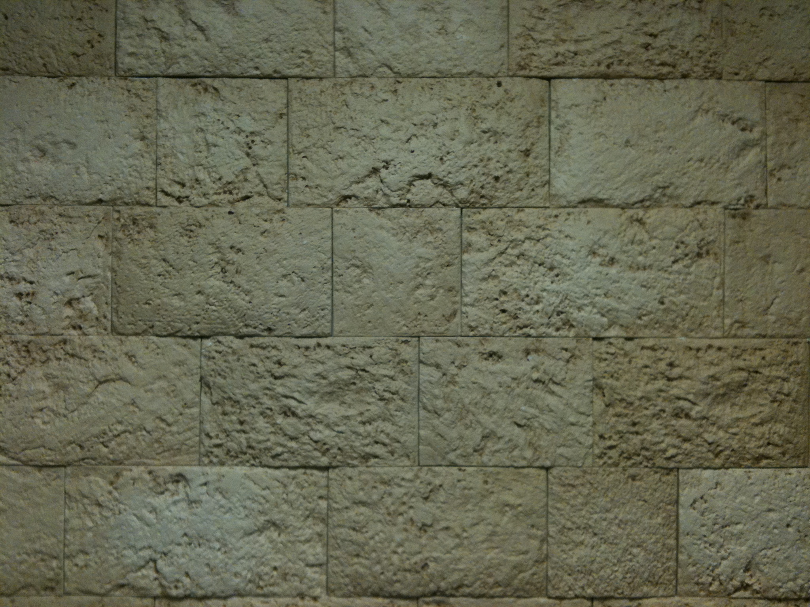
Revelation
Chapters 8 & 9

Slide 2
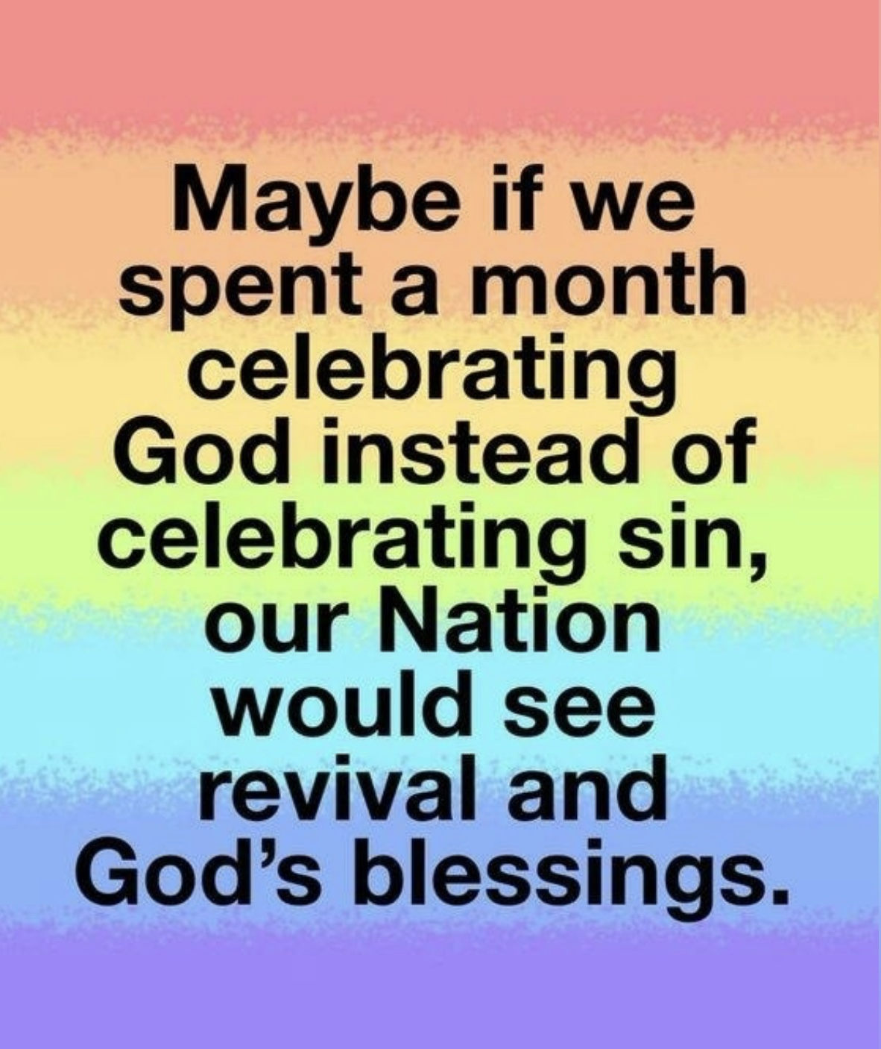

Slide 3
The Revelation Judgments
 | 1 | 2 | 3 | 4 | 5 | 6 |  | 7
Reference | Rev 6:1-2 | Rev 6:3-4 | Rev 6:5-6 | Rev 6:7-8 | Rev 6:9-11 | Rev 6:12-17 |  | Rev 8:1-6
Seal Judgments | White Horse Bow Crown (Stephanos) Overcomer THE CHURCH | Red Horse Takes Peace Cause to Kill One Another Great Sword WAR | Black Horse Balance (Yoke) Inflation on Needed Things Not Luxuries ECONOMIC | Pale Horse Death & Hades Power Over 1/4 Sword, Hunger, Death & Beasts FAMINE PESTILANCE | Martyred Souls Under Altar "How Long?" White Robes Wait for the Remnant | Earthquake Black Sun & Blood Moon Stars Fall Mts & Isles Move Men Hide from God's Coming Wrath |  | Silence in Heaven Angel w/ Censer Noises, Thunderings, Lightnings & Earthquake
 | 1 | 2 | 3 | 4 | 5 | 6 |  | 7
Reference | Rev 8:7 | Rev 8:8-9 | Rev 8:10-11 | Rev 8:12-13 | Rev 9:1-12 | Rev 9:13-21 |  | Rev 11:15-19
Trumpet Judgments | Heaven to Earth Hail & Fire Mingled w/ Blood Burn 1/3 of Trees Burn All Grass | Burning Mountain into Sea 1/3 of Sea Creatures Die Destroy 1/3 of Ships | Star Falls on 1/3 of Rivers & Springs Become Bitter Many Men Die | 1/3 of Sun, Moon Stars Dark Day & Night 1/3 Shorter "Woe, Woe, Woe" to Earth | Star from Heaven with Key to Pit Smoke & Darkness Locusts Harm Those w/out God's Mark 9 Months "Woe, Woe" | 4 Angels from Euphrates River Kill 1/3 of Mankind with Fire, Smoke & Brimstone Men Don't Repent 3rd "Woe" |  | Nations Become God's Noises, Thunderings, Lightnings & Earthquake Temple Opened
Seven Thunders Rev 10:3-4 Sealed Up !!!
 | 1 | 2 | 3 | 4 | 5 | 6 |  | 7
Reference | Rev 16:2 | Rev 16:3 | Rev 16:4-7 | Rev 16:8-9 | Rev 16:10-11 | Rev 16:12-16 | Rev 16:17-21
Bowl Judgments | Poured on Earth Sores on All Men with Mark of the Beast | Poured on Sea Becomes Blood Every Sea Creature Dies | Rivers & Springs Become Blood "True & Righteous are Your Judgments" | Sun Scorches All Men Do Not Repent | Darkness on Beast Kingdom Men Gnaw Tongues in Pain | Euphrates Dries Up 3 Unclean Spirits Gather Entire Earth to Battle at HarMegiddo | Poured on the Air "It is Done" Noises, Thunderings, Lightnings, Earthquake & Hail

Slide 4
Trumpet & Bowl Events
Consist of:
Form Function
What is it? What is its Purpose?
How Does it Work? Why is it There?

Slide 5
Trumpet & Bowl Events
Consist of:
Form Function
What is it? What is its Purpose?
How Does it Work? Why is it There?

Slide 6
The Revelation Judgments
 | 1 | 2 | 3 | 4 | 5 | 6 |  | 7
Reference | Rev 6:1-2 | Rev 6:3-4 | Rev 6:5-6 | Rev 6:7-8 | Rev 6:9-11 | Rev 6:12-17 |  | Rev 8:1-6
Seal Judgments | White Horse Bow Crown (Stephanos) Overcomer THE CHURCH | Red Horse Takes Peace Cause to Kill One Another Great Sword WAR | Black Horse Balance (Yoke) Inflation on Needed Things Not Luxuries ECONOMIC | Pale Horse Death & Hades Power Over 1/4 Sword, Hunger, Death & Beasts FAMINE PESTILANCE | Martyred Souls Under Altar "How Long?" White Robes Wait for the Remnant | Earthquake Black Sun & Blood Moon Stars Fall Mts & Isles Move Men Hide from God's Coming Wrath |  | Silence in Heaven Angel w/ Censer Noises, Thunderings, Lightnings & Earthquake
 | 1 | 2 | 3 | 4 | 5 | 6 |  | 7
Reference | Rev 8:7 | Rev 8:8-9 | Rev 8:10-11 | Rev 8:12-13 | Rev 9:1-12 | Rev 9:13-21 |  | Rev 11:15-19
Trumpet Judgments | Heaven to Earth Hail & Fire Mingled w/ Blood Burn 1/3 of Trees Burn All Grass | Burning Mountain into Sea 1/3 of Sea Creatures Die Destroy 1/3 of Ships | Star Falls on 1/3 of Rivers & Springs Become Bitter Many Men Die | 1/3 of Sun, Moon Stars Dark Day & Night 1/3 Shorter "Woe, Woe, Woe" to Earth | Star from Heaven with Key to Pit Smoke & Darkness Locusts Harm Those w/out God's Mark 9 Months "Woe, Woe" | 4 Angels from Euphrates River Kill 1/3 of Mankind with Fire, Smoke & Brimstone Men Don't Repent 3rd "Woe" |  | Nations Become God's Noises, Thunderings, Lightnings & Earthquake Temple Opened
Seven Thunders Rev 10:3-4 Sealed Up !!!
 | 1 | 2 | 3 | 4 | 5 | 6 |  | 7
Reference | Rev 16:2 | Rev 16:3 | Rev 16:4-7 | Rev 16:8-9 | Rev 16:10-11 | Rev 16:12-16 | Rev 16:17-21
Bowl Judgments | Poured on Earth Sores on All Men with Mark of the Beast | Poured on Sea Becomes Blood Every Sea Creature Dies | Rivers & Springs Become Blood "True & Righteous are Your Judgments" | Sun Scorches All Men Do Not Repent | Darkness on Beast Kingdom Men Gnaw Tongues in Pain | Euphrates Dries Up 3 Unclean Spirits Gather Entire Earth to Battle at HarMegiddo | Poured on the Air "It is Done" Noises, Thunderings, Lightnings, Earthquake & Hail

Slide 7
The Revelation Judgments
 | 1 | 2 | 3 | 4 | 5 | 6 |  | 7
Reference | Rev 6:1-2 | Rev 6:3-4 | Rev 6:5-6 | Rev 6:7-8 | Rev 6:9-11 | Rev 6:12-17 |  | Rev 8:1-6
Seal Judgments | White Horse Bow Crown (Stephanos) Overcomer THE CHURCH | Red Horse Takes Peace Cause to Kill One Another Great Sword WAR | Black Horse Balance (Yoke) Inflation on Needed Things Not Luxuries ECONOMIC | Pale Horse Death & Hades Power Over 1/4 Sword, Hunger, Death & Beasts FAMINE PESTILANCE | Martyred Souls Under Altar "How Long?" White Robes Wait for the Remnant | Earthquake Black Sun & Blood Moon Stars Fall Mts & Isles Move Men Hide from God's Coming Wrath |  | Silence in Heaven Angel w/ Censer Noises, Thunderings, Lightnings & Earthquake
 | 1 | 2 | 3 | 4 | 5 | 6 |  | 7
Reference | Rev 8:7 | Rev 8:8-9 | Rev 8:10-11 | Rev 8:12-13 | Rev 9:1-12 | Rev 9:13-21 |  | Rev 11:15-19
Trumpet Judgments | Heaven to Earth Hail & Fire Mingled w/ Blood Burn 1/3 of Trees Burn All Grass | Burning Mountain into Sea 1/3 of Sea Creatures Die Destroy 1/3 of Ships | Star Falls on 1/3 of Rivers & Springs Become Bitter Many Men Die | 1/3 of Sun, Moon Stars Dark Day & Night 1/3 Shorter "Woe, Woe, Woe" to Earth | Star from Heaven with Key to Pit Smoke & Darkness Locusts Harm Those w/out God's Mark 9 Months "Woe, Woe" | 4 Angels from Euphrates River Kill 1/3 of Mankind with Fire, Smoke & Brimstone Men Don't Repent 3rd "Woe" |  | Nations Become God's Noises, Thunderings, Lightnings & Earthquake Temple Opened
Seven Thunders Rev 10:3-4 Sealed Up !!!
 | 1 | 2 | 3 | 4 | 5 | 6 |  | 7
Reference | Rev 16:2 | Rev 16:3 | Rev 16:4-7 | Rev 16:8-9 | Rev 16:10-11 | Rev 16:12-16 | Rev 16:17-21
Bowl Judgments | Poured on Earth Sores on All Men with Mark of the Beast | Poured on Sea Becomes Blood Every Sea Creature Dies | Rivers & Springs Become Blood "True & Righteous are Your Judgments" | Sun Scorches All Men Do Not Repent | Darkness on Beast Kingdom Men Gnaw Tongues in Pain | Euphrates Dries Up 3 Unclean Spirits Gather Entire Earth to Battle at HarMegiddo | Poured on the Air "It is Done" Noises, Thunderings, Lightnings, Earthquake & Hail

Slide 8
The Revelation Judgments
 | 1 | 2 | 3 | 4 | 5 | 6 |  | 7
Reference | Rev 6:1-2 | Rev 6:3-4 | Rev 6:5-6 | Rev 6:7-8 | Rev 6:9-11 | Rev 6:12-17 |  | Rev 8:1-6
Seal Judgments | White Horse Bow Crown (Stephanos) Overcomer THE CHURCH | Red Horse Takes Peace Cause to Kill One Another Great Sword WAR | Black Horse Balance (Yoke) Inflation on Needed Things Not Luxuries ECONOMIC | Pale Horse Death & Hades Power Over 1/4 Sword, Hunger, Death & Beasts FAMINE PESTILANCE | Martyred Souls Under Altar "How Long?" White Robes Wait for the Remnant | Earthquake Black Sun & Blood Moon Stars Fall Mts & Isles Move Men Hide from God's Coming Wrath |  | Silence in Heaven Angel w/ Censer Noises, Thunderings, Lightnings & Earthquake
 | 1 | 2 | 3 | 4 | 5 | 6 |  | 7
Reference | Rev 8:7 | Rev 8:8-9 | Rev 8:10-11 | Rev 8:12-13 | Rev 9:1-12 | Rev 9:13-21 |  | Rev 11:15-19
Trumpet Judgments | Heaven to Earth Hail & Fire Mingled w/ Blood Burn 1/3 of Trees Burn All Grass | Burning Mountain into Sea 1/3 of Sea Creatures Die Destroy 1/3 of Ships | Star Falls on 1/3 of Rivers & Springs Become Bitter Many Men Die | 1/3 of Sun, Moon Stars Dark Day & Night 1/3 Shorter "Woe, Woe, Woe" to Earth | Star from Heaven with Key to Pit Smoke & Darkness Locusts Harm Those w/out God's Mark 9 Months "Woe, Woe" | 4 Angels from Euphrates River Kill 1/3 of Mankind with Fire, Smoke & Brimstone Men Don't Repent 3rd "Woe" |  | Nations Become God's Noises, Thunderings, Lightnings & Earthquake Temple Opened
Seven Thunders Rev 10:3-4 Sealed Up !!!
 | 1 | 2 | 3 | 4 | 5 | 6 |  | 7
Reference | Rev 16:2 | Rev 16:3 | Rev 16:4-7 | Rev 16:8-9 | Rev 16:10-11 | Rev 16:12-16 | Rev 16:17-21
Bowl Judgments | Poured on Earth Sores on All Men with Mark of the Beast | Poured on Sea Becomes Blood Every Sea Creature Dies | Rivers & Springs Become Blood "True & Righteous are Your Judgments" | Sun Scorches All Men Do Not Repent | Darkness on Beast Kingdom Men Gnaw Tongues in Pain | Euphrates Dries Up 3 Unclean Spirits Gather Entire Earth to Battle at HarMegiddo | Poured on the Air "It is Done" Noises, Thunderings, Lightnings, Earthquake & Hail

Slide 9
The Revelation Judgments
 | 1 | 2 | 3 | 4 | 5 | 6 |  | 7
Reference | Rev 6:1-2 | Rev 6:3-4 | Rev 6:5-6 | Rev 6:7-8 | Rev 6:9-11 | Rev 6:12-17 |  | Rev 8:1-6
Seal Judgments | White Horse Bow Crown (Stephanos) Overcomer THE CHURCH | Red Horse Takes Peace Cause to Kill One Another Great Sword WAR | Black Horse Balance (Yoke) Inflation on Needed Things Not Luxuries ECONOMIC | Pale Horse Death & Hades Power Over 1/4 Sword, Hunger, Death & Beasts FAMINE PESTILANCE | Martyred Souls Under Altar "How Long?" White Robes Wait for the Remnant | Earthquake Black Sun & Blood Moon Stars Fall Mts & Isles Move Men Hide from God's Coming Wrath |  | Silence in Heaven Angel w/ Censer Noises, Thunderings, Lightnings & Earthquake
 | 1 | 2 | 3 | 4 | 5 | 6 |  | 7
Reference | Rev 8:7 | Rev 8:8-9 | Rev 8:10-11 | Rev 8:12-13 | Rev 9:1-12 | Rev 9:13-21 |  | Rev 11:15-19
Trumpet Judgments | Heaven to Earth Hail & Fire Mingled w/ Blood Burn 1/3 of Trees Burn All Grass | Burning Mountain into Sea 1/3 of Sea Creatures Die Destroy 1/3 of Ships | Star Falls on 1/3 of Rivers & Springs Become Bitter Many Men Die | 1/3 of Sun, Moon Stars Dark Day & Night 1/3 Shorter "Woe, Woe, Woe" to Earth | Star from Heaven with Key to Pit Smoke & Darkness Locusts Harm Those w/out God's Mark 9 Months "Woe, Woe" | 4 Angels from Euphrates River Kill 1/3 of Mankind with Fire, Smoke & Brimstone Men Don't Repent 3rd "Woe" |  | Nations Become God's Noises, Thunderings, Lightnings & Earthquake Temple Opened
Seven Thunders Rev 10:3-4 Sealed Up !!!
 | 1 | 2 | 3 | 4 | 5 | 6 |  | 7
Reference | Rev 16:2 | Rev 16:3 | Rev 16:4-7 | Rev 16:8-9 | Rev 16:10-11 | Rev 16:12-16 | Rev 16:17-21
Bowl Judgments | Poured on Earth Sores on All Men with Mark of the Beast | Poured on Sea Becomes Blood Every Sea Creature Dies | Rivers & Springs Become Blood "True & Righteous are Your Judgments" | Sun Scorches All Men Do Not Repent | Darkness on Beast Kingdom Men Gnaw Tongues in Pain | Euphrates Dries Up 3 Unclean Spirits Gather Entire Earth to Battle at HarMegiddo | Poured on the Air "It is Done" Noises, Thunderings, Lightnings, Earthquake & Hail

Slide 10
The Revelation Judgments
 | 1 | 2 | 3 | 4 | 5 | 6 |  | 7
Reference | Rev 6:1-2 | Rev 6:3-4 | Rev 6:5-6 | Rev 6:7-8 | Rev 6:9-11 | Rev 6:12-17 |  | Rev 8:1-6
Seal Judgments | White Horse Bow Crown (Stephanos) Overcomer THE CHURCH | Red Horse Takes Peace Cause to Kill One Another Great Sword WAR | Black Horse Balance (Yoke) Inflation on Needed Things Not Luxuries ECONOMIC | Pale Horse Death & Hades Power Over 1/4 Sword, Hunger, Death & Beasts FAMINE PESTILANCE | Martyred Souls Under Altar "How Long?" White Robes Wait for the Remnant | Earthquake Black Sun & Blood Moon Stars Fall Mts & Isles Move Men Hide from God's Coming Wrath |  | Silence in Heaven Angel w/ Censer Noises, Thunderings, Lightnings & Earthquake
 | 1 | 2 | 3 | 4 | 5 | 6 |  | 7
Reference | Rev 8:7 | Rev 8:8-9 | Rev 8:10-11 | Rev 8:12-13 | Rev 9:1-12 | Rev 9:13-21 |  | Rev 11:15-19
Trumpet Judgments | Heaven to Earth Hail & Fire Mingled w/ Blood Burn 1/3 of Trees Burn All Grass | Burning Mountain into Sea 1/3 of Sea Creatures Die Destroy 1/3 of Ships | Star Falls on 1/3 of Rivers & Springs Become Bitter Many Men Die | 1/3 of Sun, Moon Stars Dark Day & Night 1/3 Shorter "Woe, Woe, Woe" to Earth | Star from Heaven with Key to Pit Smoke & Darkness Locusts Harm Those w/out God's Mark 9 Months "Woe, Woe" | 4 Angels from Euphrates River Kill 1/3 of Mankind with Fire, Smoke & Brimstone Men Don't Repent 3rd "Woe" |  | Nations Become God's Noises, Thunderings, Lightnings & Earthquake Temple Opened
Seven Thunders Rev 10:3-4 Sealed Up !!!
 | 1 | 2 | 3 | 4 | 5 | 6 |  | 7
Reference | Rev 16:2 | Rev 16:3 | Rev 16:4-7 | Rev 16:8-9 | Rev 16:10-11 | Rev 16:12-16 | Rev 16:17-21
Bowl Judgments | Poured on Earth Sores on All Men with Mark of the Beast | Poured on Sea Becomes Blood Every Sea Creature Dies | Rivers & Springs Become Blood "True & Righteous are Your Judgments" | Sun Scorches All Men Do Not Repent | Darkness on Beast Kingdom Men Gnaw Tongues in Pain | Euphrates Dries Up 3 Unclean Spirits Gather Entire Earth to Battle at HarMegiddo | Poured on the Air "It is Done" Noises, Thunderings, Lightnings, Earthquake & Hail

Slide 11
The Revelation Judgments
 | 1 | 2 | 3 | 4 | 5 | 6 |  | 7
Reference | Rev 6:1-2 | Rev 6:3-4 | Rev 6:5-6 | Rev 6:7-8 | Rev 6:9-11 | Rev 6:12-17 |  | Rev 8:1-6
Seal Judgments | White Horse Bow Crown (Stephanos) Overcomer THE CHURCH | Red Horse Takes Peace Cause to Kill One Another Great Sword WAR | Black Horse Balance (Yoke) Inflation on Needed Things Not Luxuries ECONOMIC | Pale Horse Death & Hades Power Over 1/4 Sword, Hunger, Death & Beasts FAMINE PESTILANCE | Martyred Souls Under Altar "How Long?" White Robes Wait for the Remnant | Earthquake Black Sun & Blood Moon Stars Fall Mts & Isles Move Men Hide from God's Coming Wrath |  | Silence in Heaven Angel w/ Censer Noises, Thunderings, Lightnings & Earthquake
 | 1 | 2 | 3 | 4 | 5 | 6 |  | 7
Reference | Rev 8:7 | Rev 8:8-9 | Rev 8:10-11 | Rev 8:12-13 | Rev 9:1-12 | Rev 9:13-21 |  | Rev 11:15-19
Trumpet Judgments | Heaven to Earth Hail & Fire Mingled w/ Blood Burn 1/3 of Trees Burn All Grass | Burning Mountain into Sea 1/3 of Sea Creatures Die Destroy 1/3 of Ships | Star Falls on 1/3 of Rivers & Springs Become Bitter Many Men Die | 1/3 of Sun, Moon Stars Dark Day & Night 1/3 Shorter "Woe, Woe, Woe" to Earth | Star from Heaven with Key to Pit Smoke & Darkness Locusts Harm Those w/out God's Mark 5 Months "Woe, Woe" | 4 Angels from Euphrates River Kill 1/3 of Mankind with Fire, Smoke & Brimstone Men Don't Repent 3rd "Woe" |  | Nations Become God's Noises, Thunderings, Lightnings & Earthquake Temple Opened
Seven Thunders Rev 10:3-4 Sealed Up !!!
 | 1 | 2 | 3 | 4 | 5 | 6 |  | 7
Reference | Rev 16:2 | Rev 16:3 | Rev 16:4-7 | Rev 16:8-9 | Rev 16:10-11 | Rev 16:12-16 | Rev 16:17-21
Bowl Judgments | Poured on Earth Sores on All Men with Mark of the Beast | Poured on Sea Becomes Blood Every Sea Creature Dies | Rivers & Springs Become Blood "True & Righteous are Your Judgments" | Sun Scorches All Men Do Not Repent | Darkness on Beast Kingdom Men Gnaw Tongues in Pain | Euphrates Dries Up 3 Unclean Spirits Gather Entire Earth to Battle at HarMegiddo | Poured on the Air "It is Done" Noises, Thunderings, Lightnings, Earthquake & Hail

Slide 12
The Revelation Judgments
 | 1 | 2 | 3 | 4 | 5 | 6 |  | 7
Reference | Rev 6:1-2 | Rev 6:3-4 | Rev 6:5-6 | Rev 6:7-8 | Rev 6:9-11 | Rev 6:12-17 |  | Rev 8:1-6
Seal Judgments | White Horse Bow Crown (Stephanos) Overcomer THE CHURCH | Red Horse Takes Peace Cause to Kill One Another Great Sword WAR | Black Horse Balance (Yoke) Inflation on Needed Things Not Luxuries ECONOMIC | Pale Horse Death & Hades Power Over 1/4 Sword, Hunger, Death & Beasts FAMINE PESTILANCE | Martyred Souls Under Altar "How Long?" White Robes Wait for the Remnant | Earthquake Black Sun & Blood Moon Stars Fall Mts & Isles Move Men Hide from God's Coming Wrath |  | Silence in Heaven Angel w/ Censer Noises, Thunderings, Lightnings & Earthquake
 | 1 | 2 | 3 | 4 | 5 | 6 |  | 7
Reference | Rev 8:7 | Rev 8:8-9 | Rev 8:10-11 | Rev 8:12-13 | Rev 9:1-12 | Rev 9:13-21 |  | Rev 11:15-19
Trumpet Judgments | Heaven to Earth Hail & Fire Mingled w/ Blood Burn 1/3 of Trees Burn All Grass | Burning Mountain into Sea 1/3 of Sea Creatures Die Destroy 1/3 of Ships | Star Falls on 1/3 of Rivers & Springs Become Bitter Many Men Die | 1/3 of Sun, Moon Stars Dark Day & Night 1/3 Shorter "Woe, Woe, Woe" to Earth | Star from Heaven with Key to Pit Smoke & Darkness Locusts Harm Those w/out God's Mark 5 Months "Woe, Woe" | 4 Angels from Euphrates River Kill 1/3 of Mankind with Fire, Smoke & Brimstone Men Don't Repent 3rd "Woe" |  | Nations Become God's Noises, Thunderings, Lightnings & Earthquake Temple Opened
Seven Thunders Rev 10:3-4 Sealed Up !!!
 | 1 | 2 | 3 | 4 | 5 | 6 |  | 7
Reference | Rev 16:2 | Rev 16:3 | Rev 16:4-7 | Rev 16:8-9 | Rev 16:10-11 | Rev 16:12-16 | Rev 16:17-21
Bowl Judgments | Poured on Earth Sores on All Men with Mark of the Beast | Poured on Sea Becomes Blood Every Sea Creature Dies | Rivers & Springs Become Blood "True & Righteous are Your Judgments" | Sun Scorches All Men Do Not Repent | Darkness on Beast Kingdom Men Gnaw Tongues in Pain | Euphrates Dries Up 3 Unclean Spirits Gather Entire Earth to Battle at HarMegiddo | Poured on the Air "It is Done" Noises, Thunderings, Lightnings, Earthquake & Hail

Slide 13
The Revelation Judgments
 | 1 | 2 | 3 | 4 | 5 | 6 |  | 7
Reference | Rev 6:1-2 | Rev 6:3-4 | Rev 6:5-6 | Rev 6:7-8 | Rev 6:9-11 | Rev 6:12-17 |  | Rev 8:1-6
Seal Judgments | White Horse Bow Crown (Stephanos) Overcomer THE CHURCH | Red Horse Takes Peace Cause to Kill One Another Great Sword WAR | Black Horse Balance (Yoke) Inflation on Needed Things Not Luxuries ECONOMIC | Pale Horse Death & Hades Power Over 1/4 Sword, Hunger, Death & Beasts FAMINE PESTILANCE | Martyred Souls Under Altar "How Long?" White Robes Wait for the Remnant | Earthquake Black Sun & Blood Moon Stars Fall Mts & Isles Move Men Hide from God's Coming Wrath |  | Silence in Heaven Angel w/ Censer Noises, Thunderings, Lightnings & Earthquake
 | 1 | 2 | 3 | 4 | 5 | 6 |  | 7
Reference | Rev 8:7 | Rev 8:8-9 | Rev 8:10-11 | Rev 8:12-13 | Rev 9:1-12 | Rev 9:13-21 |  | Rev 11:15-19
Trumpet Judgments | Heaven to Earth Hail & Fire Mingled w/ Blood Burn 1/3 of Trees Burn All Grass | Burning Mountain into Sea 1/3 of Sea Creatures Die Destroy 1/3 of Ships | Star Falls on 1/3 of Rivers & Springs Become Bitter Many Men Die | 1/3 of Sun, Moon Stars Dark Day & Night 1/3 Shorter "Woe, Woe, Woe" to Earth | Star from Heaven with Key to Pit Smoke & Darkness Locusts Harm Those w/out God's Mark 5 Months "Woe, Woe" | 4 Angels from Euphrates River Kill 1/3 of Mankind with Fire, Smoke & Brimstone Men Don't Repent 3rd "Woe" |  | Nations Become God's Noises, Thunderings, Lightnings & Earthquake Temple Opened
Seven Thunders Rev 10:3-4 Sealed Up !!!
 | 1 | 2 | 3 | 4 | 5 | 6 |  | 7
Reference | Rev 16:2 | Rev 16:3 | Rev 16:4-7 | Rev 16:8-9 | Rev 16:10-11 | Rev 16:12-16 | Rev 16:17-21
Bowl Judgments | Poured on Earth Sores on All Men with Mark of the Beast | Poured on Sea Becomes Blood Every Sea Creature Dies | Rivers & Springs Become Blood "True & Righteous are Your Judgments" | Sun Scorches All Men Do Not Repent | Darkness on Beast Kingdom Men Gnaw Tongues in Pain | Euphrates Dries Up 3 Unclean Spirits Gather Entire Earth to Battle at HarMegiddo | Poured on the Air "It is Done" Noises, Thunderings, Lightnings, Earthquake & Hail

Slide 14
Our Upcoming Test of Adultery
The Woman (Wife) on the Beast Rev 17:3-6
“Let Loose” Judgments Rev 8:1-6
Grain Offering Rev 8:7
Curses into Water Rev 8:10
Water Becomes Bitter Rev 8:11
Drink Bitter Water Rev 14:8
Belly Swells & Thigh Rots
Scorpion Stings Rev 9:10

