Slide 1
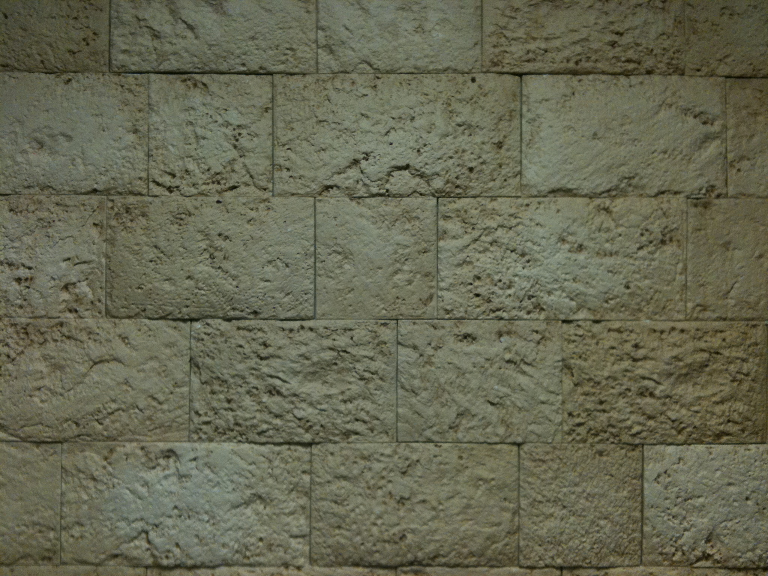
Revelation
Chapters 8 & 9

Slide 3
The Revelation Judgments
 | 1 | 2 | 3 | 4 | 5 | 6 |  | 7
Reference | Rev 6:1-2 | Rev 6:3-4 | Rev 6:5-6 | Rev 6:7-8 | Rev 6:9-11 | Rev 6:12-17 |  | Rev 8:1-6
Seal Judgments | White Horse Bow Crown (Stephanos) Overcomer THE CHURCH | Red Horse Takes Peace Cause to Kill One Another Great Sword WAR | Black Horse Balance (Yoke) Inflation on Needed Things Not Luxuries ECONOMIC | Pale Horse Death & Hades Power Over 1/4 Sword, Hunger, Death & Beasts FAMINE / PESTILANCE | Martyred Souls Under Altar "How Long?" White Robes Wait for the Remnant | Earthquake Black Sun & Blood Moon Stars Fall Mts & Isles Move Rich Men Hide from God’s Coming Wrath |  | Silence in Heaven Angel w/ Censer Noises, Thunderings, Lightnings & Earthquake
Reference | Rev 8:7 | Rev 8:8-9 | Rev 8:10-11 | Rev 8:12-13 | Rev 9:1-12 | Rev 9:13-21 |  | Rev 11:15-19
Trumpet Judgments | Hail & Fire from Heaven Mingled w/ Blood Burn 1/3 of Trees Burn All Grass | Burning Mountain into Sea 1/3 of Sea Creatures Die Destroy 1/3 of Ships | Star Falls on 1/3 of Rivers & Springs Become Bitter Many Men Die | 1/3 of Sun, Moon Stars Dark Day & Night 1/3 Shorter "Woe, Woe, Woe“ to Earth | Star from Heaven with Key to Pit Smoke & Locusts Harm Those Without God's Mark "Woe, Woe" | 4 Angels from Euphrates River Kill 1/3 of Mankind with Fire, Smoke & Brimstone Men Don't Repent 3rd "Woe" |  | Nations to God Elders Worship Noises, Thunderings, Lightnings & Earthquake Temple Opened
Seven Thunders Rev 10:3-4 Sealed Up !!!
Reference | Rev 16:2 | Rev 16:3 | Rev 16:4-7 | Rev 16:8-9 | Rev 16:10-11 | Rev 16:12-16 | Rev 16:17-21
Bowl Judgments | Sores on All Men with Mark of the Beast | Sea Becomes Blood Every Sea Creature Dies | Rivers & Springs Become Blood "True & Righteous are Your Judgments" | Sun Scorches All Men Do Not Repent | Darkness on Beast Kingdom Men Gnaw Tongues in Pain | Euphrates Dries Up 3 Unclean Spirits Gather Entire Earth to Battle at HarMegiddo | Poured on the Air "It is Done" Noises, Thunderings, Lightnings, Earthquake & Hail

Slide 4
The Revelation Judgments
 | 1 | 2 | 3 | 4 | 5 | 6 |  | 7
Reference | Rev 6:1-2 | Rev 6:3-4 | Rev 6:5-6 | Rev 6:7-8 | Rev 6:9-11 | Rev 6:12-17 |  | Rev 8:1-6
Seal Judgments | White Horse Bow Crown (Stephanos) Overcomer THE CHURCH | Red Horse Takes Peace Cause to Kill One Another Great Sword WAR | Black Horse Balance (Yoke) Inflation on Needed Things Not Luxuries ECONOMIC | Pale Horse Death & Hades Power Over 1/4 Sword, Hunger, Death & Beasts FAMINE / PESTILANCE | Martyred Souls Under Altar "How Long?" White Robes Wait for the Remnant | Earthquake Black Sun & Blood Moon Stars Fall Mts & Isles Move Rich Men Hide from God’s Coming Wrath |  | Silence in Heaven Angel w/ Censer Noises, Thunderings, Lightnings & Earthquake
Reference | Rev 8:7 | Rev 8:8-9 | Rev 8:10-11 | Rev 8:12-13 | Rev 9:1-12 | Rev 9:13-21 |  | Rev 11:15-19
Trumpet Judgments | Hail & Fire from Heaven Mingled w/ Blood Burn 1/3 of Trees Burn All Grass | Burning Mountain into Sea 1/3 of Sea Creatures Die Destroy 1/3 of Ships | Star Falls on 1/3 of Rivers & Springs Become Bitter Many Men Die | 1/3 of Sun, Moon Stars Dark Day & Night 1/3 Shorter "Woe, Woe, Woe“ to Earth | Star from Heaven with Key to Pit Smoke & Locusts Harm Those Without God's Mark "Woe, Woe" | 4 Angels from Euphrates River Kill 1/3 of Mankind with Fire, Smoke & Brimstone Men Don't Repent 3rd "Woe" |  | Nations to God Elders Worship Noises, Thunderings, Lightnings & Earthquake Temple Opened
Seven Thunders Rev 10:3-4 Sealed Up !!!
Reference | Rev 16:2 | Rev 16:3 | Rev 16:4-7 | Rev 16:8-9 | Rev 16:10-11 | Rev 16:12-16 | Rev 16:17-21
Bowl Judgments | Sores on All Men with Mark of the Beast | Sea Becomes Blood Every Sea Creature Dies | Rivers & Springs Become Blood "True & Righteous are Your Judgments" | Sun Scorches All Men Do Not Repent | Darkness on Beast Kingdom Men Gnaw Tongues in Pain | Euphrates Dries Up 3 Unclean Spirits Gather Entire Earth to Battle at HarMegiddo | Poured on the Air "It is Done" Noises, Thunderings, Lightnings, Earthquake & Hail
“Fall on us and hide us from the face of Him who sits on the throne and from the wrath of the Lamb! For the great day of His wrath has come, and who is able to stand?” Rev 6:16-17

Slide 5
Revelation 7:
vv 1-8: Sealing of the 144,000
vv 9-17: Multitude Couldn’t Be Numbered
Nations ethnos Ethnic Group
Tribes phlye Clan
Peoples laos Of Same Stock & Customs
Tongues glossa Unique Language

Slide 6
Sealed with The Spirit
“Now He who establishes us with you in Messiah and has anointed us is God, who also has sealed us and given us the Spirit in our hearts as a guarantee.” II Corinth 1:21-22
“In Him you also trusted, after you heard the word of truth, the gospel of your salvation; in whom also, having believed, you were sealed with the Holy Spirit of promise, who is the guarantee of our inheritance until the redemption of the purchased possession, to the praise of His glory.” Ephesians 1:13-14
“And do not grieve the Holy Spirit of God, by whom you were sealed for the day of redemption.” Ephesians 4:30

Slide 7
Sealed with the Mark of God
“Therefore the children of Israel shall keep the Sabbath, to observe the Sabbath throughout their generations as a perpetual covenant. It is a sign between Me and the children of Israel forever; for in six days the Lord made the heavens and the earth, and on the seventh day He rested and was refreshed.” Exodus 31:16-17
“And Moses said to the people: “Remember this day in which you went out of Egypt … It shall be as a sign to you … Unleavened bread shall be eaten seven days … for with a strong hand the Lord has brought you out of Egypt.” Exodus 13:3, 8-10

Slide 8
Sealed with the Mark of God
“And these words which I command you today shall be in your heart. You shall teach them diligently to your children, and shall talk of them when you sit in your house, when you walk by the way, when you lie down, and when you rise up. You shall bind them as a sign on your hand, and they shall be as frontlets between your eyes. You shall write them on the doorposts of your house and on your gates. Deuteronomy 6:6-9

Slide 9
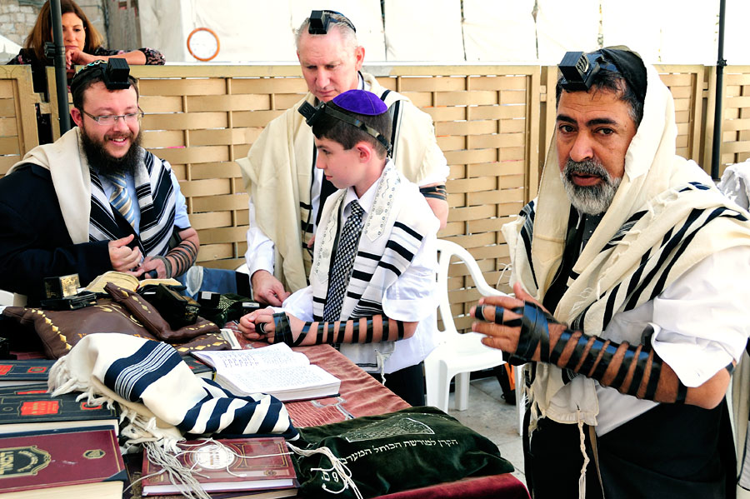

Slide 10
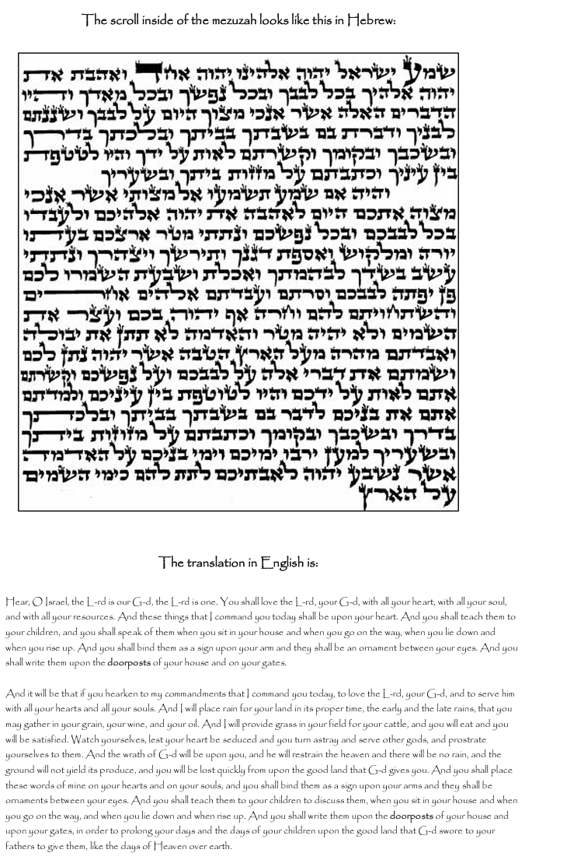

Slide 11
Deuteronomy 6:4-9
Deuteronomy 11:13-21

Slide 12
Sealed with the Mark of God
“And these words which I command you today shall be in your heart. You shall teach them diligently to your children, and shall talk of them when you sit in your house, when you walk by the way, when you lie down, and when you rise up. You shall bind them as a sign on your hand, and they shall be as frontlets between your eyes. You shall write them on the doorposts of your house and on your gates. Deuteronomy 6:6-9
Keep Shabbat
Keep the Feasts of the LORD
Keep God’s Commandments

Slide 13
The Revelation Judgments
 | 1 | 2 | 3 | 4 | 5 | 6 |  | 7
Reference | Rev 6:1-2 | Rev 6:3-4 | Rev 6:5-6 | Rev 6:7-8 | Rev 6:9-11 | Rev 6:12-17 |  | Rev 8:1-6
Seal Judgments | White Horse Bow Crown (Stephanos) Overcomer THE CHURCH | Red Horse Takes Peace Cause to Kill One Another Great Sword WAR | Black Horse Balance (Yoke) Inflation on Needed Things Not Luxuries ECONOMIC | Pale Horse Death & Hades Power Over 1/4 Sword, Hunger, Death & Beasts FAMINE / PESTILANCE | Martyred Souls Under Altar "How Long?" White Robes Wait for the Remnant | Earthquake Black Sun & Blood Moon Stars Fall Mts & Isles Move Rich Men Hide from God’s Coming Wrath |  | Silence in Heaven Angel w/ Censer Noises, Thunderings, Lightnings & Earthquake
Reference | Rev 8:7 | Rev 8:8-9 | Rev 8:10-11 | Rev 8:12-13 | Rev 9:1-12 | Rev 9:13-21 |  | Rev 11:15-19
Trumpet Judgments | Hail & Fire from Heaven Mingled w/ Blood Burn 1/3 of Trees Burn All Grass | Burning Mountain into Sea 1/3 of Sea Creatures Die Destroy 1/3 of Ships | Star Falls on 1/3 of Rivers & Springs Become Bitter Many Men Die | 1/3 of Sun, Moon Stars Dark Day & Night 1/3 Shorter "Woe, Woe, Woe“ to Earth | Star from Heaven with Key to Pit Smoke & Locusts Harm Those Without God's Mark "Woe, Woe" | 4 Angels from Euphrates River Kill 1/3 of Mankind with Fire, Smoke & Brimstone Men Don't Repent 3rd "Woe" |  | Nations to God Elders Worship Noises, Thunderings, Lightnings & Earthquake Temple Opened
Seven Thunders Rev 10:3-4 Sealed Up !!!
Reference | Rev 16:2 | Rev 16:3 | Rev 16:4-7 | Rev 16:8-9 | Rev 16:10-11 | Rev 16:12-16 | Rev 16:17-21
Bowl Judgments | Sores on All Men with Mark of the Beast | Sea Becomes Blood Every Sea Creature Dies | Rivers & Springs Become Blood "True & Righteous are Your Judgments" | Sun Scorches All Men Do Not Repent | Darkness on Beast Kingdom Men Gnaw Tongues in Pain | Euphrates Dries Up 3 Unclean Spirits Gather Entire Earth to Battle at HarMegiddo | Poured on the Air "It is Done" Noises, Thunderings, Lightnings, Earthquake & Hail

Slide 14
The Revelation Judgments
 | 1 | 2 | 3 | 4 | 5 | 6 |  | 7
Reference | Rev 6:1-2 | Rev 6:3-4 | Rev 6:5-6 | Rev 6:7-8 | Rev 6:9-11 | Rev 6:12-17 |  | Rev 8:1-6
Seal Judgments | White Horse Bow Crown (Stephanos) Overcomer THE CHURCH | Red Horse Takes Peace Cause to Kill One Another Great Sword WAR | Black Horse Balance (Yoke) Inflation on Needed Things Not Luxuries ECONOMIC | Pale Horse Death & Hades Power Over 1/4 Sword, Hunger, Death & Beasts FAMINE / PESTILANCE | Martyred Souls Under Altar "How Long?" White Robes Wait for the Remnant | Earthquake Black Sun & Blood Moon Stars Fall Mts & Isles Move Rich Men Hide from God’s Coming Wrath |  | Silence in Heaven Angel w/ Censer Noises, Thunderings, Lightnings & Earthquake
Reference | Rev 8:7 | Rev 8:8-9 | Rev 8:10-11 | Rev 8:12-13 | Rev 9:1-12 | Rev 9:13-21 |  | Rev 11:15-19
Trumpet Judgments | Hail & Fire from Heaven Mingled w/ Blood Burn 1/3 of Trees Burn All Grass | Burning Mountain into Sea 1/3 of Sea Creatures Die Destroy 1/3 of Ships | Star Falls on 1/3 of Rivers & Springs Become Bitter Many Men Die | 1/3 of Sun, Moon Stars Dark Day & Night 1/3 Shorter "Woe, Woe, Woe“ to Earth | Star from Heaven with Key to Pit Smoke & Locusts Harm Those Without God's Mark "Woe, Woe" | 4 Angels from Euphrates River Kill 1/3 of Mankind with Fire, Smoke & Brimstone Men Don't Repent 3rd "Woe" |  | Nations to God Elders Worship Noises, Thunderings, Lightnings & Earthquake Temple Opened
Seven Thunders Rev 10:3-4 Sealed Up !!!
Reference | Rev 16:2 | Rev 16:3 | Rev 16:4-7 | Rev 16:8-9 | Rev 16:10-11 | Rev 16:12-16 | Rev 16:17-21
Bowl Judgments | Sores on All Men with Mark of the Beast | Sea Becomes Blood Every Sea Creature Dies | Rivers & Springs Become Blood "True & Righteous are Your Judgments" | Sun Scorches All Men Do Not Repent | Darkness on Beast Kingdom Men Gnaw Tongues in Pain | Euphrates Dries Up 3 Unclean Spirits Gather Entire Earth to Battle at HarMegiddo | Poured on the Air "It is Done" Noises, Thunderings, Lightnings, Earthquake & Hail

Slide 15
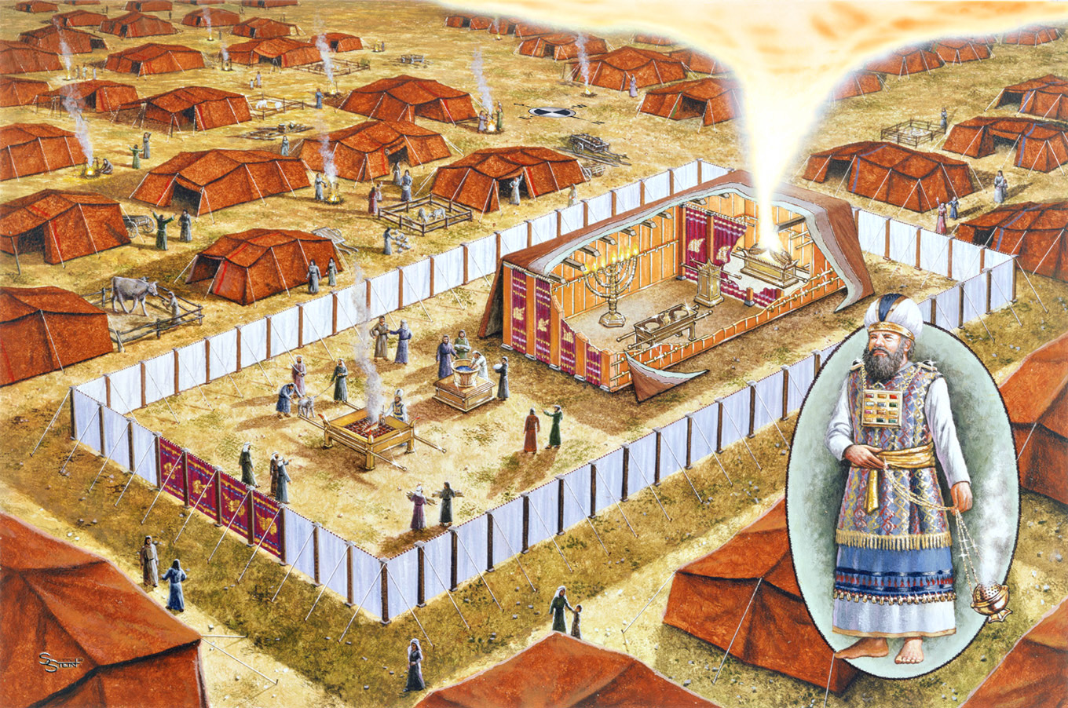
Incense Altar

Slide 16
The Ordeal of Jealousy Numbers 5
Husband Brings Jealousy (Grain) Offering
Priest Mixes Dust from the Ground with Living Water (Makes Bitter)
Priest Lets Her Hair Down
Priest Gives Her the Jealousy Offering
Priest Puts the Woman Under an Oath
Priest Writes her ( Alleged) Sins on a Scroll
….and Scrapes the Words into the “Bitter Water”
The Woman Drinks the “Bitter Water”
If She is Guilty, Her “Belly Swells & Her Thigh Rots”
If Not: Woman is Free to Conceive Children

Slide 17
The Ordeal of Jealousy Numbers 5
Husband Brings Jealousy (Grain) Offering
Priest Mixes Dust from the Ground with Living Water (Makes Bitter)
Priest Lets Her Hair Down
Priest Gives Her the Jealousy Offering
Priest Puts the Woman Under an Oath
Priest Writes her ( Alleged) Sins on a Scroll
….and Scrapes the Words into the “Bitter Water”
The Woman Drinks the “Bitter Water”
If She is Guilty, Her “Belly Swells & Her Thigh Rots”
If Not: Woman is Free to Conceive Children

Slide 18
The Ordeal of Jealousy Numbers 5
Applications:
Moses at the Golden Calf Exodus 32
Joseph & Mary Matthew 1
Yeshua & the Adulterous Woman John 8
The Woman Rides the Beast Revelation 17
Clarification (Correction):
“Nailed to the Cross” Colossians 2:14

Slide 19
The Revelation Judgments
 | 1 | 2 | 3 | 4 | 5 | 6 |  | 7
Reference | Rev 6:1-2 | Rev 6:3-4 | Rev 6:5-6 | Rev 6:7-8 | Rev 6:9-11 | Rev 6:12-17 |  | Rev 8:1-6
Seal Judgments | White Horse Bow Crown (Stephanos) Overcomer THE CHURCH | Red Horse Takes Peace Cause to Kill One Another Great Sword WAR | Black Horse Balance (Yoke) Inflation on Needed Things Not Luxuries ECONOMIC | Pale Horse Death & Hades Power Over 1/4 Sword, Hunger, Death & Beasts FAMINE / PESTILANCE | Martyred Souls Under Altar "How Long?" White Robes Wait for the Remnant | Earthquake Black Sun & Blood Moon Stars Fall Mts & Isles Move Rich Men Hide from God’s Coming Wrath |  | Silence in Heaven Angel w/ Censer Noises, Thunderings, Lightnings & Earthquake
Reference | Rev 8:7 | Rev 8:8-9 | Rev 8:10-11 | Rev 8:12-13 | Rev 9:1-12 | Rev 9:13-21 |  | Rev 11:15-19
Trumpet Judgments | Hail & Fire from Heaven Mingled w/ Blood Burn 1/3 of Trees Burn All Grass | Burning Mountain into Sea 1/3 of Sea Creatures Die Destroy 1/3 of Ships | Star Falls on 1/3 of Rivers & Springs Become Bitter Many Men Die | 1/3 of Sun, Moon Stars Dark Day & Night 1/3 Shorter "Woe, Woe, Woe“ to Earth | Star from Heaven with Key to Pit Smoke & Locusts Harm Those Without God's Mark "Woe, Woe" | 4 Angels from Euphrates River Kill 1/3 of Mankind with Fire, Smoke & Brimstone Men Don't Repent 3rd "Woe" |  | Nations to God Elders Worship Noises, Thunderings, Lightnings & Earthquake Temple Opened
Seven Thunders Rev 10:3-4 Sealed Up !!!
Reference | Rev 16:2 | Rev 16:3 | Rev 16:4-7 | Rev 16:8-9 | Rev 16:10-11 | Rev 16:12-16 | Rev 16:17-21
Bowl Judgments | Sores on All Men with Mark of the Beast | Sea Becomes Blood Every Sea Creature Dies | Rivers & Springs Become Blood "True & Righteous are Your Judgments" | Sun Scorches All Men Do Not Repent | Darkness on Beast Kingdom Men Gnaw Tongues in Pain | Euphrates Dries Up 3 Unclean Spirits Gather Entire Earth to Battle at HarMegiddo | Poured on the Air "It is Done" Noises, Thunderings, Lightnings, Earthquake & Hail

Slide 20
The Revelation Judgments
 | 1 | 2 | 3 | 4 | 5 | 6 |  | 7
Reference | Rev 6:1-2 | Rev 6:3-4 | Rev 6:5-6 | Rev 6:7-8 | Rev 6:9-11 | Rev 6:12-17 |  | Rev 8:1-6
Seal Judgments | White Horse Bow Crown (Stephanos) Overcomer THE CHURCH | Red Horse Takes Peace Cause to Kill One Another Great Sword WAR | Black Horse Balance (Yoke) Inflation on Needed Things Not Luxuries ECONOMIC | Pale Horse Death & Hades Power Over 1/4 Sword, Hunger, Death & Beasts FAMINE / PESTILANCE | Martyred Souls Under Altar "How Long?" White Robes Wait for the Remnant | Earthquake Black Sun & Blood Moon Stars Fall Mts & Isles Move Rich Men Hide from God’s Coming Wrath |  | Silence in Heaven Angel w/ Censer Noises, Thunderings, Lightnings & Earthquake
Reference | Rev 8:7 | Rev 8:8-9 | Rev 8:10-11 | Rev 8:12-13 | Rev 9:1-12 | Rev 9:13-21 |  | Rev 11:15-19
Trumpet Judgments | Hail & Fire from Heaven Mingled w/ Blood Burn 1/3 of Trees Burn All Grass | Burning Mountain into Sea 1/3 of Sea Creatures Die Destroy 1/3 of Ships | Star Falls on 1/3 of Rivers & Springs Become Bitter Many Men Die | 1/3 of Sun, Moon Stars Dark Day & Night 1/3 Shorter "Woe, Woe, Woe“ to Earth | Star from Heaven with Key to Pit Smoke & Locusts Harm Those Without God's Mark "Woe, Woe" | 4 Angels from Euphrates River Kill 1/3 of Mankind with Fire, Smoke & Brimstone Men Don't Repent 3rd "Woe" |  | Nations to God Elders Worship Noises, Thunderings, Lightnings & Earthquake Temple Opened
Seven Thunders Rev 10:3-4 Sealed Up !!!
Reference | Rev 16:2 | Rev 16:3 | Rev 16:4-7 | Rev 16:8-9 | Rev 16:10-11 | Rev 16:12-16 | Rev 16:17-21
Bowl Judgments | Sores on All Men with Mark of the Beast | Sea Becomes Blood Every Sea Creature Dies | Rivers & Springs Become Blood "True & Righteous are Your Judgments" | Sun Scorches All Men Do Not Repent | Darkness on Beast Kingdom Men Gnaw Tongues in Pain | Euphrates Dries Up 3 Unclean Spirits Gather Entire Earth to Battle at HarMegiddo | Poured on the Air "It is Done" Noises, Thunderings, Lightnings, Earthquake & Hail

Slide 21
The Revelation Judgments
 | 1 | 2 | 3 | 4 | 5 | 6 |  | 7
Reference | Rev 6:1-2 | Rev 6:3-4 | Rev 6:5-6 | Rev 6:7-8 | Rev 6:9-11 | Rev 6:12-17 |  | Rev 8:1-6
Seal Judgments | White Horse Bow Crown (Stephanos) Overcomer THE CHURCH | Red Horse Takes Peace Cause to Kill One Another Great Sword WAR | Black Horse Balance (Yoke) Inflation on Needed Things Not Luxuries ECONOMIC | Pale Horse Death & Hades Power Over 1/4 Sword, Hunger, Death & Beasts FAMINE / PESTILANCE | Martyred Souls Under Altar "How Long?" White Robes Wait for the Remnant | Earthquake Black Sun & Blood Moon Stars Fall Mts & Isles Move Rich Men Hide from God’s Coming Wrath |  | Silence in Heaven Angel w/ Censer Noises, Thunderings, Lightnings & Earthquake
Reference | Rev 8:7 | Rev 8:8-9 | Rev 8:10-11 | Rev 8:12-13 | Rev 9:1-12 | Rev 9:13-21 |  | Rev 11:15-19
Trumpet Judgments | Hail & Fire from Heaven Mingled w/ Blood Burn 1/3 of Trees Burn All Grass | Burning Mountain into Sea 1/3 of Sea Creatures Die Destroy 1/3 of Ships | Star Falls on 1/3 of Rivers & Springs Become Bitter Many Men Die | 1/3 of Sun, Moon Stars Dark Day & Night 1/3 Shorter "Woe, Woe, Woe“ to Earth | Star from Heaven with Key to Pit Smoke & Locusts Harm Those Without God's Mark "Woe, Woe" | 4 Angels from Euphrates River Kill 1/3 of Mankind with Fire, Smoke & Brimstone Men Don't Repent 3rd "Woe" |  | Nations to God Elders Worship Noises, Thunderings, Lightnings & Earthquake Temple Opened
Seven Thunders Rev 10:3-4 Sealed Up !!!
Reference | Rev 16:2 | Rev 16:3 | Rev 16:4-7 | Rev 16:8-9 | Rev 16:10-11 | Rev 16:12-16 | Rev 16:17-21
Bowl Judgments | Sores on All Men with Mark of the Beast | Sea Becomes Blood Every Sea Creature Dies | Rivers & Springs Become Blood "True & Righteous are Your Judgments" | Sun Scorches All Men Do Not Repent | Darkness on Beast Kingdom Men Gnaw Tongues in Pain | Euphrates Dries Up 3 Unclean Spirits Gather Entire Earth to Battle at HarMegiddo | Poured on the Air "It is Done" Noises, Thunderings, Lightnings, Earthquake & Hail

Slide 22
The Revelation Judgments
 | 1 | 2 | 3 | 4 | 5 | 6 |  | 7
Reference | Rev 6:1-2 | Rev 6:3-4 | Rev 6:5-6 | Rev 6:7-8 | Rev 6:9-11 | Rev 6:12-17 |  | Rev 8:1-6
Seal Judgments | White Horse Bow Crown (Stephanos) Overcomer THE CHURCH | Red Horse Takes Peace Cause to Kill One Another Great Sword WAR | Black Horse Balance (Yoke) Inflation on Needed Things Not Luxuries ECONOMIC | Pale Horse Death & Hades Power Over 1/4 Sword, Hunger, Death & Beasts FAMINE / PESTILANCE | Martyred Souls Under Altar "How Long?" White Robes Wait for the Remnant | Earthquake Black Sun & Blood Moon Stars Fall Mts & Isles Move Rich Men Hide from God’s Coming Wrath |  | Silence in Heaven Angel w/ Censer Noises, Thunderings, Lightnings & Earthquake
Reference | Rev 8:7 | Rev 8:8-9 | Rev 8:10-11 | Rev 8:12-13 | Rev 9:1-12 | Rev 9:13-21 |  | Rev 11:15-19
Trumpet Judgments | Hail & Fire from Heaven Mingled w/ Blood Burn 1/3 of Trees Burn All Grass | Burning Mountain into Sea 1/3 of Sea Creatures Die Destroy 1/3 of Ships | Star Falls on 1/3 of Rivers & Springs Become Bitter Many Men Die | 1/3 of Sun, Moon Stars Dark Day & Night 1/3 Shorter "Woe, Woe, Woe“ to Earth | Star from Heaven with Key to Pit Smoke & Locusts Harm Those Without God's Mark "Woe, Woe" | 4 Angels from Euphrates River Kill 1/3 of Mankind with Fire, Smoke & Brimstone Men Don't Repent 3rd "Woe" |  | Nations to God Elders Worship Noises, Thunderings, Lightnings & Earthquake Temple Opened
Seven Thunders Rev 10:3-4 Sealed Up !!!
Reference | Rev 16:2 | Rev 16:3 | Rev 16:4-7 | Rev 16:8-9 | Rev 16:10-11 | Rev 16:12-16 | Rev 16:17-21
Bowl Judgments | Sores on All Men with Mark of the Beast | Sea Becomes Blood Every Sea Creature Dies | Rivers & Springs Become Blood "True & Righteous are Your Judgments" | Sun Scorches All Men Do Not Repent | Darkness on Beast Kingdom Men Gnaw Tongues in Pain | Euphrates Dries Up 3 Unclean Spirits Gather Entire Earth to Battle at HarMegiddo | Poured on the Air "It is Done" Noises, Thunderings, Lightnings, Earthquake & Hail

Slide 23
The Revelation Judgments
 | 1 | 2 | 3 | 4 | 5 | 6 |  | 7
Reference | Rev 6:1-2 | Rev 6:3-4 | Rev 6:5-6 | Rev 6:7-8 | Rev 6:9-11 | Rev 6:12-17 |  | Rev 8:1-6
Seal Judgments | White Horse Bow Crown (Stephanos) Overcomer THE CHURCH | Red Horse Takes Peace Cause to Kill One Another Great Sword WAR | Black Horse Balance (Yoke) Inflation on Needed Things Not Luxuries ECONOMIC | Pale Horse Death & Hades Power Over 1/4 Sword, Hunger, Death & Beasts FAMINE / PESTILANCE | Martyred Souls Under Altar "How Long?" White Robes Wait for the Remnant | Earthquake Black Sun & Blood Moon Stars Fall Mts & Isles Move Rich Men Hide from God’s Coming Wrath |  | Silence in Heaven Angel w/ Censer Noises, Thunderings, Lightnings & Earthquake
Reference | Rev 8:7 | Rev 8:8-9 | Rev 8:10-11 | Rev 8:12-13 | Rev 9:1-12 | Rev 9:13-21 |  | Rev 11:15-19
Trumpet Judgments | Hail & Fire from Heaven Mingled w/ Blood Burn 1/3 of Trees Burn All Grass | Burning Mountain into Sea 1/3 of Sea Creatures Die Destroy 1/3 of Ships | A Star Falls on 1/3 of Rivers & Springs Become Bitter Many Men Die | 1/3 of Sun, Moon Stars Dark Day & Night 1/3 Shorter "Woe, Woe, Woe“ to Earth | Star from Heaven with Key to Pit Smoke & Locusts Harm Those Without God's Mark "Woe, Woe" | 4 Angels from Euphrates River Kill 1/3 of Mankind with Fire, Smoke & Brimstone Men Don't Repent 3rd "Woe" |  | Nations to God Elders Worship Noises, Thunderings, Lightnings & Earthquake Temple Opened
Seven Thunders Rev 10:3-4 Sealed Up !!!
Reference | Rev 16:2 | Rev 16:3 | Rev 16:4-7 | Rev 16:8-9 | Rev 16:10-11 | Rev 16:12-16 | Rev 16:17-21
Bowl Judgments | Sores on All Men with Mark of the Beast | Sea Becomes Blood Every Sea Creature Dies | Rivers & Springs Become Blood "True & Righteous are Your Judgments" | Sun Scorches All Men Do Not Repent | Darkness on Beast Kingdom Men Gnaw Tongues in Pain | Euphrates Dries Up 3 Unclean Spirits Gather Entire Earth to Battle at HarMegiddo | Poured on the Air "It is Done" Noises, Thunderings, Lightnings, Earthquake & Hail

Slide 24
The Revelation Judgments
 | 1 | 2 | 3 | 4 | 5 | 6 |  | 7
Reference | Rev 6:1-2 | Rev 6:3-4 | Rev 6:5-6 | Rev 6:7-8 | Rev 6:9-11 | Rev 6:12-17 |  | Rev 8:1-6
Seal Judgments | White Horse Bow Crown (Stephanos) Overcomer THE CHURCH | Red Horse Takes Peace Cause to Kill One Another Great Sword WAR | Black Horse Balance (Yoke) Inflation on Needed Things Not Luxuries ECONOMIC | Pale Horse Death & Hades Power Over 1/4 Sword, Hunger, Death & Beasts FAMINE / PESTILANCE | Martyred Souls Under Altar "How Long?" White Robes Wait for the Remnant | Earthquake Black Sun & Blood Moon Stars Fall Mts & Isles Move Rich Men Hide from God’s Coming Wrath |  | Silence in Heaven Angel w/ Censer Noises, Thunderings, Lightnings & Earthquake
Reference | Rev 8:7 | Rev 8:8-9 | Rev 8:10-11 | Rev 8:12-13 | Rev 9:1-12 | Rev 9:13-21 |  | Rev 11:15-19
Trumpet Judgments | Hail & Fire from Heaven Mingled w/ Blood Burn 1/3 of Trees Burn All Grass | Burning Mountain into Sea 1/3 of Sea Creatures Die Destroy 1/3 of Ships | A Star Falls on 1/3 of Rivers & Springs Become Bitter Many Men Die | 1/3 of Sun, Moon Stars Dark Day & Night 1/3 Shorter "Woe, Woe, Woe“ to Earth | Star from Heaven with Key to Pit Smoke & Locusts Harm Those Without God's Mark "Woe, Woe" | 4 Angels from Euphrates River Kill 1/3 of Mankind with Fire, Smoke & Brimstone Men Don't Repent 3rd "Woe" |  | Nations to God Elders Worship Noises, Thunderings, Lightnings & Earthquake Temple Opened
Seven Thunders Rev 10:3-4 Sealed Up !!!
Reference | Rev 16:2 | Rev 16:3 | Rev 16:4-7 | Rev 16:8-9 | Rev 16:10-11 | Rev 16:12-16 | Rev 16:17-21
Bowl Judgments | Sores on All Men with Mark of the Beast | Sea Becomes Blood Every Sea Creature Dies | Rivers & Springs Become Blood "True & Righteous are Your Judgments" | Sun Scorches All Men Do Not Repent | Darkness on Beast Kingdom Men Gnaw Tongues in Pain | Euphrates Dries Up 3 Unclean Spirits Gather Entire Earth to Battle at HarMegiddo | Poured on the Air "It is Done" Noises, Thunderings, Lightnings, Earthquake & Hail

Slide 25
The Revelation Judgments
 | 1 | 2 | 3 | 4 | 5 | 6 |  | 7
Reference | Rev 6:1-2 | Rev 6:3-4 | Rev 6:5-6 | Rev 6:7-8 | Rev 6:9-11 | Rev 6:12-17 |  | Rev 8:1-6
Seal Judgments | White Horse Bow Crown (Stephanos) Overcomer THE CHURCH | Red Horse Takes Peace Cause to Kill One Another Great Sword WAR | Black Horse Balance (Yoke) Inflation on Needed Things Not Luxuries ECONOMIC | Pale Horse Death & Hades Power Over 1/4 Sword, Hunger, Death & Beasts FAMINE / PESTILANCE | Martyred Souls Under Altar "How Long?" White Robes Wait for the Remnant | Earthquake Black Sun & Blood Moon Stars Fall Mts & Isles Move Rich Men Hide from God’s Coming Wrath |  | Silence in Heaven Angel w/ Censer Noises, Thunderings, Lightnings & Earthquake
Reference | Rev 8:7 | Rev 8:8-9 | Rev 8:10-11 | Rev 8:12-13 | Rev 9:1-12 | Rev 9:13-21 |  | Rev 11:15-19
Trumpet Judgments | Hail & Fire from Heaven Mingled w/ Blood Burn 1/3 of Trees Burn All Grass | Burning Mountain into Sea 1/3 of Sea Creatures Die Destroy 1/3 of Ships | A Star Falls on 1/3 of Rivers & Springs Become Bitter Many Men Die | 1/3 of Sun, Moon Stars Dark Day & Night 1/3 Shorter "Woe, Woe, Woe“ to Earth | Star from Heaven with Key to Pit Smoke & Locusts Harm Those w/out God's Mark 5 Mo. "Woe, Woe" | 4 Angels from Euphrates River Kill 1/3 of Mankind with Fire, Smoke & Brimstone Men Don't Repent 3rd "Woe" |  | Nations to God Elders Worship Noises, Thunderings, Lightnings & Earthquake Temple Opened
Seven Thunders Rev 10:3-4 Sealed Up !!!
Reference | Rev 16:2 | Rev 16:3 | Rev 16:4-7 | Rev 16:8-9 | Rev 16:10-11 | Rev 16:12-16 | Rev 16:17-21
Bowl Judgments | Sores on All Men with Mark of the Beast | Sea Becomes Blood Every Sea Creature Dies | Rivers & Springs Become Blood "True & Righteous are Your Judgments" | Sun Scorches All Men Do Not Repent | Darkness on Beast Kingdom Men Gnaw Tongues in Pain | Euphrates Dries Up 3 Unclean Spirits Gather Entire Earth to Battle at HarMegiddo | Poured on the Air "It is Done" Noises, Thunderings, Lightnings, Earthquake & Hail

Slide 26
The Revelation Judgments
 | 1 | 2 | 3 | 4 | 5 | 6 |  | 7
Reference | Rev 6:1-2 | Rev 6:3-4 | Rev 6:5-6 | Rev 6:7-8 | Rev 6:9-11 | Rev 6:12-17 |  | Rev 8:1-6
Seal Judgments | White Horse Bow Crown (Stephanos) Overcomer THE CHURCH | Red Horse Takes Peace Cause to Kill One Another Great Sword WAR | Black Horse Balance (Yoke) Inflation on Needed Things Not Luxuries ECONOMIC | Pale Horse Death & Hades Power Over 1/4 Sword, Hunger, Death & Beasts FAMINE / PESTILANCE | Martyred Souls Under Altar "How Long?" White Robes Wait for the Remnant | Earthquake Black Sun & Blood Moon Stars Fall Mts & Isles Move Rich Men Hide from God’s Coming Wrath |  | Silence in Heaven Angel w/ Censer Noises, Thunderings, Lightnings & Earthquake
Reference | Rev 8:7 | Rev 8:8-9 | Rev 8:10-11 | Rev 8:12-13 | Rev 9:1-12 | Rev 9:13-21 |  | Rev 11:15-19
Trumpet Judgments | Hail & Fire from Heaven Mingled w/ Blood Burn 1/3 of Trees Burn All Grass | Burning Mountain into Sea 1/3 of Sea Creatures Die Destroy 1/3 of Ships | A Star Falls on 1/3 of Rivers & Springs Become Bitter Many Men Die | 1/3 of Sun, Moon Stars Dark Day & Night 1/3 Shorter "Woe, Woe, Woe“ to Earth | Star from Heaven with Key to Pit Smoke & Locusts Harm Those w/out God's Mark 5 Mo. "Woe, Woe" | 4 Angels from Euphrates River Kill 1/3 of Mankind with Fire, Smoke & Brimstone Men Don't Repent 3rd "Woe" |  | Nations to God Elders Worship Noises, Thunderings, Lightnings & Earthquake Temple Opened
Seven Thunders Rev 10:3-4 Sealed Up !!!
Reference | Rev 16:2 | Rev 16:3 | Rev 16:4-7 | Rev 16:8-9 | Rev 16:10-11 | Rev 16:12-16 | Rev 16:17-21
Bowl Judgments | Sores on All Men with Mark of the Beast | Sea Becomes Blood Every Sea Creature Dies | Rivers & Springs Become Blood "True & Righteous are Your Judgments" | Sun Scorches All Men Do Not Repent | Darkness on Beast Kingdom Men Gnaw Tongues in Pain | Euphrates Dries Up 3 Unclean Spirits Gather Entire Earth to Battle at HarMegiddo | Poured on the Air "It is Done" Noises, Thunderings, Lightnings, Earthquake & Hail

Slide 27
The Revelation Judgments
 | 1 | 2 | 3 | 4 | 5 | 6 |  | 7
Reference | Rev 6:1-2 | Rev 6:3-4 | Rev 6:5-6 | Rev 6:7-8 | Rev 6:9-11 | Rev 6:12-17 |  | Rev 8:1-6
Seal Judgments | White Horse Bow Crown (Stephanos) Overcomer THE CHURCH | Red Horse Takes Peace Cause to Kill One Another Great Sword WAR | Black Horse Balance (Yoke) Inflation on Needed Things Not Luxuries ECONOMIC | Pale Horse Death & Hades Power Over 1/4 Sword, Hunger, Death & Beasts FAMINE / PESTILANCE | Martyred Souls Under Altar "How Long?" White Robes Wait for the Remnant | Earthquake Black Sun & Blood Moon Stars Fall Mts & Isles Move Rich Men Hide from God’s Coming Wrath |  | Silence in Heaven Angel w/ Censer Noises, Thunderings, Lightnings & Earthquake
Reference | Rev 8:7 | Rev 8:8-9 | Rev 8:10-11 | Rev 8:12-13 | Rev 9:1-12 | Rev 9:13-21 |  | Rev 11:15-19
Trumpet Judgments | Hail & Fire from Heaven Mingled w/ Blood Burn 1/3 of Trees Burn All Grass | Burning Mountain into Sea 1/3 of Sea Creatures Die Destroy 1/3 of Ships | A Star Falls on 1/3 of Rivers & Springs Become Bitter Many Men Die | 1/3 of Sun, Moon Stars Dark Day & Night 1/3 Shorter "Woe, Woe, Woe“ to Earth | Star from Heaven with Key to Pit Smoke & Locusts Harm Those w/out God's Mark 5 Mo. "Woe, Woe" | 4 Angels from Euphrates River Kill 1/3 of Mankind with Fire, Smoke & Brimstone Men Don't Repent 3rd "Woe" |  | Nations to God Elders Worship Noises, Thunderings, Lightnings & Earthquake Temple Opened
Seven Thunders Rev 10:3-4 Sealed Up !!!
Reference | Rev 16:2 | Rev 16:3 | Rev 16:4-7 | Rev 16:8-9 | Rev 16:10-11 | Rev 16:12-16 | Rev 16:17-21
Bowl Judgments | Sores on All Men with Mark of the Beast | Sea Becomes Blood Every Sea Creature Dies | Rivers & Springs Become Blood "True & Righteous are Your Judgments" | Sun Scorches All Men Do Not Repent | Darkness on Beast Kingdom Men Gnaw Tongues in Pain | Euphrates Dries Up 3 Unclean Spirits Gather Entire Earth to Battle at HarMegiddo | Poured on the Air "It is Done" Noises, Thunderings, Lightnings, Earthquake & Hail

