Slide 1
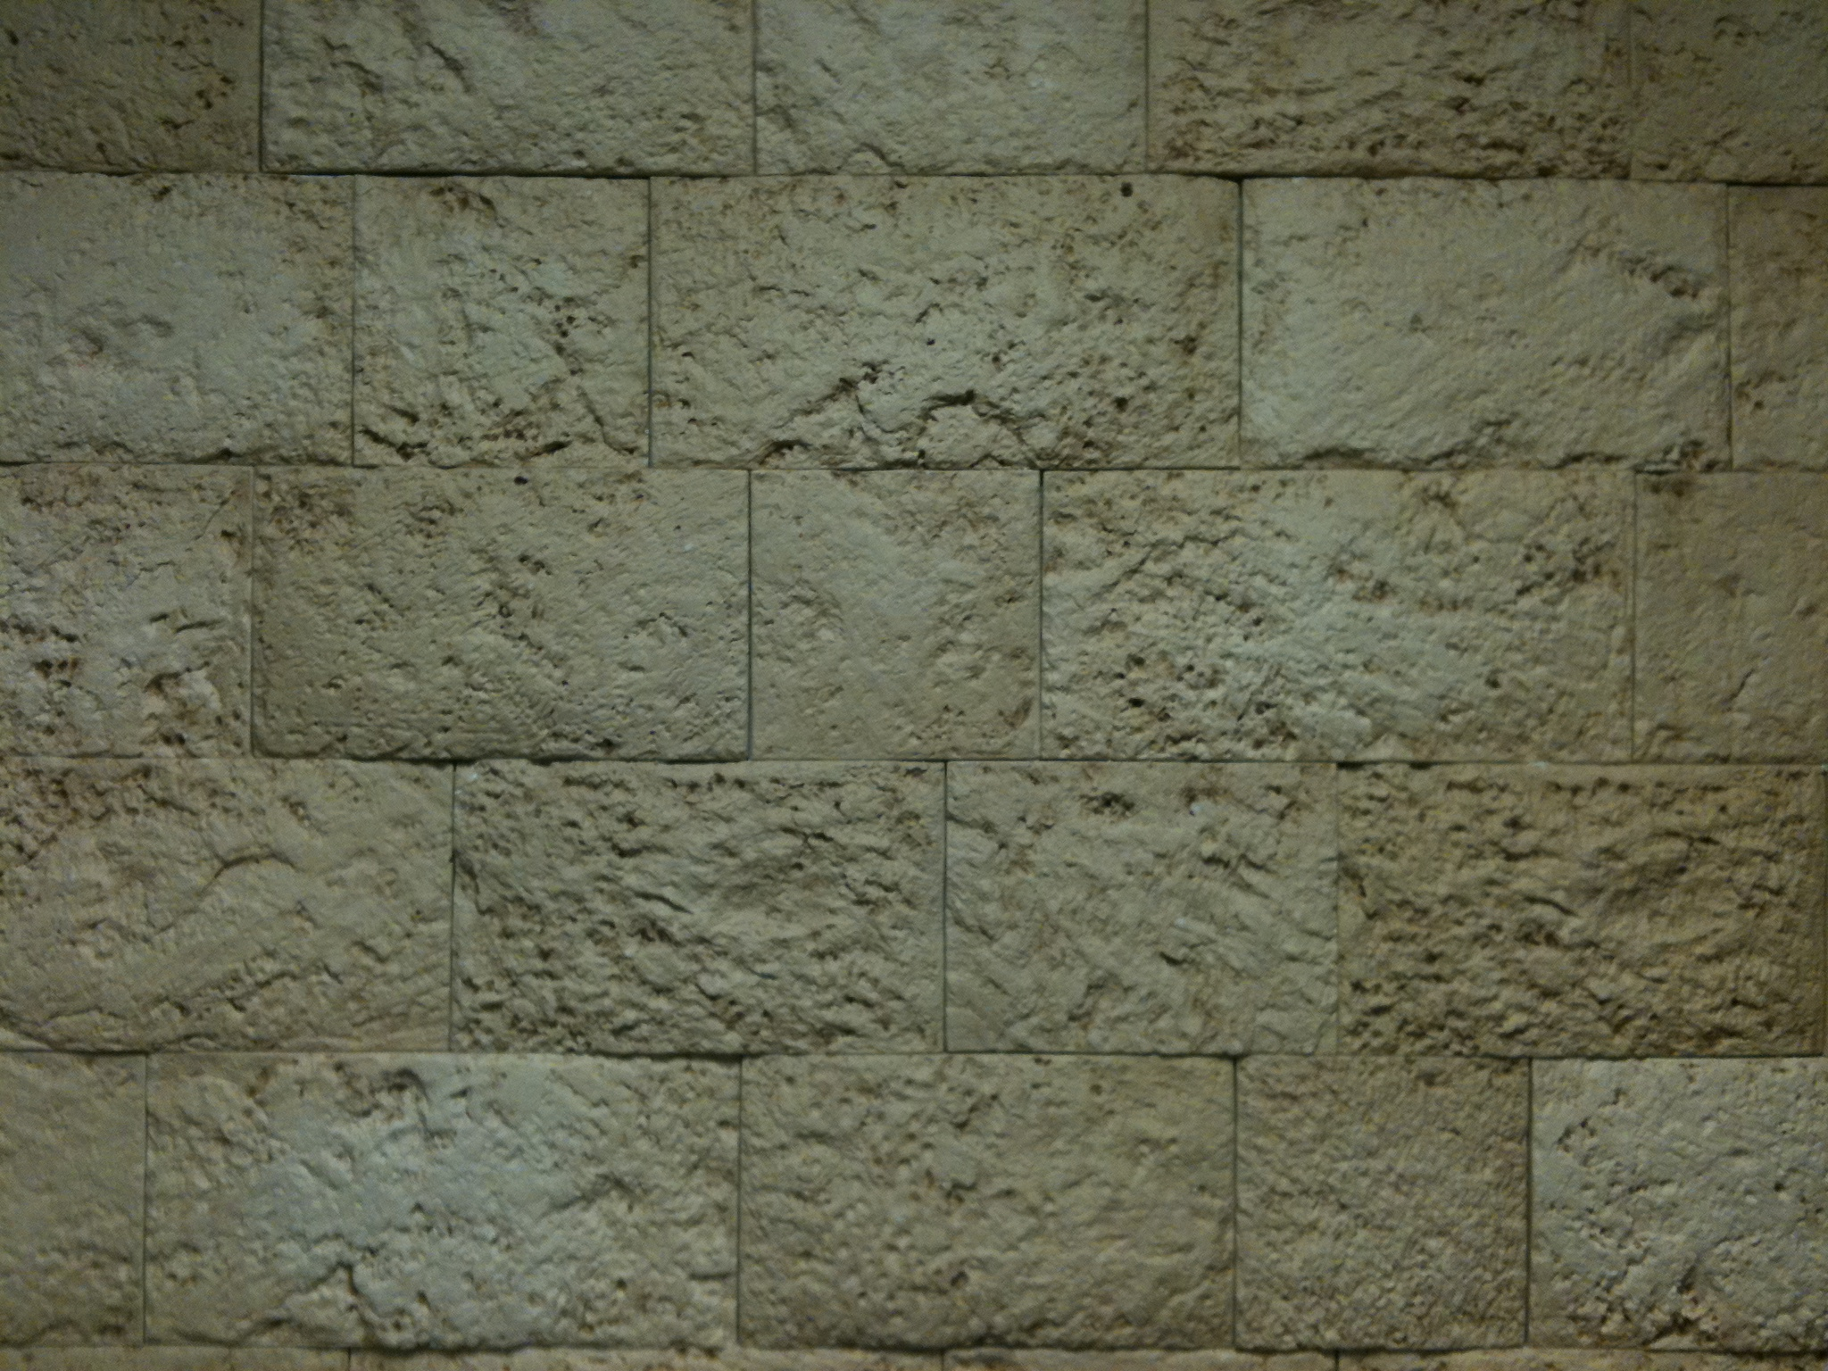
Revelation
Arranging
Seals, Trumpets & Bowls

Slide 2
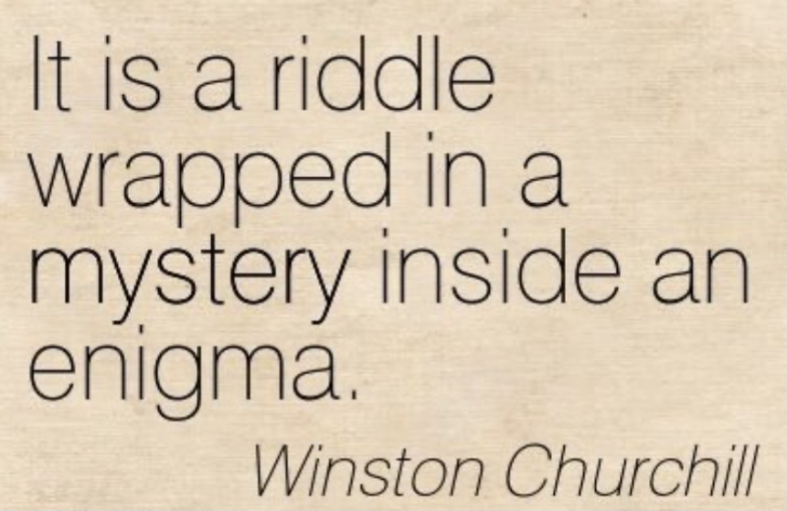

Slide 4
Three Event Lines
Seal Judgments
(Tribulation)
1
2
3
4
5
6
7
Trumpet Judgments
(God’s Wrath)
7
1
2
3
4
5
6
Bowl Judgments
(God’s Wrath)
1
2
3
4
5
6
7

Slide 5
Three Testimony Lines
Seal Judgments
(Tribulation)
1
2
3
4
5
6
7
The Father’s Testimony
Trumpet Judgments
(God’s Wrath)
7
1
2
3
4
5
6
The Spirit’s Testimony
Bowl Judgments
(God’s Wrath)
1
2
3
4
5
6
7
The Son’s Testimony

Slide 6
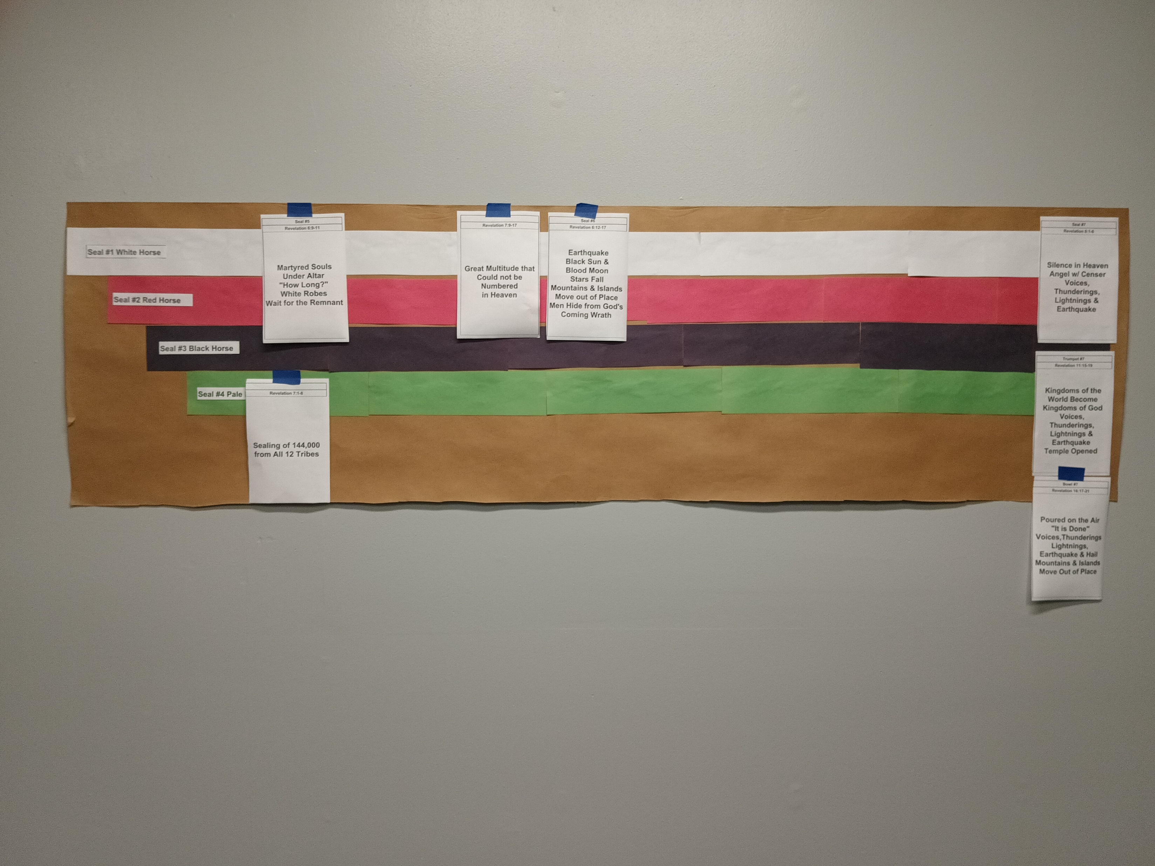

Slide 7
The Revelation Judgments
 | 1 | 2 | 3 | 4 | 5 | 6 |  | 7
Reference | Rev 6:1-2 | Rev 6:3-4 | Rev 6:5-6 | Rev 6:7-8 | Rev 6:9-11 | Rev 6:12-17 |  | Rev 8:1-6
Seal Judgments | White Horse Bow Crown (Stephanos) Overcomer THE CHURCH | Red Horse Takes Peace Cause to Kill One Another Great Sword WAR | Black Horse Balance (Yoke) Inflation on Needed Things Not Luxuries ECONOMIC | Pale Horse Death & Hades Power Over 1/4 Sword, Hunger, Death & Beasts FAMINE PESTILANCE | Martyred Souls Under Altar "How Long?" White Robes Wait for the Remnant | Earthquake Black Sun & Blood Moon Stars Fall Mts & Isles Move Men Hide from God's Coming Wrath |  | Silence in Heaven Angel w/ Censer Voices, Thunderings, Lightnings & Earthquake
 | 1 | 2 | 3 | 4 | 5 | 6 |  | 7
Reference | Rev 8:7 | Rev 8:8-9 | Rev 8:10-11 | Rev 8:12-13 | Rev 9:1-12 | Rev 9:13-21 |  | Rev 11:15-19
Trumpet Judgments | Heaven to Earth Hail & Fire Mingled w/ Blood Burn 1/3 of Trees Burn All Grass | Burning Mountain into Sea 1/3 of Sea Creatures Die Destroy 1/3 of Ships | Star Falls on 1/3 of Rivers & Springs Become Bitter Many Men Die | 1/3 of Sun, Moon Stars Dark Day & Night 1/3 Shorter "Woe, Woe, Woe" to Earth | Star from Heaven with Key to Pit Smoke & Darkness Locusts Harm Those w/out God's Mark 5 Months "Woe, Woe" | 4 Angels from Euphrates River Kill 1/3 of Mankind with Fire, Smoke & Brimstone Men Don't Repent 3rd "Woe" |  | Nations Become God's Voices, Thunderings, Lightnings & Earthquake Temple Opened
Seven Thunders Rev 10:3-4 Sealed Up !!!
 | 1 | 2 | 3 | 4 | 5 | 6 |  | 7
Reference | Rev 16:2 | Rev 16:3 | Rev 16:4-7 | Rev 16:8-9 | Rev 16:10-11 | Rev 16:12-16 | Rev 16:17-21
Bowl Judgments | Poured on Earth Sores on All Men with Mark of the Beast | Poured on Sea Becomes Blood Every Sea Creature Dies | Rivers & Springs Become Blood "True & Righteous are Your Judgments" | Sun Scorches All Men Do Not Repent | Darkness on Beast Kingdom Men Gnaw Tongues in Pain | Euphrates Dries Up 3 Unclean Spirits Gather Entire Earth to Battle at HarMegiddo | Poured on the Air "It is Done" Voices, Thunderings, Lightnings, Earthquake & Hail Mts & Isles Move

Slide 8
“I, John, both your brother and companion in the tribulation and kingdom and patience of Jesus Christ, was on the island that is called Patmos …” Revelation 1:9

Slide 9
A Possible Arrangement
Yeshua’s Return
~32 AD
1st Seal: White Horse
2nd Seal: Red Horse
3rd Seal: Black Horse
4th Seal: Pale Horse

Slide 10
The Revelation Judgments
 | 1 | 2 | 3 | 4 | 5 | 6 |  | 7
Reference | Rev 6:1-2 | Rev 6:3-4 | Rev 6:5-6 | Rev 6:7-8 | Rev 6:9-11 | Rev 6:12-17 |  | Rev 8:1-6
Seal Judgments | White Horse Bow Crown (Stephanos) Overcomer THE CHURCH | Red Horse Takes Peace Cause to Kill One Another Great Sword WAR | Black Horse Balance (Yoke) Inflation on Needed Things Not Luxuries ECONOMIC | Pale Horse Death & Hades Power Over 1/4 Sword, Hunger, Death & Beasts FAMINE PESTILANCE | Martyred Souls Under Altar "How Long?" White Robes Wait for the Remnant | Earthquake Black Sun & Blood Moon Stars Fall Mts & Isles Move Men Hide from God's Coming Wrath |  | Silence in Heaven Angel w/ Censer Voices, Thunderings, Lightnings & Earthquake
 | 1 | 2 | 3 | 4 | 5 | 6 |  | 7
Reference | Rev 8:7 | Rev 8:8-9 | Rev 8:10-11 | Rev 8:12-13 | Rev 9:1-12 | Rev 9:13-21 |  | Rev 11:15-19
Trumpet Judgments | Heaven to Earth Hail & Fire Mingled w/ Blood Burn 1/3 of Trees Burn All Grass | Burning Mountain into Sea 1/3 of Sea Creatures Die Destroy 1/3 of Ships | Star Falls on 1/3 of Rivers & Springs Become Bitter Many Men Die | 1/3 of Sun, Moon Stars Dark Day & Night 1/3 Shorter "Woe, Woe, Woe" to Earth | Star from Heaven with Key to Pit Smoke & Darkness Locusts Harm Those w/out God's Mark 5 Months "Woe, Woe" | 4 Angels from Euphrates River Kill 1/3 of Mankind with Fire, Smoke & Brimstone Men Don't Repent 3rd "Woe" |  | Nations Become God's Voices, Thunderings, Lightnings & Earthquake Temple Opened
Seven Thunders Rev 10:3-4 Sealed Up !!!
 | 1 | 2 | 3 | 4 | 5 | 6 |  | 7
Reference | Rev 16:2 | Rev 16:3 | Rev 16:4-7 | Rev 16:8-9 | Rev 16:10-11 | Rev 16:12-16 | Rev 16:17-21
Bowl Judgments | Poured on Earth Sores on All Men with Mark of the Beast | Poured on Sea Becomes Blood Every Sea Creature Dies | Rivers & Springs Become Blood "True & Righteous are Your Judgments" | Sun Scorches All Men Do Not Repent | Darkness on Beast Kingdom Men Gnaw Tongues in Pain | Euphrates Dries Up 3 Unclean Spirits Gather Entire Earth to Battle at HarMegiddo | Poured on the Air "It is Done" Voices, Thunderings, Lightnings, Earthquake & Hail Mts & Isles Move

Slide 11
6
A Possible Arrangement
Yeshua’s Return
~32 AD
1st Seal: White Horse
5
Martyred Souls Under Altar "How Long" White Robes Wait for the Remnant
2nd Seal: Red Horse
3rd Seal: Black Horse
4th Seal: Pale Horse

Slide 12
The Revelation Judgments
 | 1 | 2 | 3 | 4 | 5 | 6 |  | 7
Reference | Rev 6:1-2 | Rev 6:3-4 | Rev 6:5-6 | Rev 6:7-8 | Rev 6:9-11 | Rev 6:12-17 |  | Rev 8:1-6
Seal Judgments | White Horse Bow Crown (Stephanos) Overcomer THE CHURCH | Red Horse Takes Peace Cause to Kill One Another Great Sword WAR | Black Horse Balance (Yoke) Inflation on Needed Things Not Luxuries ECONOMIC | Pale Horse Death & Hades Power Over 1/4 Sword, Hunger, Death & Beasts FAMINE PESTILANCE | Martyred Souls Under Altar "How Long?" White Robes Wait for the Remnant | Earthquake Black Sun & Blood Moon Stars Fall Mts & Isles Move Men Hide from God's Coming Wrath |  | Silence in Heaven Angel w/ Censer Voices, Thunderings, Lightnings & Earthquake
 | 1 | 2 | 3 | 4 | 5 | 6 |  | 7
Reference | Rev 8:7 | Rev 8:8-9 | Rev 8:10-11 | Rev 8:12-13 | Rev 9:1-12 | Rev 9:13-21 |  | Rev 11:15-19
Trumpet Judgments | Heaven to Earth Hail & Fire Mingled w/ Blood Burn 1/3 of Trees Burn All Grass | Burning Mountain into Sea 1/3 of Sea Creatures Die Destroy 1/3 of Ships | Star Falls on 1/3 of Rivers & Springs Become Bitter Many Men Die | 1/3 of Sun, Moon Stars Dark Day & Night 1/3 Shorter "Woe, Woe, Woe" to Earth | Star from Heaven with Key to Pit Smoke & Darkness Locusts Harm Those w/out God's Mark 5 Months "Woe, Woe" | 4 Angels from Euphrates River Kill 1/3 of Mankind with Fire, Smoke & Brimstone Men Don't Repent 3rd "Woe" |  | Nations Become God's Voices, Thunderings, Lightnings & Earthquake Temple Opened
Seven Thunders Rev 10:3-4 Sealed Up !!!
 | 1 | 2 | 3 | 4 | 5 | 6 |  | 7
Reference | Rev 16:2 | Rev 16:3 | Rev 16:4-7 | Rev 16:8-9 | Rev 16:10-11 | Rev 16:12-16 | Rev 16:17-21
Bowl Judgments | Poured on Earth Sores on All Men with Mark of the Beast | Poured on Sea Becomes Blood Every Sea Creature Dies | Rivers & Springs Become Blood "True & Righteous are Your Judgments" | Sun Scorches All Men Do Not Repent | Darkness on Beast Kingdom Men Gnaw Tongues in Pain | Euphrates Dries Up 3 Unclean Spirits Gather Entire Earth to Battle at HarMegiddo | Poured on the Air "It is Done" Voices, Thunderings, Lightnings, Earthquake & Hail Mts & Isles Move

Slide 13
“I looked when He opened the sixth seal, and behold, there was a great earthquake; and the sun became black as sackcloth of hair, and the moon became like blood. And the stars of heaven fell to the earth, as a fig tree drops its late figs when it is shaken by a mighty wind. Then the sky receded as a scroll when it is rolled up, and every mountain and island was moved out of its place.” Revelation 6:12-14

Slide 14
“Immediately after the tribulation of those days the sun will be darkened, and the moon will not give its light; the stars will fall from heaven, and the powers of the heavens will be shaken. Then the sign of the Son of Man will appear in heaven, and then all the tribes of the earth will mourn, and they will see the Son of Man coming on the clouds of heaven with power and great glory. And He will send His angels with a great sound of a trumpet, and they will gather together His elect from the four winds, from one end of heaven to the other.” Matthew 24:29-31

Slide 15
“And there will be signs in the sun, in the moon, and in the stars; and on the earth distress of nations, with perplexity, the sea and the waves roaring; men’s hearts failing them from fear and the expectation of those things which are coming on the earth, for the powers of the heavens will be shaken. Then they will see the Son of Man coming in a cloud with power and great glory. Now when these things begin to happen, look up and lift up your heads, because your redemption draws near.” Luke 21:25-28

Slide 16
“Now a great sign appeared in heaven: a woman clothed with the sun, with the moon under her feet, and on her head a garland of twelve stars … And war broke out in heaven: Michael and his angels fought with the dragon; and the dragon and his angels fought, but they did not prevail, nor was a place found for them in heaven any longer. So the great dragon was cast out, that serpent of old, called the Devil and Satan, who deceives the whole world; he was cast to the earth, and his angels were cast out with him. Revelation 12:1 & 7-9

Slide 17
6
A Possible Arrangement
Yeshua’s Return
~32 AD
1st Seal: White Horse
5
6
Martyred Souls Under Altar "How Long" White Robes Wait for the Remnant
Earthquake Black Sun Blood Moon Stars Fall Mts & Isles Move Men Hide from God's Wrath
2nd Seal: Red Horse
3rd Seal: Black Horse
4th Seal: Pale Horse

Slide 18
The Revelation Judgments
 | 1 | 2 | 3 | 4 | 5 | 6 |  | 7
Reference | Rev 6:1-2 | Rev 6:3-4 | Rev 6:5-6 | Rev 6:7-8 | Rev 6:9-11 | Rev 6:12-17 |  | Rev 8:1-6
Seal Judgments | White Horse Bow Crown (Stephanos) Overcomer THE CHURCH | Red Horse Takes Peace Cause to Kill One Another Great Sword WAR | Black Horse Balance (Yoke) Inflation on Needed Things Not Luxuries ECONOMIC | Pale Horse Death & Hades Power Over 1/4 Sword, Hunger, Death & Beasts FAMINE PESTILANCE | Martyred Souls Under Altar "How Long?" White Robes Wait for the Remnant | Earthquake Black Sun & Blood Moon Stars Fall Mts & Isles Move Men Hide from God's Coming Wrath |  | Silence in Heaven Angel w/ Censer Voices, Thunderings, Lightnings & Earthquake
 | 1 | 2 | 3 | 4 | 5 | 6 |  | 7
Reference | Rev 8:7 | Rev 8:8-9 | Rev 8:10-11 | Rev 8:12-13 | Rev 9:1-12 | Rev 9:13-21 |  | Rev 11:15-19
Trumpet Judgments | Heaven to Earth Hail & Fire Mingled w/ Blood Burn 1/3 of Trees Burn All Grass | Burning Mountain into Sea 1/3 of Sea Creatures Die Destroy 1/3 of Ships | Star Falls on 1/3 of Rivers & Springs Become Bitter Many Men Die | 1/3 of Sun, Moon Stars Dark Day & Night 1/3 Shorter "Woe, Woe, Woe" to Earth | Star from Heaven with Key to Pit Smoke & Darkness Locusts Harm Those w/out God's Mark 5 Months "Woe, Woe" | 4 Angels from Euphrates River Kill 1/3 of Mankind with Fire, Smoke & Brimstone Men Don't Repent 3rd "Woe" |  | Nations Become God's Voices, Thunderings, Lightnings & Earthquake Temple Opened
Seven Thunders Rev 10:3-4 Sealed Up !!!
 | 1 | 2 | 3 | 4 | 5 | 6 |  | 7
Reference | Rev 16:2 | Rev 16:3 | Rev 16:4-7 | Rev 16:8-9 | Rev 16:10-11 | Rev 16:12-16 | Rev 16:17-21
Bowl Judgments | Poured on Earth Sores on All Men with Mark of the Beast | Poured on Sea Becomes Blood Every Sea Creature Dies | Rivers & Springs Become Blood "True & Righteous are Your Judgments" | Sun Scorches All Men Do Not Repent | Darkness on Beast Kingdom Men Gnaw Tongues in Pain | Euphrates Dries Up 3 Unclean Spirits Gather Entire Earth to Battle at HarMegiddo | Poured on the Air "It is Done" Voices, Thunderings, Lightnings, Earthquake & Hail Mts & Isles Move

Slide 19
6
A Possible Arrangement
Yeshua’s Return
~32 AD
1st Seal: White Horse
5
6
Martyred Souls Under Altar "How Long" White Robes Wait for the Remnant
Earthquake Black Sun Blood Moon Stars Fall Mts & Isles Move Men Hide from God's Wrath
7
Silence in Heaven Angel w/ Censer Voices, Thunderings Lightnings & Earthquake
2nd Seal: Red Horse
3rd Seal: Black Horse
4th Seal: Pale Horse

Slide 20
The Revelation Judgments
 | 1 | 2 | 3 | 4 | 5 | 6 |  | 7
Reference | Rev 6:1-2 | Rev 6:3-4 | Rev 6:5-6 | Rev 6:7-8 | Rev 6:9-11 | Rev 6:12-17 |  | Rev 8:1-6
Seal Judgments | White Horse Bow Crown (Stephanos) Overcomer THE CHURCH | Red Horse Takes Peace Cause to Kill One Another Great Sword WAR | Black Horse Balance (Yoke) Inflation on Needed Things Not Luxuries ECONOMIC | Pale Horse Death & Hades Power Over 1/4 Sword, Hunger, Death & Beasts FAMINE PESTILANCE | Martyred Souls Under Altar "How Long?" White Robes Wait for the Remnant | Earthquake Black Sun & Blood Moon Stars Fall Mts & Isles Move Men Hide from God's Coming Wrath |  | Silence in Heaven Angel w/ Censer Voices, Thunderings, Lightnings & Earthquake
 | 1 | 2 | 3 | 4 | 5 | 6 |  | 7
Reference | Rev 8:7 | Rev 8:8-9 | Rev 8:10-11 | Rev 8:12-13 | Rev 9:1-12 | Rev 9:13-21 |  | Rev 11:15-19
Trumpet Judgments | Heaven to Earth Hail & Fire Mingled w/ Blood Burn 1/3 of Trees Burn All Grass | Burning Mountain into Sea 1/3 of Sea Creatures Die Destroy 1/3 of Ships | Star Falls on 1/3 of Rivers & Springs Become Bitter Many Men Die | 1/3 of Sun, Moon Stars Dark Day & Night 1/3 Shorter "Woe, Woe, Woe" to Earth | Star from Heaven with Key to Pit Smoke & Darkness Locusts Harm Those w/out God's Mark 5 Months "Woe, Woe" | 4 Angels from Euphrates River Kill 1/3 of Mankind with Fire, Smoke & Brimstone Men Don't Repent 3rd "Woe" |  | Nations Become God's Voices, Thunderings, Lightnings & Earthquake Temple Opened
Seven Thunders Rev 10:3-4 Sealed Up !!!
 | 1 | 2 | 3 | 4 | 5 | 6 |  | 7
Reference | Rev 16:2 | Rev 16:3 | Rev 16:4-7 | Rev 16:8-9 | Rev 16:10-11 | Rev 16:12-16 | Rev 16:17-21
Bowl Judgments | Poured on Earth Sores on All Men with Mark of the Beast | Poured on Sea Becomes Blood Every Sea Creature Dies | Rivers & Springs Become Blood "True & Righteous are Your Judgments" | Sun Scorches All Men Do Not Repent | Darkness on Beast Kingdom Men Gnaw Tongues in Pain | Euphrates Dries Up 3 Unclean Spirits Gather Entire Earth to Battle at HarMegiddo | Poured on the Air "It is Done" Voices, Thunderings, Lightnings, Earthquake & Hail Mts & Isles Move

Slide 21
A Possible Arrangement
Yeshua’s Return
~32 AD
1st Seal: White Horse
5
6
Martyred Souls Under Altar "How Long" White Robes Wait for the Remnant
Earthquake Black Sun Blood Moon Stars Fall Mts & Isles Move Men Hide from God's Wrath
7
Silence in Heaven Angel w/ Censer Voices, Thunderings Lightnings & Earthquake
2nd Seal: Red Horse
7
3rd Seal: Black Horse
4th Seal: Pale Horse
7
Nations Become God's Voices, Thunderings Lightnings & Earthquake Temple Opened
7
On the Air "It is Done" Voices,Thun-derings Lightnings, Earthquake & Hail Mts & Isles Move

Slide 22
A Possible Arrangement
Yeshua’s Return
~32 AD
1st Seal: White Horse
5
6
Martyred Souls Under Altar "How Long" White Robes Wait for the Remnant
Earthquake Black Sun Blood Moon Stars Fall Mts & Isles Move Men Hide from God's Wrath
7
Silence in Heaven Angel w/ Censer Voices, Thunderings Lightnings & Earthquake
2nd Seal: Red Horse
7
3rd Seal: Black Horse
4th Seal: Pale Horse
7
Nations Become God's Voices, Thunderings Lightnings & Earthquake Temple Opened
7
On the Air "It is Done" Voices,Thun-derings Lightnings, Earthquake & Hail Mts & Isles Move

Slide 23
A Possible Arrangement
Yeshua’s Return
~32 AD
1st Seal: White Horse
5
6
Ch. 7b
Martyred Souls Under Altar "How Long" White Robes Wait for the Remnant
Earthquake Black Sun Blood Moon Stars Fall Mts & Isles Move Men Hide from God's Wrath
Great Multitude in Heaven
7
Silence in Heaven Angel w/ Censer Voices, Thunderings Lightnings & Earthquake
2nd Seal: Red Horse
7
3rd Seal: Black Horse
4th Seal: Pale Horse
7
Nations Become God's Voices, Thunderings Lightnings & Earthquake Temple Opened
7
On the Air "It is Done" Voices,Thun-derings Lightnings, Earthquake & Hail Mts & Isles Move

Slide 24
A Possible Arrangement
Yeshua’s Return
~32 AD
1st Seal: White Horse
5
6
Ch. 7b
Martyred Souls Under Altar "How Long" White Robes Wait for the Remnant
Earthquake Black Sun Blood Moon Stars Fall Mts & Isles Move Men Hide from God's Wrath
Great Multitude in Heaven
7
Silence in Heaven Angel w/ Censer Voices, Thunderings Lightnings & Earthquake
2nd Seal: Red Horse
7
3rd Seal: Black Horse
4th Seal: Pale Horse
Ch. 7a
Trumpet Judgments
7
144,000 Sealed
1
2
3
4
5
6
Nations Become God's Voices, Thunderings Lightnings & Earthquake Temple Opened
7
On the Air "It is Done" Voices,Thun-derings Lightnings, Earthquake & Hail Mts & Isles Move

