Slide 1
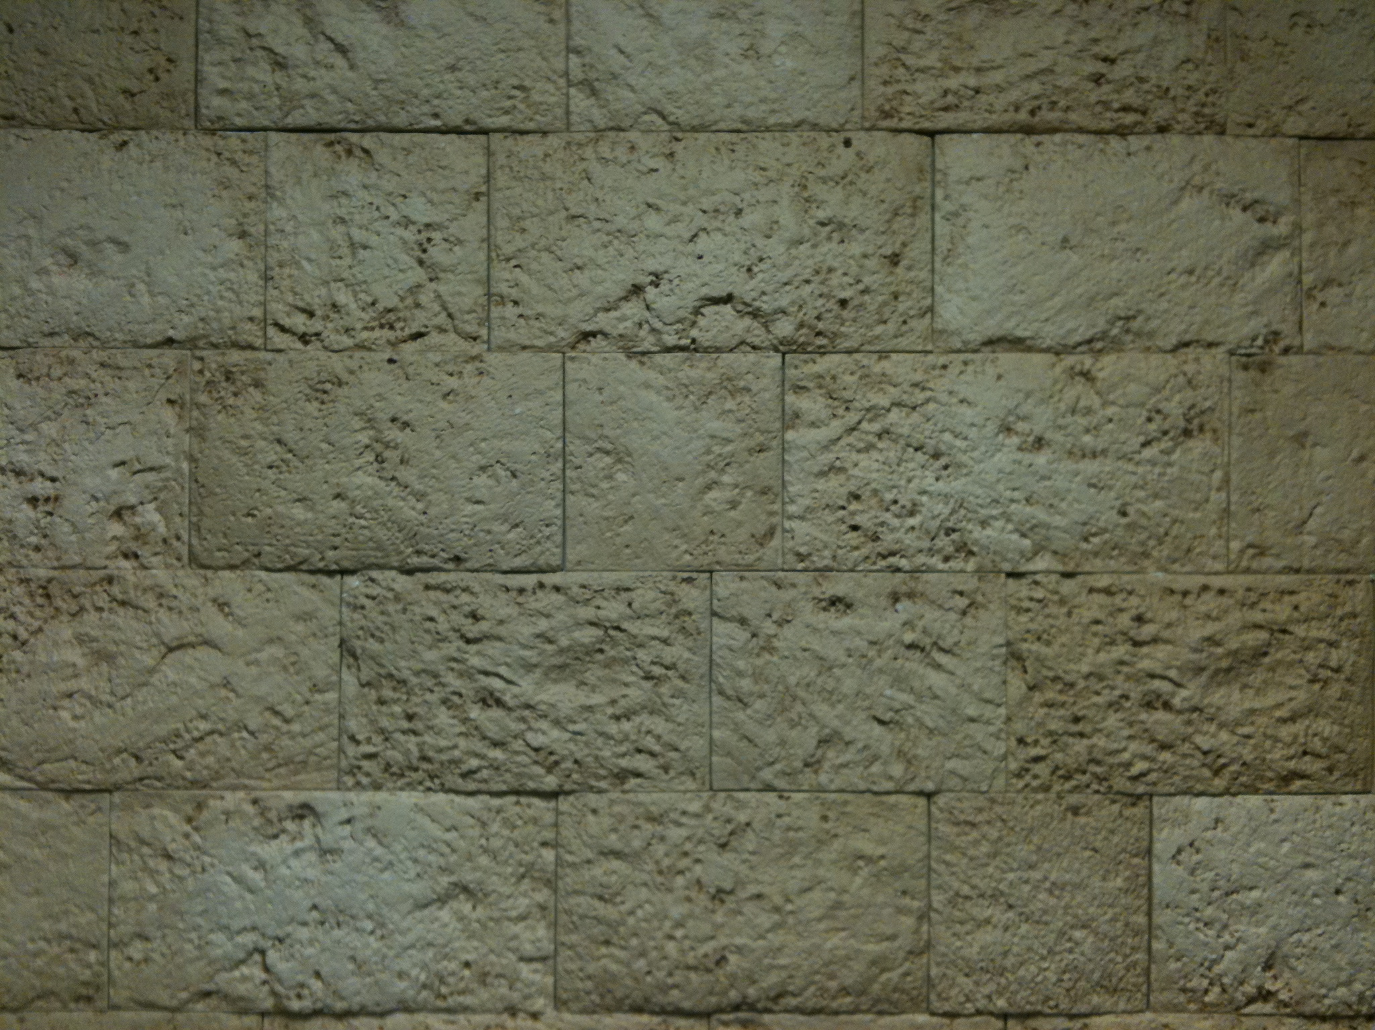
Revelation
Arranging
Seals & Trumpets

Slide 2
The Revelation Judgments
 | 1 | 2 | 3 | 4 | 5 | 6 |  | 7
Reference | Rev 6:1-2 | Rev 6:3-4 | Rev 6:5-6 | Rev 6:7-8 | Rev 6:9-11 | Rev 6:12-17 |  | Rev 8:1-6
Seal Judgments | White Horse Bow Crown (Stephanos) Overcomer THE CHURCH | Red Horse Takes Peace Cause to Kill One Another Great Sword WAR | Black Horse Balance (Yoke) Inflation on Needed Things Not Luxuries ECONOMIC | Pale Horse Death & Hades Power Over 1/4 Sword, Hunger, Death & Beasts FAMINE PESTILANCE | Martyred Souls Under Altar "How Long?" White Robes Wait for the Remnant | Earthquake Black Sun & Blood Moon Stars Fall Mts & Isles Move Men Hide from God's Coming Wrath |  | Silence in Heaven Angel w/ Censer Voices, Thunderings, Lightnings & Earthquake
 | 1 | 2 | 3 | 4 | 5 | 6 |  | 7
Reference | Rev 8:7 | Rev 8:8-9 | Rev 8:10-11 | Rev 8:12-13 | Rev 9:1-12 | Rev 9:13-21 |  | Rev 11:15-19
Trumpet Judgments | Heaven to Earth Hail & Fire Mingled w/ Blood Burn 1/3 of Trees Burn All Grass | Burning Mountain into Sea 1/3 of Sea Creatures Die Destroy 1/3 of Ships | Star Falls on 1/3 of Rivers & Springs Become Bitter Many Men Die | 1/3 of Sun, Moon Stars Dark Day & Night 1/3 Shorter "Woe, Woe, Woe" to Earth | Star from Heaven with Key to Pit Smoke & Darkness Locusts Harm Those w/out God's Mark 5 Months "Woe, Woe" | 4 Angels from Euphrates River Kill 1/3 of Mankind with Fire, Smoke & Brimstone Men Don't Repent 3rd "Woe" |  | Nations Become God's Voices, Thunderings, Lightnings & Earthquake Temple Opened
Seven Thunders Rev 10:3-4 Sealed Up !!!
 | 1 | 2 | 3 | 4 | 5 | 6 |  | 7
Reference | Rev 16:2 | Rev 16:3 | Rev 16:4-7 | Rev 16:8-9 | Rev 16:10-11 | Rev 16:12-16 | Rev 16:17-21
Bowl Judgments | Poured on Earth Sores on All Men with Mark of the Beast | Poured on Sea Becomes Blood Every Sea Creature Dies | Rivers & Springs Become Blood "True & Righteous are Your Judgments" | Sun Scorches All Men Do Not Repent | Darkness on Beast Kingdom Men Gnaw Tongues in Pain | Euphrates Dries Up 3 Unclean Spirits Gather Entire Earth to Battle at HarMegiddo | Poured on the Air "It is Done" Voices, Thunderings, Lightnings, Earthquake & Hail Mts & Isles Move

Slide 3
A Possible Arrangement
~32 AD
1st Seal: White Horse
2nd Seal: Red Horse
3rd Seal: Black Horse
4th Seal: Pale Horse

Slide 4
A Possible Arrangement
~32 AD
1st Seal: White Horse
5
6
Martyred Souls Under Altar "How Long" White Robes Wait for the Remnant
Earthquake Black Sun Blood Moon Stars Fall Mts & Isles Move Men Hide from God's Wrath
7
Silence in Heaven Angel w/ Censer Voices, Thunderings Lightnings & Earthquake
2nd Seal: Red Horse
3rd Seal: Black Horse
4th Seal: Pale Horse

Slide 5
A Possible Arrangement
~32 AD
1st Seal: White Horse
5
6
Martyred Souls Under Altar "How Long" White Robes Wait for the Remnant
Earthquake Black Sun Blood Moon Stars Fall Mts & Isles Move Men Hide from God's Wrath
7
Silence in Heaven Angel w/ Censer Voices, Thunderings Lightnings & Earthquake
2nd Seal: Red Horse
3rd Seal: Black Horse
4th Seal: Pale Horse
7
Nations Become God's Voices, Thunderings Lightnings & Earthquake Temple Opened
7
On the Air "It is Done" Voices,Thun-derings Lightnings, Earthquake & Hail Mts & Isles Move

Slide 6
A Possible Arrangement
~32 AD
1st Seal: White Horse
5
6
Martyred Souls Under Altar "How Long" White Robes Wait for the Remnant
Earthquake Black Sun Blood Moon Stars Fall Mts & Isles Move Men Hide from God's Wrath
7
Silence in Heaven Angel w/ Censer Voices, Thunderings Lightnings & Earthquake
2nd Seal: Red Horse
3rd Seal: Black Horse
4th Seal: Pale Horse
7
Nations Become God's Voices, Thunderings Lightnings & Earthquake Temple Opened
Yeshua’s Return
7
On the Air "It is Done" Voices,Thun-derings Lightnings, Earthquake & Hail Mts & Isles Move

Slide 7
A Possible Arrangement
~32 AD
1st Seal: White Horse
5
6
Ch. 7b
Martyred Souls Under Altar "How Long" White Robes Wait for the Remnant
Earthquake Black Sun Blood Moon Stars Fall Mts & Isles Move Men Hide from God's Wrath
Great Multitude in Heaven
7
Silence in Heaven Angel w/ Censer Voices, Thunderings Lightnings & Earthquake
2nd Seal: Red Horse
3rd Seal: Black Horse
4th Seal: Pale Horse
Resurrection??
7
Nations Become God's Voices, Thunderings Lightnings & Earthquake Temple Opened
Yeshua’s Return
7
On the Air "It is Done" Voices,Thun-derings Lightnings, Earthquake & Hail Mts & Isles Move

Slide 8
A Possible Arrangement
~32 AD
1st Seal: White Horse
5
6
Ch. 7b
Martyred Souls Under Altar "How Long" White Robes Wait for the Remnant
Earthquake Black Sun Blood Moon Stars Fall Mts & Isles Move Men Hide from God's Wrath
Great Multitude in Heaven
7
Silence in Heaven Angel w/ Censer Voices, Thunderings Lightnings & Earthquake
2nd Seal: Red Horse
3rd Seal: Black Horse
4th Seal: Pale Horse
Ch. 7a
7
144,000 Sealed
Trumpet Judgments
Nations Become God's Voices, Thunderings Lightnings & Earthquake Temple Opened
1
2
3
4
5
6
Yeshua’s Return
7
On the Air "It is Done" Voices,Thun-derings Lightnings, Earthquake & Hail Mts & Isles Move

Slide 9
A Possible Arrangement
~32 AD
1st Seal: White Horse
5
6
Ch. 7b
Martyred Souls Under Altar "How Long" White Robes Wait for the Remnant
Earthquake Black Sun Blood Moon Stars Fall Mts & Isles Move Men Hide from God's Wrath
Great Multitude in Heaven
7
Silence in Heaven Angel w/ Censer Voices, Thunderings Lightnings & Earthquake
2nd Seal: Red Horse
3rd Seal: Black Horse
4th Seal: Pale Horse
Ch. 7a
1
2
3
4
5
6
7
144,000 Sealed
To Earth Hail & Fire Mingled w/ Blood Burn 1/3 of Trees Burn All Grass
Burning Mountain into Sea 1/3 of Sea Creatures Die Destroy 1/3 of Ships
Star Falls on 1/3 of Rivers & Springs Become Bitter Many Men Die
1/3 of Sun, Moon Stars Dark Day & Night 1/3 Shorter "Woe, Woe, Woe" to Earth
Star from Heaven with Key to Pit; Smoke & Dark, Locusts Harm Those w/out God's Mark 5 Mo.
4 Angels from Euphrates Kill 1/3 of Mankind with Fire, Smoke & Brimstone Men Don't Repent
Nations Become God's Voices, Thunderings Lightnings & Earthquake Temple Opened
Yeshua’s Return
7
On the Air "It is Done" Voices,Thun-derings Lightnings, Earthquake & Hail Mts & Isles Move

Slide 10
A Possible Arrangement
~32 AD
6
1st Seal: White Horse
5
6
Ch. 7b
Martyred Souls Under Altar "How Long" White Robes Wait for the Remnant
Earthquake Black Sun Blood Moon Stars Fall Mts & Isles Move Men Hide from God's Wrath
Great Multitude in Heaven
7
Silence in Heaven Angel w/ Censer Voices, Thunderings Lightnings & Earthquake
2nd Seal: Red Horse
3rd Seal: Black Horse
4th Seal: Pale Horse
Ch. 7a
1
2
3
4
5
6
7
144,000 Sealed
To Earth Hail & Fire Mingled w/ Blood Burn 1/3 of Trees Burn All Grass
Burning Mountain into Sea 1/3 of Sea Creatures Die Destroy 1/3 of Ships
Star Falls on 1/3 of Rivers & Springs Become Bitter Many Men Die
1/3 of Sun, Moon Stars Dark Day & Night 1/3 Shorter "Woe, Woe, Woe" to Earth
Star from Heaven with Key to Pit; Smoke & Dark, Locusts Harm Those w/out God's Mark 5 Mo.
4 Angels from Euphrates Kill 1/3 of Mankind with Fire, Smoke & Brimstone Men Don't Repent
Nations Become God's Voices, Thunderings Lightnings & Earthquake Temple Opened
Yeshua’s Return
7
On the Air "It is Done" Voices,Thun-derings Lightnings, Earthquake & Hail Mts & Isles Move

Slide 11
A Possible Arrangement
~32 AD
1st Seal: White Horse
5
6
Ch. 7b
7
Martyred Souls Under Altar "How Long" White Robes Wait for the Remnant
Earthquake Black Sun Blood Moon Stars Fall Mts & Isles Move Men Hide from God's Wrath
Great Multitude in Heaven
Silence in Heaven Angel w/ Censer Voices, Thunderings Lightnings & Earthquake
2nd Seal: Red Horse
3rd Seal: Black Horse
4th Seal: Pale Horse
Ch. 7a
1
2
3
4
5
6
7
144,000 Sealed
To Earth Hail & Fire Mingled w/ Blood Burn 1/3 of Trees Burn All Grass
Burning Mountain into Sea 1/3 of Sea Creatures Die Destroy 1/3 of Ships
Star Falls on 1/3 of Rivers & Springs Become Bitter Many Men Die
1/3 of Sun, Moon Stars Dark Day & Night 1/3 Shorter "Woe, Woe, Woe" to Earth
Star from Heaven with Key to Pit; Smoke & Dark, Locusts Harm Those w/out God's Mark 5 Mo.
4 Angels from Euphrates Kill 1/3 of Mankind with Fire, Smoke & Brimstone Men Don't Repent
Nations Become God's Voices, Thunderings Lightnings & Earthquake Temple Opened
Yeshua’s Return
7
On the Air "It is Done" Voices,Thun-derings Lightnings, Earthquake & Hail Mts & Isles Move

Slide 12
The Rapture

Slide 13
What We are Told it is…
Prior to the Great Tribulation, Jesus suddenly returns (a second time) in the air to “catch away” Believers from the Earth and takes them to heaven. He returns (a third time) to the Earth at the end of the Great Tribulation.
The Purpose:
To remove Believers from the Earth in order for Them to escape the Great Tribulation.

Slide 14
Resurrection:
Dead Arising with Resurrection Bodies
Yeshua After 3 Days
“Graves Opened” After Yeshua Matthew 27:52-53
Seal #5 Saints Revelation 7:9-14
“Rapture”:
Living Changed into Resurrection Bodies
Enoch & Elijah?? Gen 5:24 & II Kings 2:11

Slide 15
God’s Promise to Philadelphia: Revelation 3:10
“I also will keep you from the hour of trial which shall come upon the whole world, to test those who dwell on the earth.”
“For God did not appoint us to wrath, but to obtain salvation through our Lord Jesus Christ, who died for us, that whether we wake or sleep, we should live together with Him.” I Thess 5:9-10
“These things I have spoken to you, that in Me you may have peace. In the world you will have tribulation; but be of good cheer, I have overcome the world.” John 16:33

Slide 16
What the Bible Says About it…
John 14:1-4 “I go the prepare a place for you…”
Matthew 24:29-31 “Gather His elect from the four winds”
I Thess 4:13 – 5:11 Dead in Christ rise first; then those
who are alive and remain
I Corinth 15:50-58 Corruptible to Incorruptible
Mortal to Immortal
II Thess 2:1-4 LORD’s coming & our gathering

Slide 17
God Keeps His People from “the Hour of Trial”:
144,000 Sealed on the Earth
“Then the woman fled into the wilderness, where she has a place prepared by God, that they should feed her there one thousand two hundred and sixty days.” Rev 12:6

Slide 18
What the Bible Says About it…
John 14:1-4 “I go the prepare a place for you…”
Matthew 24:29-31 “Gather His elect from the four winds”
I Thess 4:13 – 5:11 Dead in Christ rise first; then those
who are alive and remain
I Corinth 15:50-58 Corruptible to Incorruptible
Mortal to Immortal
II Thess 2:1-4 LORD’s coming & our gathering

