Slide 2
What Do These Events Have in Common?
12 Spies Report 1491 BC
1st Temple Destroyed 586 BC
2nd Temple Destroyed 70 AD
Bar Kochvah Revolt Crushed 132
Rome Plowed Temple Ruins 133
Start of 1st Crusade 1096
Jews Expelled from England 1290
Jews Expelled from France 1306
Jews Expelled from Spain 1492
Jews Expelled from Rome 1555
World War I Started 1914
Hitler’s “Final Solution” 1941
Jews Deported from Warsaw 1942
Bombing of Jewish Center
in Buenos Aires 1994
Israel Turned Over Gaza 2005

Slide 3
They All Happened on the Same Date: The 9th of Av
What Are the Dire Straits?

Slide 4
The Dire Straits
21 Day Period Between:
17th of Tammuz (July 23, 2024)
&
9th of Av (August 13, 2024)

Slide 5
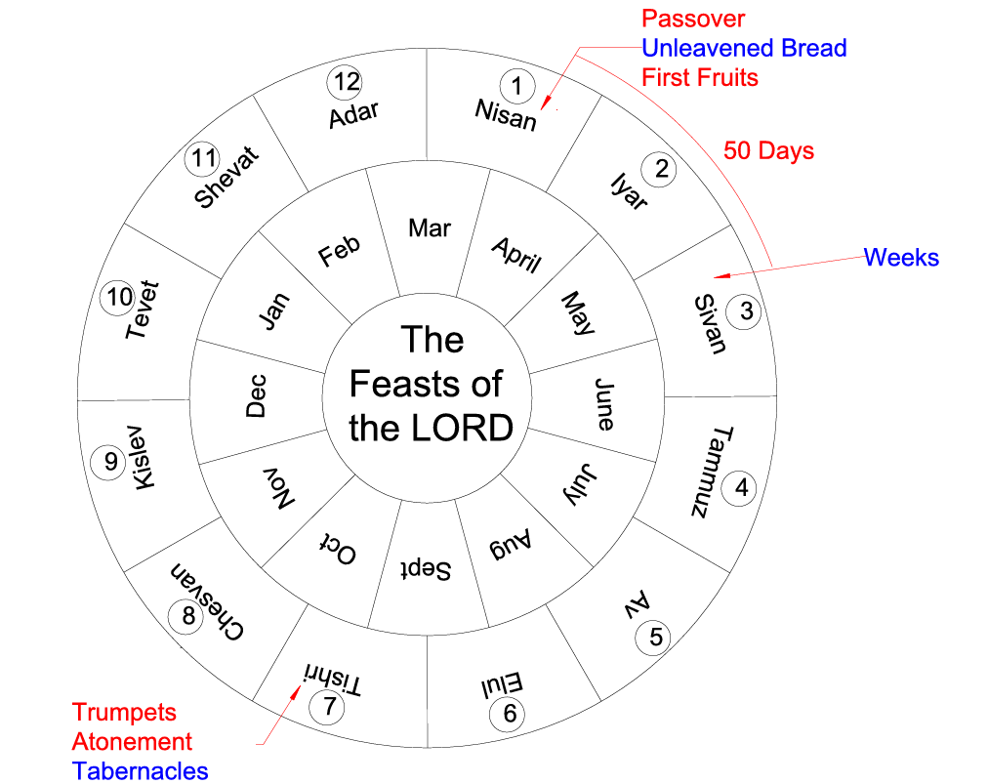
Spring
Feasts
(Pentecost)
Moses on Sinai 40 Days
Golden Calf
Tammuz 17
Dire Straits
9th of Av
Fall
Feasts

Slide 6
Events of the Past Seven Days:
Sat. (7/27) Hezbollah Attack on Druze village
of Majdal Shams; 12 dead, 29 injured
Tue (7/30) Israel Kills Hezbollah leader Fuad Shukr in Beirut
Wed (7/31) Israel Kills Hamas Political Leader Ismail Haniyeh in Tehran

Slide 7
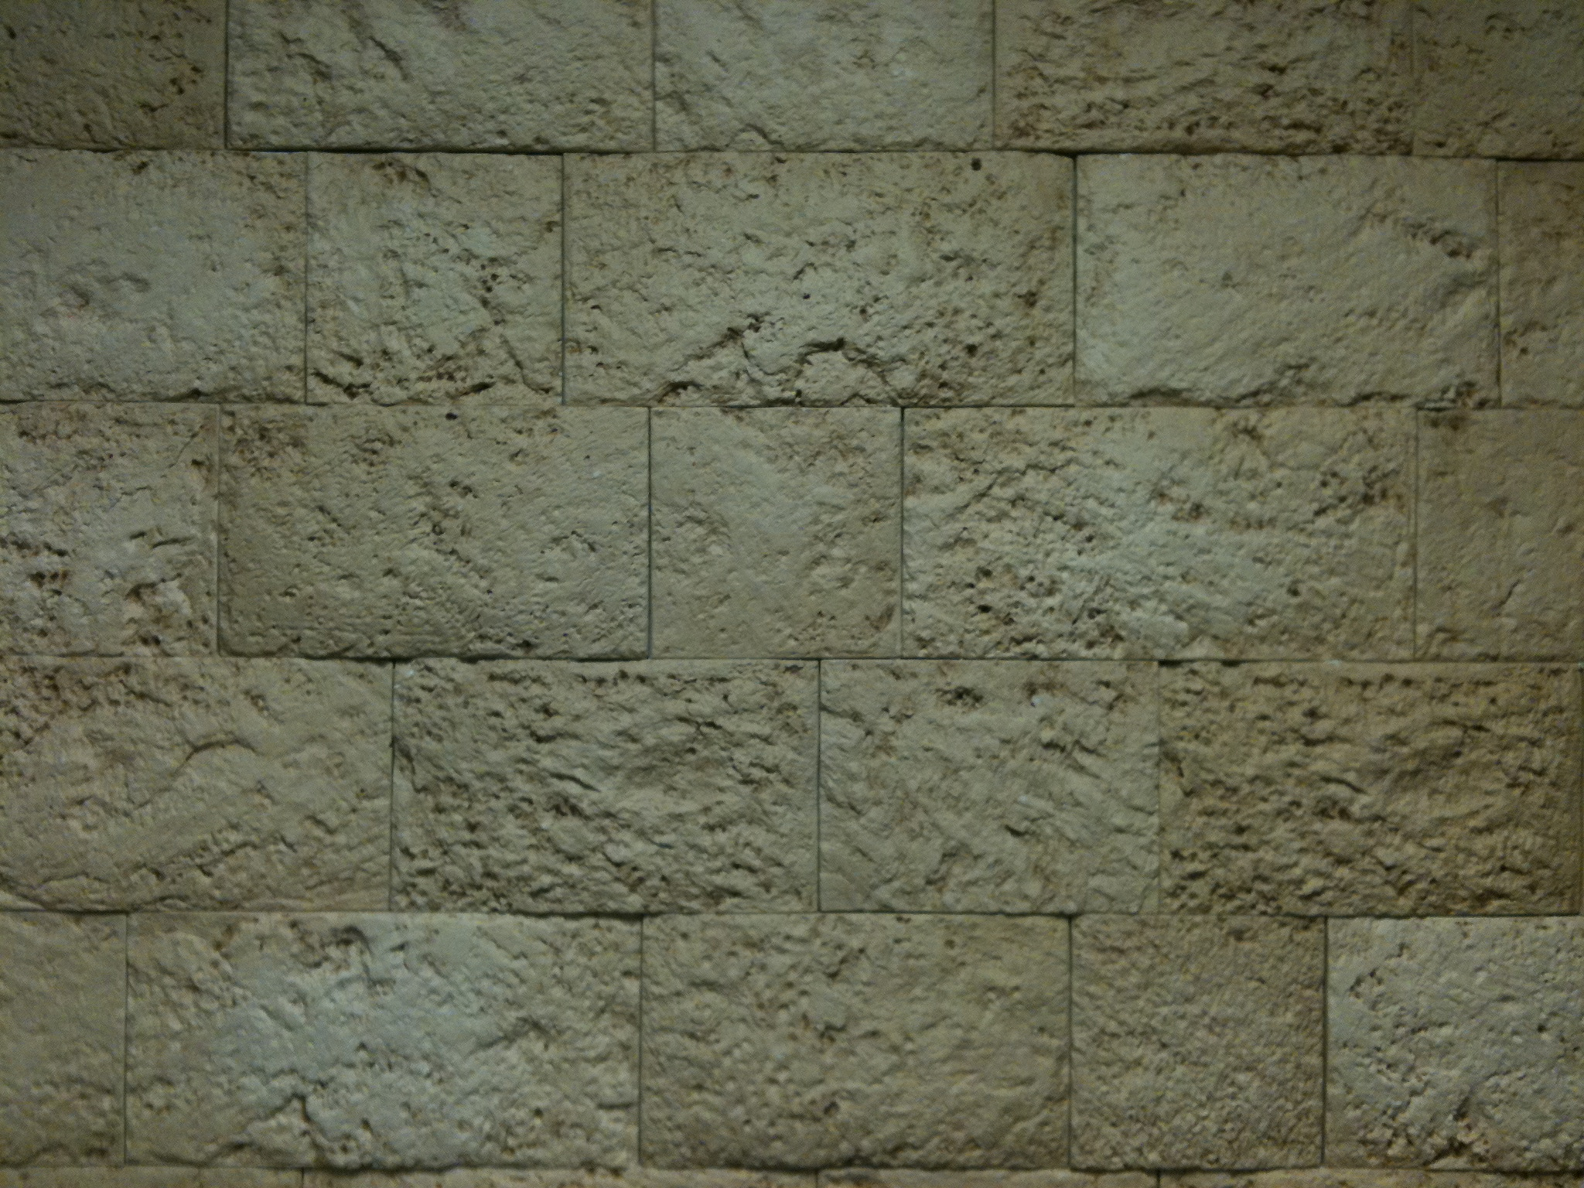
Revelation
Chapter 10

Slide 8
The Revelation Judgments
 | 1 | 2 | 3 | 4 | 5 | 6 |  | 7
Reference | Rev 6:1-2 | Rev 6:3-4 | Rev 6:5-6 | Rev 6:7-8 | Rev 6:9-11 | Rev 6:12-17 |  | Rev 8:1-6
Seal Judgments | White Horse Bow Crown (Stephanos) Overcomer THE CHURCH | Red Horse Takes Peace Cause to Kill One Another Great Sword WAR | Black Horse Balance (Yoke) Inflation on Needed Things Not Luxuries ECONOMIC | Pale Horse Death & Hades Power Over 1/4 Sword, Hunger, Death & Beasts FAMINE PESTILANCE | Martyred Souls Under Altar "How Long?" White Robes Wait for the Remnant | Earthquake Black Sun & Blood Moon Stars Fall Mts & Isles Move Men Hide from God's Coming Wrath |  | Silence in Heaven Angel w/ Censer Voices, Thunderings, Lightnings & Earthquake
 | 1 | 2 | 3 | 4 | 5 | 6 |  | 7
Reference | Rev 8:7 | Rev 8:8-9 | Rev 8:10-11 | Rev 8:12-13 | Rev 9:1-12 | Rev 9:13-21 |  | Rev 11:15-19
Trumpet Judgments | Heaven to Earth Hail & Fire Mingled w/ Blood Burn 1/3 of Trees Burn All Grass | Burning Mountain into Sea 1/3 of Sea Creatures Die Destroy 1/3 of Ships | Star Falls on 1/3 of Rivers & Springs Become Bitter Many Men Die | 1/3 of Sun, Moon Stars Dark Day & Night 1/3 Shorter "Woe, Woe, Woe" to Earth | Star from Heaven with Key to Pit Smoke & Darkness Locusts Harm Those w/out God's Mark 5 Months "Woe, Woe" | 4 Angels from Euphrates River Kill 1/3 of Mankind with Fire, Smoke & Brimstone Men Don't Repent 3rd "Woe" |  | Nations Become God's Voices, Thunderings, Lightnings & Earthquake Temple Opened
Seven Thunders Rev 10:3-4 Sealed Up !!!
 | 1 | 2 | 3 | 4 | 5 | 6 |  | 7
Reference | Rev 16:2 | Rev 16:3 | Rev 16:4-7 | Rev 16:8-9 | Rev 16:10-11 | Rev 16:12-16 | Rev 16:17-21
Bowl Judgments | Poured on Earth Sores on All Men with Mark of the Beast | Poured on Sea Becomes Blood Every Sea Creature Dies | Rivers & Springs Become Blood "True & Righteous are Your Judgments" | Sun Scorches All Men Do Not Repent | Darkness on Beast Kingdom Men Gnaw Tongues in Pain | Euphrates Dries Up 3 Unclean Spirits Gather Entire Earth to Battle at HarMegiddo | Poured on the Air "It is Done" Voices, Thunderings, Lightnings, Earthquake & Hail Mts & Isles Move

Slide 9
Angel or Yeshua??
Rainbow on Head
“there was a rainbow around the throne…” Rev 4:3
Face Like Sun
“His countenance was like the sun…” Rev 1:16
Feet Like Fire
“His feet were like fine brass…” Rev 1:15

Slide 10
Angel or Yeshua??
Rainbow on Head
“there was a rainbow around the throne…” Rev 4:3
Face Like Sun
“His countenance was like the sun…” Rev 1:16
Feet Like Fire
“His feet were like fine brass…” Rev 1:15

Slide 11
Angel or Yeshua??
Rainbow on Head
“there was a rainbow around the throne…” Rev 4:3
Face Like Sun
“His countenance was like the sun…” Rev 1:16
Feet Like Fire
“His feet were like fine brass…” Rev 1:15

Slide 12
“Angel of the LORD”
Appeared to Hagar & Ishmael Genesis 16
At the Binding of Isaac Genesis 22 At Burning Bush Exodus 3:2
To Balaam & His Donkey Numbers 22
Throughout the Book of Judges
To Elijah Multiple Times I Kings 19 & II Kings 1
Killed 185,000 Assyrians II Kings 19
To David I Chron 21
“My Angel shall go before you…” Exodus 32 & 33

Slide 13
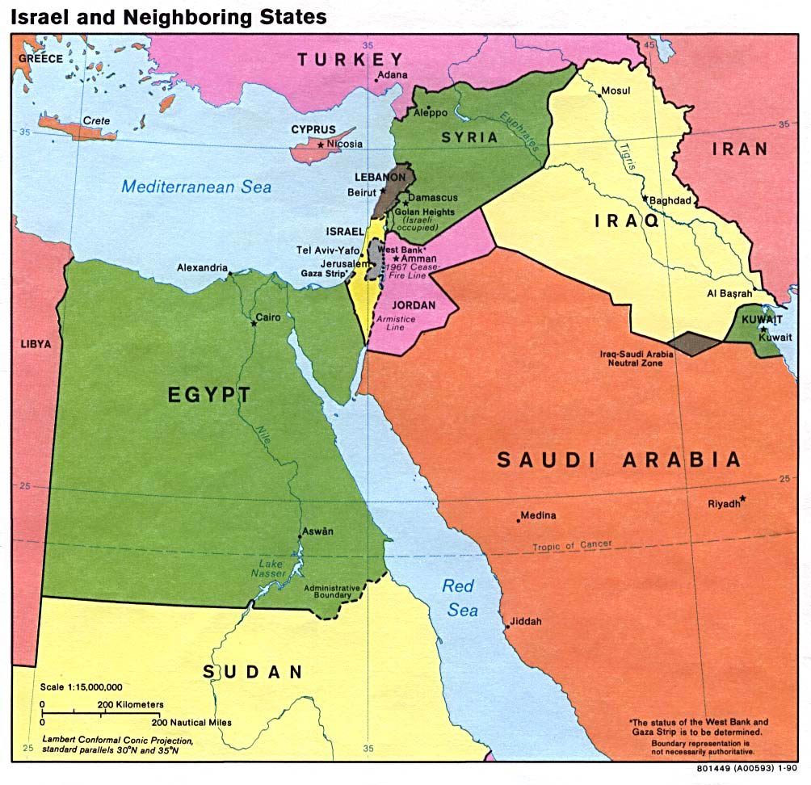

Slide 15
“Now when I looked, there was a hand stretched out to me; and behold, a scroll of a book was in it. Then He spread it before me; and there was writing on the inside and on the outside, and written on it were lamentations and mourning and woe… Moreover, He said to me, “Son of man, eat what you find; eat this scroll, and go, speak to the house of Israel.” So I opened my mouth, and He caused me to eat that scroll. And He said to me, “Son of man, feed your belly, and fill your stomach with this scroll that I give you.” So I ate, and it was in my mouth like honey in sweetness.” Ezekiel 2:9-10 & 3:1-3

