Slide 1
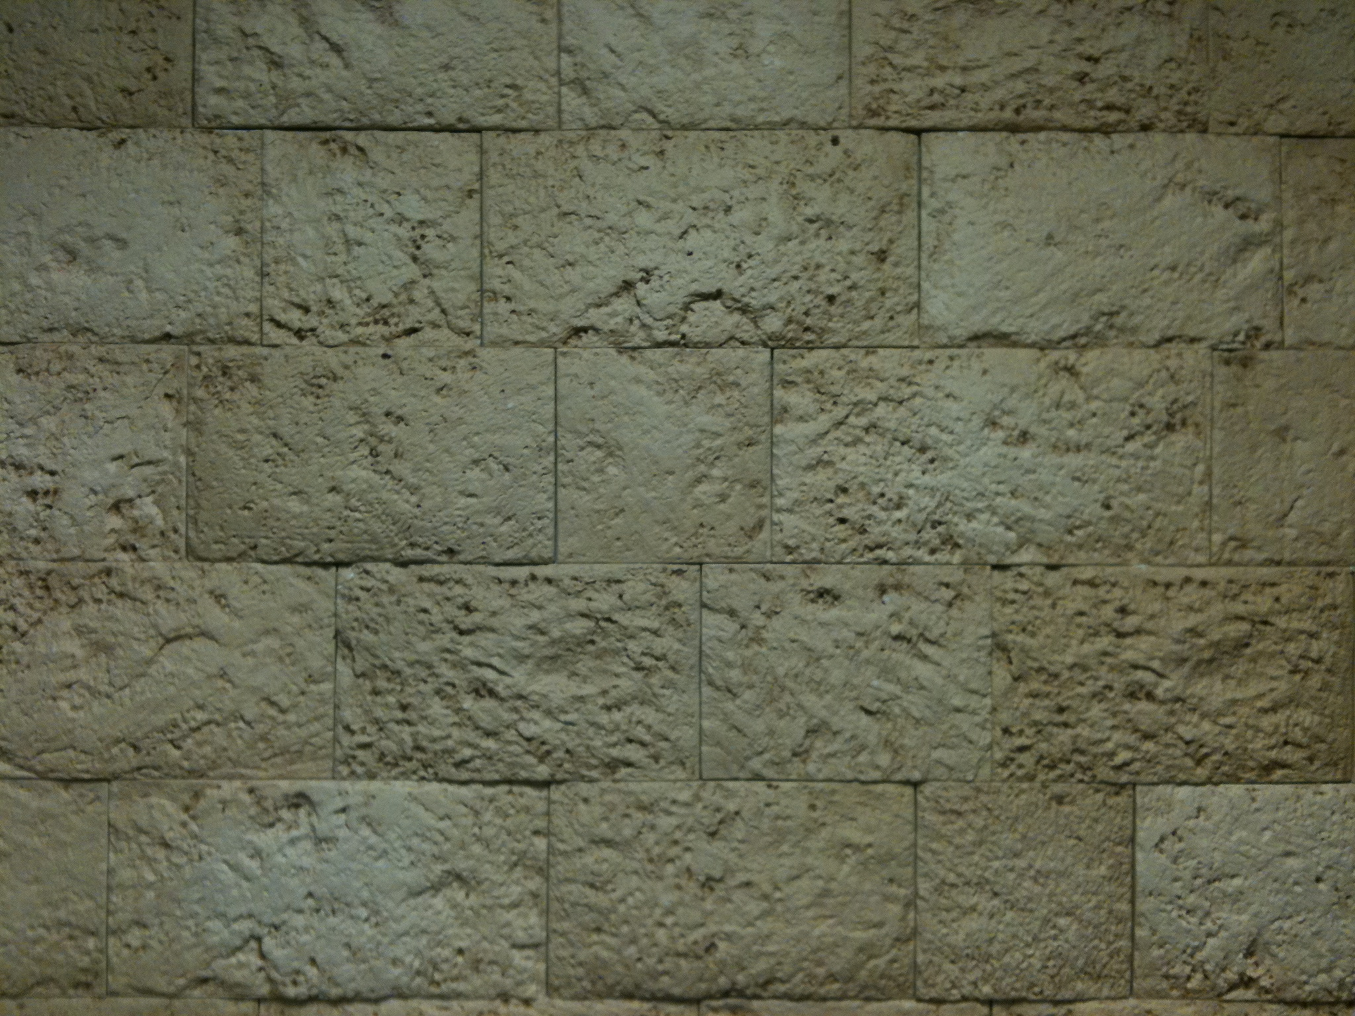
Multiple “Raptures”

Slide 2
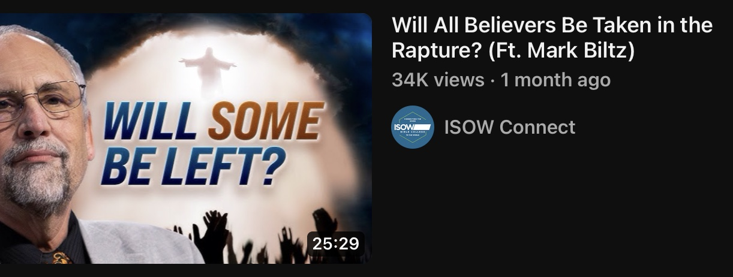
Mark Biltz
“Will All Believers Be Taken in the Rapture?”
https://youtu.be/7qCwHdaLb5M?t=11

Slide 3
Resurrection:
Dead Arise with Resurrection Bodies
Yeshua After 3 Days
“Graves Opened” After Yeshua Matthew 27:52-53
Seal #5 Saints Revelation 7:9-14
“Rapture”:
Living Change into Resurrection Bodies
Enoch & Elijah Gen 5:24 & II Kings 2:11

Slide 4
Resurrection:
Dead Arise with Resurrection Bodies
Yeshua After 3 Days
“Graves Opened” After Yeshua Matthew 27:52-53
Seal #5 Martyrs Revelation 7:9-14
“Rapture”:
Living Change into Resurrection Bodies
Enoch & Elijah Gen 5:24 & II Kings 2:11

Slide 5
A Possible Arrangement
~32 AD
1st Seal: White Horse
5
6
Ch. 7b
7
Martyred Souls Under Altar "How Long" White Robes Wait for the Remnant
Earthquake Black Sun Blood Moon Stars Fall Mts & Isles Move Men Hide from God's Wrath
Great Multitude in Heaven
Silence in Heaven Angel w/ Censer Voices, Thunderings Lightnings & Earthquake
2nd Seal: Red Horse
3rd Seal: Black Horse
4th Seal: Pale Horse
Resurrection
Ch. 7a
1
2
3
4
5
6
7
144,000 Sealed
To Earth Hail & Fire Mingled w/ Blood Burn 1/3 of Trees Burn All Grass
Burning Mountain into Sea 1/3 of Sea Creatures Die Destroy 1/3 of Ships
Star Falls on 1/3 of Rivers & Springs Become Bitter Many Men Die
1/3 of Sun, Moon Stars Dark Day & Night 1/3 Shorter "Woe, Woe, Woe" to Earth
Star from Heaven with Key to Pit; Smoke & Dark, Locusts Harm Those w/out God's Mark 5 Mo.
4 Angels from Euphrates Kill 1/3 of Mankind with Fire, Smoke & Brimstone Men Don't Repent
Nations Become God's Voices, Thunderings Lightnings & Earthquake Temple Opened
Yeshua’s Return
Bowl Judgments
7
1
2
3
4
5
6
On the Air "It is Done" Voices,Thun-derings Lightnings, Earthquake & Hail Mts & Isles Move
7

Slide 6
Resurrection:
Dead Arise with Resurrection Bodies
Yeshua After 3 Days
“Graves Opened” After Yeshua Matthew 27:52-53
Seal #5 Martyrs Revelation 7:9-14
“Rapture”:
Living Change into Resurrection Bodies
Enoch & Elijah Gen 5:24 & II Kings 2:11

Slide 7
Yeshua’s Interaction with the Centurion:
“When Jesus heard it, He marveled, and said to those who followed, ’Assuredly, I say to you, I have not found such great faith, not even in Israel! And I say to you that many will come from east and west, and sit down with Abraham, Isaac, and Jacob in the kingdom of heaven. But the sons of the kingdom will be cast out into outer darkness. There will be weeping and gnashing of teeth.’” Matthew 8:10-12

Slide 8
The Parable of the Foundations I Corinth 3:10-15
“According to the grace of God which was given to me, as a wise master builder I have laid the foundation, and another builds on it. But let each one take heed how he builds on it. For no other foundation can anyone lay than that which is laid, which is Jesus Christ. Now if anyone builds on this foundation with gold, silver, precious stones, wood, hay, straw, each one’s work will become clear; for the Day will declare it, because it will be revealed by fire; and the fire will test each one’s work, of what sort it is. If anyone’s work which he has built on it endures, he will receive a reward. If anyone’s work is burned, he will suffer loss; but he himself will be saved, yet so as through fire.”

Slide 9
The Parable of the Wedding Feast
The King God the Father (Yehovah)
The Son Yeshua
The Bride Bride of Messiah (Church??)
The Guests The Other Part of the Bride
Matthew 22

Slide 10
The Parable of the Wedding Feast
The King God the Father (Yehovah)
The Son Yeshua
The Bride Bride of Messiah (Part)
The Guests The Other Part of the Bride
Matthew 22

Slide 11
The Parable of the Faithful & Evil Servants Luke 12:35-38
“Let your waist be girded and your lamps burning; and you yourselves be like men who wait for their master, when he will return from the wedding, that when he comes and knocks they may open to him immediately. Blessed are those servants whom the master, when he comes, will find watching. Assuredly, I say to you that he will gird himself and have them sit down to eat, and will come and serve them. And if he should come in the second watch, or come in the third watch, and find them so, blessed are those servants.”

Slide 12
“ Then I looked, and behold, a white cloud, and on the cloud sat One like the Son of Man, having on His head a golden crown, and in His hand a sharp sickle. And another angel came out of the temple, crying with a loud voice to Him who sat on the cloud, “Thrust in Your sickle and reap, for the time has come for You to reap, for the harvest of the earth is ripe.” So He who sat on the cloud thrust in His sickle on the earth, and the earth was reaped. Then another angel came out of the temple which is in heaven, he also having a sharp sickle. And another angel came out from the altar, who had power over fire, and he cried with a loud cry to him who had the sharp sickle, saying, “Thrust in your sharp sickle and gather the clusters of the vine of the earth, for her grapes are fully ripe.” So the angel thrust his sickle into the earth and gathered the vine of the earth, and threw it into the great winepress of the wrath of God. And the winepress was trampled outside the city, and blood came out of the winepress, up to the horses’ bridles, for one thousand six hundred furlongs.” Revelation 14:14-20

Slide 13
Resurrection:
Dead Arise with Resurrection Bodies
Yeshua After 3 Days
“Graves Opened” After Yeshua Matthew 27:52-53
Seal #5 Martyrs Revelation 7:9-14
“Rapture”:
Living Change into Resurrection Bodies
Enoch & Elijah Gen 5:24 & II Kings 2:11

Slide 14
Resurrection:
Dead Arise with Resurrection Bodies
Yeshua After 3 Days
“Graves Opened” After Yeshua Matthew 27:52-53
Seal #5 Saints Revelation 7:9-14
“Rapture”:
Living Change into Resurrection Bodies
Enoch & Elijah Gen 5:24 & II Kings 2:11
Future Events??

Slide 15
Resurrection:
Dead Arise with Resurrection Bodies
@ 7th Seal / Trumpet / Bowl:
Martyrs Since 6th Seal??
“Rapture”:
@ 7th Seal / Trumpet / Bowl:
E 144,000 Sealed??
Rev 12:6 “Wilderness People”??

Slide 16
A Possible Arrangement
~32 AD
1st Seal: White Horse
5
6
Ch. 7b
7
Martyred Souls Under Altar "How Long" White Robes Wait for the Remnant
Earthquake Black Sun Blood Moon Stars Fall Mts & Isles Move Men Hide from God's Wrath
Great Multitude in Heaven
Silence in Heaven Angel w/ Censer Voices, Thunderings Lightnings & Earthquake
2nd Seal: Red Horse
3rd Seal: Black Horse
4th Seal: Pale Horse
Resurrection
Ch. 7a
1
2
3
4
5
6
7
144,000 Sealed
To Earth Hail & Fire Mingled w/ Blood Burn 1/3 of Trees Burn All Grass
Burning Mountain into Sea 1/3 of Sea Creatures Die Destroy 1/3 of Ships
Star Falls on 1/3 of Rivers & Springs Become Bitter Many Men Die
1/3 of Sun, Moon Stars Dark Day & Night 1/3 Shorter "Woe, Woe, Woe" to Earth
Star from Heaven with Key to Pit; Smoke & Dark, Locusts Harm Those w/out God's Mark 5 Mo.
4 Angels from Euphrates Kill 1/3 of Mankind with Fire, Smoke & Brimstone Men Don't Repent
Nations Become God's Voices, Thunderings Lightnings & Earthquake Temple Opened
Yeshua’s Return
Bowl Judgments
7
1
2
3
4
5
6
On the Air "It is Done" Voices,Thun-derings Lightnings, Earthquake & Hail Mts & Isles Move
7

Slide 17
Resurrection:
Dead Arise with Resurrection Bodies
@ 7th Seal / Trumpet / Bowl:
Martyrs Since 6th Seal??
“Rapture”:
@ 7th Seal / Trumpet / Bowl:
E 144,000 Sealed??
Rev 12:6 “Wilderness People”??

Slide 18
Abraham’s Descendants
“Then the Angel of the Lord called to Abraham a second time out of heaven, and said: “By Myself I have sworn, says the Lord, because you have done this thing, and have not withheld your son, your only son — blessing I will bless you, and multiplying I will multiply your descendants as the stars of the heaven and as the sand which is on the seashore;” Genesis 22:15-17

Slide 19
Another Possibility
3 Harvest Cycles in Israel:
Spring (Firstfruits) Barley Winnowing Fork
Summer (Pentecost) Tribulum Sled
Fall (Tabernacles) Wine Press

Slide 21
God’s Promise to Philadelphia: Revelation 3:10
“I also will keep you from the hour of trial which shall come upon the whole world, to test those who dwell on the earth.”
“For God did not appoint us to wrath, but to obtain salvation through our Lord Jesus Christ, who died for us, that whether we wake or sleep, we should live together with Him.” I Thess 5:9-10
“These things I have spoken to you, that in Me you may have peace. In the world you will have tribulation; but be of good cheer, I have overcome the world.” John 16:33

Slide 22
What the Bible Says About it…
John 14:1-4 “I go the prepare a place for you…”
Matthew 24:29-31 “Gather His elect from the four winds”
I Thess 4:13 – 5:11 Dead in Christ rise first; then those
who are alive and remain
I Corinth 15:50-58 Corruptible to Incorruptible
Mortal to Immortal
II Thess 2:1-4 LORD’s coming & our gathering

Slide 23
God Keeps His People from “the Hour of Trial”:
144,000 Sealed on the Earth
“Then the woman fled into the wilderness, where she has a place prepared by God, that they should feed her there one thousand two hundred and sixty days.” Rev 12:6

