Slide 2
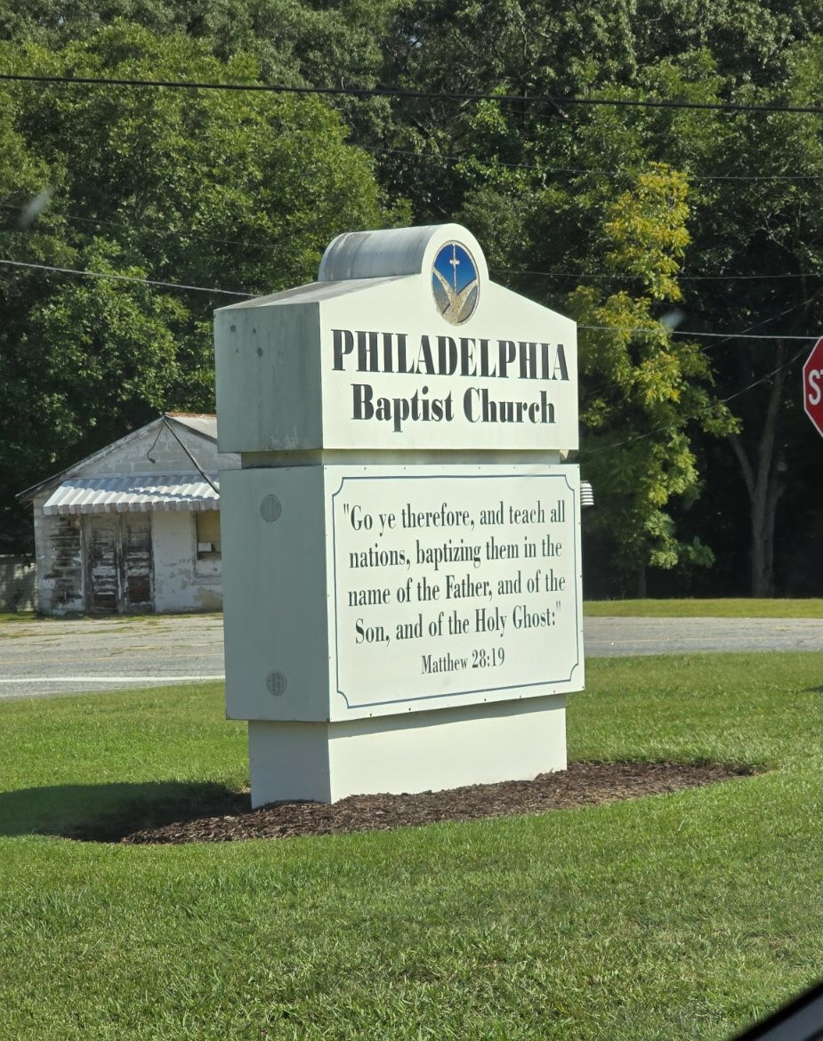

Slide 3
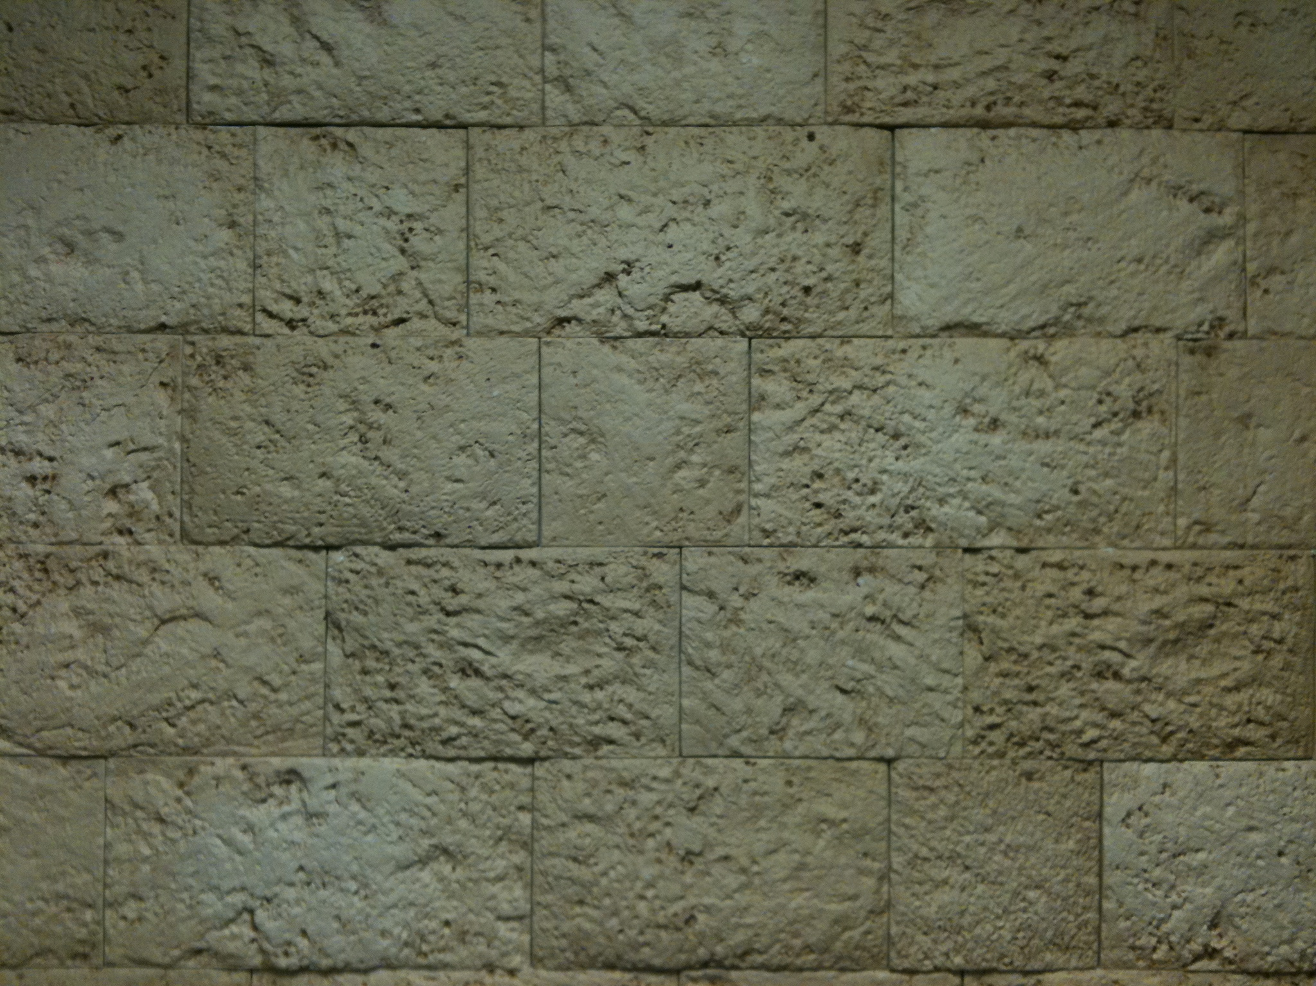
Elul 1
Sept 4, 2024

Slide 4
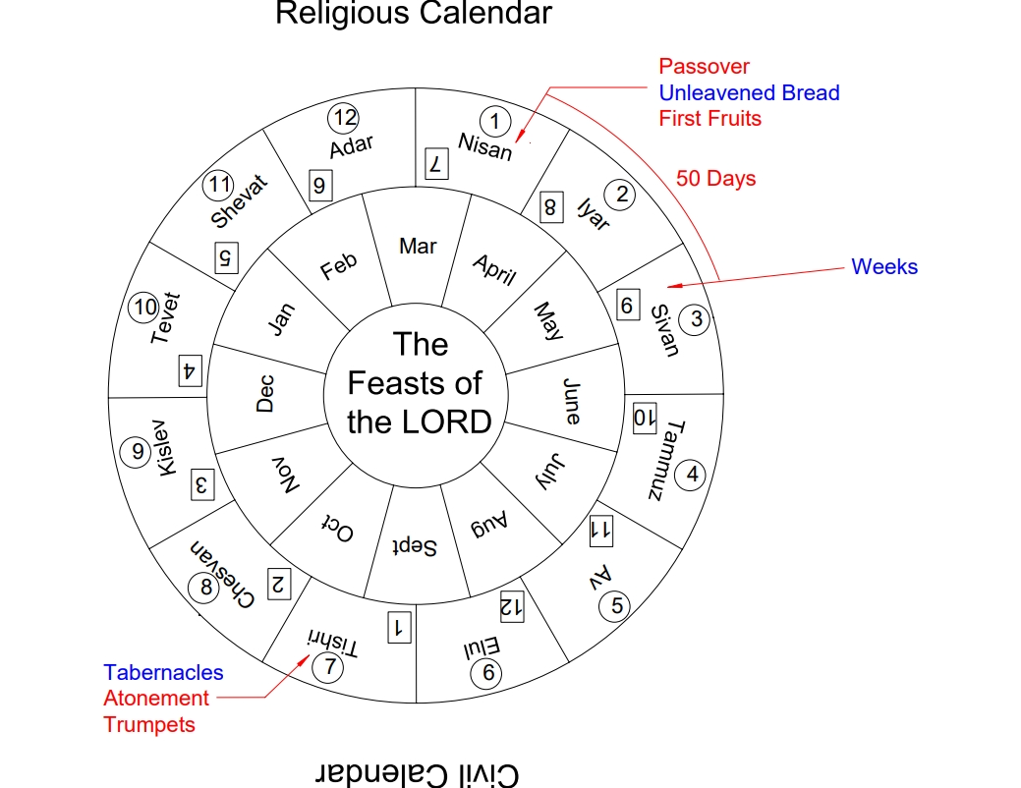

Slide 6
The Feasts of the LORD
“Concerning the feasts of the LORD, which you shall proclaim to be holy convocations, even these are My feasts.” Lev 23:2

Slide 7
The Feasts of the LORD
“Concerning the feasts of the LORD, which you shall proclaim to be holy convocations, even these are My feasts.” Lev 23:2
“..it shall be a statute forever throughout your generations..”
Lev 23:14

Slide 8
The Feasts of the LORD
“Concerning the feasts of the LORD, which you shall proclaim to be holy convocations, even these are My feasts.” Lev 23:2
Still Relevant to Us Today!
“..it shall be a statute forever throughout your generations..”
Lev 23:14

Slide 9
The Feasts of the LORD
Passover Nisan 14
Unleavened Bread Nisan 15 - 21
Firstfruits Day after Shabbat
Weeks 50 days after FF
Trumpets Tishri 1
Atonement Tishri 10
Tabernacles Tishri 15 – 21

Slide 10
The Feasts of the LORD
Passover Nisan 14
Unleavened Bread Nisan 15 - 21
Firstfruits Day after Shabbat
Weeks 50 days after FF
Trumpets Tishri 1
Atonement Tishri 10
Tabernacles Tishri 15 – 21
Spring
Feasts
Fall
Feasts

Slide 11
Spring Feasts Yeshua’s Final Week
Passover:
“You know that after two days is the Passover, and the Son of Man will be delivered up to be crucified.” Matthew 26:2

Slide 12
Spring Feasts Yeshua’s Final Week
Unleavened Bread:
“Therefore, because it was the Preparation Day [Passover], that the bodies should not remain on the cross on the Sabbath (for that Sabbath was a high day) [Unleavened Bread], the Jews asked Pilate that their legs might be broken, and that they might be taken away.” John 19:31

Slide 13
Spring Feasts Yeshua’s Final Week
First Fruits:
“For as Jonah was three days and three nights in the belly of the great fish, so will the Son of Man be three days and three nights in the heart of the earth.” Matthew 12:40

Slide 14
Spring Feasts Yeshua’s Final Week
First Fruits:
“For as Jonah was three days and three nights in the belly of the great fish, so will the Son of Man be three days and three nights in the heart of the earth.” Matthew 12:40
“Now the first day of the week Mary Magdalene went to the tomb early, while it was still dark, and saw that the stone had been taken away from the tomb.” John 20:1

Slide 15
Spring Feasts Giving of the Holy Spirit
Shavuot (Pentecost):
“When the Day of Pentecost had fully come, they were all with one accord in one place … And they were all filled with the Holy Spirit and began to speak with other tongues, as the Spirit gave them utterance. Acts 2:1 & 4

Slide 16
Fulfillment at Yeshua’s First Coming
Passover Yeshua Crucified
Unleavened Bread Yeshua Buried
First Fruits Yeshua Resurrected!!
Pentecost Holy Spirit Given

Slide 17
Elul 1
The King is
in The Field

Slide 18
The Feasts of the LORD
Passover Nisan 14
Unleavened Bread Nisan 15 - 21
Firstfruits Day after Shabbat
Weeks 50 days after FF
Trumpets Tishri 1
Atonement Tishri 10
Tabernacles Tishri 15 – 21
Spring
Feasts
Fall
Feasts

Slide 20
The Fall Feasts
Tishri 1
Tishri 10
Tishri 15
Tishri 21
Elul 1
Feast of Trumpets
Day of Atonement
Feast of Tabernacles

Slide 21
The Fall Feasts
30 Days
Tishri 1
Tishri 10
Tishri 15
Tishri 21
Elul 1
Feast of Trumpets
Day of Atonement
Feast of Tabernacles

Slide 22
The Fall Feasts
“Days of Awe”
10 Days
5
7 Days
30 Days
Tishri 1
Tishri 10
Tishri 15
Tishri 21
Elul 1
Feast of Trumpets
Day of Atonement
Feast of Tabernacles

Slide 23
The Fall Feasts
40 Days “The King is in the Field”
“Days of Awe”
10 Days
5
7 Days
30 Days
Tishri 1
Tishri 10
Tishri 15
Tishri 21
Elul 1
Feast of Trumpets
Day of Atonement
Feast of Tabernacles

