Slide 2
Rev 2:7 “He who has an ear, let him hear what the Spirit says to the churches. To him who overcomes I will give to eat from the tree of life, which is in the midst of the Paradise of God.”
Rev 2:11 “He who has an ear, let him hear what the Spirit says to the churches. He who overcomes shall not be hurt by the second death.”
Rev 2:17 “He who has an ear, let him hear what the Spirit says to the churches. To him who overcomes I will give some of the hidden manna to eat. And I will give him a white stone, and on the stone a new name written which no one knows except him who receives it.”
Rev 2:26 “And he who overcomes, and keeps My works until the end, to him I will give power over the nations.”
Rev 3:5 “He who overcomes shall be clothed in white garments, and I will not blot out his name from the Book of Life; but I will confess his name before My Father and before His angels.”
Rev 3:12 “He who overcomes, I will make him a pillar in the temple of My God, and he shall go out no more. I will write on him the name of My God and the name of the city of My God, the New Jerusalem, which comes down out of heaven from My God. And I will write on him My new name.”
Rev 3:21 “To him who overcomes I will grant to sit with Me on My throne, as I also overcame and sat down with My Father on His throne.”
Rev 21:7 “He who overcomes shall inherit all things, and I will be his God and he shall be My son.”

Slide 5
“But it is not that the word of God has taken no effect. For they are not all Israel who are of Israel, nor are they all children because they are the seed of Abraham; but, ’In Isaac your seed shall be called.’”
Romans 9:6-7

Slide 6
Israel
(The 12 Sons (Tribes) of Jacob)
Jacob
Reuben
Simeon
Zebulun
Issachar
Dan
Gad
Asher
Naphthali
Joseph
Judah
Benjamin
Levi

Slide 7
Israel
(The 12 Sons (Tribes) of Jacob)
Jacob
Reuben
Simeon
Zebulun
Issachar
Dan
Gad
Asher
Naphthali
Joseph
Northern Kingdom
Conquered & Dispersed
By Assyria
In 722 BC
Judah
Benjamin
Levi

Slide 8
Israel
(The 12 Sons (Tribes) of Jacob)
Jacob
Reuben
Simeon
Zebulun
Issachar
Dan
Gad
Asher
Naphthali
Joseph
Southern Kingdom
Conquered & Dispersed
By Babylon
In 586 BC
Judah
Benjamin
Levi

Slide 9
Israel
(The 12 Sons (Tribes) of Jacob)
Jacob
Reuben
Simeon
Zebulun
Issachar
Dan
Gad
Asher
Naphthali
Joseph
A Remnant Returned After Babylonian Exile
Known as the “Jews”
Judah
Benjamin
Levi

Slide 10
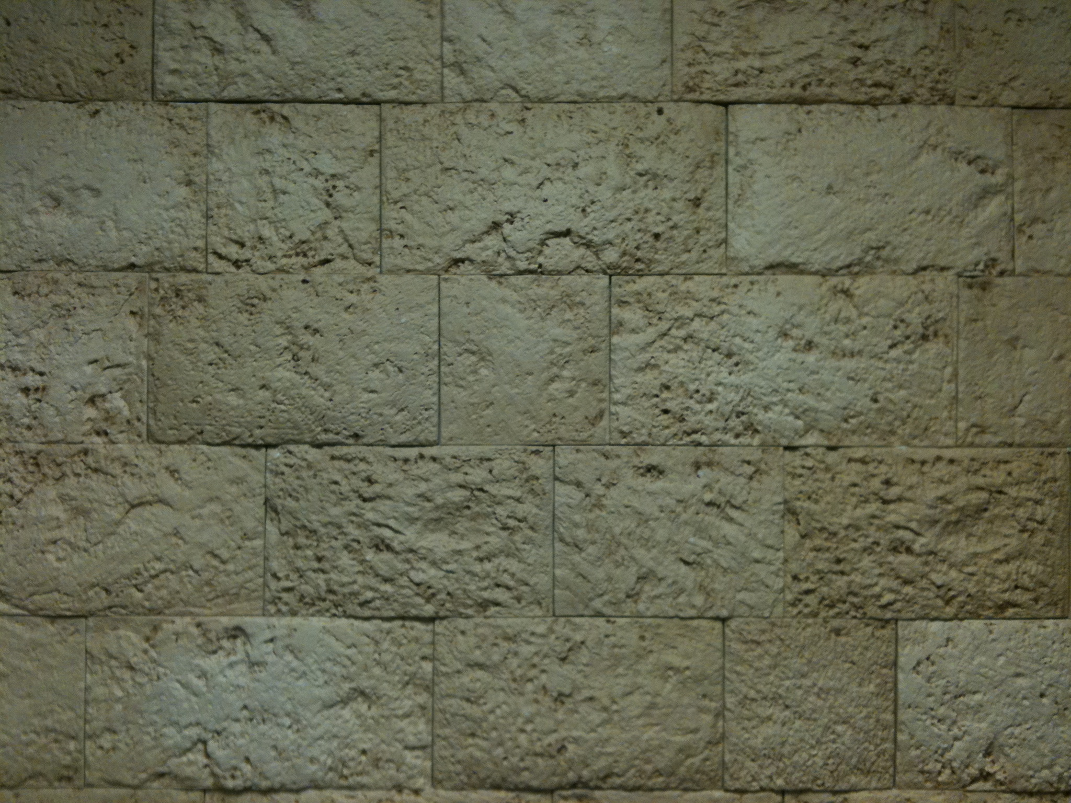
Revelation
Chapter 12

Slide 11
“Now a great sign appeared in heaven: a woman clothed with the sun, with the moon under her feet, and on her head a garland of twelve stars.”
Revelation 12:1

Slide 12
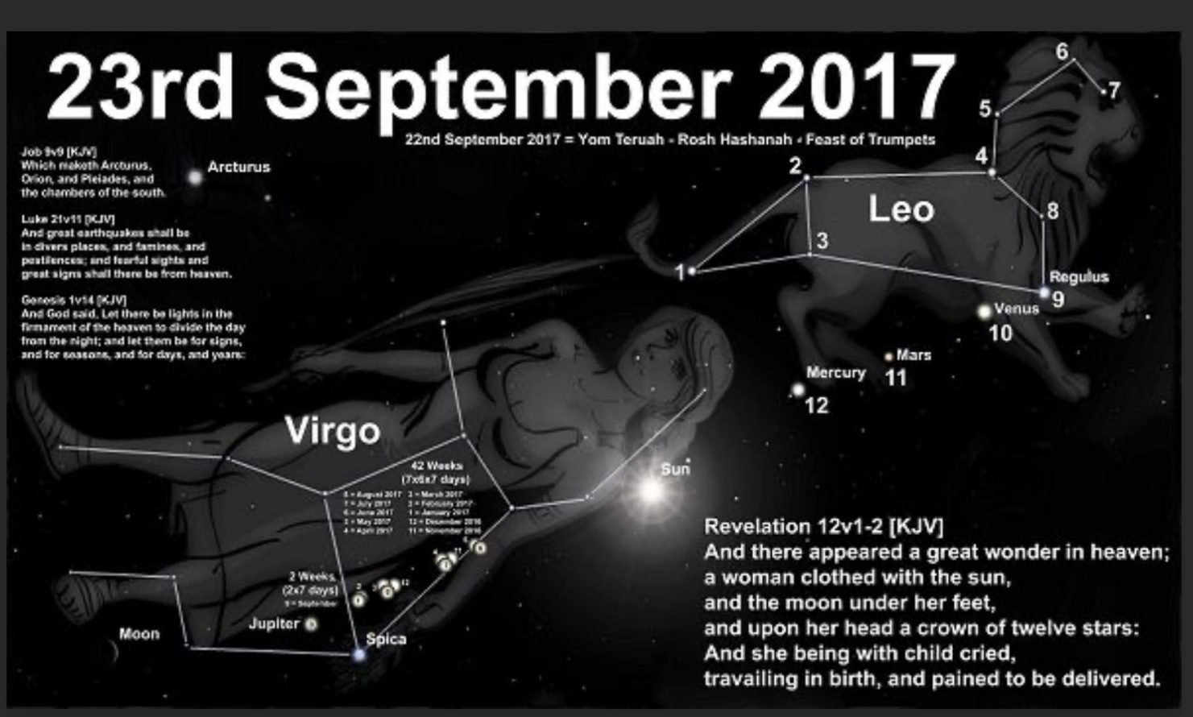

Slide 13
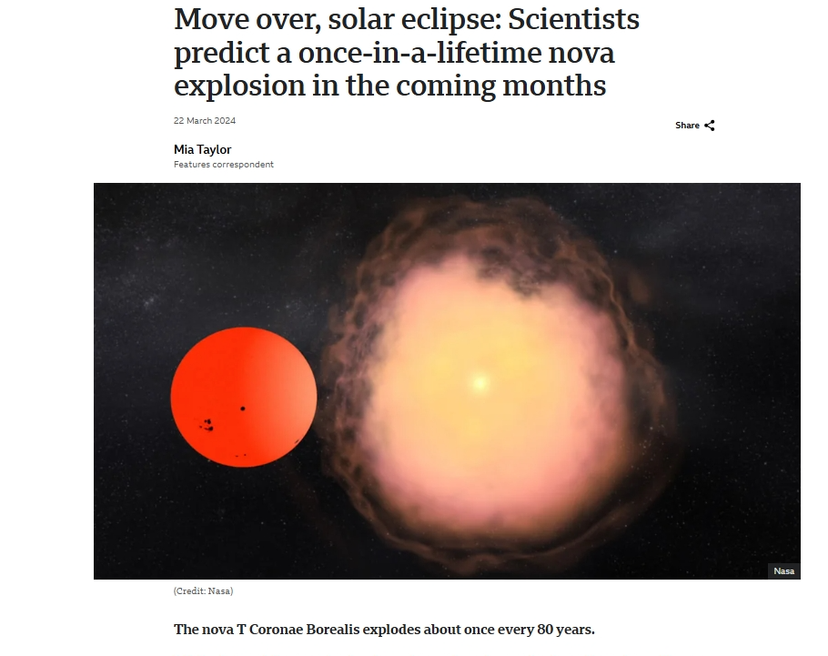

Slide 19
Back to …
Revelation
Chapter 12

Slide 20
“Now a great sign appeared in heaven: a woman clothed with the sun, with the moon under her feet, and on her head a garland of twelve stars.”
Revelation 12:1

Slide 21
“Then being with child, she cried out in labor and in pain to give birth ... And the dragon stood before the woman who was ready to give birth, to devour her Child as soon as it was born. She bore a male Child who was to rule all nations with a rod of iron. And her Child was caught up to God and His throne. Then the woman fled into the wilderness, where she has a place prepared by God, that they should feed her there one thousand two hundred and sixty days.” Revelation 12:2 & 4b-6

Slide 22
“Then being with child, she cried out in labor and in pain to give birth ... And the dragon stood before the woman who was ready to give birth, to devour her Child as soon as it was born. She bore a male Child who was to rule all nations with a rod of iron. And her Child was caught up to God and His throne. Then the woman fled into the wilderness, where she has a place prepared by God, that they should feed her there one thousand two hundred and sixty days.” History Future Both Revelation 12:2 & 4b-6

Slide 23
“And another sign appeared in heaven: behold, a great, fiery red dragon having seven heads and ten horns, and seven diadems on his heads. His tail drew a third of the stars of heaven and threw them to the earth…” Revelation 12:3-4a

Slide 24
“And another sign appeared in heaven: behold, a great, fiery red dragon having seven heads and ten horns, and seven diadems on his heads. His tail drew a third of the stars of heaven and threw them to the earth…” Revelation 12:3-4a
“So the great dragon was cast out, that serpent of old, called the Devil and Satan, who deceives the whole world…” Revelation 12:9a

Slide 25
Lucifer’s Fall Step 1: Lost Heavenly Authority Isaiah 14:12-19 Kept Access to Throne Rev 12:10 Gained Access to Earth Job 1:6-7 Step 2: Looses Heavenly Access Rev 12:9 Full Freedom upon Earth I Peter 5:8 Inflicts Havoc on Earth Rev 12:12 Step 3: Looses Earthly Freedom Rev 20:1-3 & 7-8 Bound for 1,000 Years Step 4: Final Defeat Rev 20:9-10

Slide 26
Lucifer’s Fall Step 1: Lost Heavenly Authority Isaiah 14:12-19 Kept Access to Throne Rev 12:10 Gained Access to Earth Job 1:6-7 Step 2: Looses Heavenly Access Rev 12:9 Full Freedom upon Earth I Peter 5:8 Inflicts Havoc on Earth Rev 12:12 Step 3: Looses Earthly Freedom Rev 20:1-3 & 7-8 Bound for 1,000 Years Step 4: Final Defeat Rev 20:9-10

Slide 27
Lucifer’s Fall Step 1: Lost Heavenly Authority Isaiah 14:12-19 Kept Access to Throne Rev 12:10 Gained Access to Earth Job 1:6-7 Step 2: Will Lose Heavenly Access Rev 12:9 Full Freedom upon Earth I Peter 5:8 Inflicts Havoc on Earth Rev 12:12 Step 3: Looses Earthly Freedom Rev 20:1-3 & 7-8 Bound for 1,000 Years Step 4: Final Defeat Rev 20:9-10

Slide 28
Lucifer’s Fall Step 1: Lost Heavenly Authority Isaiah 14:12-19 Kept Access to Throne Rev 12:10 Gained Access to Earth Job 1:6-7 Step 2: Will Lose Heavenly Access Rev 12:9 Full Freedom upon Earth I Peter 5:8 Inflicts Havoc on Earth Rev 12:12 Step 3: Will Lose Earthly Freedom Rev 20:1-3 & 7-8 Bound for 1,000 Years Step 4: Final Defeat Rev 20:9-10

Slide 29
Lucifer’s Fall Step 1: Lost Heavenly Authority Isaiah 14:12-19 Kept Access to Throne Rev 12:10 Gained Access to Earth Job 1:6-7 Step 2: Will Lose Heavenly Access Rev 12:9 Full Freedom upon Earth I Peter 5:8 Inflicts Havoc on Earth Rev 12:12 Step 3: Will Lose Earthly Freedom Rev 20:1-3 & 7-8 Bound for 1,000 Years Step 4: Final Defeat Rev 20:9-10

Slide 30
“And another sign appeared in heaven: behold, a great, fiery red dragon having seven heads and ten horns, and seven diadems on his heads. His tail drew a third of the stars of heaven and threw them to the earth…” Revelation 12:3-4a
“So the great dragon was cast out, that serpent of old, called the Devil and Satan, who deceives the whole world; he was cast to the earth, and his angels were cast out with him.” Revelation 12:9

Slide 31
“And another sign appeared in heaven: behold, a great, fiery red dragon having seven heads and ten horns, and seven diadems on his heads. His tail drew a third of the stars of heaven and threw them to the earth…” Revelation 12:3-4a
1st Step
(Past)
“So the great dragon was cast out, that serpent of old, called the Devil and Satan, who deceives the whole world; he was cast to the earth, and his angels were cast out with him.” Revelation 12:9

Slide 32
“And another sign appeared in heaven: behold, a great, fiery red dragon having seven heads and ten horns, and seven diadems on his heads. His tail drew a third of the stars of heaven and threw them to the earth…” Revelation 12:3-4a
1st Step
(Past)
“So the great dragon was cast out, that serpent of old, called the Devil and Satan, who deceives the whole world; he was cast to the earth, and his angels were cast out with him.” Revelation 12:9

Slide 33
“And another sign appeared in heaven: behold, a great, fiery red dragon having seven heads and ten horns, and seven diadems on his heads. His tail drew a third of the stars of heaven and threw them to the earth…” Revelation 12:3-4a
1st Step
(Past)
“So the great dragon was cast out, that serpent of old, called the Devil and Satan, who deceives the whole world; he was cast to the earth, and his angels were cast out with him.” Revelation 12:9
2nd Step
(Future)

Slide 34
“And another sign appeared in heaven: behold, a great, fiery red dragon having seven heads and ten horns, and seven diadems on his heads.” Rev 12:3

Slide 35
“And another sign appeared in heaven: behold, a great, fiery red dragon having seven heads and ten horns, and seven diadems on his heads.” Rev 12:3
Daniel’s Vision: Daniel 7:1-7
Heads Horns
1st Beast 1 0
2nd Beast 1 0
3rd Beast 4 0
4th Beast 1 10 3
7 10

