Slide 2
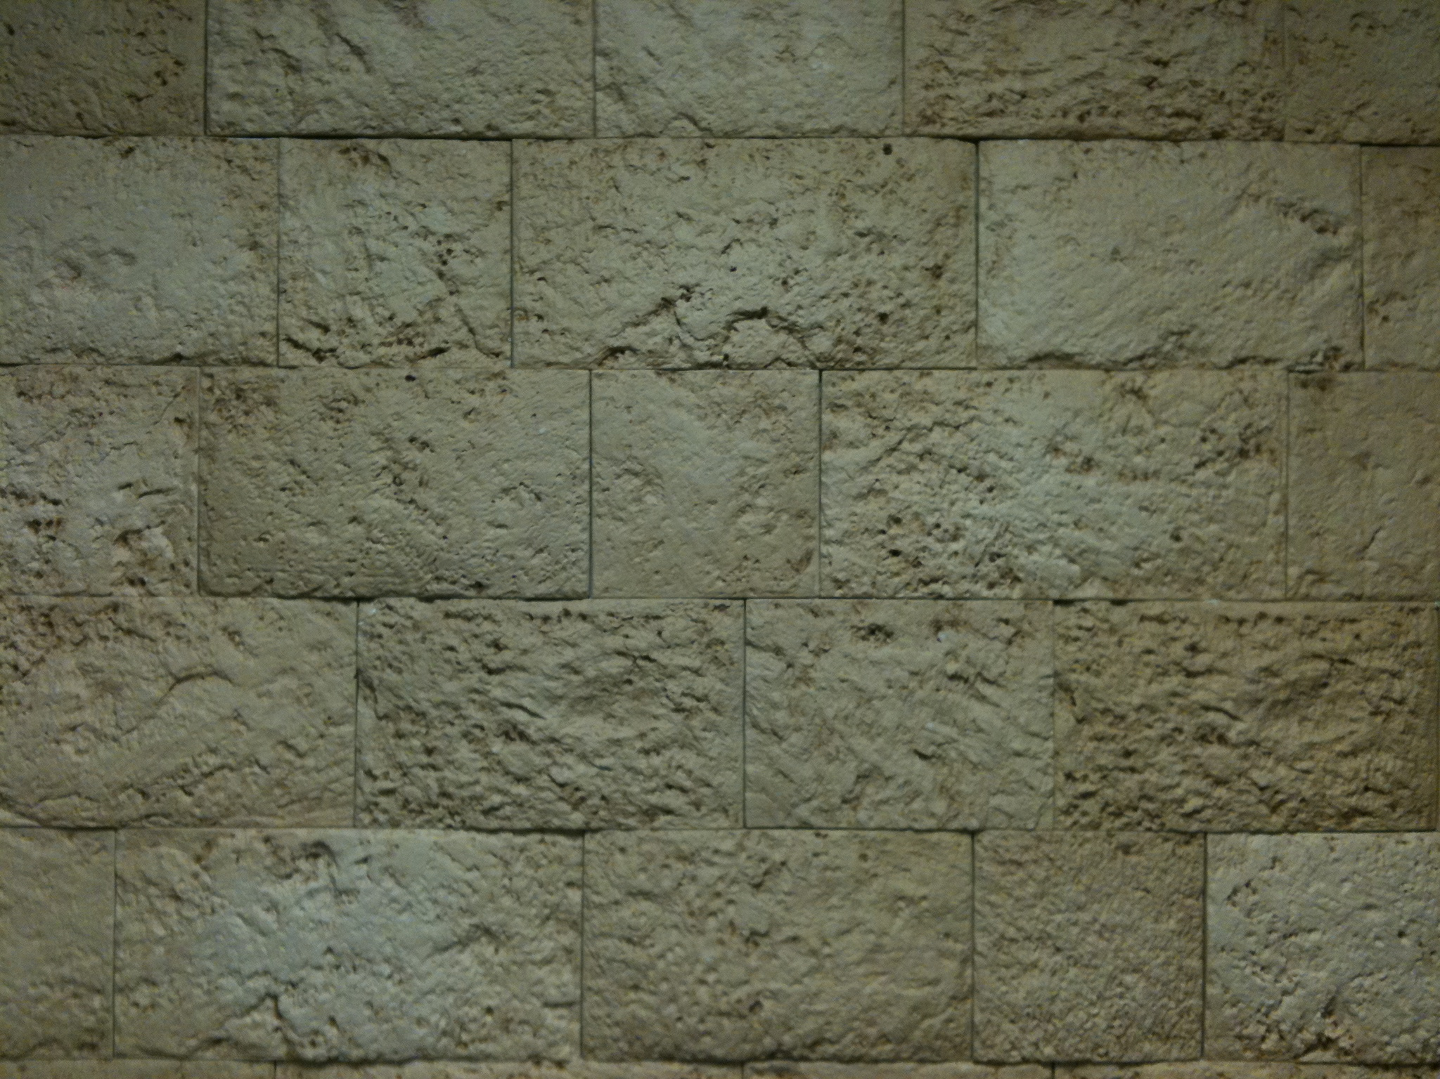
Revelation
Chapter 11

Slide 3
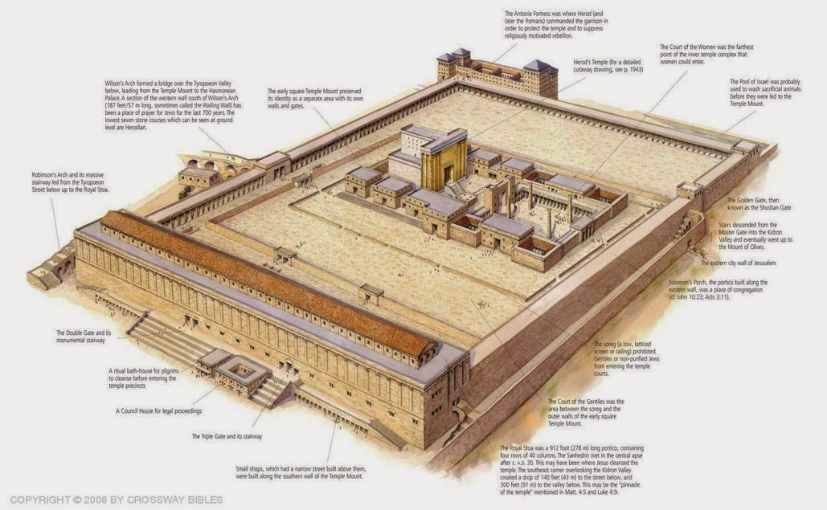
Herod’s Temple

Slide 4
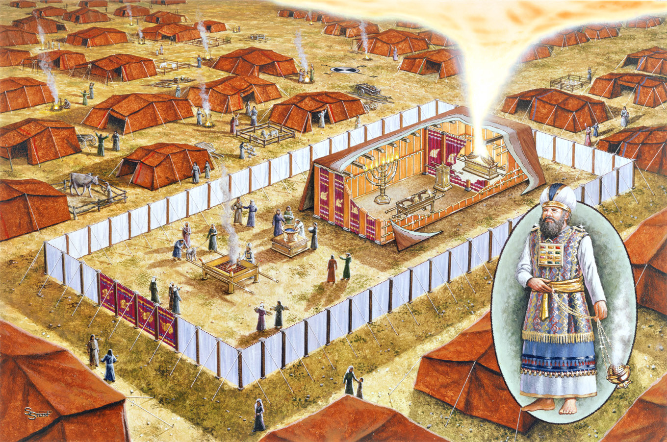

Slide 5
Herod’s Temple

Slide 6
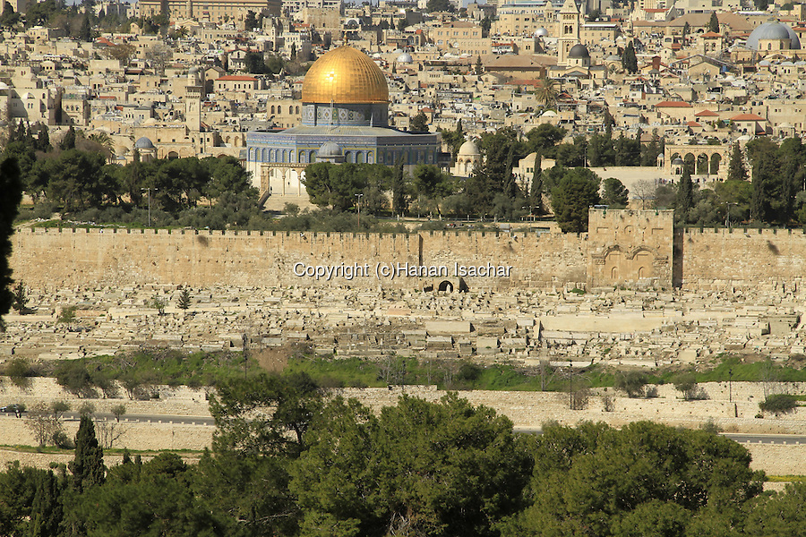

Slide 8
The Two
Witnesses

Slide 9
The Two Witnesses
Two Groups??
2 Olive Trees & 2 Lampstands?? Zech 4
Two Individuals??
Enoch & Elijah (Both “Raptured”) Gen 5 & II Kings 2
Moses & Elijah
Water to Blood & Fire from Heaven Exo 7 & I Kings 18
Shut Up Heaven I Kings 17
At Transfiguration Matt 17

Slide 10
The Two Witnesses
Two Groups??
2 Olive Trees & 2 Lampstands?? Zech 4
144,000 Sealed & “Wilderness People”?? Rev 12:6
Two Individuals??
Enoch & Elijah (Both “Raptured”) Gen 5 & II Kings 2
Moses & Elijah
Water to Blood & Fire from Heaven Exo 7 & I Kings 18
Shut Up Heaven I Kings 17
At Transfiguration Matt 17

Slide 11
The Two Witnesses
Two Groups??
2 Olive Trees & 2 Lampstands?? Zech 4
144,000 Sealed & “Wilderness People”?? Rev 12:6
Two Individuals??
Enoch & Elijah (Both “Raptured”) Gen 5 & II Kings 2
Moses & Elijah
Water to Blood & Fire from Heaven Exo 7 & I Kings 18
Shut Up Heaven I Kings 17
At Transfiguration Matt 17

Slide 12
The Two Witnesses
Two Groups??
2 Olive Trees & 2 Lampstands?? Zech 4
144,000 Sealed & “Wilderness People”?? Rev 12:6
Two Individuals??
Or Someone We Haven’t Seen Yet??
John the Baptist in Place of Elijah
Malachi 4:5-6 Matt 11:7-15

Slide 13
The Two Witnesses
Two Groups??
2 Olive Trees & 2 Lampstands?? Zech 4
144,000 Sealed & “Wilderness People”?? Rev 12:6
Two Individuals??
Or Someone We Haven’t Seen Yet??
John the Baptist in Place of Elijah
Malachi 4:5-6 Matt 11:7-15

Slide 14
A Possible Arrangement
~32 AD
1st Seal: White Horse
5
6
Ch. 7b
7
Martyred Souls Under Altar "How Long" White Robes Wait for the Remnant
Earthquake Black Sun Blood Moon Stars Fall Mts & Isles Move Men Hide from God's Wrath
Great Multitude in Heaven
Silence in Heaven Angel w/ Censer Voices, Thunderings Lightnings & Earthquake
2nd Seal: Red Horse
3rd Seal: Black Horse
4th Seal: Pale Horse
Ch. 7a
1
2
3
4
5
6
7
144,000 Sealed
To Earth Hail & Fire Mingled w/ Blood Burn 1/3 of Trees Burn All Grass
Burning Mountain into Sea 1/3 of Sea Creatures Die Destroy 1/3 of Ships
Star Falls on 1/3 of Rivers & Springs Become Bitter Many Men Die
1/3 of Sun, Moon Stars Dark Day & Night 1/3 Shorter "Woe, Woe, Woe" to Earth
Star from Heaven with Key to Pit; Smoke & Dark, Locusts Harm Those w/out God's Mark 5 Mo.
4 Angels from Euphrates Kill 1/3 of Mankind with Fire, Smoke & Brimstone Men Don't Repent
Nations Become God's Voices, Thunderings Lightnings & Earthquake Temple Opened
Yeshua’s Return
7
On the Air "It is Done" Voices,Thun-derings Lightnings, Earthquake & Hail Mts & Isles Move

Slide 15
A Possible Arrangement
~32 AD
1st Seal: White Horse
5
6
Ch. 7b
7
Martyred Souls Under Altar "How Long" White Robes Wait for the Remnant
Earthquake Black Sun Blood Moon Stars Fall Mts & Isles Move Men Hide from God's Wrath
Great Multitude in Heaven
Silence in Heaven Angel w/ Censer Voices, Thunderings Lightnings & Earthquake
2nd Seal: Red Horse
3rd Seal: Black Horse
4th Seal: Pale Horse
Ch. 7a
1
2
3
4
5
6
7
144,000 Sealed
To Earth Hail & Fire Mingled w/ Blood Burn 1/3 of Trees Burn All Grass
Burning Mountain into Sea 1/3 of Sea Creatures Die Destroy 1/3 of Ships
Star Falls on 1/3 of Rivers & Springs Become Bitter Many Men Die
1/3 of Sun, Moon Stars Dark Day & Night 1/3 Shorter "Woe, Woe, Woe" to Earth
Star from Heaven with Key to Pit; Smoke & Dark, Locusts Harm Those w/out God's Mark 5 Mo.
4 Angels from Euphrates Kill 1/3 of Mankind with Fire, Smoke & Brimstone Men Don't Repent
Nations Become God's Voices, Thunderings Lightnings & Earthquake Temple Opened
Yeshua’s Return
7
On the Air "It is Done" Voices,Thun-derings Lightnings, Earthquake & Hail Mts & Isles Move
Ch. 10
Angel on Sea & Land 7 Thunders Sealed John Eats the Scroll

Slide 16
A Possible Arrangement
~32 AD
1st Seal: White Horse
5
6
Ch. 7b
7
Martyred Souls Under Altar "How Long" White Robes Wait for the Remnant
Earthquake Black Sun Blood Moon Stars Fall Mts & Isles Move Men Hide from God's Wrath
Great Multitude in Heaven
Silence in Heaven Angel w/ Censer Voices, Thunderings Lightnings & Earthquake
2nd Seal: Red Horse
3rd Seal: Black Horse
4th Seal: Pale Horse
Ch. 7a
1
2
3
4
5
6
7
144,000 Sealed
To Earth Hail & Fire Mingled w/ Blood Burn 1/3 of Trees Burn All Grass
Burning Mountain into Sea 1/3 of Sea Creatures Die Destroy 1/3 of Ships
Star Falls on 1/3 of Rivers & Springs Become Bitter Many Men Die
1/3 of Sun, Moon Stars Dark Day & Night 1/3 Shorter "Woe, Woe, Woe" to Earth
Star from Heaven with Key to Pit; Smoke & Dark, Locusts Harm Those w/out God's Mark 5 Mo.
4 Angels from Euphrates Kill 1/3 of Mankind with Fire, Smoke & Brimstone Men Don't Repent
Nations Become God's Voices, Thunderings Lightnings & Earthquake Temple Opened
Yeshua’s Return
Ch. 11
Measure Temple Two Witnesses For 1,260 Days
?
7
On the Air "It is Done" Voices,Thun-derings Lightnings, Earthquake & Hail Mts & Isles Move
1,260 Days
Ch. 10
Angel on Sea & Land 7 Thunders Sealed John Eats the Scroll

Slide 17
Jesus Has Come (1:1-20)
Seven Letters (2:3-22)
Seven Seals (4:1 & 8:1)
144,000 Saints & 7 Trumpets (7:11:15-19)
Two Witnesses (11:1-16)
Woman Clothed with the Sun (12:1)
Chiastic
Structure
of
Revelation
Dragon in Heaven (12:4)
Woman Flees to Wilderness (12:6)
Satan Cast Out \ WE OVERCOME! (12:7-13)
Woman Flees to Wilderness (12:14)
Dragon Persecutes the Woman (12:15)
Woman’s Seed Keeps God’s Commandments (12:17)
Two Beasts (13:1 - 18)
144,000 Saints & 7 Angels (14:1:-115:4)
Seven Bowls (15:1,5 – 16:21)
Seven Angels (17:1 – 22:5)
Jesus is Returning (22:6-21)

Slide 18
Jesus Has Come (1:1-20)
Seven Letters (2:3-22)
Seven Seals (4:1 & 8:1)
144,000 Saints & 7 Trumpets (7:11:15-19)
Two Witnesses (11:1-16)
Woman Clothed with the Sun (12:1)
Chiastic
Structure
of
Revelation
Dragon in Heaven (12:4)
Woman Flees to Wilderness (12:6)
Satan Cast Out \ WE OVERCOME! (12:7-13)
Woman Flees to Wilderness (12:14)
Dragon Persecutes the Woman (12:15)
Woman’s Seed Keeps God’s Commandments (12:17)
Two Beasts (13:1 - 18)
144,000 Saints & 7 Angels (14:1:-115:4)
Seven Bowls (15:1,5 – 16:21)
Seven Angels (17:1 – 22:5)
Jesus is Returning (22:6-21)

